Slide 1


Education, Outreach & Evaluation
Bruce J. MacFadden
Co-PI & Director of Education & Outreach
Curator of Vertebrate Paleontology, FLMNH
Paleocollections Workshop
26-28 April 2012

Slide 2

Background and caveats
Front-end surveys indicate E&O not immediate priority for either iDigBio community or our workshop
Strategy: E&O activities will ramp up as:
Database and Cloud infrastructure develops
New audiences and stakeholders are engaged
Education and Outreach (E&O), will include:
Formal education (K-20)
university
K12
Informal and Lifelong Learning
Museums, cyberexhibits, citizen science, etc.

Slide 3
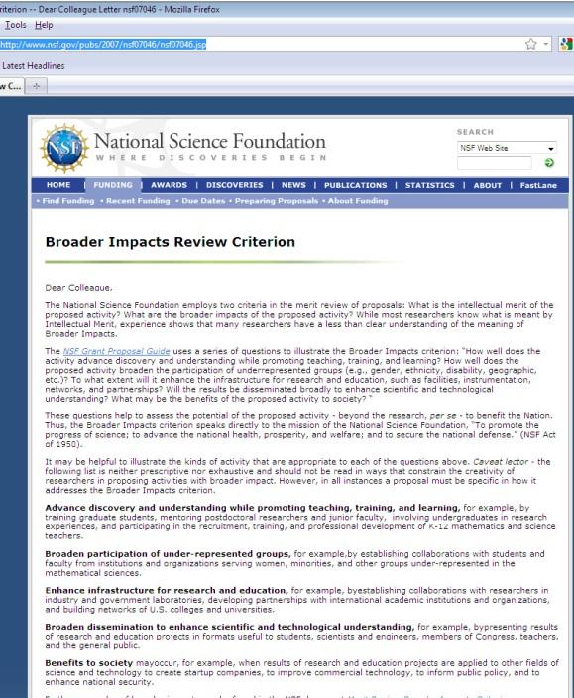
iDigBio E&O framework follows NSFs Broader Impact criteria**
Advance discovery and understanding while promoting teaching, training, and learning
Broaden participation of underrepresented groups
Enhance infrastructure for research and education
Broad dissemination to enhance scientific and technological understanding
Benefits to Society
*http://www.nsf.gov/pubs/2007/nsf07046/nsf07046.jsp

Slide 4
Need to identify target audiences and stakeholders for E&O
Collection researchers and other professionals
TCNs and other non-federal collections networks
University students and others in community
Government agencies, Policy makers
Industry and business innovation
Downstream users and other stakeholders: K12, 4H, Interest groups and clubs, etc.

Slide 5
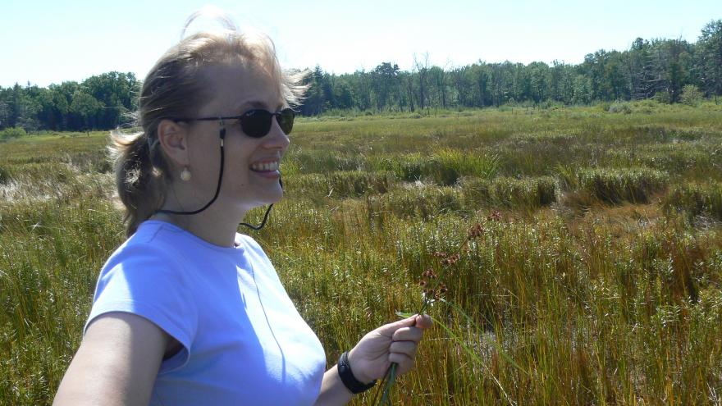
E&O activities and deliverables: Year 1
iDigBio Visiting Scholars program— focuses on broadening representation of early career professionals:
1st award made; info on web site for 2013
iDigBio 2012 Visiting Scholar: Dr. Anna Monfils, Associate Professor of Biology,
and Curator of the Herbarium, Central Michigan University

Slide 6
Other E&O
Dissemination and visibility to professional community: Talks presented at national meetings and participation in conferences and workshops (many)
For example, at NSF Town Hall meeting at Minneapolis, GSA
Developed iDigBio workshops and working groups
Paleocollections (26-28 April)
Volunteerism, crowd-sourcing, and citizen scientist (Austin Mast, FSU)
DROID Workshop

Slide 7
E&O activities & deliverables: Year 2
Continue to develop workshops and talks, and promote iDigBio to target audiences and stakeholders
Solicit input and engagement from TCNs and other user groups and target audiences
Planning grant for front-end evaluation of downstream target audience (e.g., fossil clubs in US)
Sponsor iDigBio E&O workshop in 2012-13

Slide 8
Ideas in HUB proposal, not yet implemented (opportunities): years 2+, ideas
Graduate seminar in collections digitization (need critical mass); perhaps multi-institutional
Undergraduate survey course in collections for the 21st century (perhaps follow ANSP model)
Delivered via e-learning at multiple, networked sites in real time via videoteleconferencing, webinars, and other web-enabled tools.
iDigBio travelling exhibit
Looking for partners (e.g., from TCNs) in these and other similar educational opportunities

Slide 9
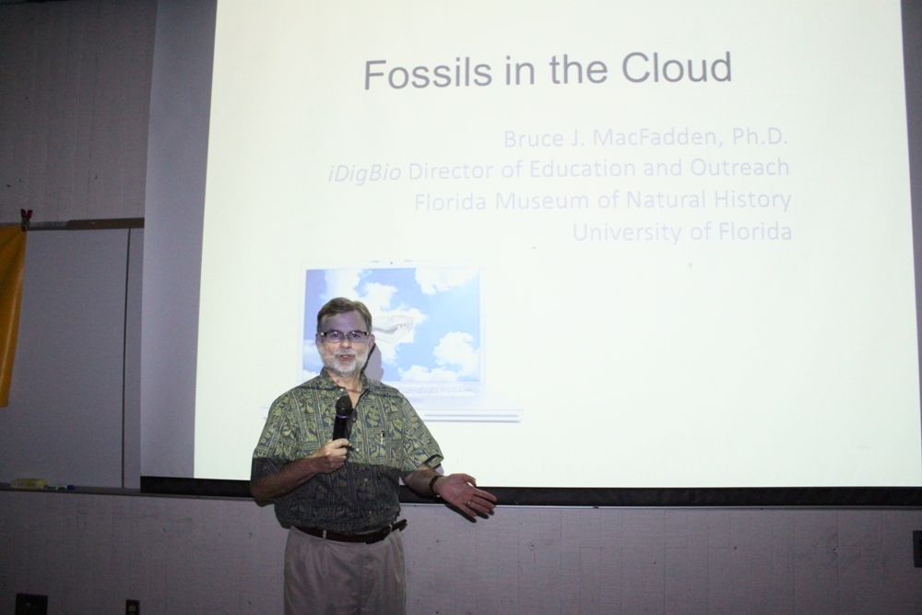
Initial Public Outreach: Fossil Clubs
Fossils in the Cloud
Presented this talk as a “trial balloon” to >100 members of the Tampa Bay Fossil Club (Jan 2012), based on their response
Will present next month to Fossil Club of Lee County
Brown Bag to iDigBio; comment made “Why only Florida?”

Slide 10
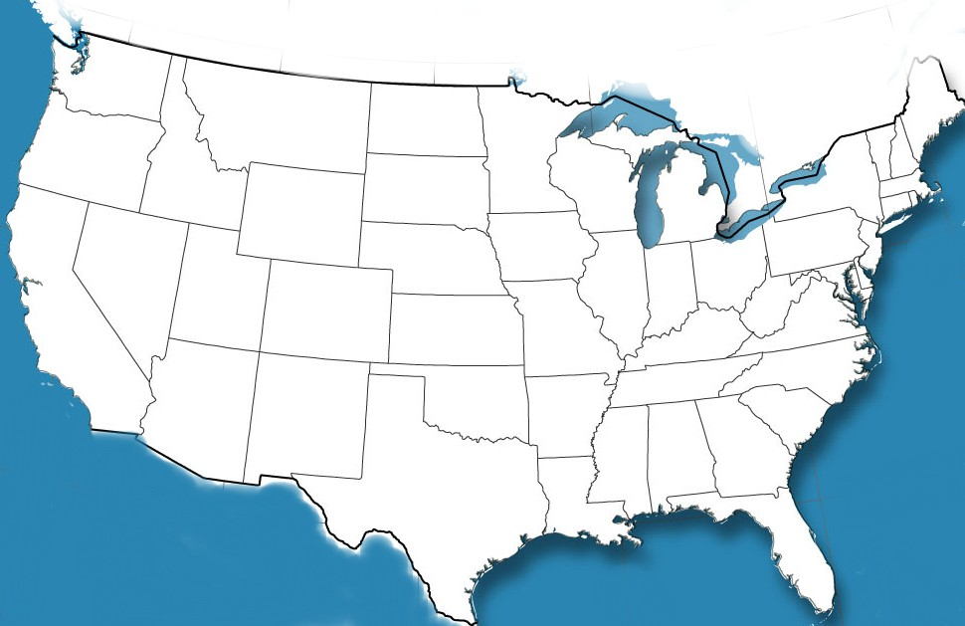
Fossils in the Cloud National Fossil Club initiative
Developed a database of 50 (all known) fossil clubs in US
Plan to contact them to potentially form a public engagement and learning network (community of practice)
US Fossil clubs,
April 2012 (first pass)

Slide 11
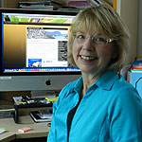
Evaluation
Professional evaluator, Dr. Shari Ellis
Develops surveys, interviews, and evaluates workshops and other iDigBio activities
Will collect and provide data for annual reports, as needed
Overall project evaluation
Process during early stages
Impacts and outcomes during later stages
Will track “markers for success,” identify metrics, indicators, and quantify impact

Slide 12
E&O: Take-home messages
E&O will ramp up as the iDigBio infrastructure is developed
While we have some deliverables, more are in the ideas or planning stages
There are lots of opportunities to get involved, or propose your own initiatives
iDigBio is available as a resource and facilitator

