Slide 1
Building a Data Sharing Community

Slide 2
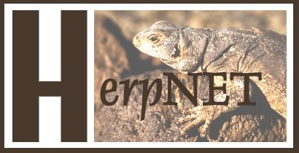
The Vertebrate Networks
Est. 1999, 2004
31 collections (2011)
Est. 2001
41 collections (2011)
188 Active Collections
86 Participating Institutions
Est. 2002
56 collections (2011)
Est. 2004
48 collections (2011)

Slide 3
The Vertebrate Networks
Primary Goals
Facilitate open access to specimen data on the web
Enhance the value of specimen collections
Conserve curatorial resources
Use a design easily adapted by other disciplines with similar needs

Slide 4
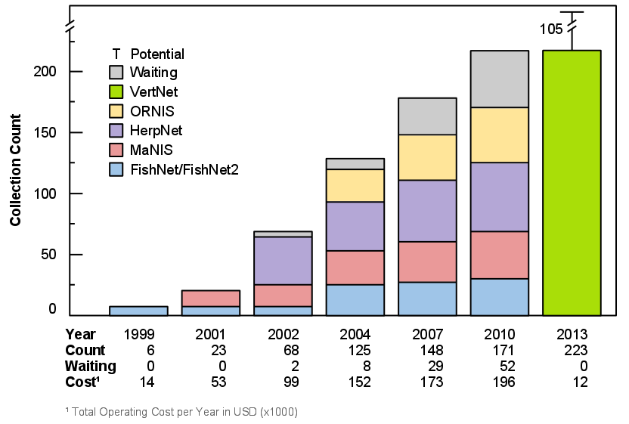
Growth of the Vertebrate Networks

Slide 5
The Vertebrate Networks
Critical Challenges
Performance
Aggregation
Costs and Sustainability
Technological Integration

Slide 6
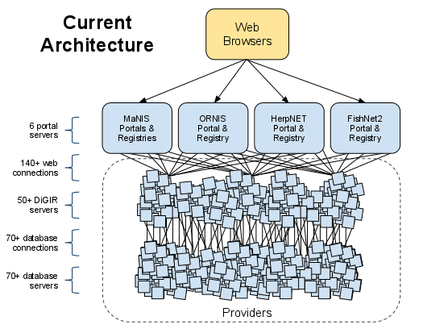
The Vertebrate Networks
Past Architecture

Slide 7
Our Philosophy
We mobilize data
Open source software development:
Create platform for innovation
Easy access
High performance
Broad aggregation of data sources
Best possible cost savings and sustainability

Slide 8
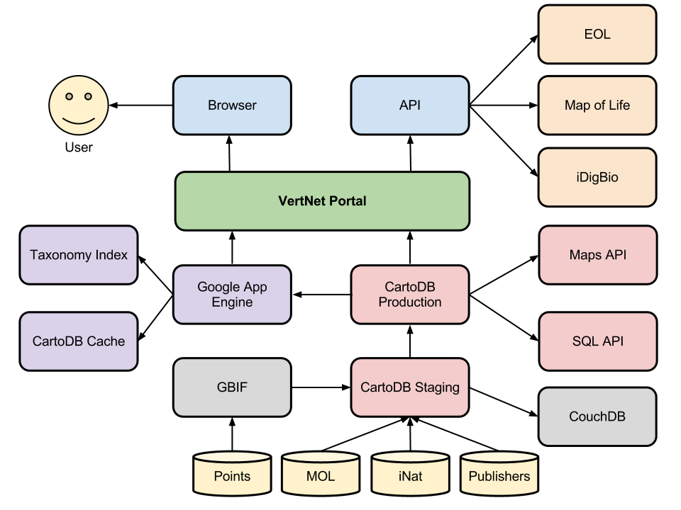
The Vertebrate Networks
New Architecture

Slide 9
Data Improvement
30 Georeferencing Workshops
US, Canada, Belgium, Denmark, Spain, Argentina,
Kenya, Tanzania, South Africa
Published Best Practices
Standard Semi-Automated Tools:
GEOLocate and BioGeomancer
250 Trainers Trained
47 Countries Served
And counting….

Slide 10
VertNet
New Features and Services
New user interfaces with expanded
search capabilities
Expanded data to include paleontological collections
New data portal, mobile apps, and VertNet gadget
Customized change notifications
Novel annotation and user feedback services
Species, specimen, and environmental attributes all in one search

Slide 11
VertNet
New Features and Services
Cost Savings and Sustainability:
$20K vs. $196K annually
Darwin Core Engine:
management, data processing, searching, data improvement, syndication
Darwin Core Thesaurus:
content management from multiple sources
New Data Portal, Mobile Apps, VertNet Gadget

Slide 12
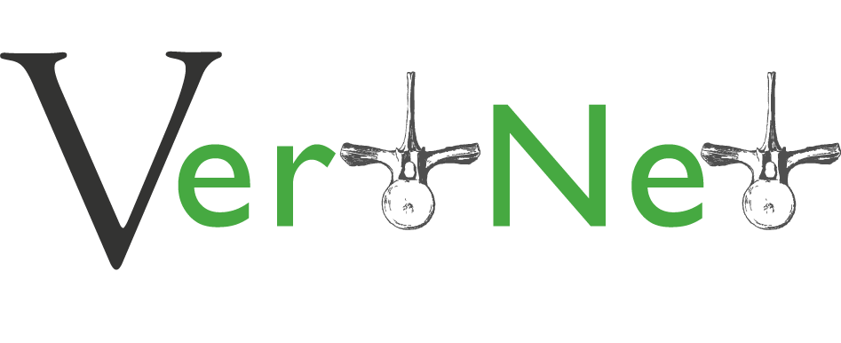
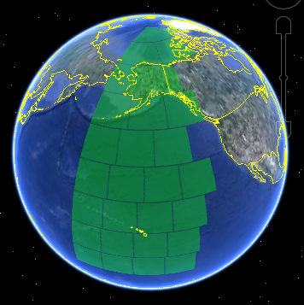
Environmental Data

Slide 13
VertNet
Integration Partners
Arctos
AmphibiaWeb
Animal Diversity Web
Specify
GEOLocate
Map of Life
Encyclopedia of Life
iNaturalist

Slide 14
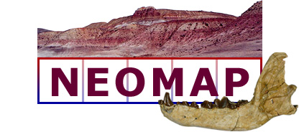
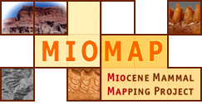
VertNet
Paleo Partners

Slide 15
The Road Ahead
NSF funding through Summer 2014
2012
Migration of all data to new VertNet (Summer)
Add environmental data (Fall)
2013
Integration tools, advanced visualization APIs
2014
More integration tools, mobile API, Vertnet gadget
Workshops: 2 Informatics, 1 Sustainability

Slide 16
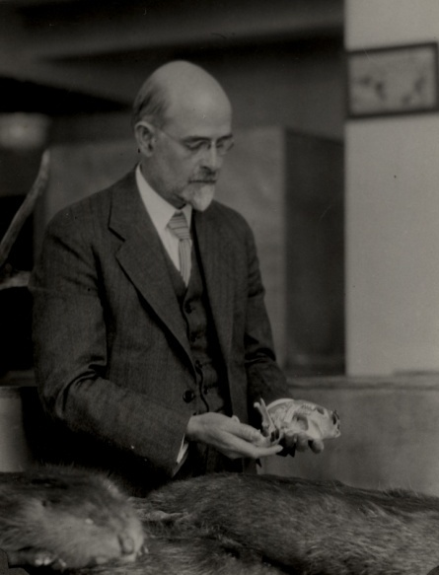
“At this point I wish to emphasize what I believe will ultimately prove to be the greatest purpose of our museum.
This value will not be realized until the lapse of many years, possibly a century, assuming that our material is safely preserved.
And this is that the student of the future will have access to the original record of faunal conditions in California.”
- Joseph Grinnell, 1910

