Slide 1
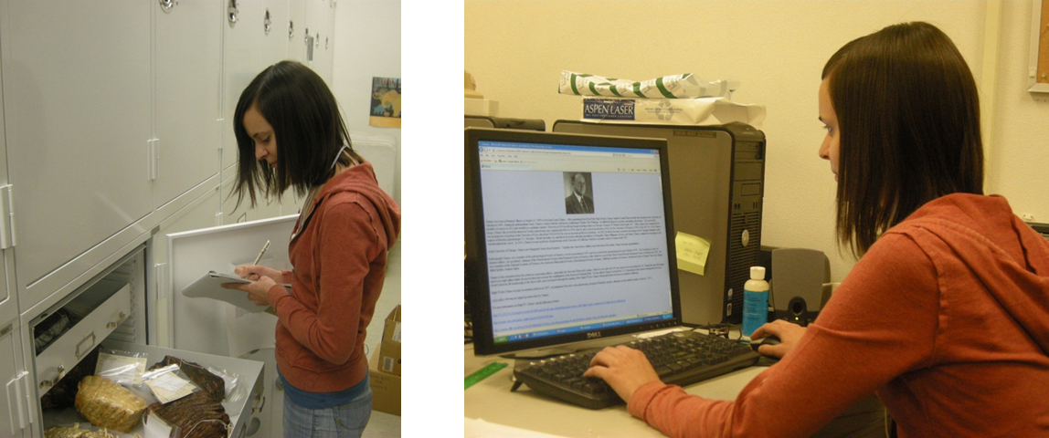
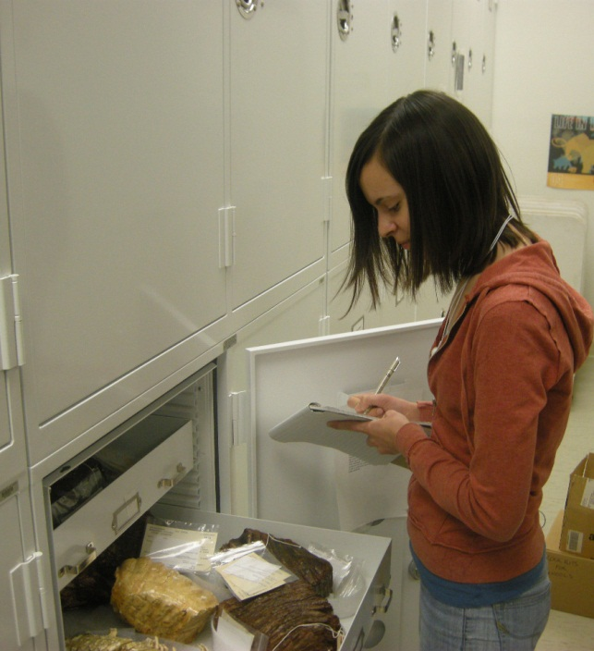
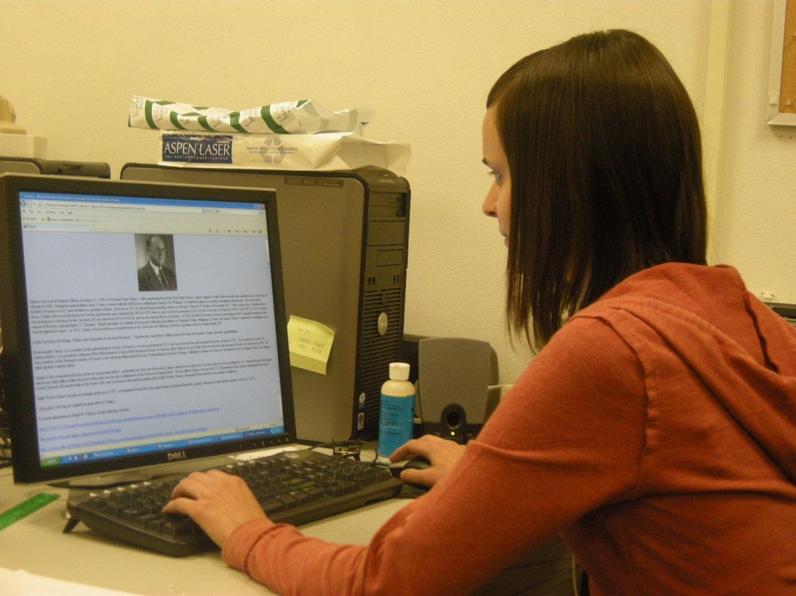
Collection digitization tiffany Adrain University of Iowa Paleontology RePository

Slide 2
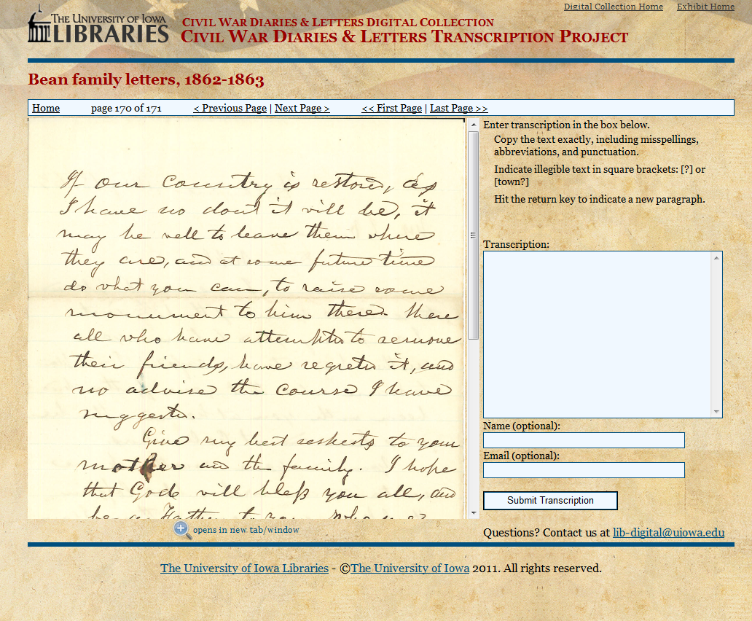
http://digital.lib.uiowa.edu/cdm4/browse_cwd.php?diary=5821&id=5819

Slide 3
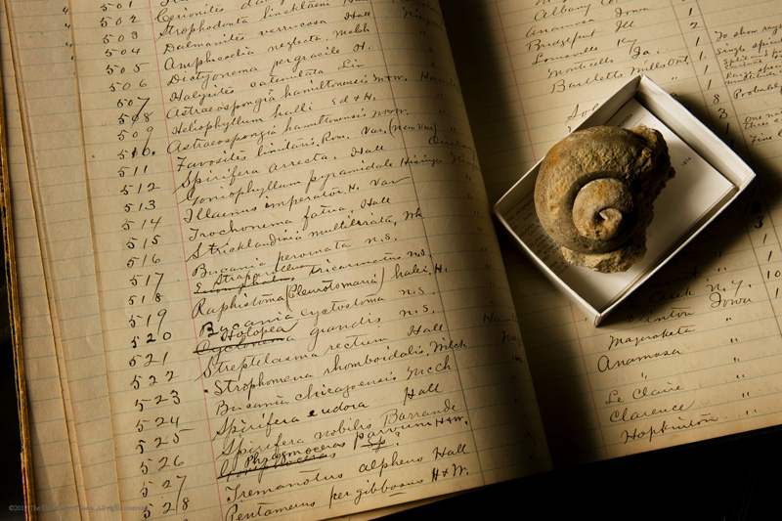
What do we digitize?
What are we digitizing?
Specimens
Specimen information on labels, in field notebooks, in printed documents, in published literature
Printed photographs

Slide 4
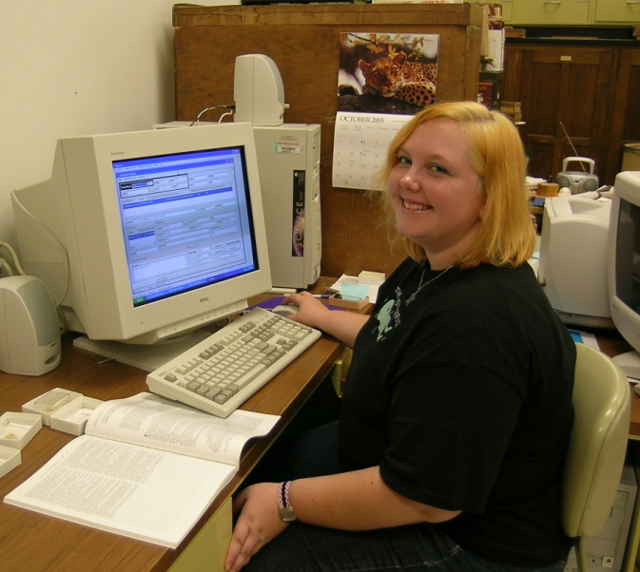
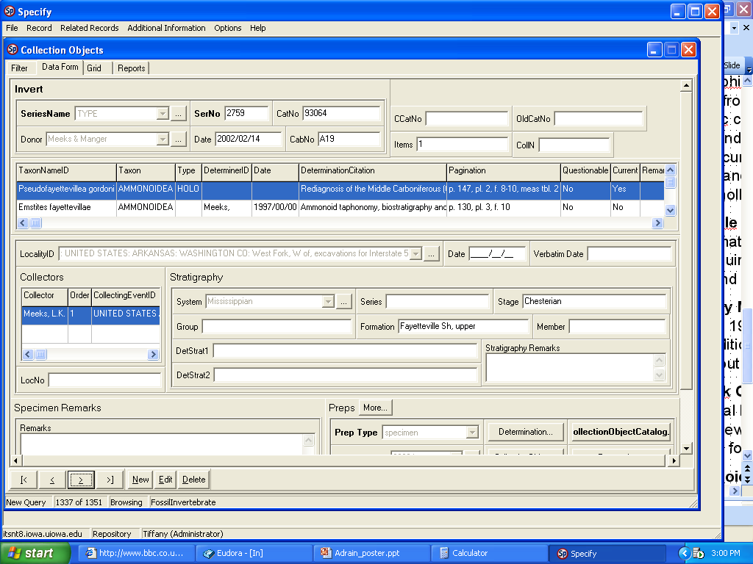
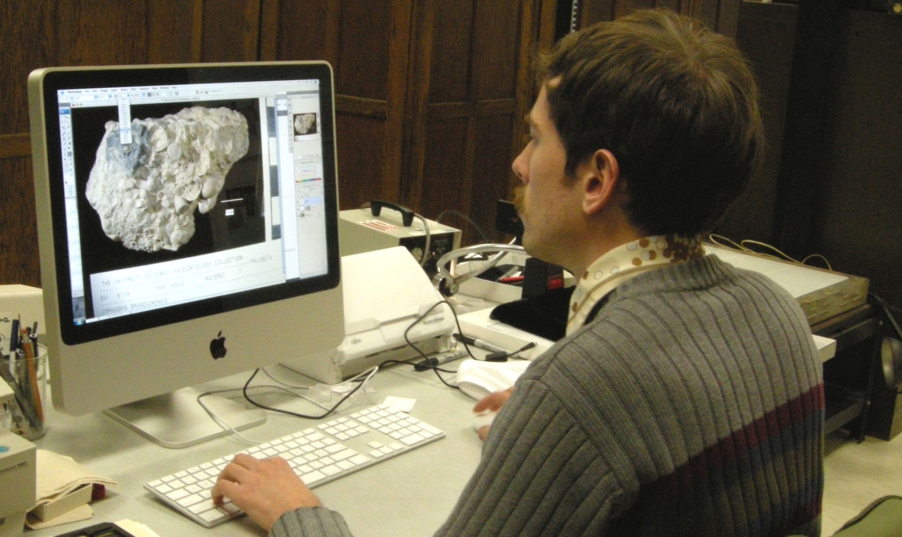
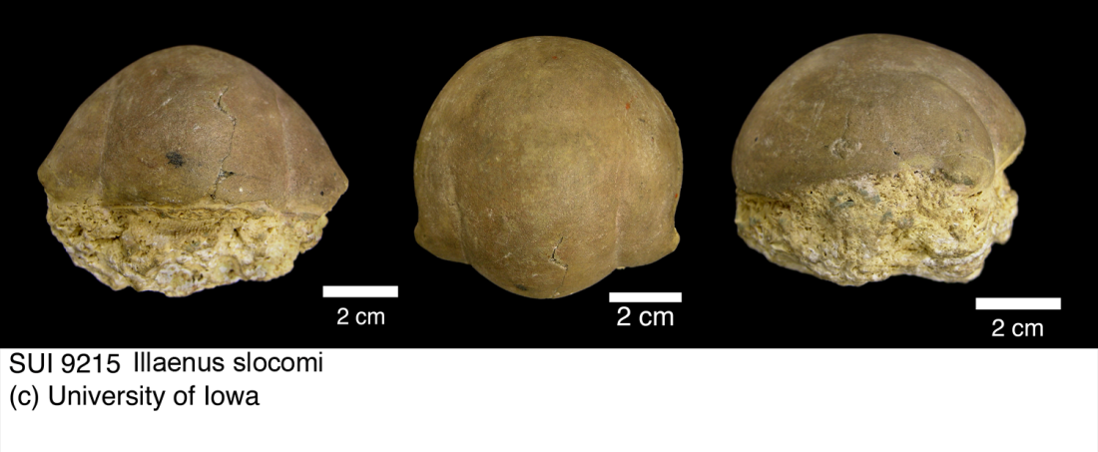
How do we digitize?
Specimen database data entry
Photographing specimens
Scanning existing photographs
Transcribing written records
Scanning written records
Interpreting data

Slide 5
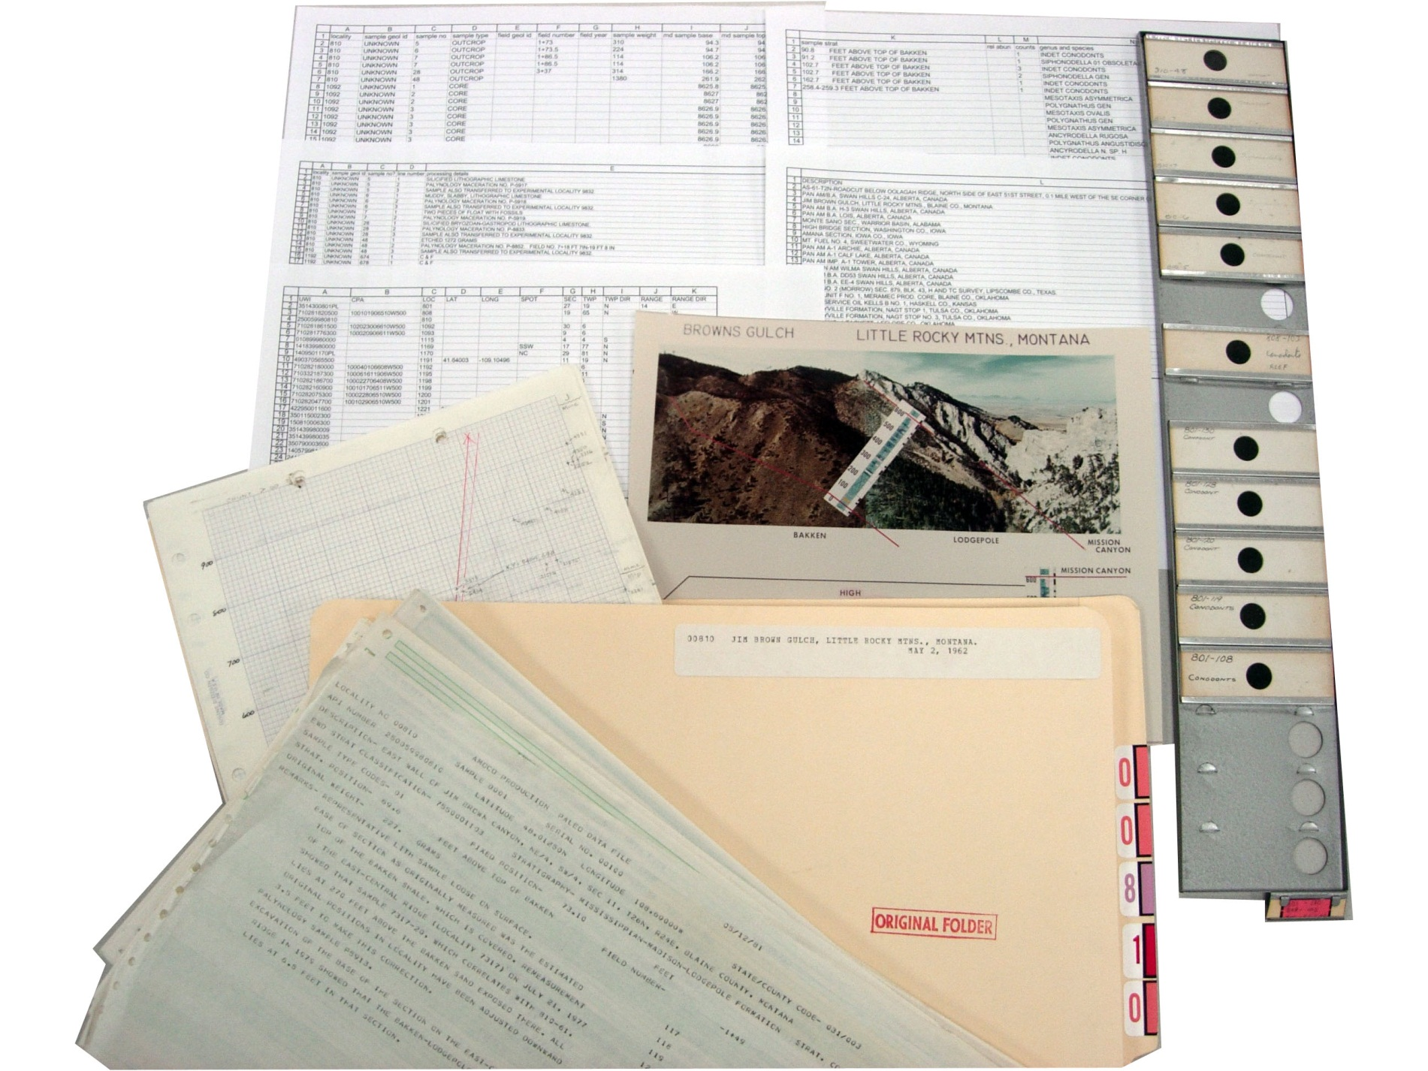
A digitization project – what, why, how?
Why digitize?
Accessibility:
Objects currently uncatalogued Object data not available for research

Slide 6
A digitization project – what, why, how?
Why digitize?
Accessibility:
Objects currently uncatalogued Object data not available for research
Achieve institutional goals

Slide 7
A digitization project – what, why, how?
Why digitize?
Accessibility:
Objects currently uncatalogued Object data not available for research
Achieve institutional goals
Aid Collections Management
Bulk acquisitions and historical backlog
Inventory and knowledge of collection

Slide 8
A digitization project – what, why, how?
Why digitize?
Accessibility:
Objects currently uncatalogued Object data not available for research
Achieve institutional goals
Aid Collections Management
Outreach and public engagement

Slide 9
Why digitize?
Accessibility:
Objects currently uncatalogued Object data not available for research
Achieve institutional goals
Aid Collections Management
Outreach and public engagement
Preservation and conservation
Object data in danger of loss
Fragility of objects

Slide 10
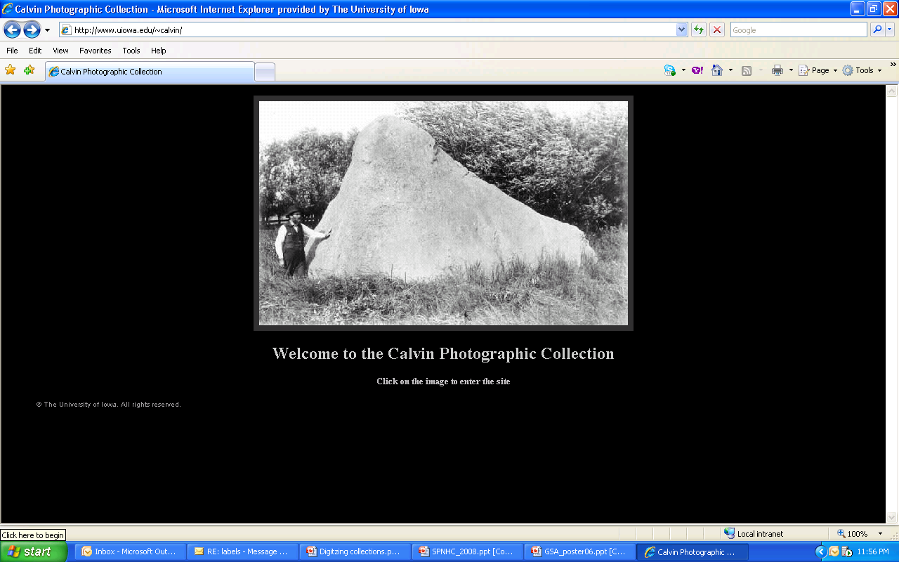

Slide 11
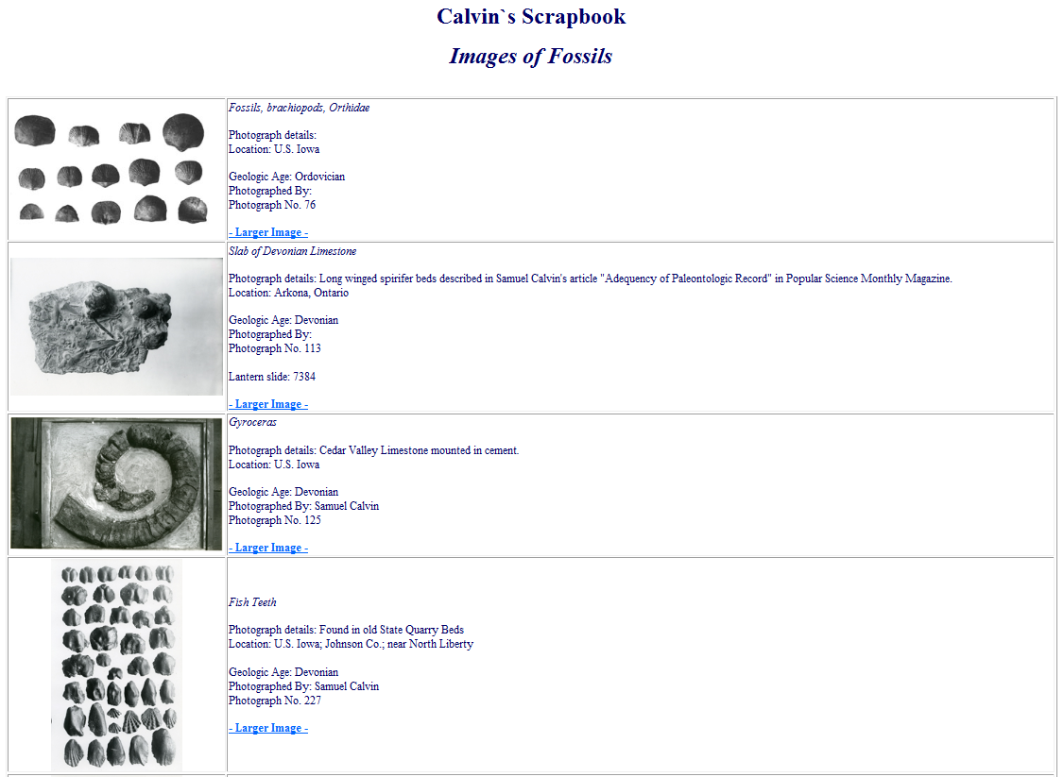

Slide 12
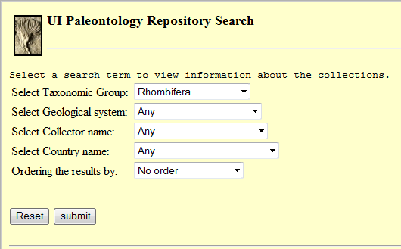
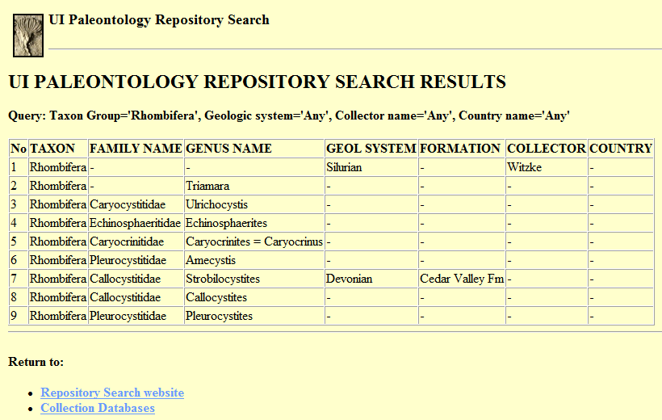
http://nmita.iowa.uiowa.edu/paleo/showtable.jsp?taxonName=Rhombifera&geolName=Any&collrName=Any&countryName=Any&orderBy=NoOrder

Slide 13
Paleontology Repository Digitization Project
Prioritize collections at risk from losing associated data
Make collections data accessible on the Internet
Increase research access to collections
Make digital images available on-line for researchers and fossil enthusiasts
Link specimen catalogue to community database projects to increase exposure
Digital preservation of associated printed documentation
Develop web-based education tools
Provide training opportunities for undergraduate, graduate, and Museum Studies students
Project planning

Slide 14
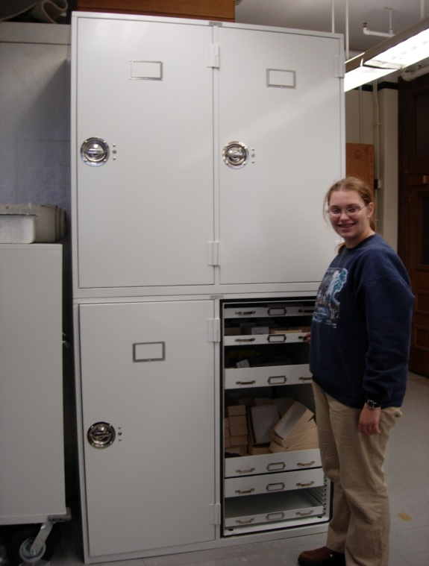

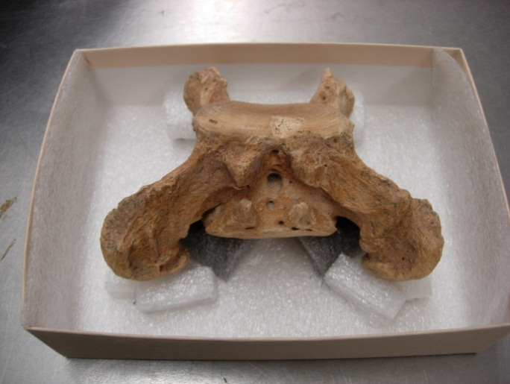
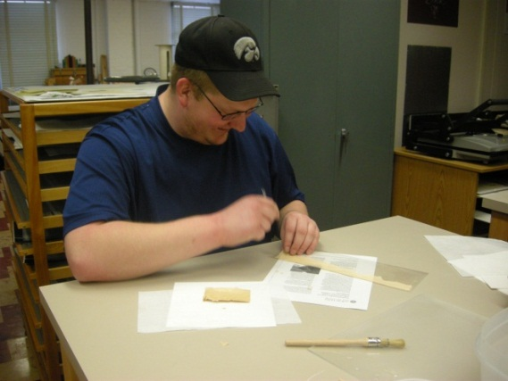
Funding for projects
State Historical Society of Iowa ($7,731) Preserving 150 Years of Iowa’s Fossil Collecting Heritage
Iowa Science Foundation ($5,000) Curation of the Tarkio Valley Ground Sloths
National Science Foundation (NSF) ($284,724) Computerization of the UI Paleontology Repository
UI Research Experiences for Undergraduates ($2,825) Collection-based research in Paleobotany
UI Innovations in Instructional Computing ($17,200) Tropical America Virtual Field School

Slide 15
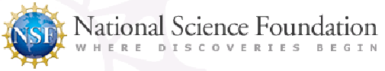
Project award and goals
Goals:
curate and catalogue priority collections
photograph selected specimens
join selected data portals
create educational resources
Funding for:
2 graduate assistant positions
Computer hardware (servers) and software
Supplies such as a camera, external hard drives
National Science Foundation Grant DBI-0544235 ($284,724); “Computerization of the University of Iowa Paleontology Repository” PI = A. F. Budd, Co-PIs = J. M. Adrain, T. S. Adrain, C. A. Brochu)

Slide 16
Teamwork!
Data Entry
TracyAnn Champagne
Erik Peterson
Kevin Murphy
Craig Draayer
Jared Rucker
Levi Gutknecht
Myra F. Laird
David Majewski
Bonnie Beck
Website development
Tawny Bailey
Sang-Cheol Seok
Juw Won Park
Document scanning Holly Berg Brittany Maltas
Photography
Kevin Cutsforth
Alex Wall
Mary Bubb
Funding
NSF University of Iowa
Rhodes Memorial Fund
Database development and data sharing Specify team
Don D’Hooge
Collection organization
and label preservation
James Bowermaster

Slide 17
Databases: Specimen catalogue Individual collection data sets NMITA Oracle database Paleo Oracle database
Collections:
Specimens
Archive
Photographs
Dynamic websites: Paleontology Portal GBIF NMITA Specify web queries Collection holdings search Fossils In My Back Yard Digital Image Project Tropical America Virtual Field School Iowa Heritage Digital Collections Iowa Digital Library, Geoscience Images
Static websites: Paleontology Repository Calvin Photographic Collection Tropical America Virtual Field School Repository Archive Finding Aid

Slide 18
Selection Criteria:
New access to previously inaccessible collections
Wider, easier access to existing, popular collections
Condition of original
Preservation
Project theme
Copyright
Availability of existing digital versions
Cost
Appropriateness for on-line viewing

Slide 19
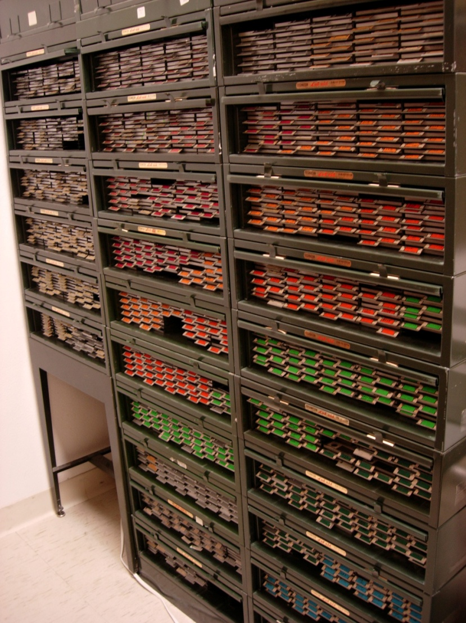

Cataloguing Priority Collections Amoco Conodont Collection (~17,500 cavity slides):
Specimens and hard copy locality files containing site descriptions, detailed stratigraphic sections supplemented by photographs and interpretive summaries.

Slide 20
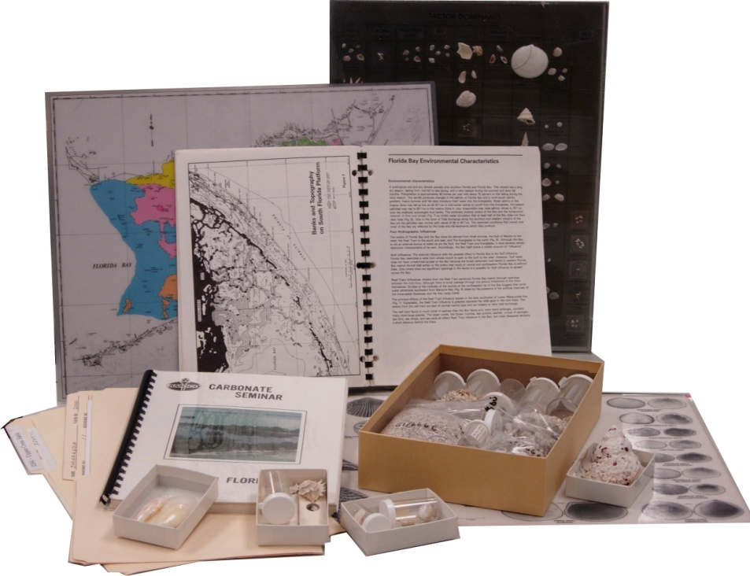
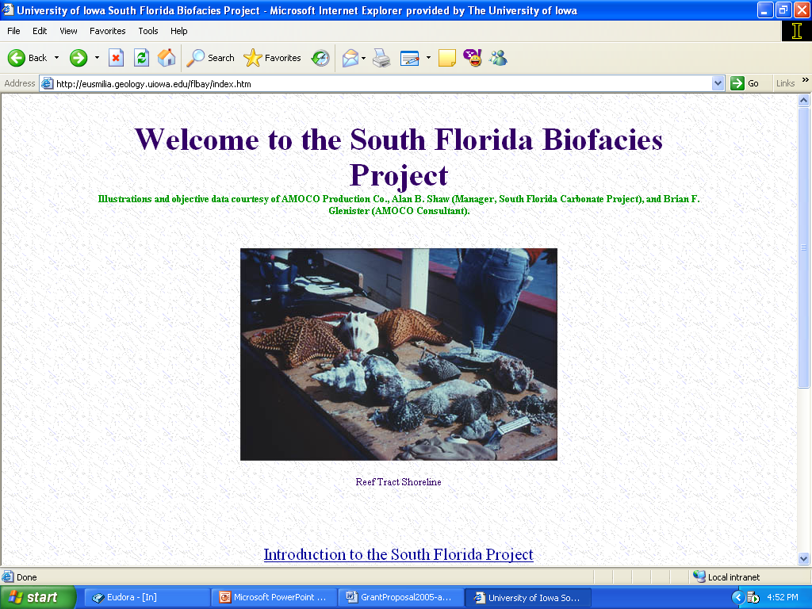
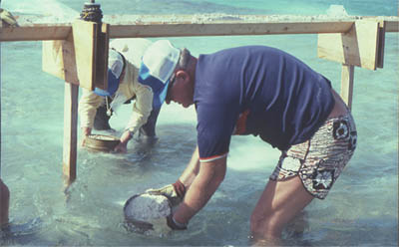
Cataloguing Priority Collections Amoco South Florida Collection (~900 samples, > 6000 photos)

Slide 21
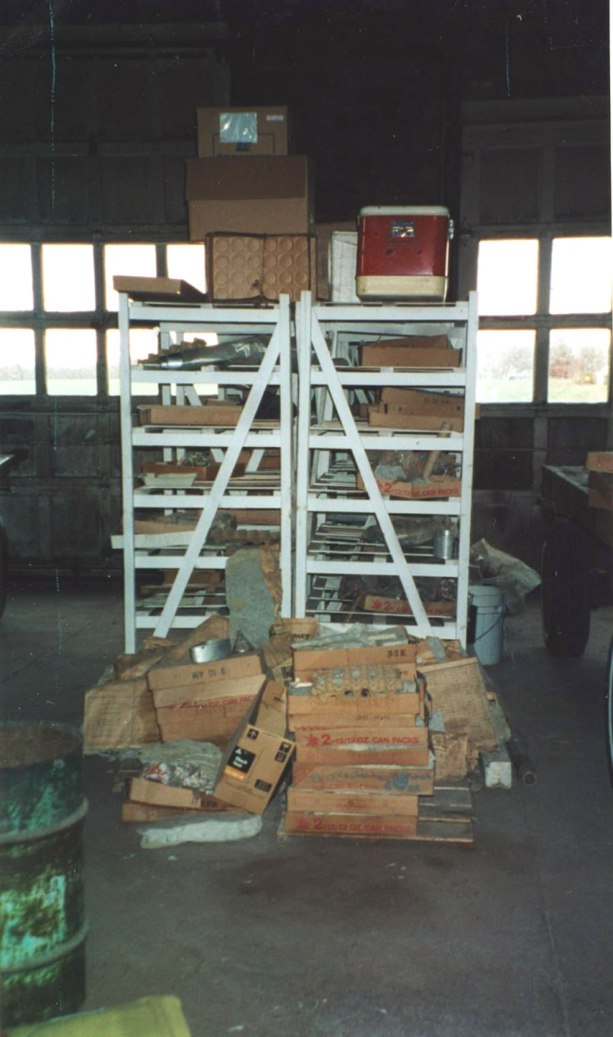
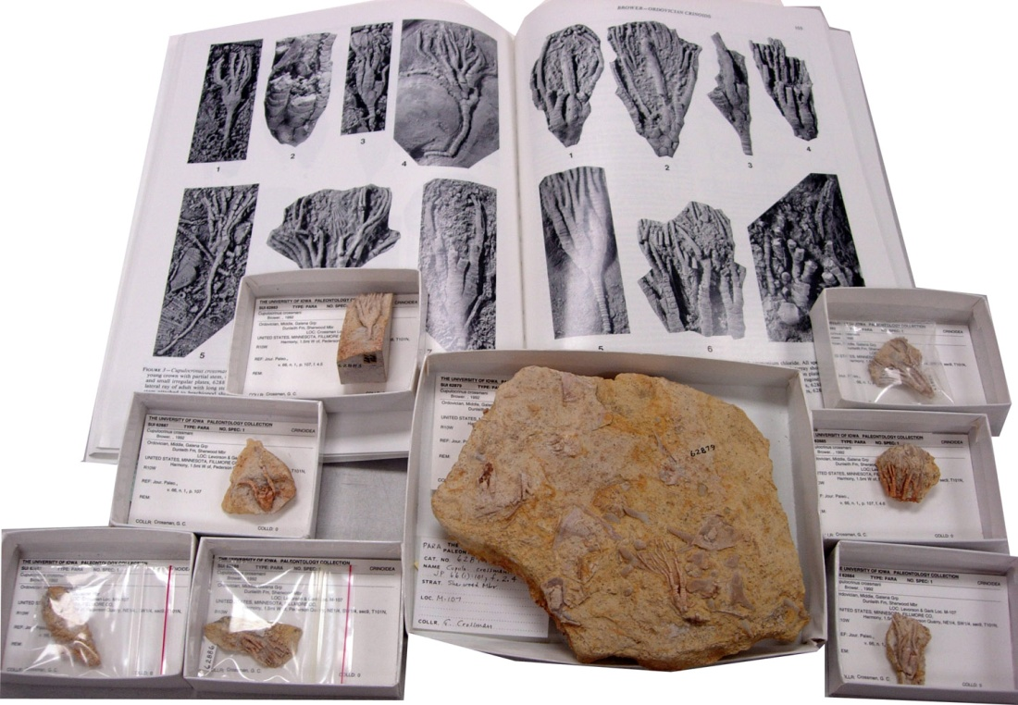
Cataloguing Priority Collections
Midwest Echinoderm Collection Bequeathed to the UI Paleontology Repository in the last 7 years by local amateur collectors. Over 10 tons of material!

Slide 22
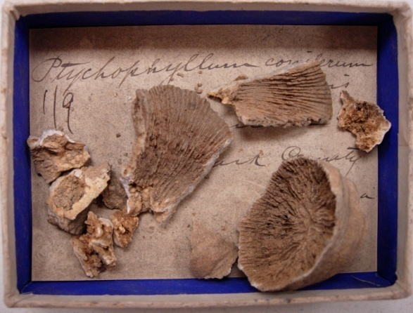
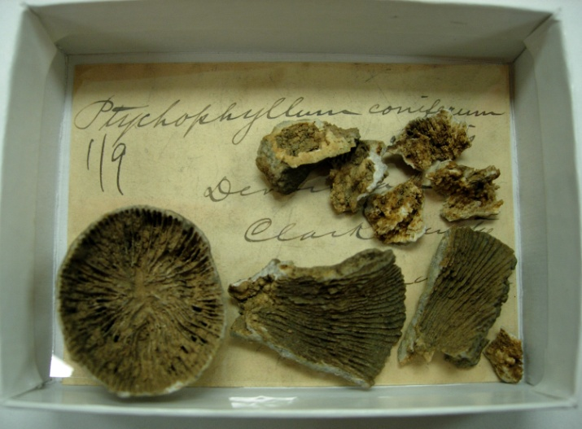
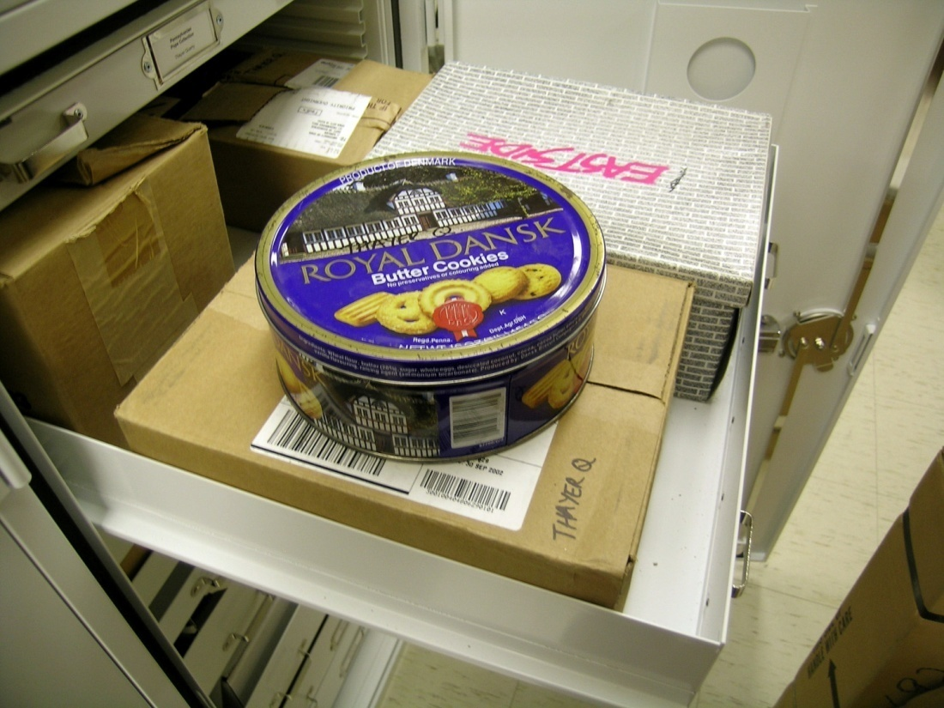
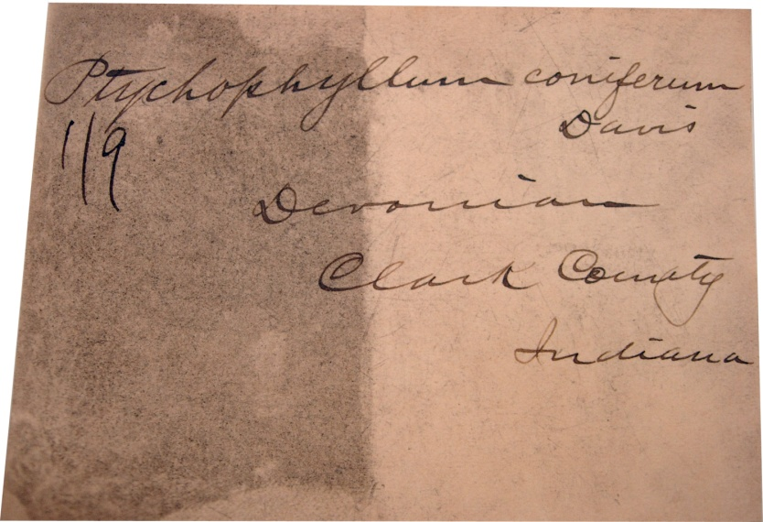
Cataloguing Priority Collections John Pope Collection
Paleozoic Coral Collection

Slide 23
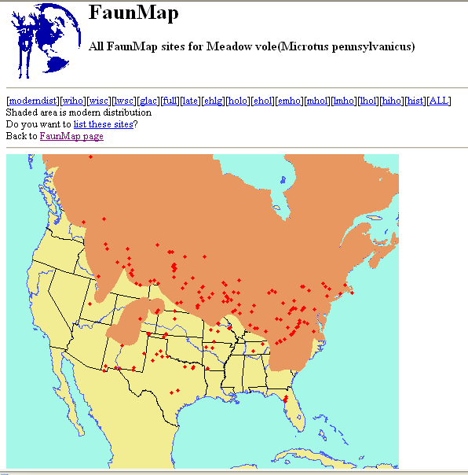
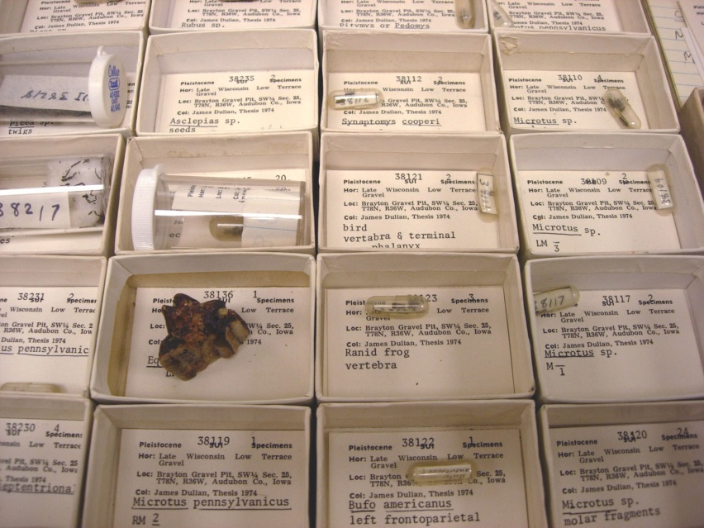
Cataloguing Priority Collections
Micromammal Collection (~30,000 specimens): The UI micromammal collection was used to provide data for Faunmap, but none of the specimen level information for the collection is electronically catalogued.

Slide 24
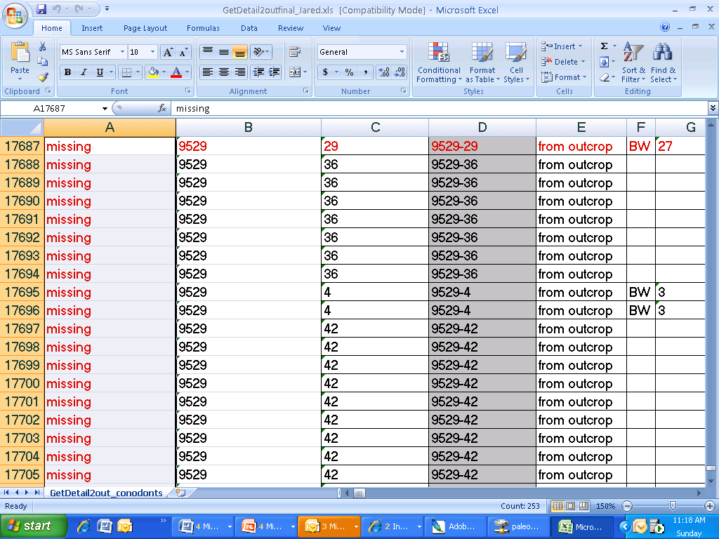
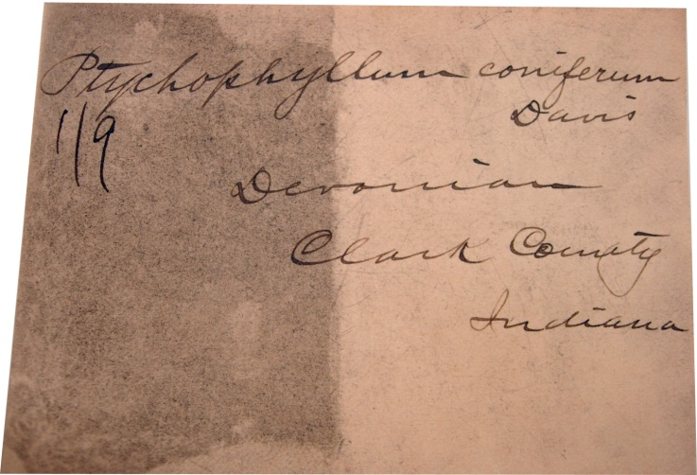
Planning a digitization project
Before you start:
State of the data

Slide 25

Planning a digitization project
Before you start:
State of the data
Personnel training, management, space

Slide 26
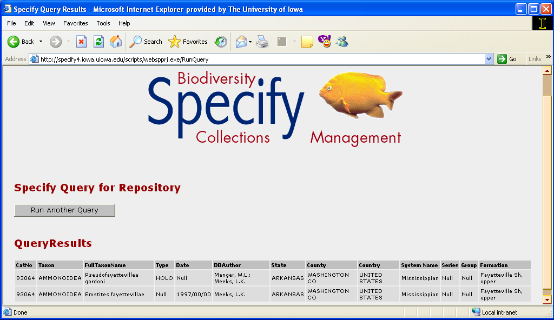
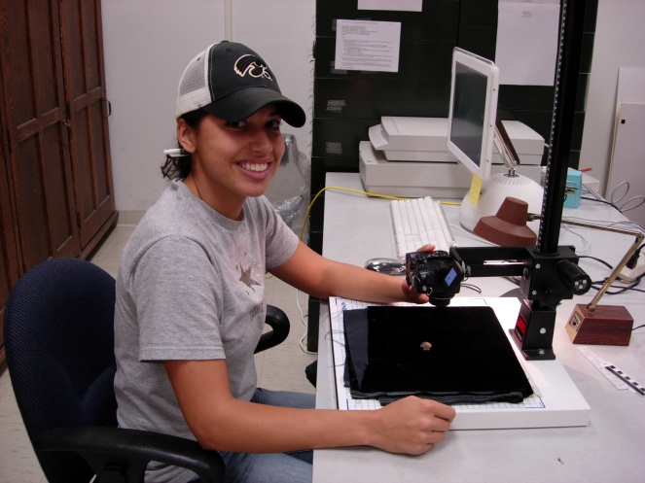
Planning a digitization project
Before you start:
State of the data
Personnel training, management, space
Hardware and software needs

Slide 27
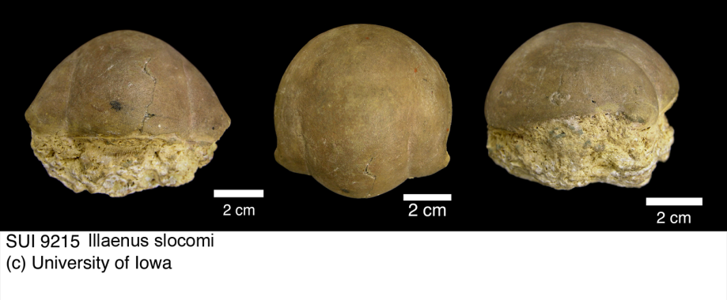
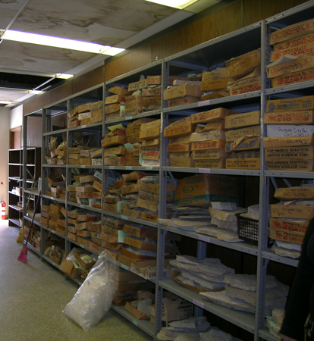
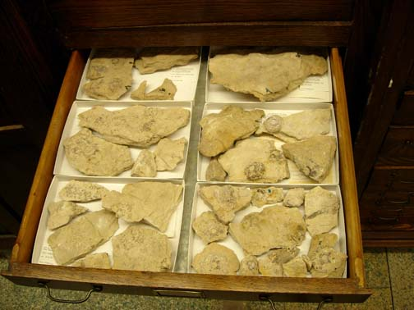
Planning a digitization project
Before you start:
Physical access to specimens

Slide 28
Planning a digitization project
Before you start:
Physical access to specimens
Task analysis and time management
~ 5 minutes per specimen data entry ~15 minutes per specimen photography and editing

Slide 29
Planning a digitization project
Digitization process
Object handling
Standards e.g. Photography:
Archive TIFF files 2000x2000 pixels
Web-formatted JPGs 600 pixels long axis, 150 dpi (~100-300 KB)
Metadata

Slide 30
Project management
Object retrieval
Preparation
Digitization
Return
File naming
File storage
On-line delivery
Server/storage media back-up

Slide 31
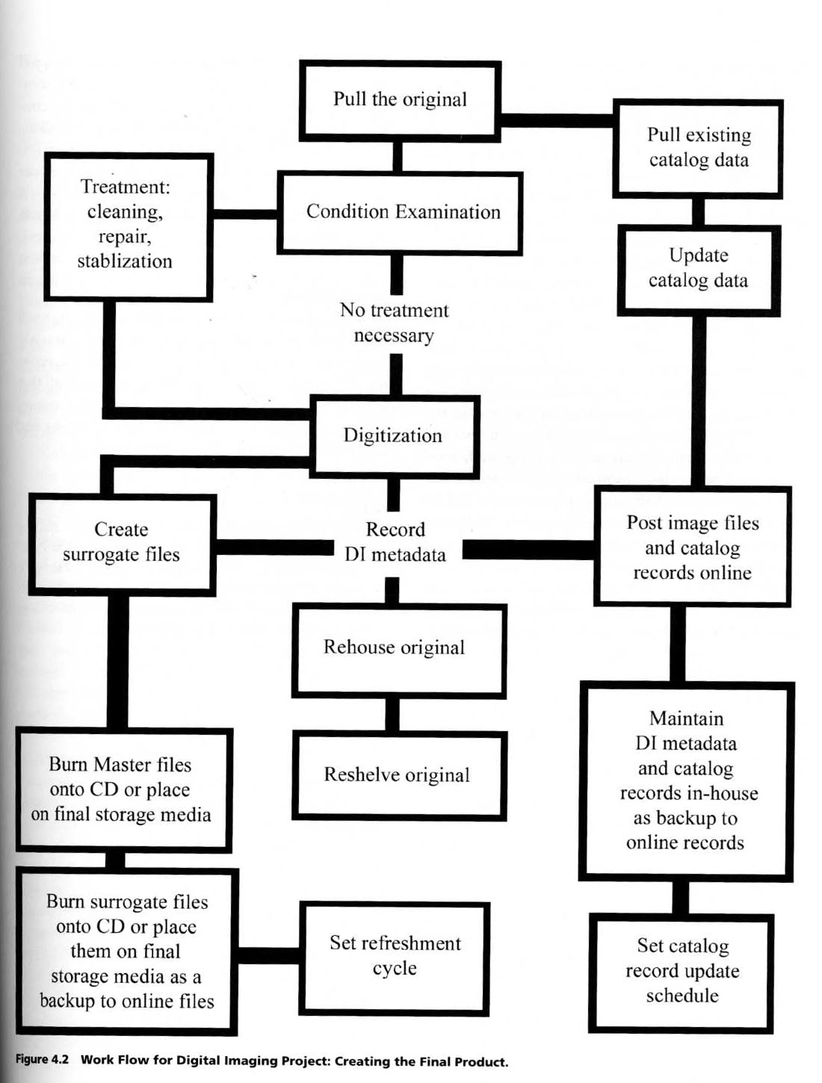
Project Management and Workflow

Slide 32
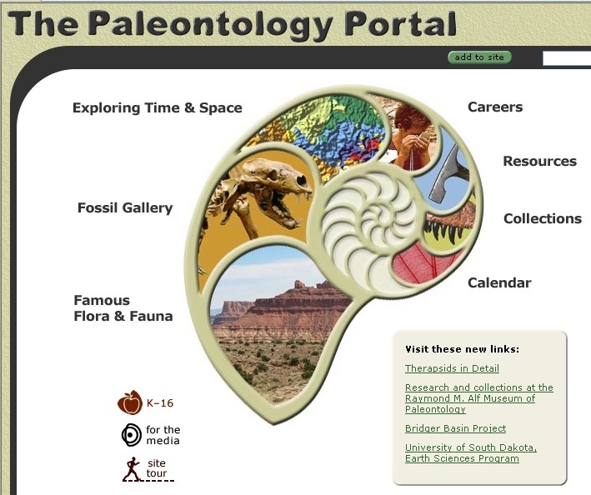
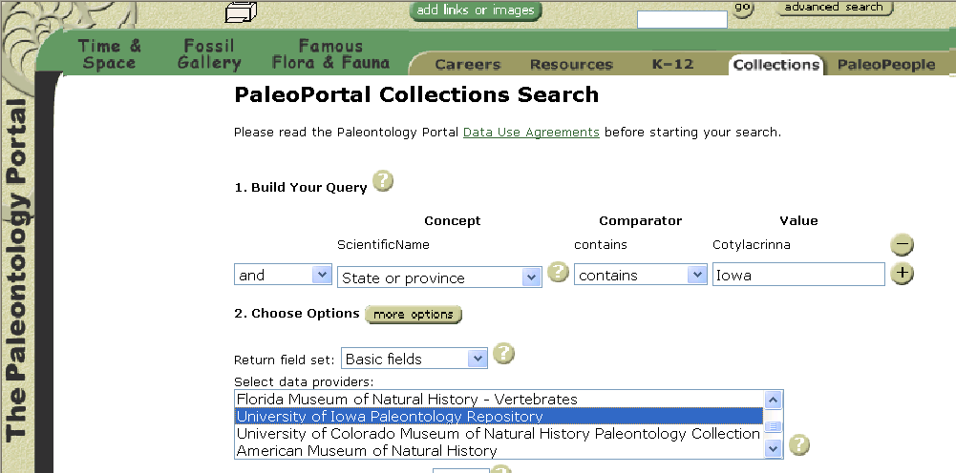
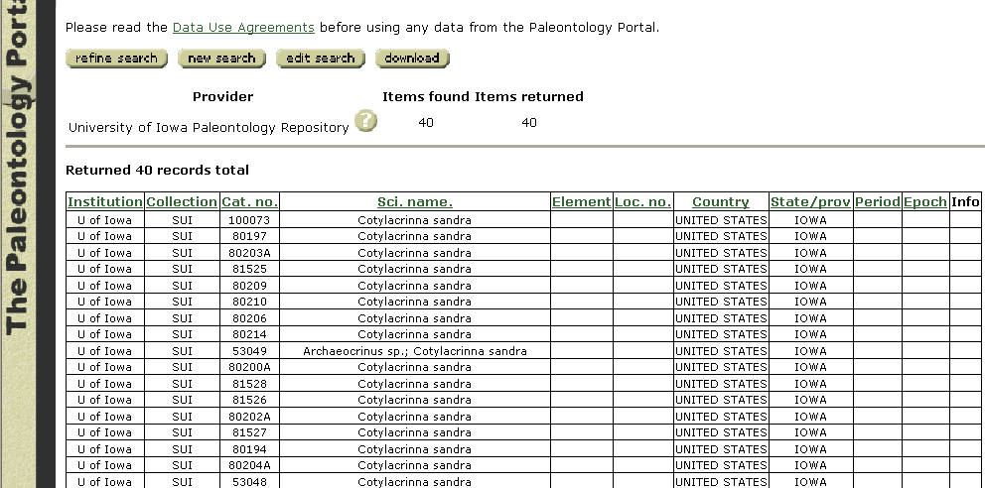
Making digitized data available
To the research community…
www.paleoportal.org

Slide 33
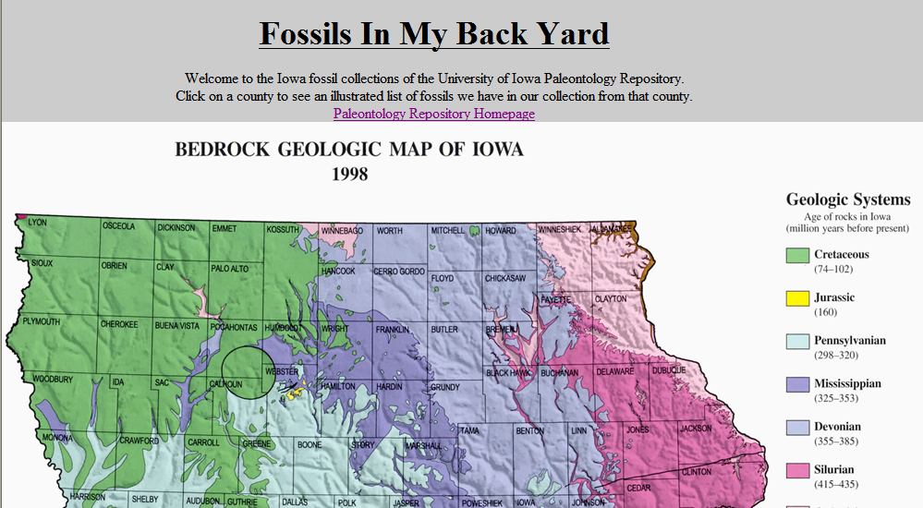
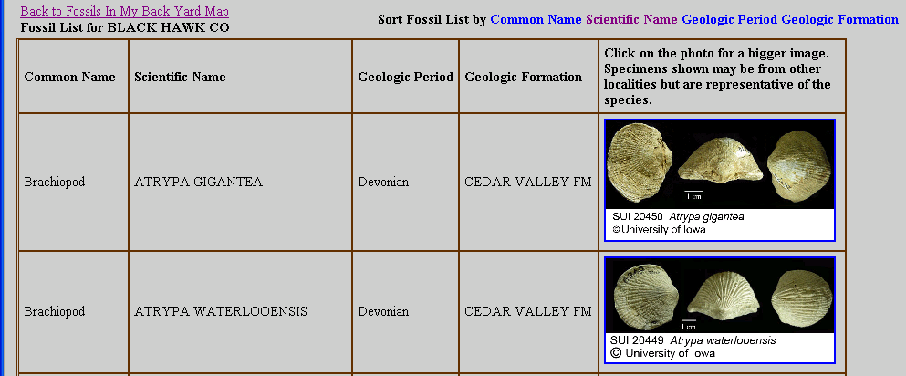
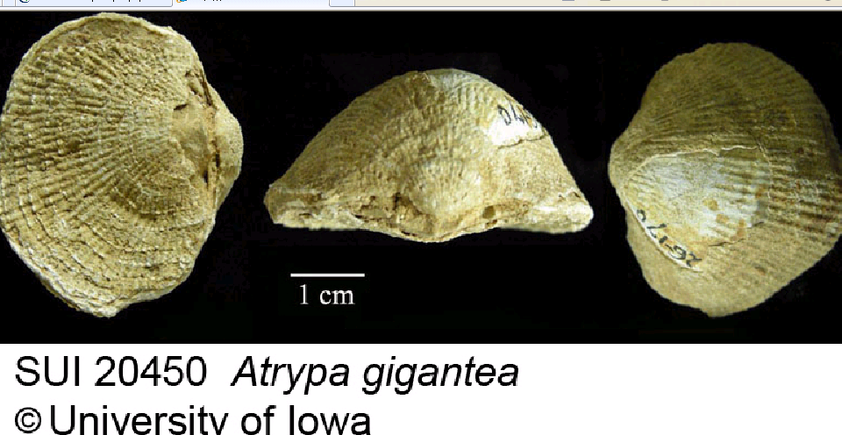
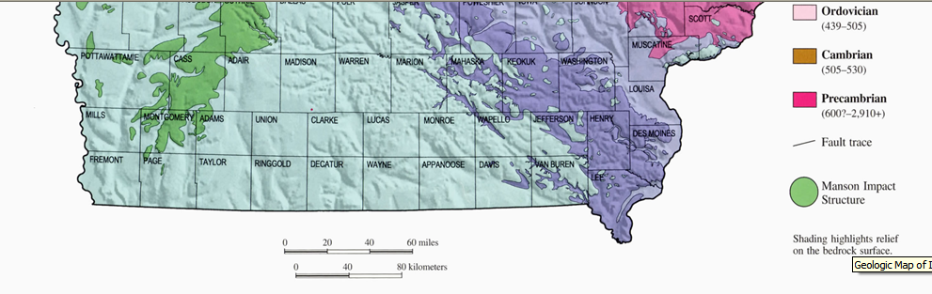
Making digitized data available
To the public…

Slide 34
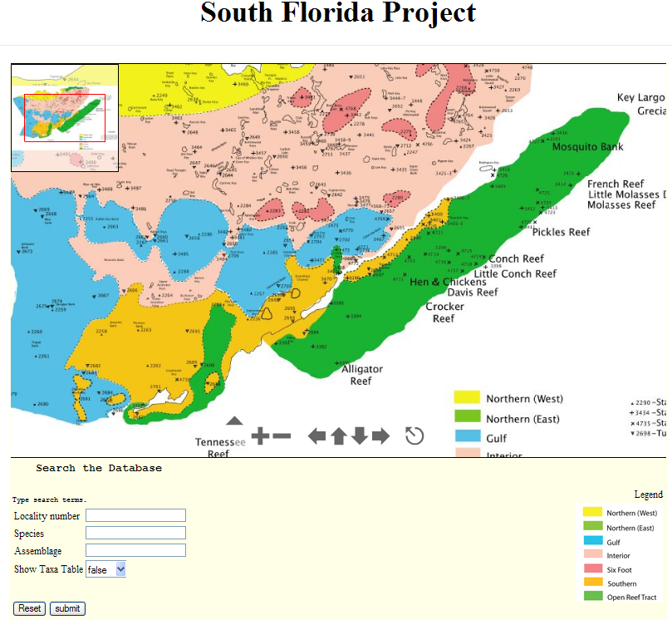
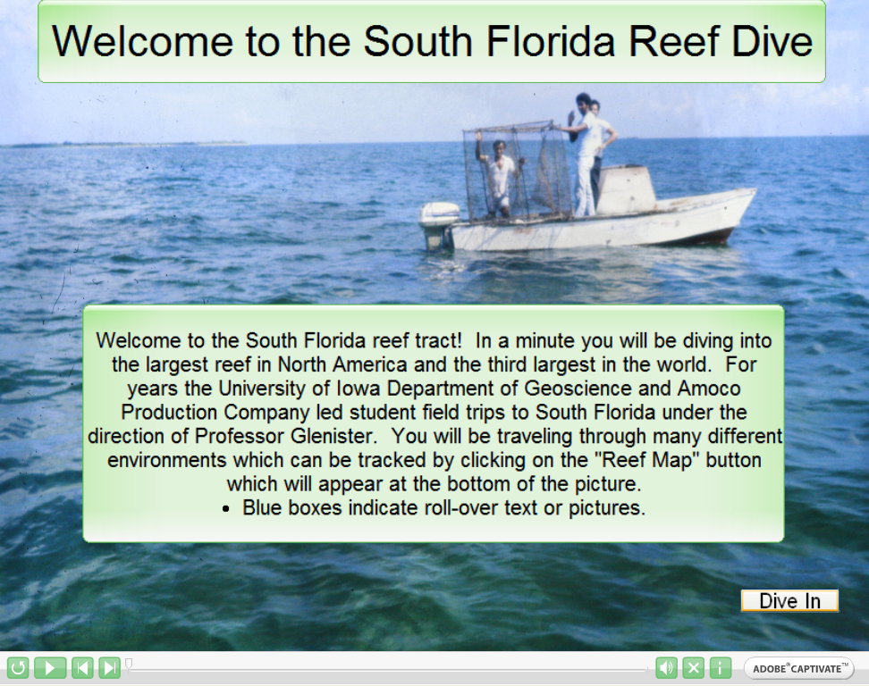
Making digitized data available
To students…

Slide 35
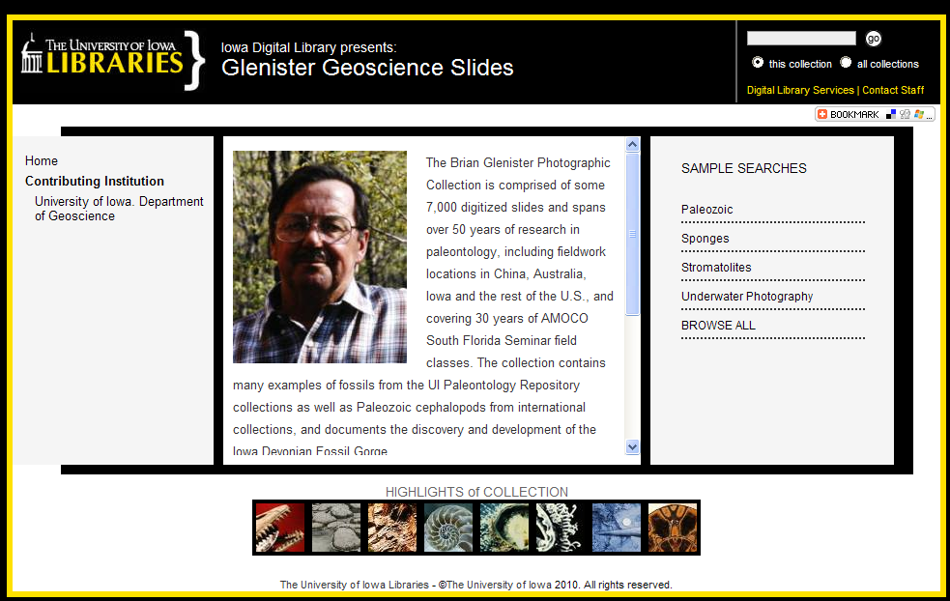
Making digitized data available
To other projects… (http://digital.lib.uiowa.edu/)

Slide 36
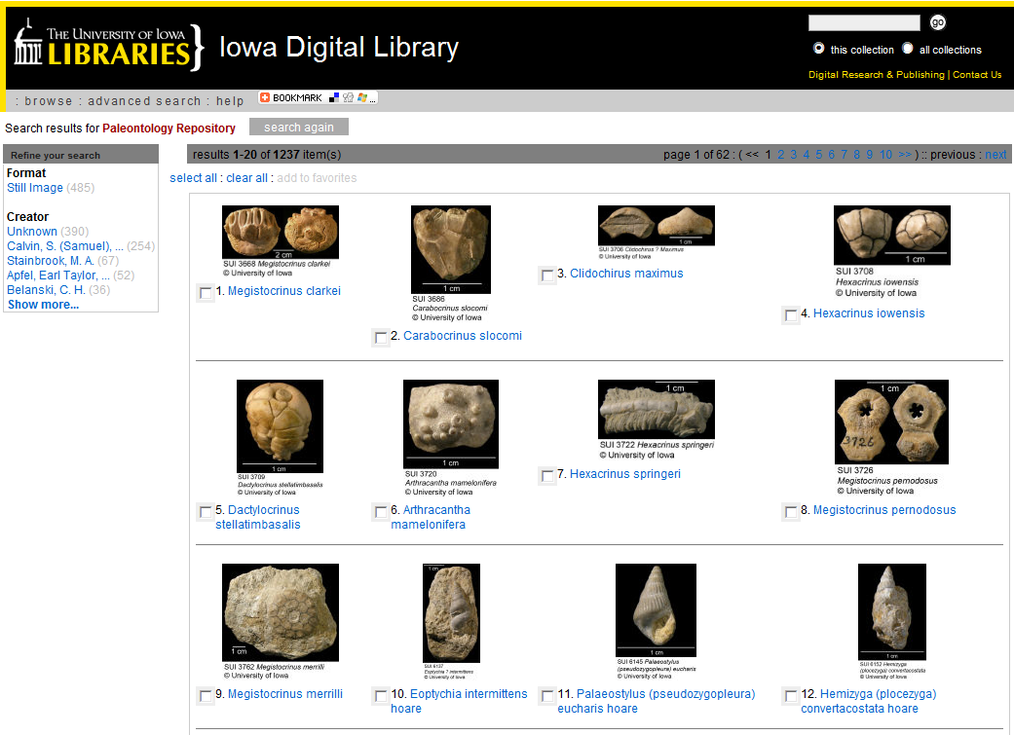
Making digitized data available
To other projects… (http://digital.lib.uiowa.edu/)

Slide 37
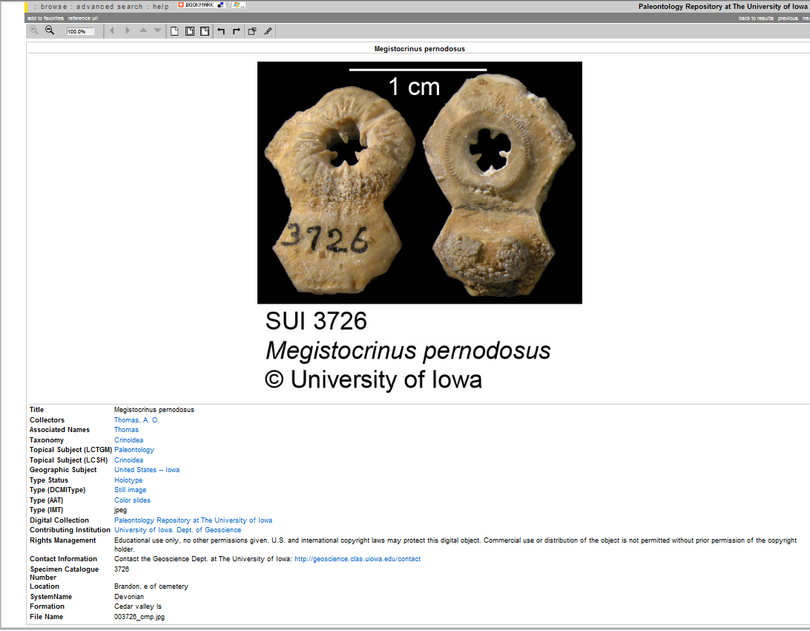
Making digitized data available
To other projects… (http://digital.lib.uiowa.edu/)

Slide 38
Pros and cons of digitizing collections
Time consuming

Slide 39
Pros and cons of digitizing collections
Time consuming
Consistency of data entry

Slide 40
Pros and cons of digitizing collections
Time consuming
Consistency of data entry
Ever-expanding tasks

Slide 41
Pros and cons of digitizing collections
Time consuming
Consistency of data entry
Ever-expanding tasks
Data preserved and associated with specimens

Slide 42
Pros and cons of digitizing collections
Time consuming
Consistency of data entry
Ever-expanding tasks
Data preserved and associated with specimens
Collection inventory

Slide 43
Pros and cons of digitizing collections
Time consuming
Consistency of data entry
Ever-expanding tasks
Data preserved and associated with specimens
Collection inventory
Improved data access

Slide 44
Pros and cons of digitizing collections
Time consuming
Consistency of data entry
Ever-expanding tasks
Data preserved and associated with specimens
Collection inventory
Improved data access
Increased interaction with the public

Slide 45
Pros and cons of digitizing collections
Time consuming
Consistency of data entry
Ever-expanding tasks
Data preserved and associated with specimens
Collection inventory
Improved data access
Increased interaction with the public
Increased research use

