Slide 1
Specify & Lifemapper
Jim Beach
University of Kansas
iDigBio Summit, 30 November 2011

Slide 2
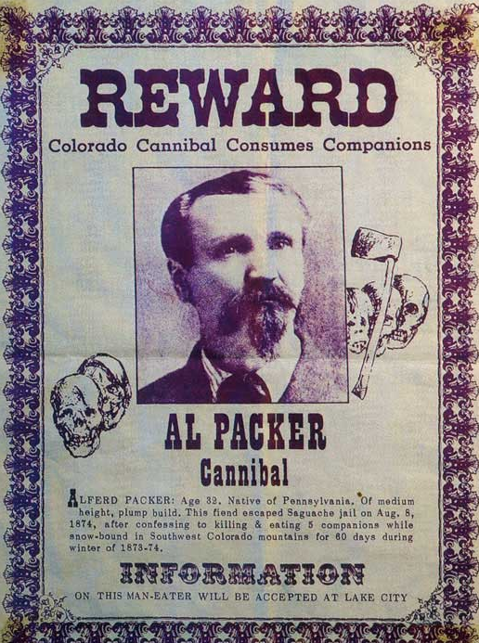

Slide 3
At the conclusion of the trial, the judge's exact words were,
"Alferd Packer, you voracious man-eater, there were only seven Democrats in Hinsdale County, and you done et five of 'em."

Slide 4
Outline
Quick Facts
Vision
Integration with TCNs and iDigBio

Slide 6
Specify Software Project – Quick Facts
Biological Collections Data Management Platform
Java, open source, free, thick clients: Win, Mac, Linux
24 years, Specify and Muse Projects, NSF, 2010-2014
Budget of $400K/yr
Staff: 3(1) software engineers, 1 helpdesk technical support, 2 student software testers, 1 trainer, 1 director.
400 Collections, (300 Prod., 80 Comm., 20 Eval.) 20% Intl, 17% collections/yr

Slide 7
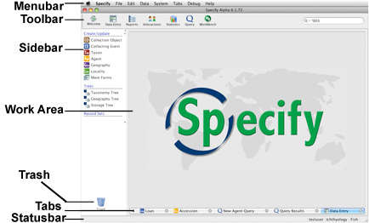
Program Interface, Layout and Navigation

Slide 8
Major User Components
Specify 6 Platform – Clients for Mac OSX, Windows, Linux, uses MySQL data manager, extendible plug-ins
Specify EZDB – No MySQL installation needed
Specify WorkBench – 2D data entry, and MobileWB
Specify Schema Mapper – Graphical mapping of incoming data fields to Specify Data model
Specify Collection Wizard – for creating a new Databases
Specify Backup and Restore – for the same
Specify iReport – design specimen labels, reports

Slide 9
CO-DEvelopment Collaborations

Slide 10
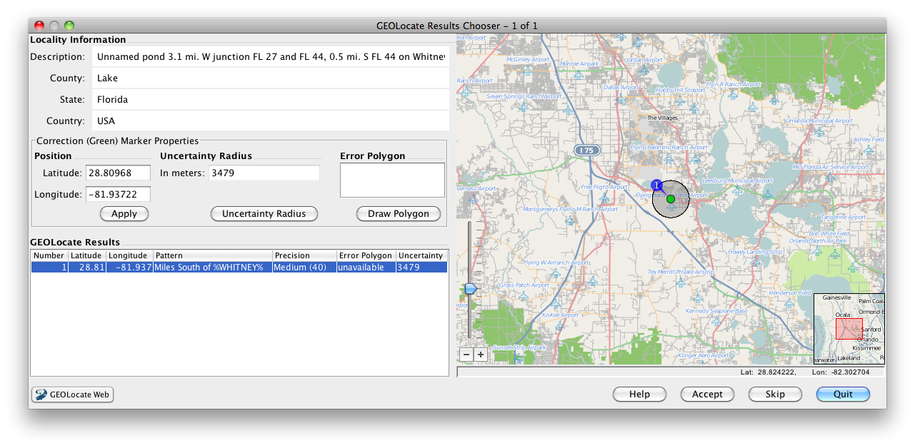
GEOLocate Georeferencing

Slide 11
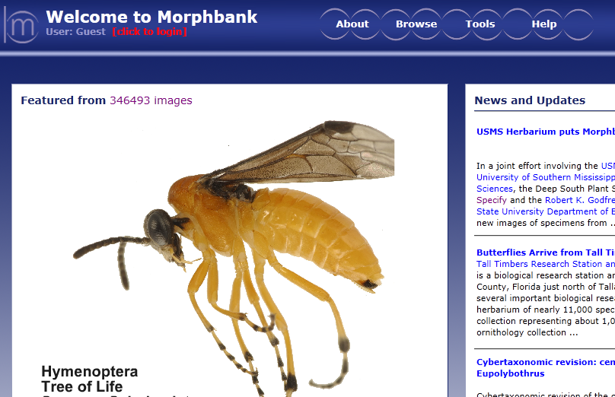
Morphbank Image Repository Services

Slide 12
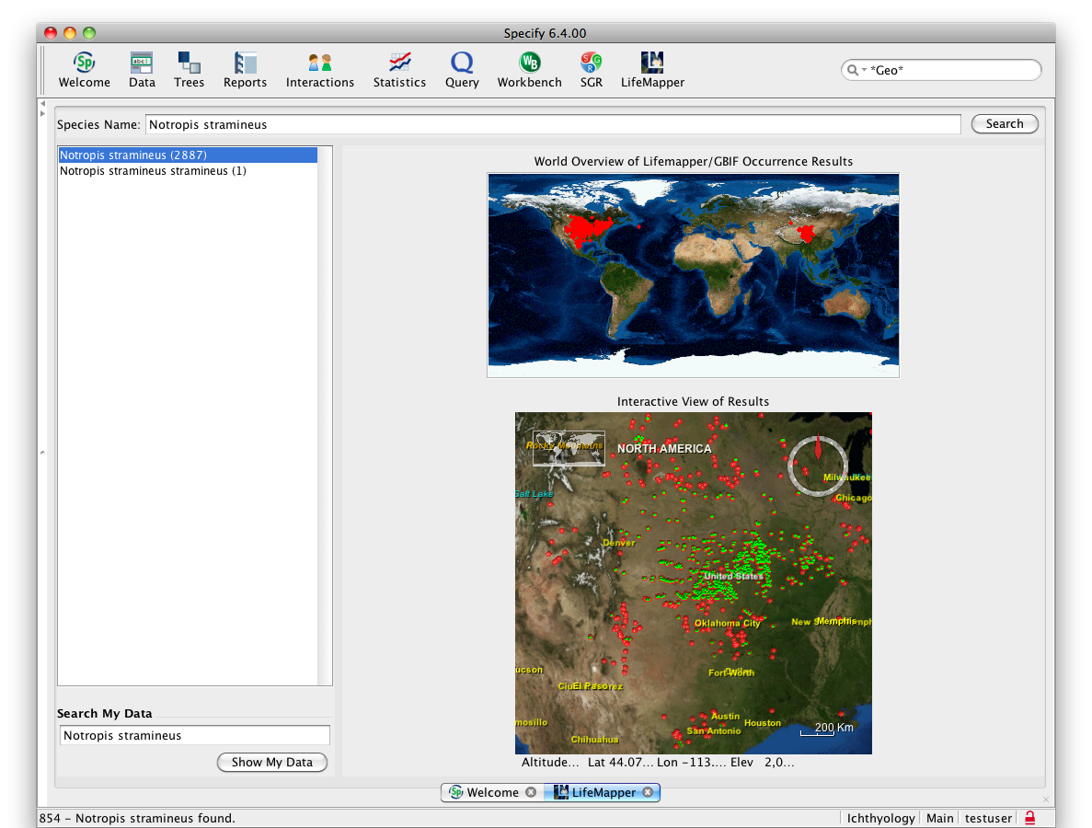
Lifemapper Geospatial Services

Slide 13
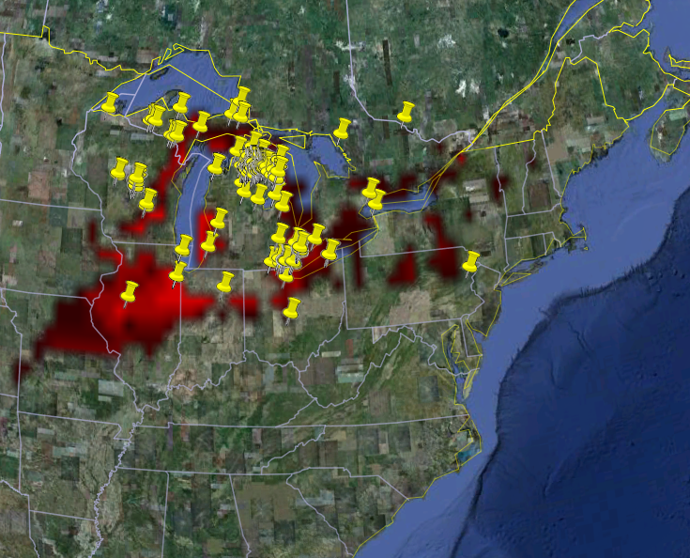
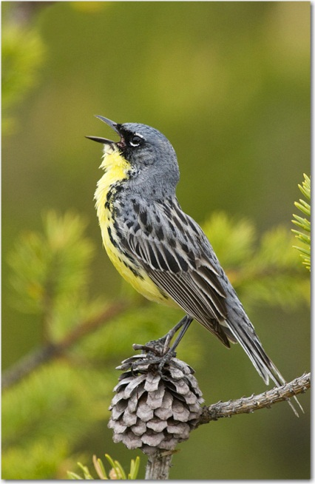
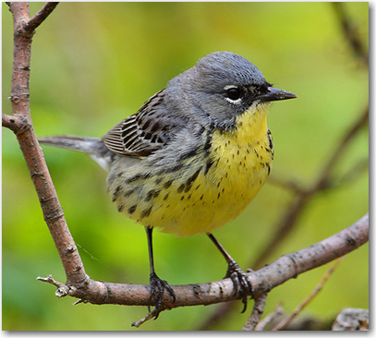
What is Lifemapper?
Current museum (GBIF) vouchered occurrences for Dendroica kirtlandii
Notes:
What is Lifemapper?
Simply, it is an archive of ecological data and a suite of tools to analyze that data.
Here we see an example of both data and the application of one of the analysis tools.
Each of the yellow “push pins” are observed occurrence points of Kirtland’s warbler retrieved from a local cache of the Global Biodiversity Information Facility’s specimen records database.
The red areas represent a probability map indicating areas where Kirtland’s warbler could potentially live where a greater color intensity indicates a higher probability.

Slide 14
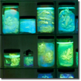
LmSDM: Species Distribution Modeling
Species Occurrence Data
SDM Modeling Algorithm
Predicted Habitat
Environmental Data
Notes:
We currently have 2 primary sets of tools – the first is Species Distribution Modeling or LmSDM
LmSDM calculates predicted habitat models using occurrence and environmental data and an OS software framework called openModeller, created by CRIA (Reference Center on Environmental Information) in Brazil
openModeller currently implements 11 algorithms for calculating SDM, each with multiple parameters to tune the calculations and can be extended to include new algorithms
Our primary data source for specimen occurrence data is GBIF. GBIF gives us a copy of their cache approximately once a month. These data are organized by scientific name and available through LM services for download and modeling. Alternatively researchers can upload their own datasets for LmSDM computation
Environmental layers are also served through LM services, including WorldClim elevation and bioclimatic variables and the same bioclimatic variables calculated from predicted future climate values from global climate models. Once again, researchers can upload their own environmental layers for use in LmSDM

Slide 15
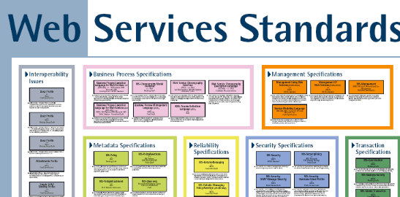
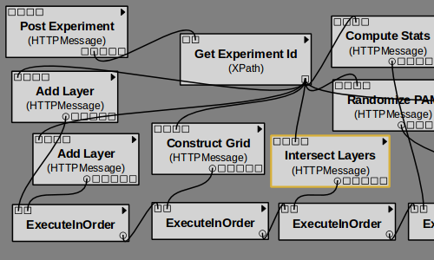
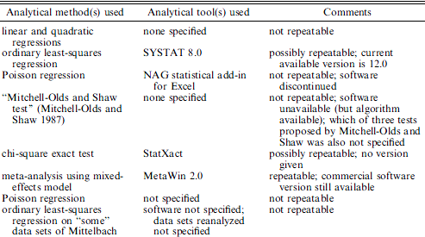
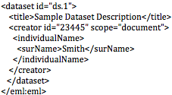
What is Lifemapper?
Integration
Work Flow Tools
Repeatable Transparent Science
Archiving
Ellison, A. 2010. J. Ecology
EEML
Notes:
Our goal is to Develop a software architecture and tools that are modular, allow open access and enable innovative science by streamlining difficult and time-consuming tasks.
The architecture uses standard protocols and formats
To Integrate scientific data and analyses in clients, such as scientific workflow tools and GIS tools
To Archive and document data, tools, metadata, and entire research experiments in public repositories
To allow creative, transparent, repeatable science.

Slide 16
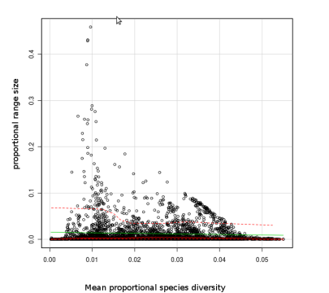
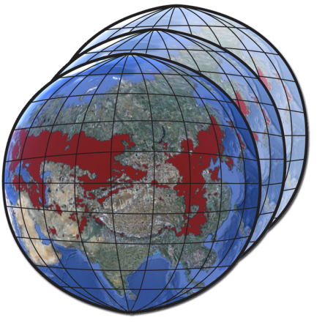
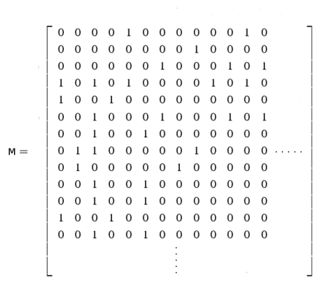
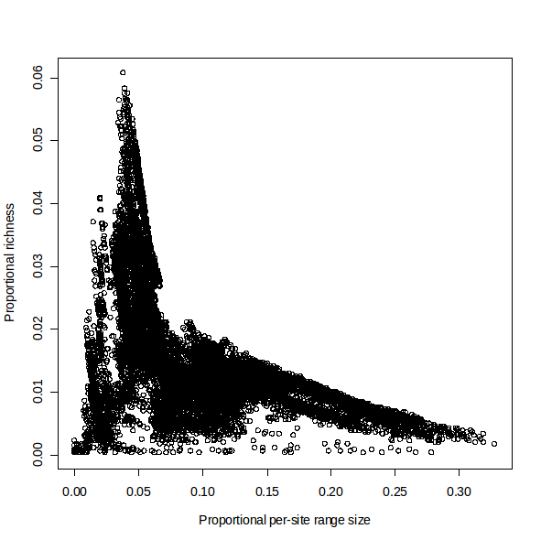
LmRAD: Range and Diversity
Presence Absence Matrix (PAM)
Species Habitat Data
Range and Diversity
Quantifications
Notes:
The second set of tools we are developing are Range and Diversity tools.
We begin with geospatial data, representing species habitat ranges for multiple species
These data are all summarized in a Presence Absence Matrix, or PAM: which then contains much of the information needed to understand species diversity.
From the PAM, we have different ways of representing species diversity, such as scatterplots, indices, and other quantifications
We Connect these in an implementation using webservices and client software,
We will support large amounts of data, from multiple sources, and analyze them at multiple scales requiring huge computational resources

Slide 17
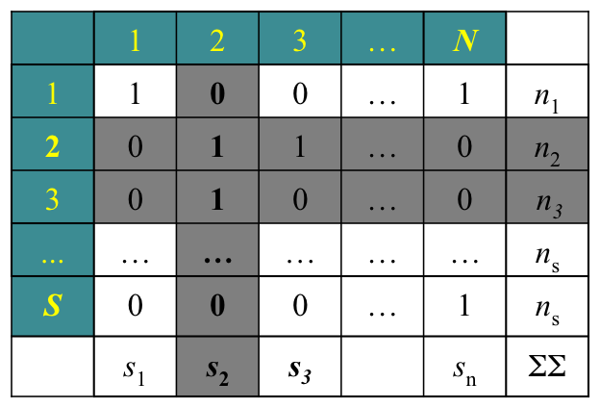
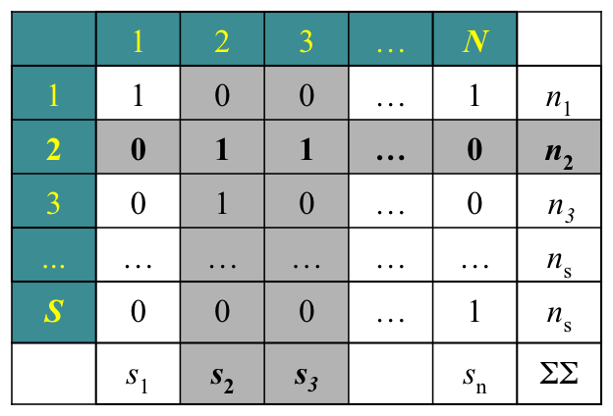
Range Diversity Plots
Presence-absence matrices
Qr-mode analysis Rq-mode analysis
Sites
Sites
Species
Species
Dispersion field Diversity field
Graves & Rahbek, 2005. PNAS. 102, 7871-7876 Arita et al. 2008. AmNat. 172, 519-532, Arita et al. 2008. AmNat. 172, 519-532 Villalobos & Arita, 2010. GEB. 19, 200-211.
Notes:
Analytical framework
An standard tool (or should I say, basic analytical tool) in biogeographic and macroecological analyses is the presence-absence matrix, which summarizes the two fundamental units of biogeography: the distributional range of species and the species diversity of sites (distribution of S species among N sites).
Commonly, each type of biodiversity attribute (diversity and distribution) is usually treated separately to describe and analyze patterns of either range size (R-mode) or species richness (Q-mode) (again, the one-dimensional view of biodiversity).
Recently Arita et al (2008) developed a novel analytical framework to extract, simultaneously, information on diversity & distribution from PAM’s (standard methodology to quantify geographic patterns of biodiversity) and analyze the intrinsic relationship of these attributes in determining geographic patterns of biodiversity.
In Qr-mode (column by row), data are computed by columns (sites), but considering the structure of the rows that intersect a given column with a non-zero entry (that is, species ocurring in the focal site). This procedure generates the “dispersion field” of a site, which is the set of range-size values of all species ocurring in that locality. Equivalenty, Rq-mode (row by column) analyses are performed by rows (species), but incorporating information of the columns that intersect the focal row with a non-zero entry (that is, the sites in which the focal species occurs). The resulting set of species richness values of the sites that form the range of a species is the “diversity field”of that species.

Slide 18
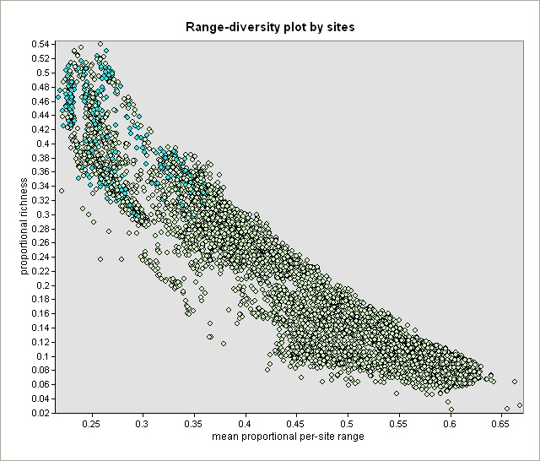
R-R Hotspots Prioritized
Total avifauna
 | Total | Protected (%) | Priority sites (#)
Domain | 7887 | 699 (8.86) | 1313 (16.65)
Hotspots quartile | 1674 | 155 (9.26) | 431 (25.75)
Notes:
Results. RD plot & geographical distribution
Hotspots quartile

Slide 19
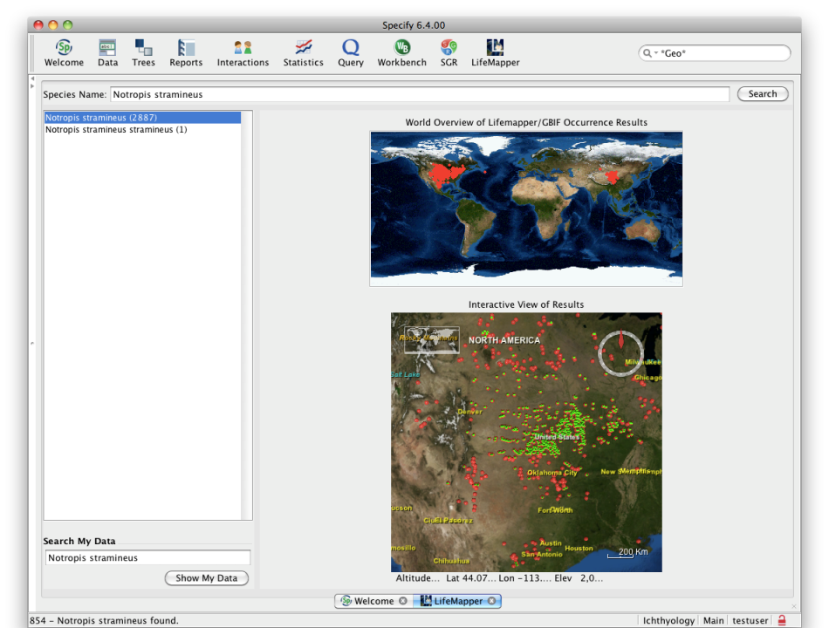
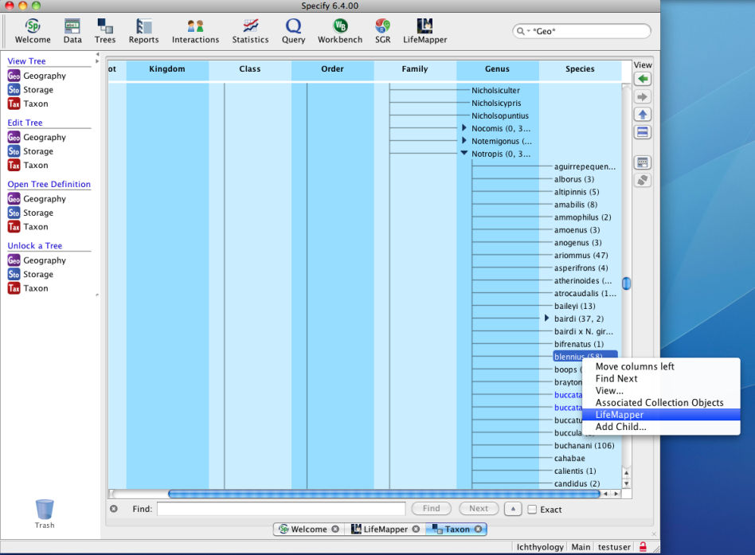
Lifemapper Geospatial Services
Functional Integration for Modeling and Analysis Job Execution

Slide 20
Scatter Gather Reconcile--Specify 6.4
Partial Records in Specify WorkBench , Mex@MICH, 3-4 fields, colors

Slide 21
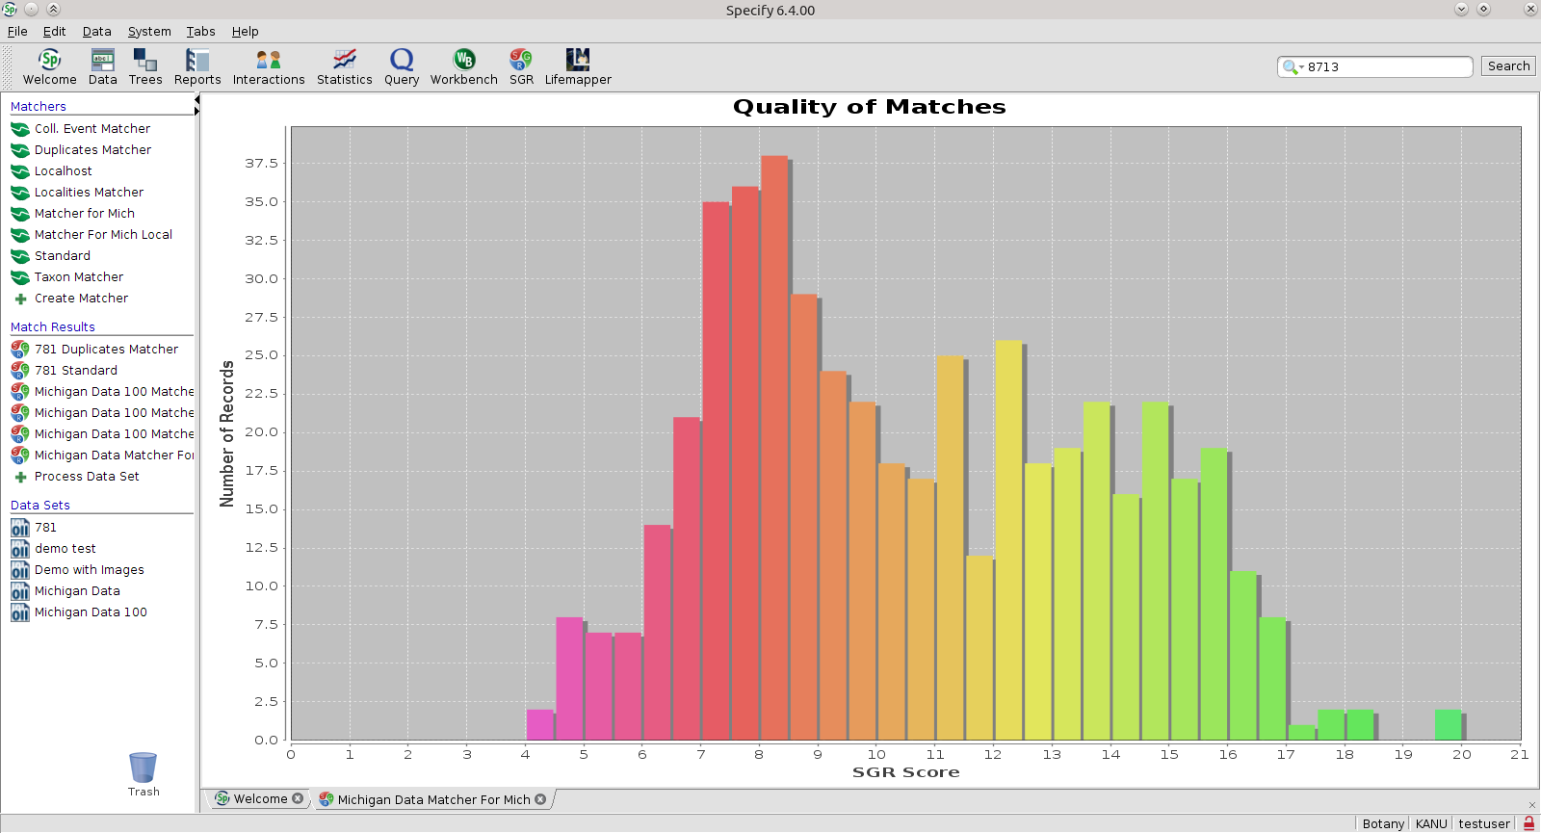
SGR Batch Query & Match Summary
Histogram of Goodness of Match for Partial Records

Slide 22
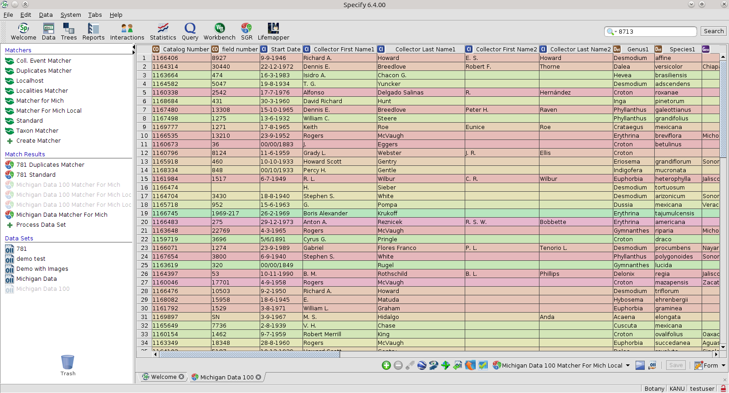
SGR Query & Match Results
Specify WorkBench Records Unsorted, color coded

Slide 23
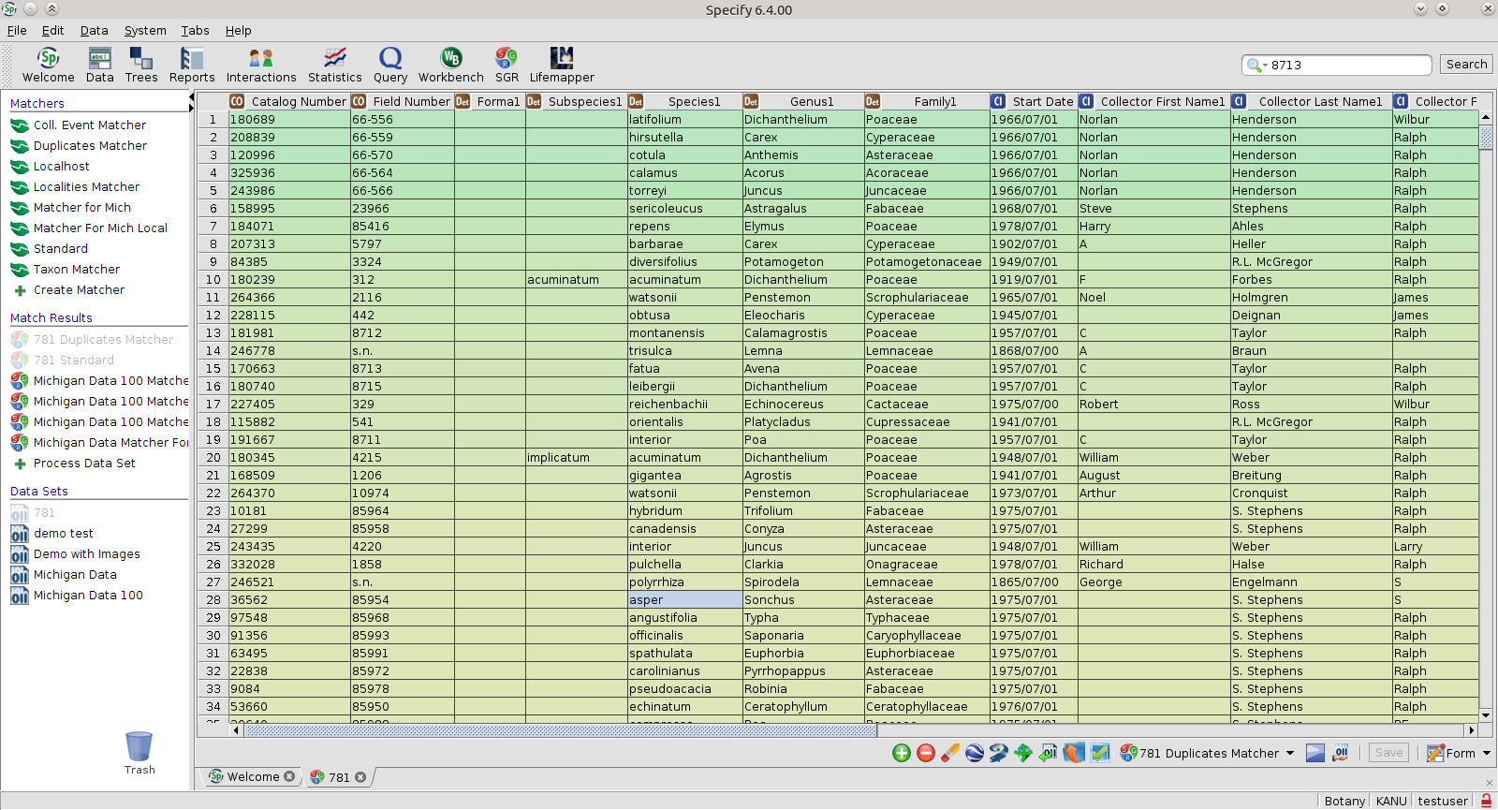
SGR Query & Match Results
Specify WorkBench Records Sorted by Goodness of Match

Slide 24
More CO-DEvelopment Collaborations
Harvard Herbarium
Filtered Push
Web Client and Portal
NRM Stockholm (DINA Project), HUH, Ag Canada

Slide 25
Digitization Workflow with Specify, SGR, GEOLocate
Final
Data
Entry
Geo-
Refer
ence
Specimen Handling &
Image Acquisition
Save & Upload
Partial Data Entry
Scatter, Gather & Reconcile
Task A:
Specimen Extraction & Handling
Task B:
Barcoding
Task C:
Image Capture
Task D:
Pre-catalog Data Entry
Task E:
Verification of Pre-catalog Data
Task F:
Specimens Returned to collection
Task G:
Search GBIF, SNIB for Matches
Task H:
Evaluate Matching Records
Task Eye:
Copy Re-Use Data
Task J:
Data Keystroke Entry
Task K:
Georefer-ence
Task L:
Save and Upload Record
H
I
A
B
C
D
E
F
G
Matches found - Copy
K
L
J
Specimen handling
No Matches – Keystroke from label Image
Data processing

Slide 26
Collaboration w/TCNs and iDigBio
Software Platform for Data Providers (+support)
Integration – Modeling and Analysis, iDB-SGR
Label Image Processing for Data Entry
Optimizing Digitization Workflows
Digitization Collaboration Support
Shared data, specimens and authority works
Web client and portal collaboration resulted from this
Engineering Interactions with UFL and TCNs

Slide 27
Bon Appétit!

