Slide 1


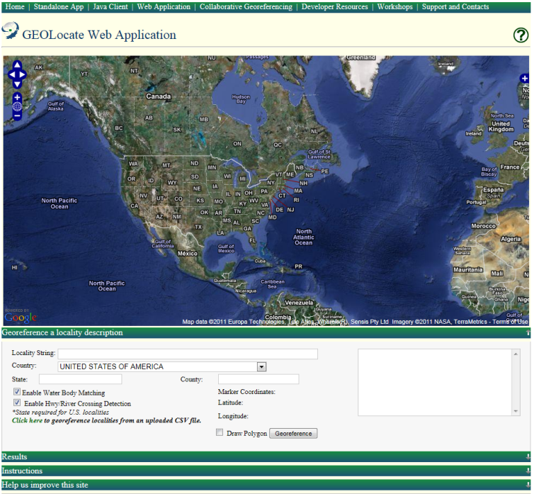
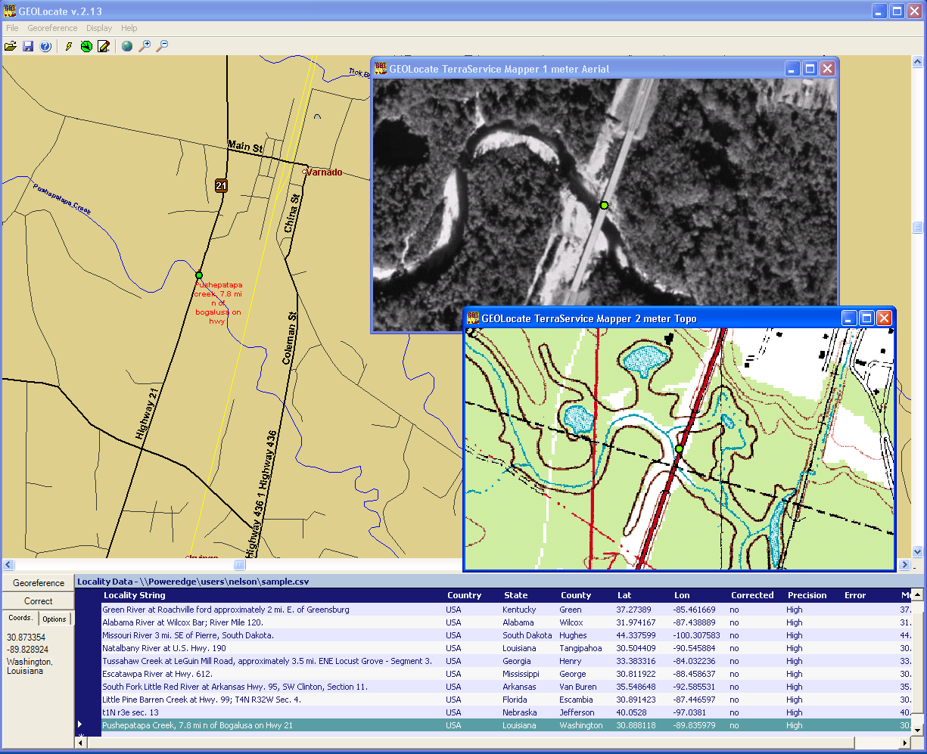
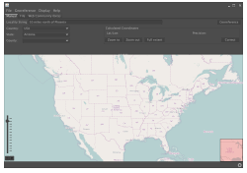
Software & services for georeferencing of natural history collections data
automated georeferencing
verification & correction
multi-lingual
kml export
interoperability
soap & rest api
batch processing
training
geographic visualization
google, bing, openstreet, wms
uncertainty determination
collaborative georeferencing

Slide 2
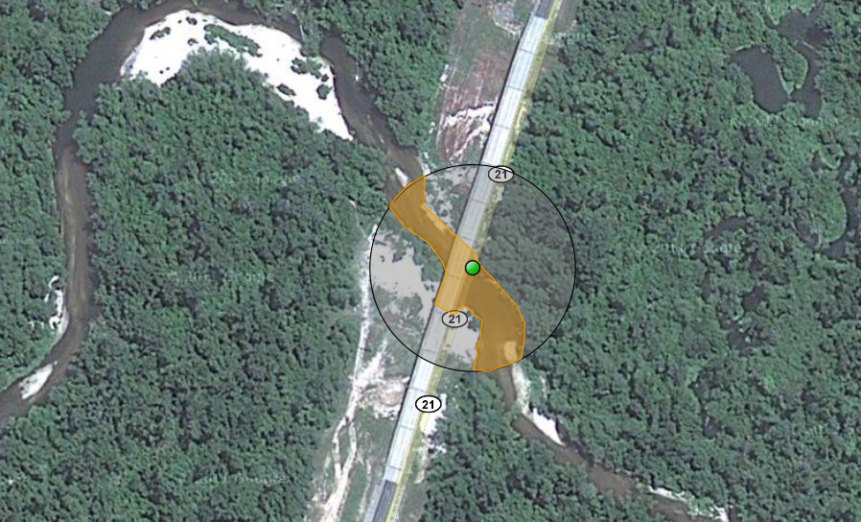
What is Georeferencing?
pushepatapa creek, trib. to pearl river, 7.8 miles north of bogalusa at hwy 21; Washington; LA; USA
latitude: 30.88797
longitude: -89.83601
uncertainty radius: 48m
uncertainty polygon: 30.88823,-89.83641, 30.88815,-89.83634, 30.88808,-89.83622…

Slide 3
Sample Workflow For
Georeferencing
Data Preparation
Automated Coordinate & Uncertainty Generation
  Locality description parsing and analysis
Verification & Adjustment of Results
  Fine tuning the results on a visual map display
  Validation services can assist

Slide 4
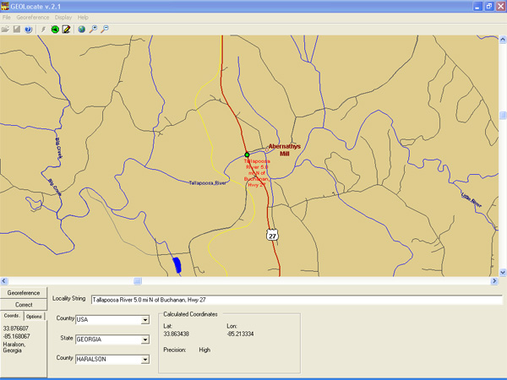
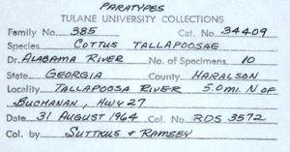
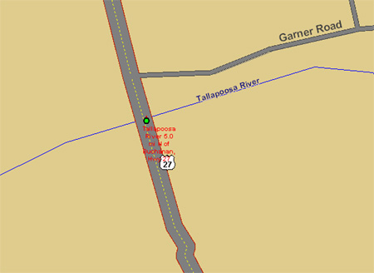
Example within GEOLocate Desktop Application

Slide 5
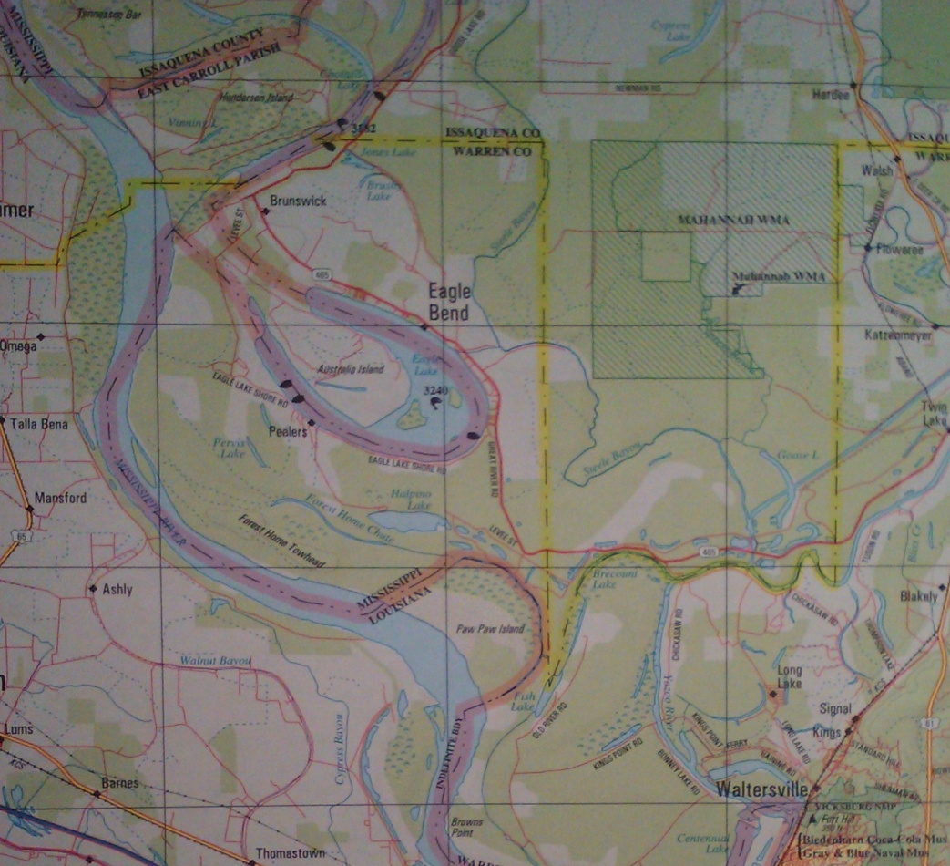
Representation of Uncertainty
Eagle Lake,
Warren County,
Mississippi,
USA

Slide 6
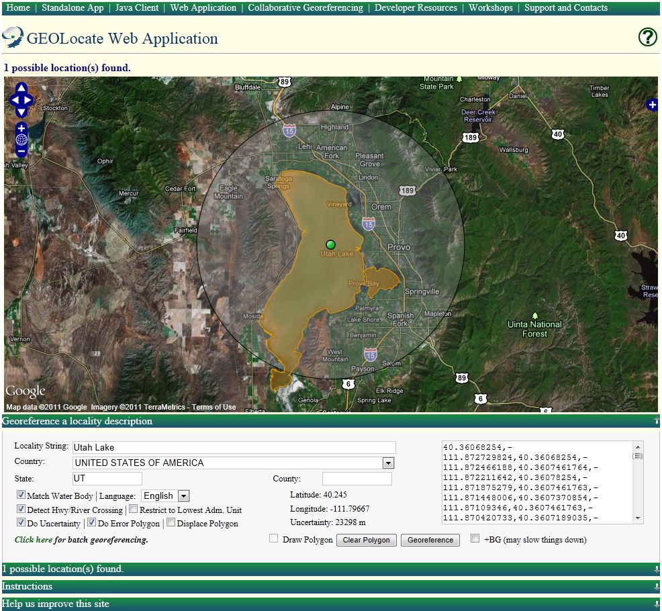
Uncertainty Within GEOLocate
Point radius and
polygonal uncertainties
Point radius represented
as a distance in meters from
georeferenced point
Polygons represented as a comma delimited array of vertices using latitude and longitude
Supports auto-detection and generation of polygons (web app only, in development for desktop app)

Slide 7
Interoperable Services
Georeferencing
  Version 1
  Version 2
Validation
  Taxon Footprint
Application
  Embeddable web client

Slide 8
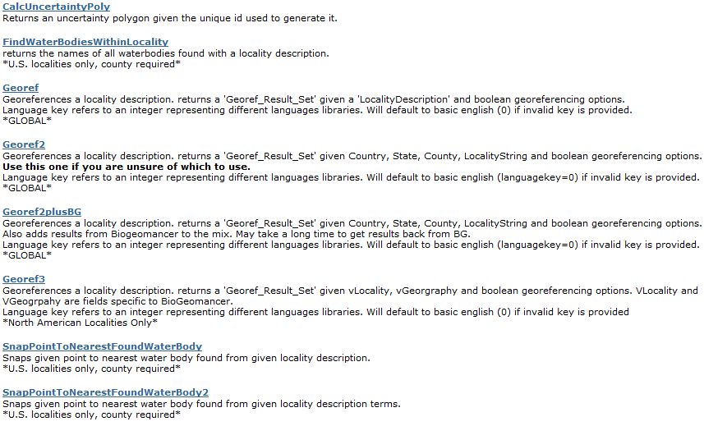
Georeferencing Services:
GEOLocate v2
SOAP & HTTP Get/Post
http://www.museum.tulane.edu/webservices/geolocatesvcv2/geolocatesvc.asmx

Slide 9
HTTP/1.1 200 OK
Content-Type: text/xml; charset=utf-8
Content-Length: length
<?xml version="1.0" encoding="utf-8"?>
<Georef_Result_Set xmlns="http://www.museum.tulane.edu/webservices/">
<EngineVersion>string</EngineVersion>
<NumResults>int</NumResults>
<ExecutionTimems>double</ExecutionTimems>
<ResultSet>
<WGS84Coordinate>
<Latitude>double</Latitude>
<Longitude>double</Longitude>
</WGS84Coordinate>
<ParsePattern>string</ParsePattern>
<Precision>string</Precision>
<Score>int</Score>
<UncertaintyRadiusMeters>string</UncertaintyRadiusMeters>
<UncertaintyPolygon>string</UncertaintyPolygon>
<ReferenceLocation>string</ReferenceLocation>
<DisplacedDistanceMiles>double</DisplacedDistanceMiles>
<DisplacedHeadingDegrees>double</DisplacedHeadingDegrees>
<Debug>string</Debug>
</ResultSet>
<ResultSet>
.
.
.
</ResultSet>
</Georef_Result_Set>
Version 2 Get Response
georef2()

Slide 10
Comparison of Service Capabilities
Feature | Version 1 | Version 2
Automated georeferencing | Yes | Yes
Bridge crossings | Yes | Yes
Water body detection | Yes | Yes
Selection of best result | Yes | Yes
Scoring & sorting of results | Partial | Yes
Uncertainty radius | No | Yes
Uncertainty polygon | No | Yes
Language option | No | Yes
Process metadata | No | Yes
Biogeomancer pass-through | No | Yes
Alternative administrative units | No | Yes
Combined, the 2 services handle an average of 10,400 georeferencing requests per day (based on Jan-Aug of 2011 data).

Slide 11
Web App as a
WS Client

Slide 12

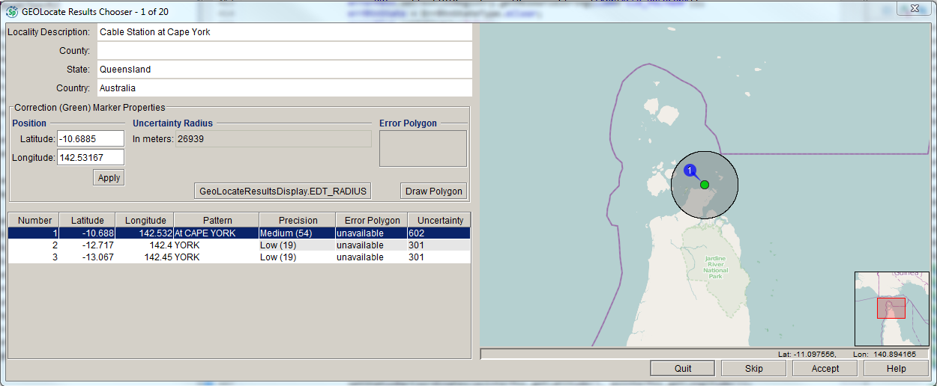

Slide 13
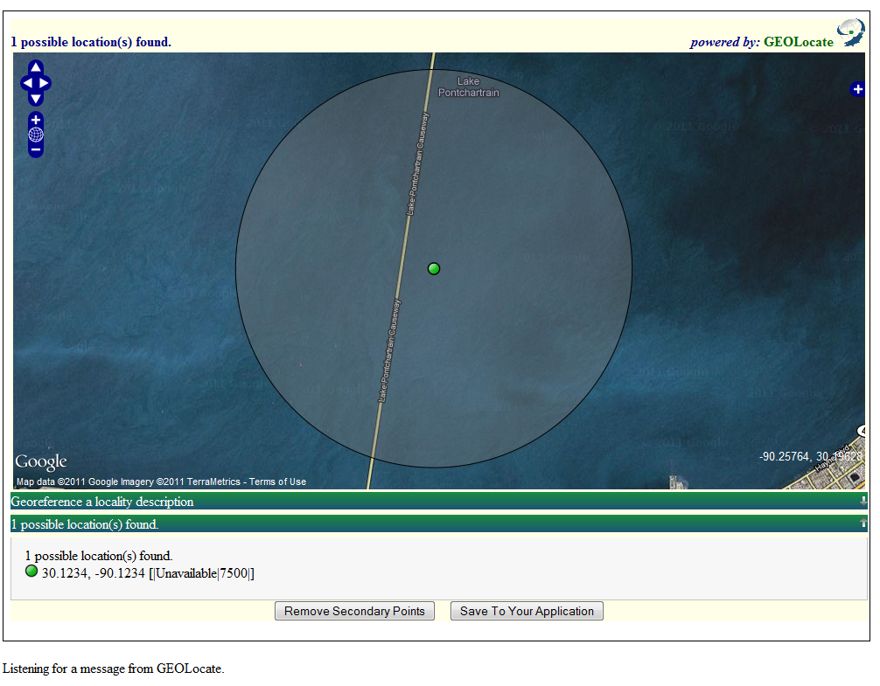
Application Service:
Embeddable Client
Lightweight web based client, specifically designed for embedding into other web applications.
Requires JavaScript postMessage – compatible with all modern browsers.

Slide 14
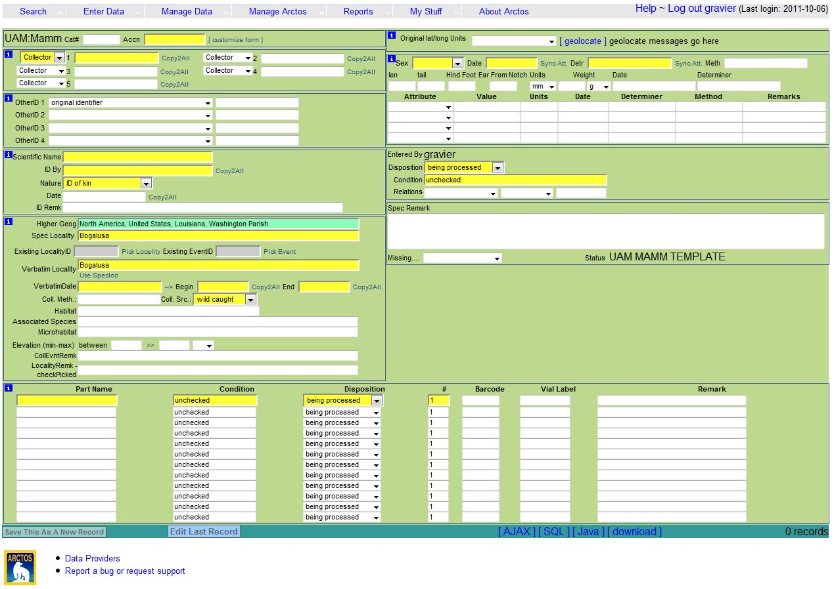

Arctos

Slide 15
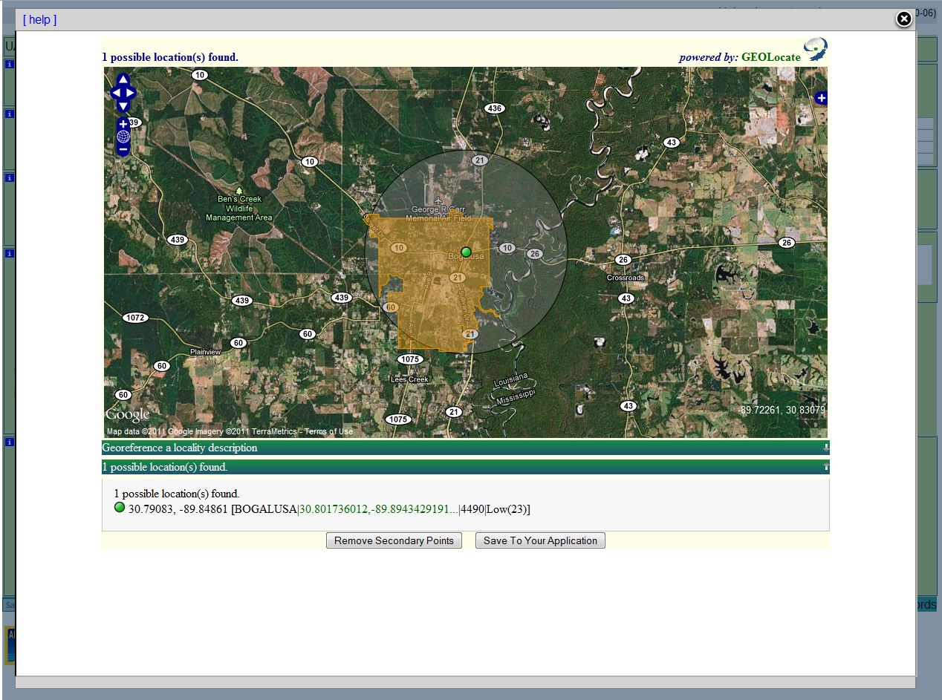

Slide 16
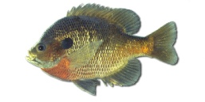
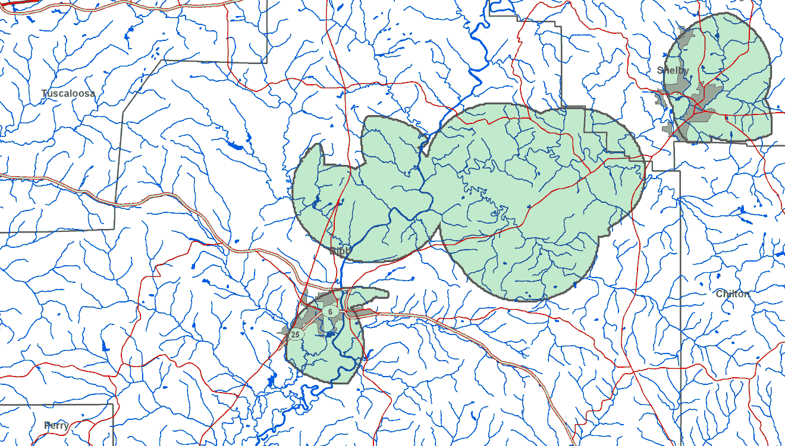
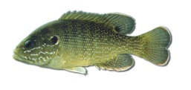
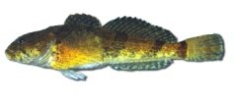
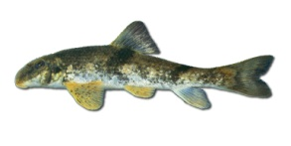
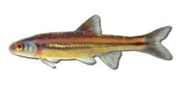
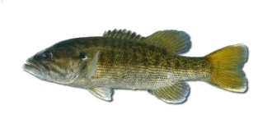
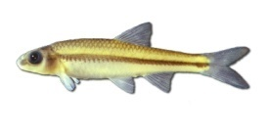
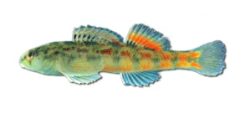
Validation via Taxonomic Footprints
Uses point occurrence data from distributed museum databases to validate georeferenced data
Lepomis macrochirus
Lepomis cyanellus
Cottus carolinae
Hypentelium etowanum
Notropis chrosomus
Micropterus coosae
Notropis volucellus
Etheostoma ramseyi
Footprint for species list collected at Little Schultz Creek, off Co. Rd. 26 (Schultz Spring Road), approx. 5 mi N of Centreville; Bibb County; White circles indicate results from automated georeferencing. Black circle indicates actual collection locality based on GPS. Occurrence data from UAIC & TUMNH

Slide 17
Validation Service:
Taxon Footprints
HTTP SOAP & Get/Post:
XML & KML output options
Get with XML Output:
http://www.museum.tulane.edu/taxonfootprint/tfp.aspx?Species=Phoxinus+erythrogaster|ictalurus+furcatus&lat=30&lon=-89&format=raw
Get with KML Ouptut:
http://www.museum.tulane.edu/taxonfootprint/tfp.aspx?Species=Phoxinus+erythrogaster|ictalurus+furcatus&lat=30&lon=-89&format=kml
SOAP:
http://www.museum.tulane.edu/webservices/bigfootws/bigfoot.asmx

Slide 18
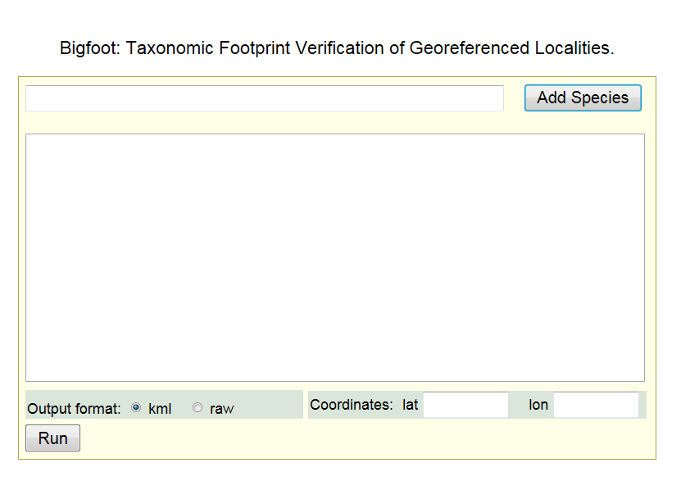
www.museum.tulane.edu/taxonfootprint

Slide 19
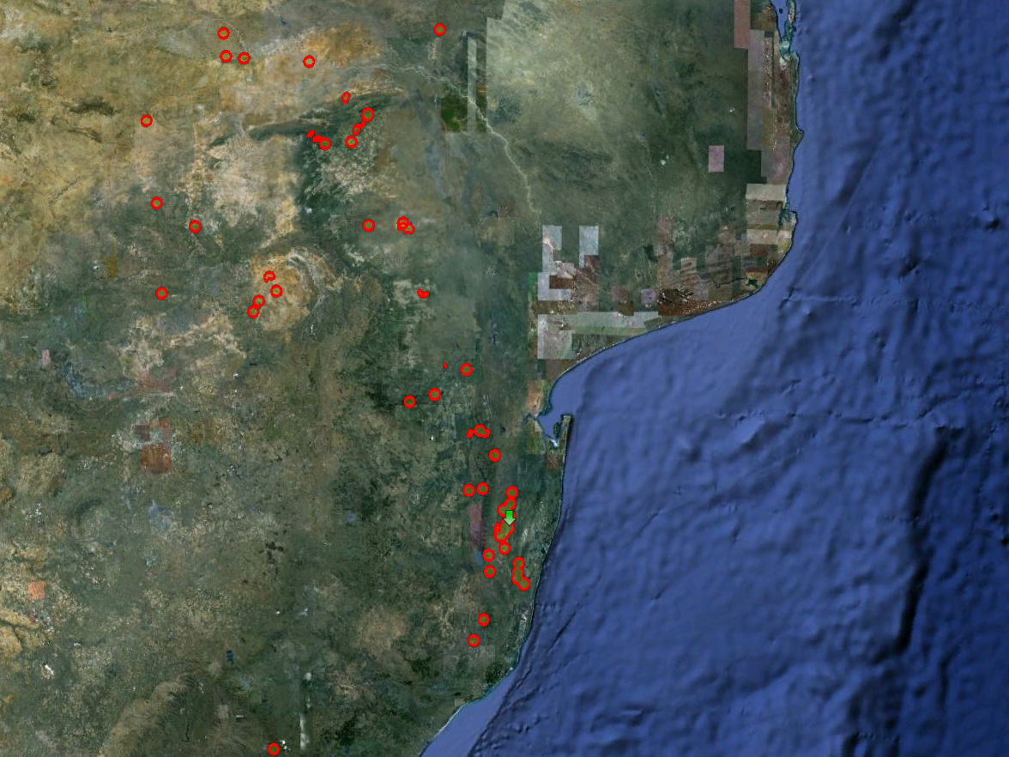
Barbus paludinosus
Mesobola brevianalis
-27.02033
32.302492

Slide 20
Collaborative Georeferencing
Efficiency of Sharing Data
  Similar records from various institutions can be matched and georeferenced simultaneously.
  DiGIR / .CSV used for data input (other alternatives in development).
Efficiency of Distributing Workloads
  Requires significant management overhead.

Slide 21
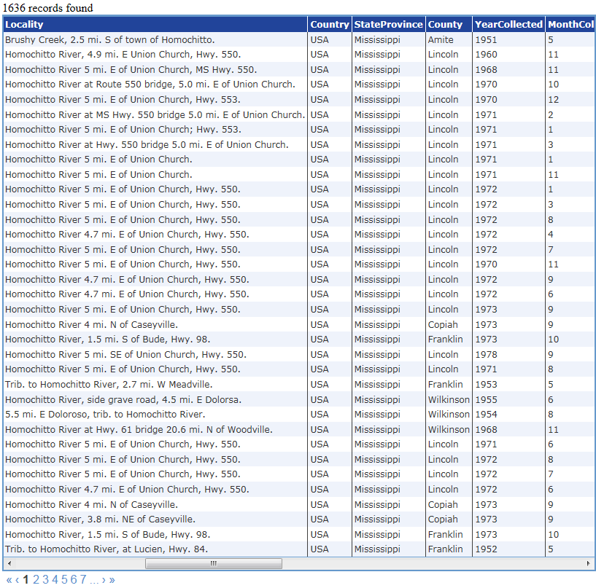
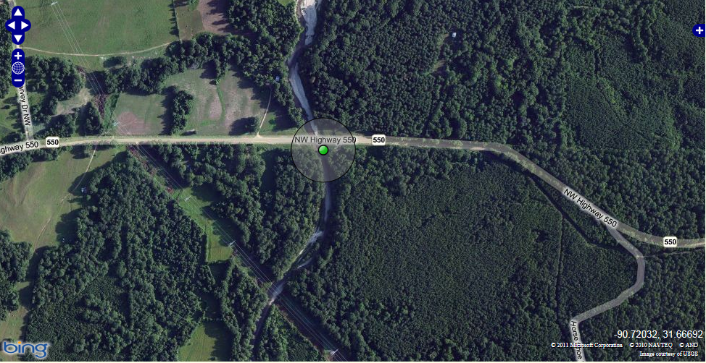
Efficiency of Sharing Data

Slide 22
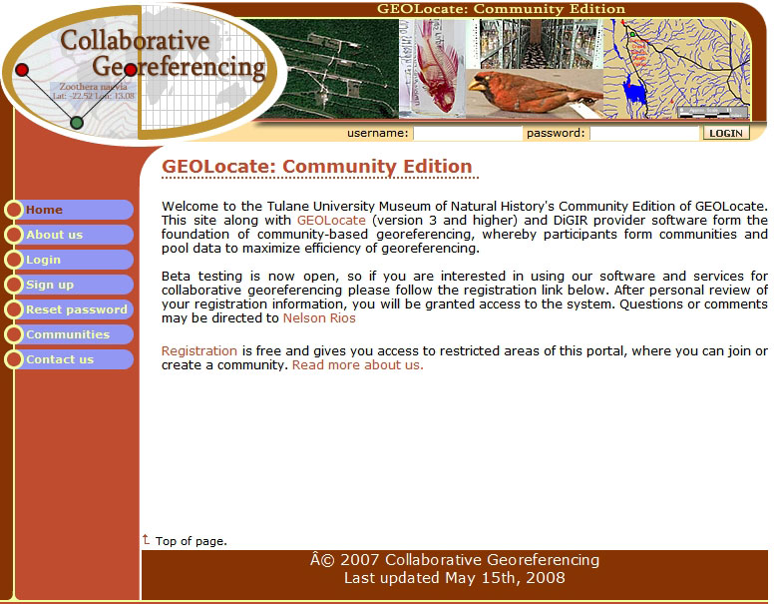
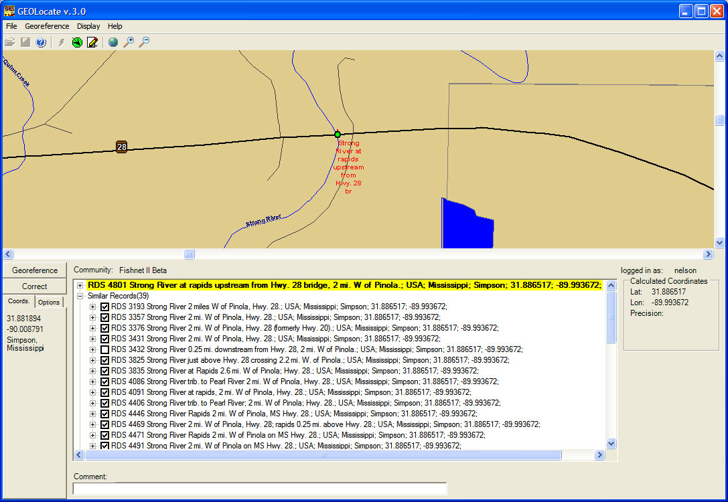
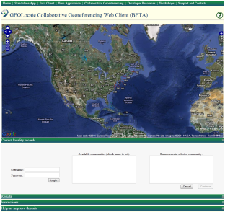
Collaborative Georeferencing
DiGIR Service
Remote
Data Source
Cache Update Web
Service
CoGe Web Portal
Application
Data Retrieval Web
Service
Data Store
CoGe Client Application
(Desktop or Web)
Insert Correction Web
Record Processor
Service
Georeferencing Web
Service

Slide 24
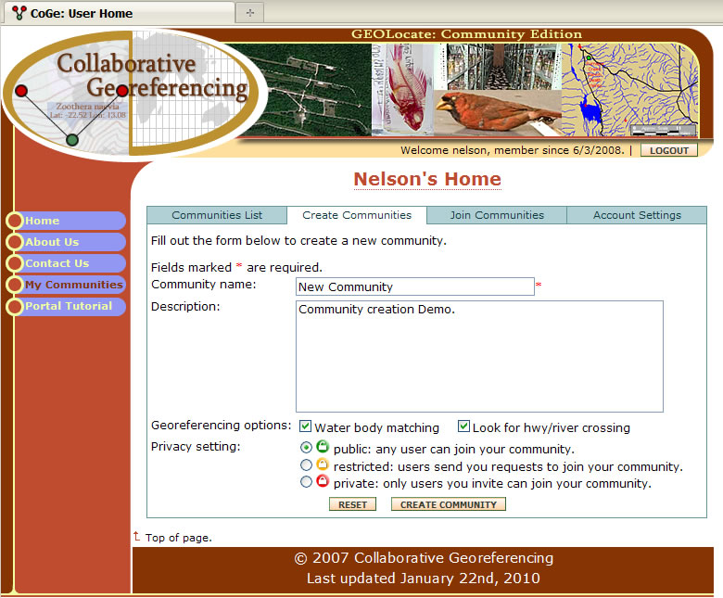
Georeferencing Communities

Slide 25
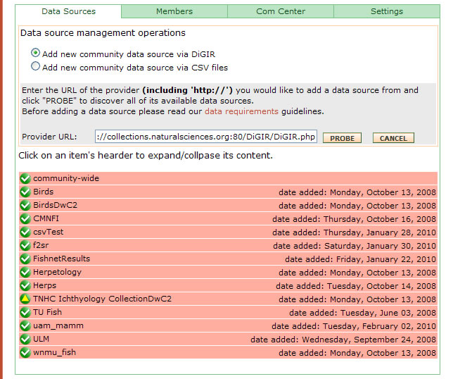
Adding
Data
Sources
Direct download from DiGIR providers or CSV file upload.

Slide 26
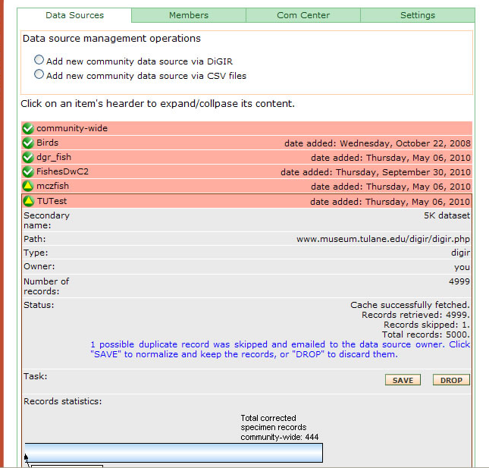
Resolving Data
Inconsistencies

Slide 27
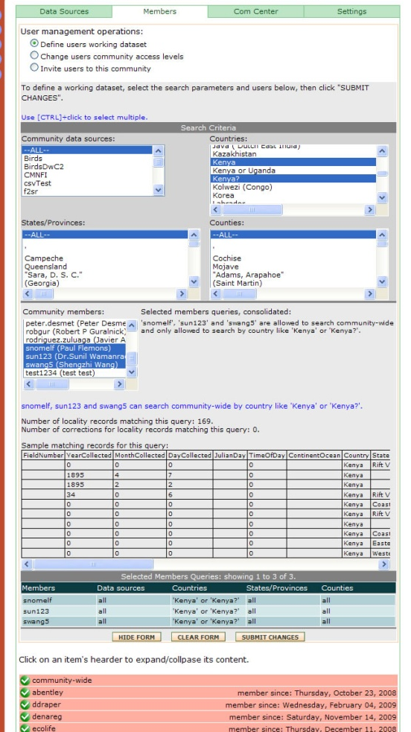
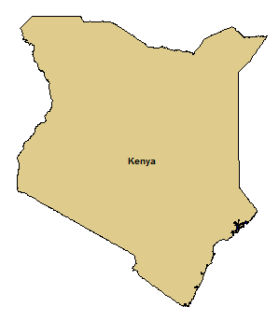
User Management:
Task Assignment
Assign all records from Kenya to
experts on East African regions

Slide 28
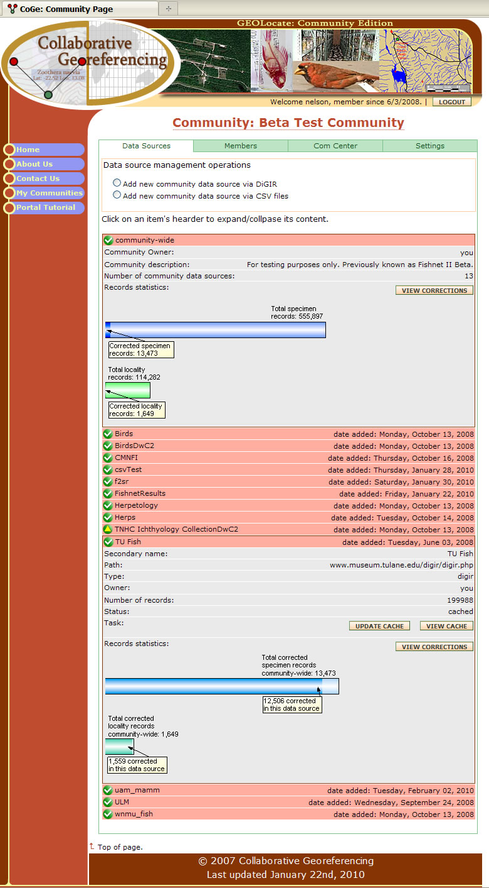
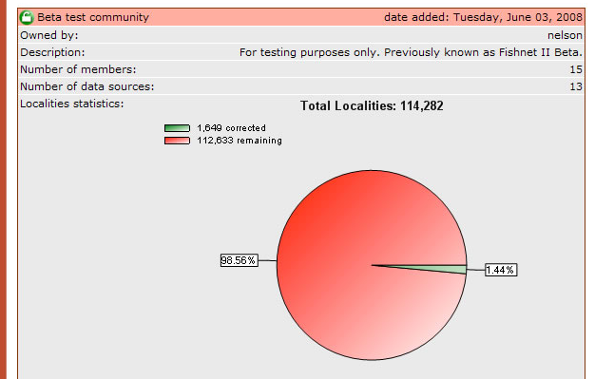
Monitoring & Managing
Progress

Slide 29
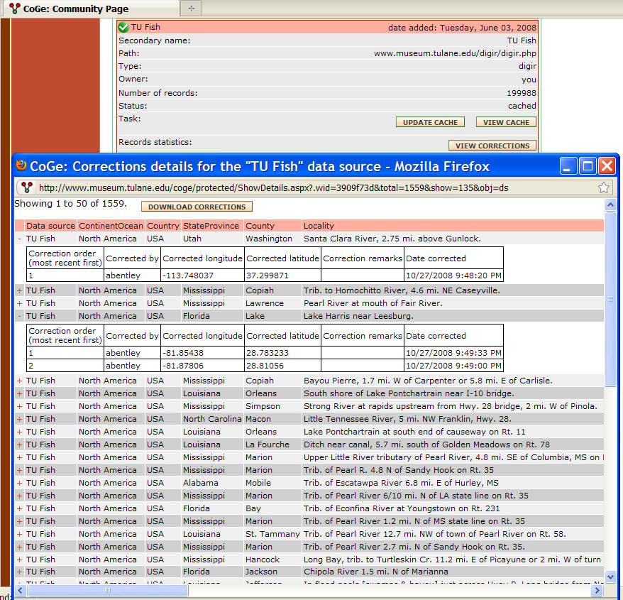
Data
Repatriation

Slide 30

Collaborative Georeferencing Web Client
Demo

