Slide 1
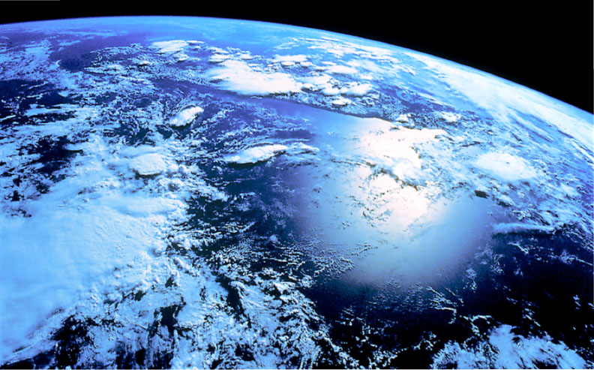
Encyclopedia of Life
James Hanken
Museum of Comparative Zoology
Harvard University

Slide 2
Short history
Funded, 2007
Launched, 2008: release of v1
Second phase, 2011: release of v2, revised governance and financial model

Slide 3
What is it, and why?
Vision: global access to knowledge about life.
Mission: increase awareness and understanding of living nature through an Encyclopedia of Life that gathers, generates and shares knowledge in an open, freely accessible and trusted digital resource.
Biodiversity portal; a one-stop shop for information about living species or access to that information.

Slide 4
Target audience
professional biologists
lay public, including citizen scientists
educators and students
policy makers, NGO’s
native speakers in English, Spanish, Arabic, Chinese, Dutch, etc.

Slide 5
Functionality
aggregates data from content partners and other sources, e.g., GBIF, MCZ
generates content, e.g., BHL
multiple languages
bioinformatics tools for data sharing and use
promotes collaborative knowledge generation

Slide 6
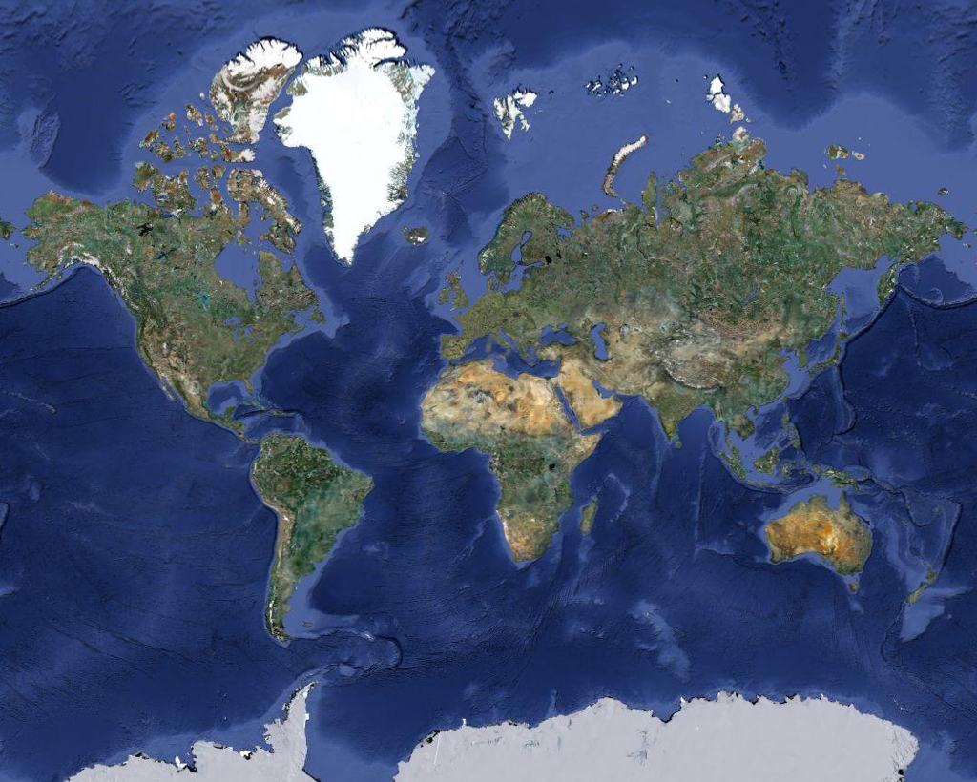
Plus 100’s of content partners, contributors and species-page curators from around the globe
Who?
Cornerstones: FMNH, Harvard/MCZ, MBL, MOBOT, SI/NMNH
Biodiversity Heritage Library (BHL): Above plus ANSP, AMNH, CalAcad, Harvard/HUH, Kew, NHM, NYBG, BHL Europe/Brazil
Regional EOL’s: ALA, CAS, CONABIO, INBio, Naturalis, NLA, SANBI, (Kenya/east Africa) + ???

Slide 7
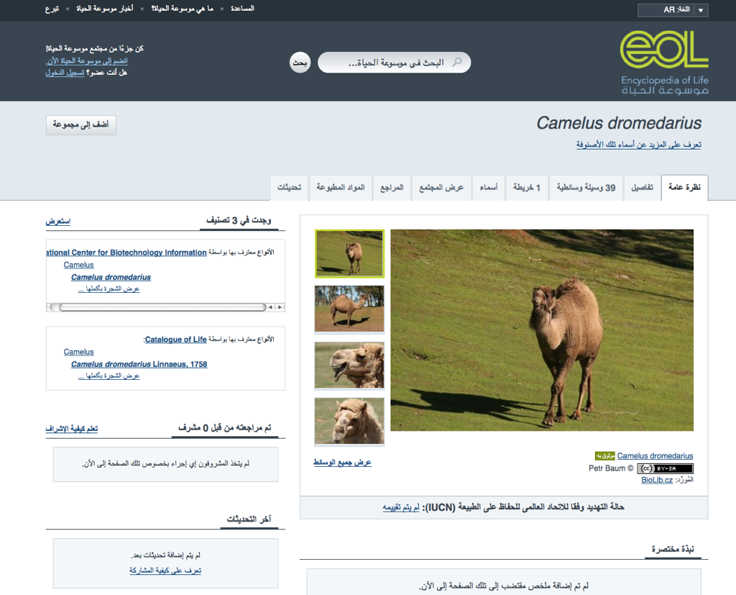
7

Slide 8
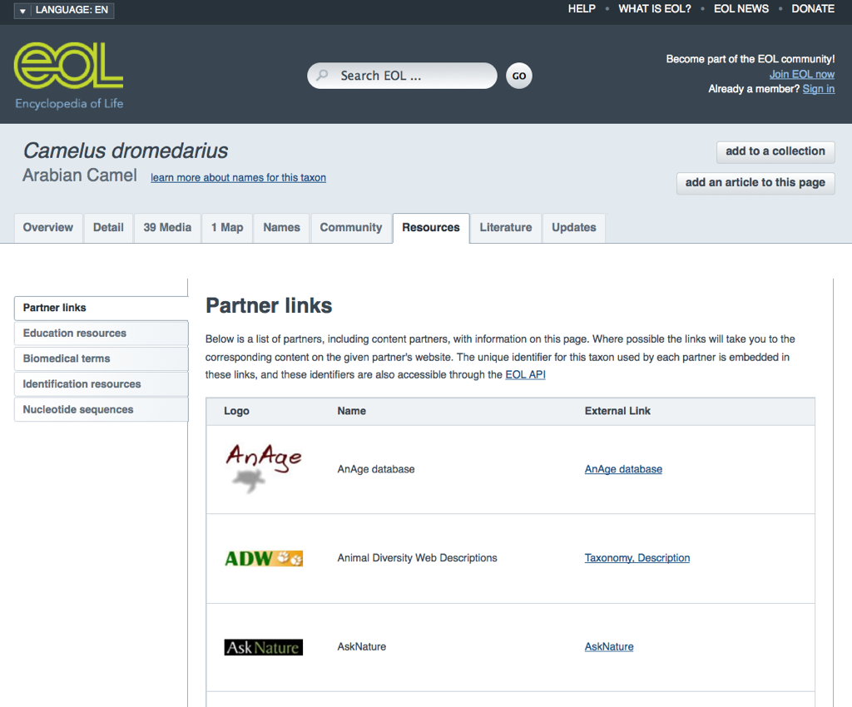
8

Slide 9
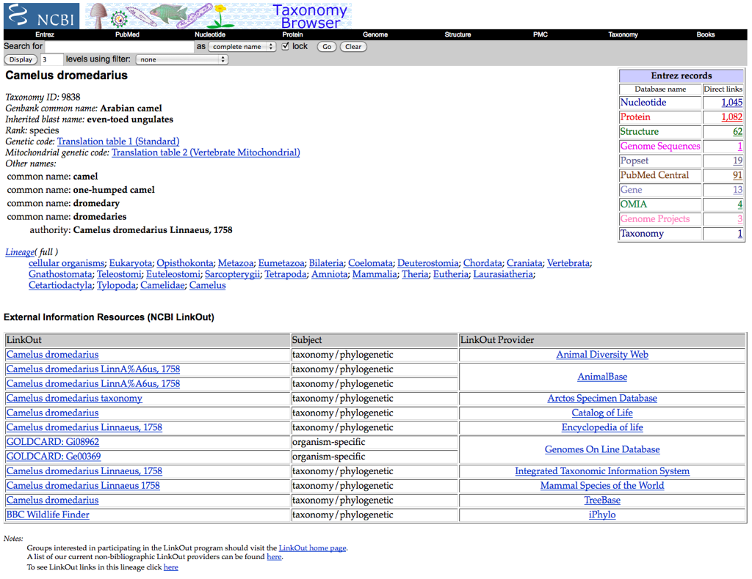
9

Slide 10
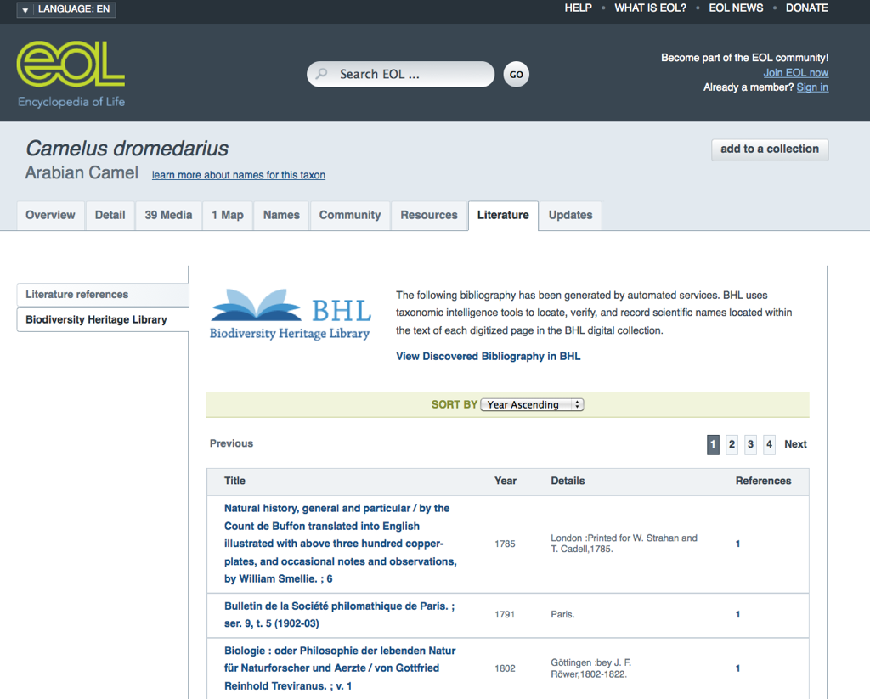
10

Slide 11
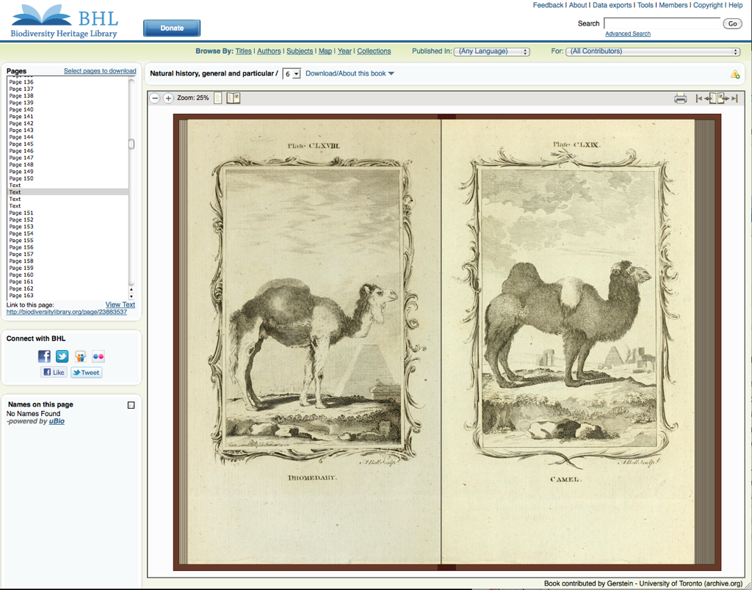
~ 94K volumes
~ 35M pages

Slide 12
What can EOL do for iDigBio?
Aggregate and deliver iDigBio products with other species-level data:
images on EOL species pages
hyperlinks to structured data
taxonomic literature
Global reach to diverse audiences in multiple languages.
Applications, tools and expertise in bioinformatics, learning and education, etc.

Slide 13
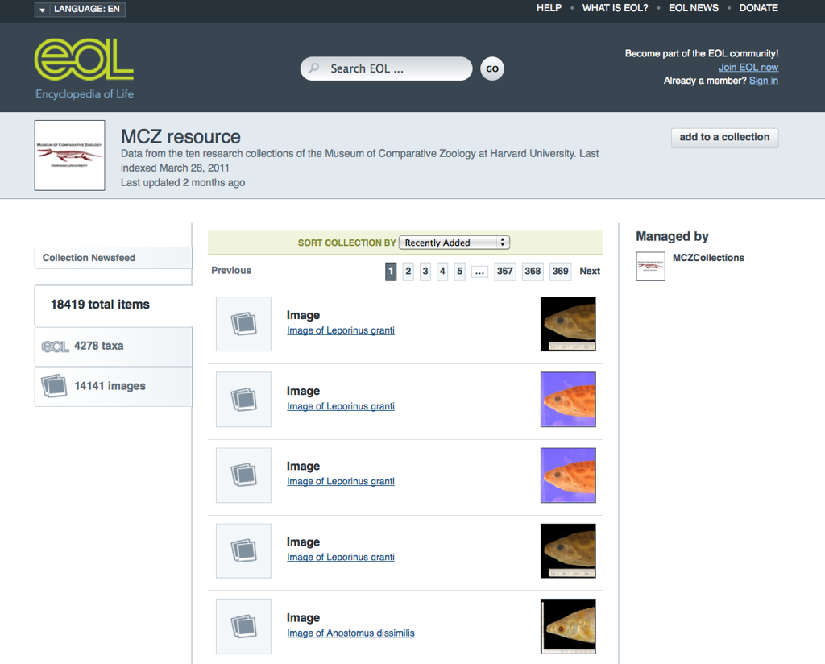
13

Slide 14
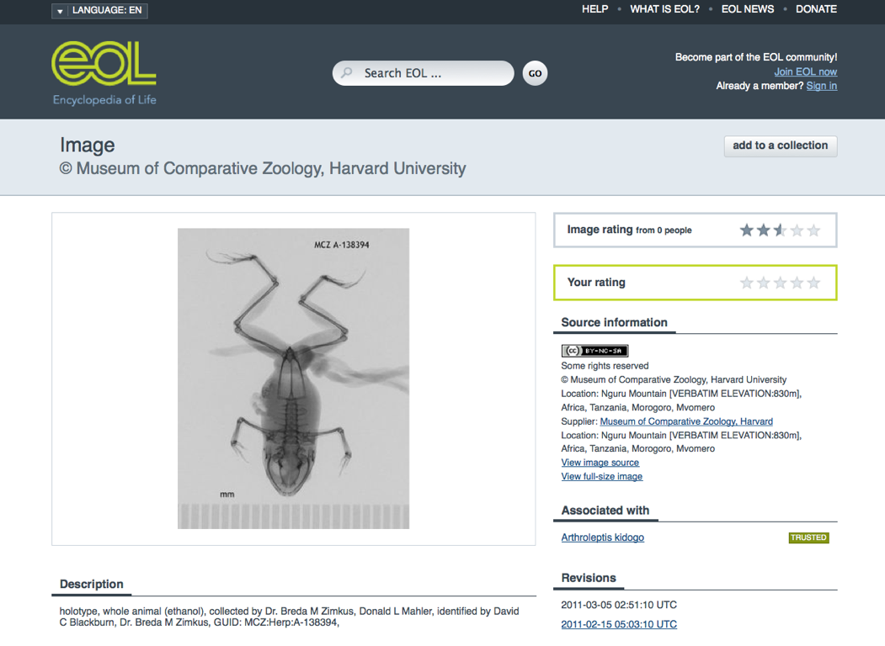
14

Slide 15
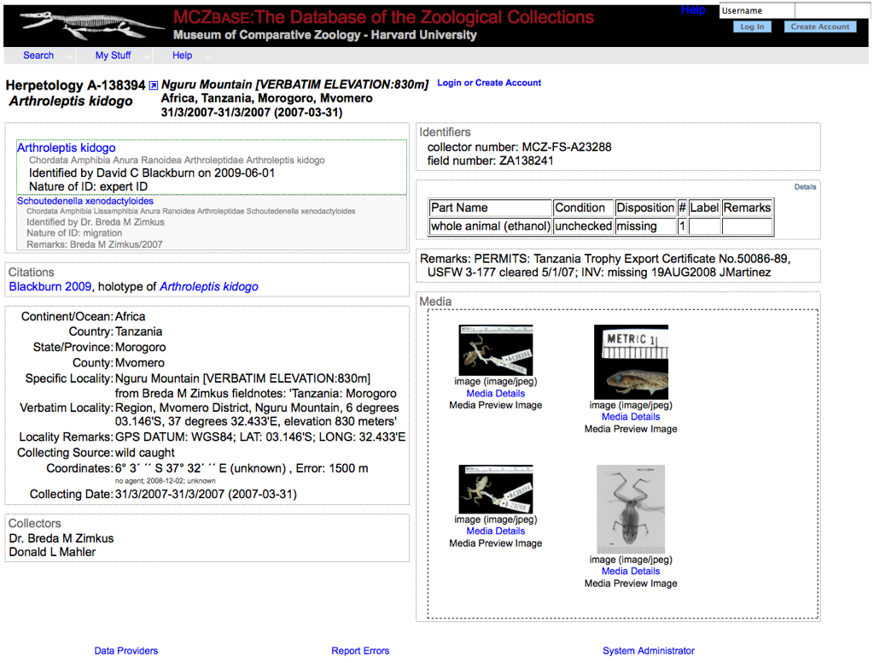
15

Slide 16
What can iDigBio do for EOL?
Further vital collaboration with professional scientific community.
Enrich species pages with validated (vouchered) images and access to structured collections data.
Enable higher-order, synthetic analyses.
Applications, tools and expertise in bioinformatics, imaging, data capture, etc.

Slide 17
Roadmap
v2 released August 2011; updates began November
More engaging, personal; attractive to general public.
v3 in three years
Will target scientific uses of computable data.
Functionalities: mapping, advanced search (semantic analysis), downloadable tools to access data, richer collections data.
Broader network of data/content partners, which enable synthetic analyses.
Long-term sustainability plan began 2011:
internationalization: global partners, regional EOL’s.
consolidation of original cornerstones into Council.

Slide 18
Availability
All software Open Source (GitHub, MIT license).
Free service; all content open-access.
IT support: full-time, paid staff at Harvard, MBL, MOBOT, NLA, SI/NMNH.

Slide 19
Integrating with iDigBio; concerns or challenges
EOL content is available through a single global API:
− could easily integrate EOL into the iDigBio portal;
− could immediately harvest images, link to collections data.
Challenge 1: EOL v3 will deliver structured data, i.e., specimen records (v2 does not). Compatibility with iDigBio will require early communication and coordination (at design and requirement stage).
Challenge 2: Whose taxonomy will iDigBio use? EOL provides alternate taxonomies.
Challenge 3: Must all use community-wide standards and protocols to insure interoperability and avoid redundancy.

Slide 20
Technology, standards and protocols used
Industry-standard software development and product management methodology, e.g., Agile.
Website: Ruby on Rails above a MySQL database; Solr used for fast searching; automated harvesting via PHP.
Data-exchange standards consistent with GBIF, TDWG (e.g., extended Darwin Core archive).
Notes:
We’re not just throwing this together in a garage

Slide 21
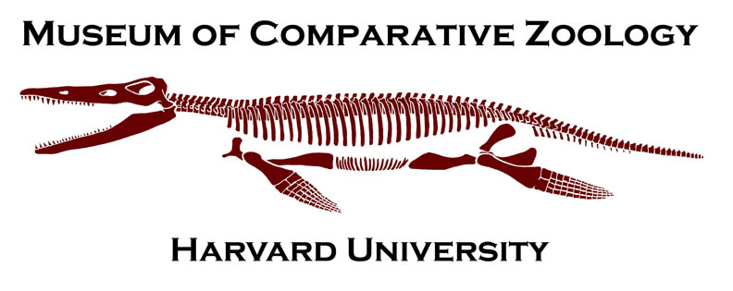
www.eol.org
Source: www.flickr.com/photos/johnlemon/263411081/

