Slide 1
InvertNet: A New Paradigm for Digitization of Invertebrate Collections
Chris Dietrich and Nahil Sobh
University of Illinois
iDigBio HUB Summit, Gainesville
Notes:
InvertNet is one of the 3 thematic collection networks funded in last year’s first round of NSF’s advancing digitization of biological collections program.

Slide 2
Outline
Overview
rationale
goals
scope
timetable
themes
Digitization Workflows
Network Architecture
Notes:
In this talk I’ll provide a brief overview of our project, its rationale, scope, and main goals, describe our basic digitization workflows and features of the InvertNet network hub, and then give a progress report on where we are now and where we hope to go with this project in the near future as well as over the longer term.

Slide 3
ADBC Goals
Digitize 1 billion specimens in 10 years for $100 million ($0.10/specimen)
Build Thematic Collection Networks (TCNs) to address specific research goals
Link TCNs under national HUB
Notes:
The overall goal of NSF’s Advancing Digitization of Biological Collections program is to digitize and provide improved access to a billion specimens from non-federal U.S. natural history collections during the next 10 years. They plan to accomplish this by building Thematic Collection Networks, or TCNs, each consisting of several collections united under a particular research theme; and then uniting these TCNs under a national HUB.

Slide 4
InvertNet Rationale
Vast majority of specimens in U.S. collections are invertebrates
primarily insects and related arthropods
less than 5% available online
only label data usually provided
Most invertebrate biodiversity research is specimen-based
all knowledge of many species is embodied in collections
Existing digitization methods are inadequate
slow and expensive ($1+ per specimen)
risk of damage to specimens from handling
Notes:
The basic rationale for Invertnet is outlined here. First, invertebrates, and insects in particular, make up of the vast majority of specimens needing to be digitized (there are hundreds of millions of specimens in existing collections, less than 5% of these have been digitized, and the data are incomplete—usually only label data have been captured, not images of the specimens themselves). Another strong justification, not only for Invertnet but for any project focusing on insect collections, is that most arthropod biodiversity research is specimen based; we rely on our collections perhaps more than any other community of biodiversity researchers because the specimens often embody the entirety of our knowledge about particular species, i.e., for most insect species there aren’t a lot of data available apart from the data on specimen labels or embodied in the preserved specimens themselves (including morphology, DNA, etc.). So, as a community, we need much much better access to our respective collections than is currently available simply to be able to do our work more efficiently. Unfortunately, existing methods for digitizing collections are inadequate; they’re slow, they’re expensive, and they entail risk of damaging the specimens through excessive handling. So these are the basic points we are trying to address with Invertnet, but they certainly aren’t limited to our project and hopefully other insect-oriented TCNs will help address these issues as well.

Slide 5
InvertNet Goals
Digitize all holdings of 22 midwestern arthropod collections (50 million + specimens)
Specimen images and metadata (label info)
Drawers, vials, slides
Advanced imaging (including 3D)
Best quality at reasonable cost (~$0.10/specimen)
Provide access to images and other data via online virtual museum
browsable/searchable/zoomable web interface
link to other data providers (GBIF, national ADBC HUB, etc.)
Provide platform for research and development of additional tools and resources
Data mining and analysis
Community building, collaboration, and support
Education, outreach, and reference
Notes:
The main practical goals of our project are as follows. First, we aim to digitize and provide universal access to all holdings of the 22 midwestern collections in our network (comprising >50 million specimens) as quickly and efficiently as possible, including drawers of pinned specimens, slides, and vials of ethanol preserved material. We plan to use advanced imaging methods for drawers that facilitate 3D reconstruction but we’re also attempting to balance quality with cost so that the total equipment package is less than $10k and the cost per specimen is 10 cents or less. Our second goal is to provide rapid, universal access to the digitized collections. We will do this by creating an online virtual museum that consists of a browsable/searchable user interface and is linked to other data providers such as GBIF and the national ADBC HUB. Finally, we intend to provide a virtual environment that facilitates research, both related to the research themes of our TCN, and beyond. This environment will include tools for data mining and analysis, tools for community building and collaboration, and resources for education and reference.

Slide 6
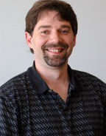
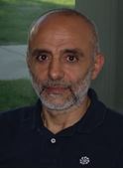
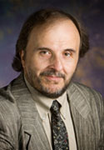
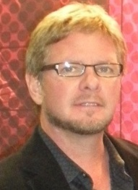
InvertNet UIUC Team
Chris Dietrich – Director
Systematic Entomologist
John Hart – CoPI
Computer Science - Graphics
Nahil Sobh – CoPI
Computational Multiscale Nanosystems
Umberto Ravaioli – CoPI
Computational Multiscale Nanosystems
David Raila – Senior Collaborator
Computer Science – Sr. Research Programmer
Others
Programmers, research assistants, hourlies
Notes:
Core members of our team at UIUC include one entomologist, two engineers and two computer scientists. John and David and their students in CS are developing and testing our digitization workflows and Nahil and Umberto (and their students) are building our network.

Slide 7
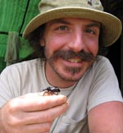
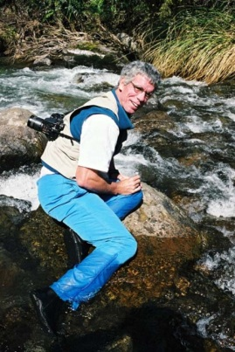
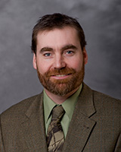
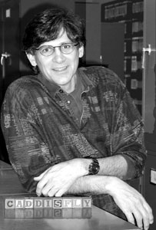
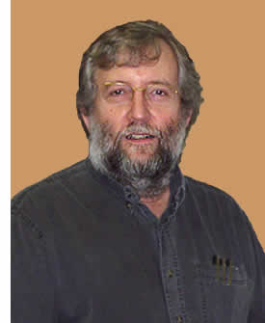
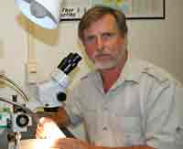
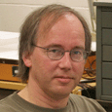
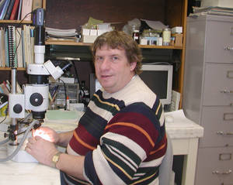
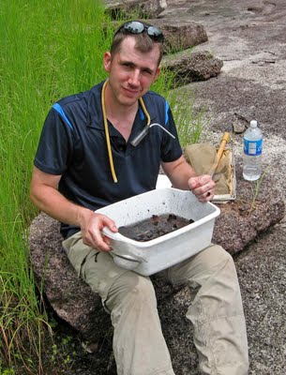
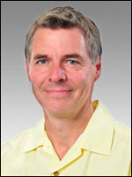
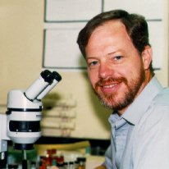
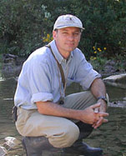
InvertNet Collaborating Curators
Collaborator | Institution
A. Cognato | MSU
G. Courtney, J. VanDyk | ISU
J. Holland | Purdue
R. Holzenthal, P. Tinerella | Minnesota
P. Johnson | SDSU
H. Klompen, M. Daly | OSU
J. Rawlins, R. Davidson, J. Fetzner | Carnegie Museum
D. Rider, G. Fauske | NDSU
A. Short | Kansas
R. Sites | Missouri
D. Young | Wisconsin-Madison
J. Zaspel | Wisconsin-Oshkosh
G. Zolnerowich | KSU
Notes:
We also have collaborating curators at 13 other institutions who are responsible for overseeing digitization work in their home collections.

Slide 8
Additional Collections
Eastern Illinois University
Western Illinois University
Southern Illinois University
Illinois State University
Milwaukee Public Museum
Northern Michigan University
U North Dakota
Valley City State University
Notes:
In addition to the 14 institutions that received funding directly from NSF, we are reaching out to several additional institutions that have significant arthropod holdings but lack the personnel and infrastructure necessary to coordinate digitization of their own collections. Responsibilities for digitizing these collections will be divided up among 3 of the lead institutions.

Slide 9
Timetable: Phase I (July 2011 – March 2012)
Stage collections for digitization
basic housekeeping (drawer and unit tray labels, updating nomenclature, organizing identified material)
curator exchanges to upgrade curatorial status of focal taxa
Develop digitization toolkit/workflow
Test variety of capture hardware, software and processes
Test and evaluate variety of image processing/reconstruction methods
Establish web portal at UIUC using HUBzero platform
Community development for collaborators
Digitization workflow
Searchable/browsable web interface for images and label data
Develop training materials for participants
InvertNet Digitization Workshop – Spring 2012
Notes:
Phase 1 of our project, which began when we received our award last July and runs through early spring of next year has these basic goals:
First, we need to stage our collections for digitization. This means making sure that everything is organized properly, the nomenclature is up to date, the unit trays have header labels, etc. To help accomplish this, curators in our network are visiting each others’ collections to curate holdings of the groups for which they have taxonomic expertise. By doing this we help ensure that we’re getting high quality data from the beginning. Meanwhile, our technical team at the UIUC is testing and developing a basic hardware and software toolkit that will be implemented at all 14 collaborating institutions. This includes the testing the camera system and building the digital pipelines that upload the raw image data, process those data, store the data in the project database, and render zoomable, high resolution images of the specimens. The testing is on schedule and we anticipate rolling out the toolkit within the next couple of months. Along with the toolkit, we’re developing training materials to use in our first invertnet training workshop to be held next spring at UIUC where we will train representatives from our collaborating institutions in the use of the equipment and software to digitize their collections.

Slide 10
Phase II (April 2012 – June 2015)
Begin digitizing collections
capture and provide immediate access to high- quality specimen images
capture label data for high-priority holdings
Refine digitization and processing tools
Workflows, image processing/segmentation, 3D, label processing
Link to other sites
National ADBC HUB, BugGuide
Incorporate data exploration, analytical, and modeling tools
Notes:
Phase 2 begins after the training workshop next spring and mainly consists digitizing the holdings of our collections. As the images and metadata are being captured, we anticipate providing immediate access via the InvertNet web portal. As digitization work proceeds at the various institutions in our network, our technical team at UIUC will continue to refine the workflows for image processing and segmentation, 3D reconstruction, and capture of label data. They will also work with the national ADBC HUB to link our network to the HUB, in addition to other portals such as GBIF and more discipline-specific sites like BugGuide. Finally, we will work with our collaborators to incorporate analytical tools into the InvertNet platform so that researchers and others can use the site not only to access collections but to perform various kinds of analyses on collection data.

Slide 11
TCN Themes
Environmental change
changes in biota over time reflect changes in climate, landscape use, etc.
Species discovery
high-res images of specimens, including new taxa, become accessible to expert taxonomists at remote locations
Species identification
replicate images of identified species used for morphometric analysis and improved identification accuracy/automated identification
Notes:
We identified three main research themes, which we anticipate supporting over the long term via InvertNet. Obviously, the material in our collections will be useful for looking at environmental change over time. The Midwestern landscape has been almost completely transformed over the past 150 years and specimens in our collections can be used to track these changes, at least to some degree. A second theme is species discovery: arthropod collections in particular constitute the major platforms for species discovery; out of the 20,000 or so new species described each year on average, the vast majority are arthropods and most of these new arthropods are discovered as a result of a taxonomist studying specimens that have been deposited in a collection. By providing access to high resolution images of specimens, Invertnet will facilitate species discovery. Our third theme is species identification; we as a community rely on collections for species identification perhaps more than any other research community. Also, because our project will provide a massive database of replicated images of identified specimens, we anticipate being able to use this as a knowledge base for future automated identification systems.

Slide 12
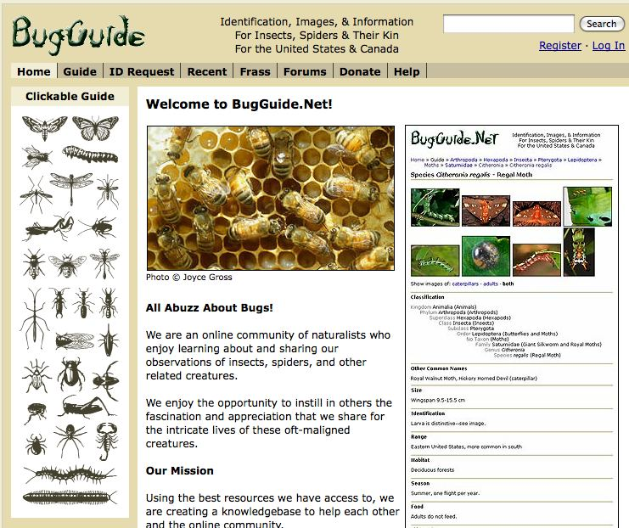
Outreach
Crowd-sourcing label data capture (Zooniverse)
Link to BugGuide: users compare photos of live bugs to images of identified specimens
Notes:
Because the population of potential users of InvertNet will extend well beyond the scientific community, we plan to devote considerable effort to the development of outreach and educational materials and tools. Here are a couple of examples. We plan to link InvertNet to BugGuide.net, which is basically an online field guide to insects and related arthropods hosted at Iowa State University and supported by a large community of amateur naturalists as well as professional or semiprofessional entomologists. BugGuide has tens of thousands of images, mostly live photos of arthropods, organized within a taxonomic hierarchy. Users can upload images and receive help on identification from the BugGuide community. We plan to link images of live insects on BugGuide to the images of authoritatively identified specimens in the collections in our InvertNet virtual museum. This will allow users of BugGuide to check their identifications by comparing their photos to images of specimens that have been identified by taxonomic experts. We also hope to engage the non-scientist community by getting them involved in crowd sourcing. Because we don’t yet have a foolproof mechanism for completely automating the process of data label capture, it will probably be necessary to transcribe a lot of the data manually, which will require a lot of effort. An organization called Zooniverse has come up with some very clever ways for getting citizen scientists involved in large-scale scientific projects. They have engaged large online communities in projects like classifying galaxies in large image databases or searching for exoplanets. We hope we can use this same approach to capture data from specimen labels.

Slide 13
Summary of goals
Short-term goals (next 4 years):
digitize 50 million specimens from 22 collections
provide access via virtual museum
provide tools supporting theme-related research, education and outreach
Long-term goals
incorporate federal and non-US collections
include all invertebrates worldwide
Notes:
So, to summarize, the main short term goals of InvertNet are to digitize ca. 50 million specimens from 22 collections over the next 4 years, provide access to these specimens via an online virtual museum, and provide tools supporting research, education and outreach related to the themes of environmental change, species discovery, and species identification. We’re building our IT infrastructure so that over the longer term we can incorporate federal and non-US collections into Invertnet and, ultimately, expand our scope to include all invertebrate collections worldwide

Slide 14
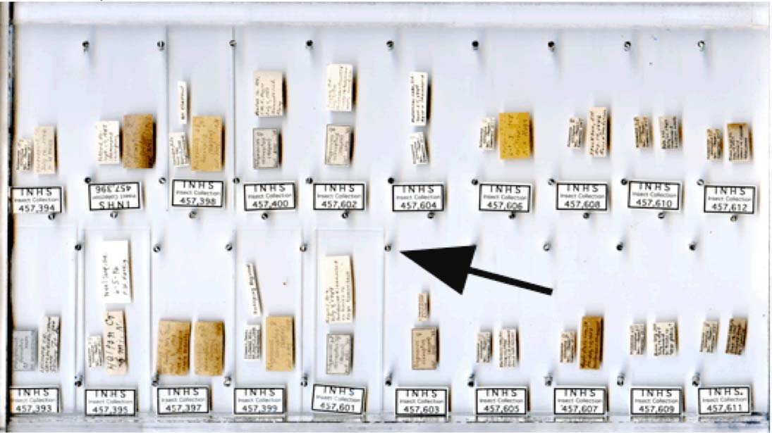
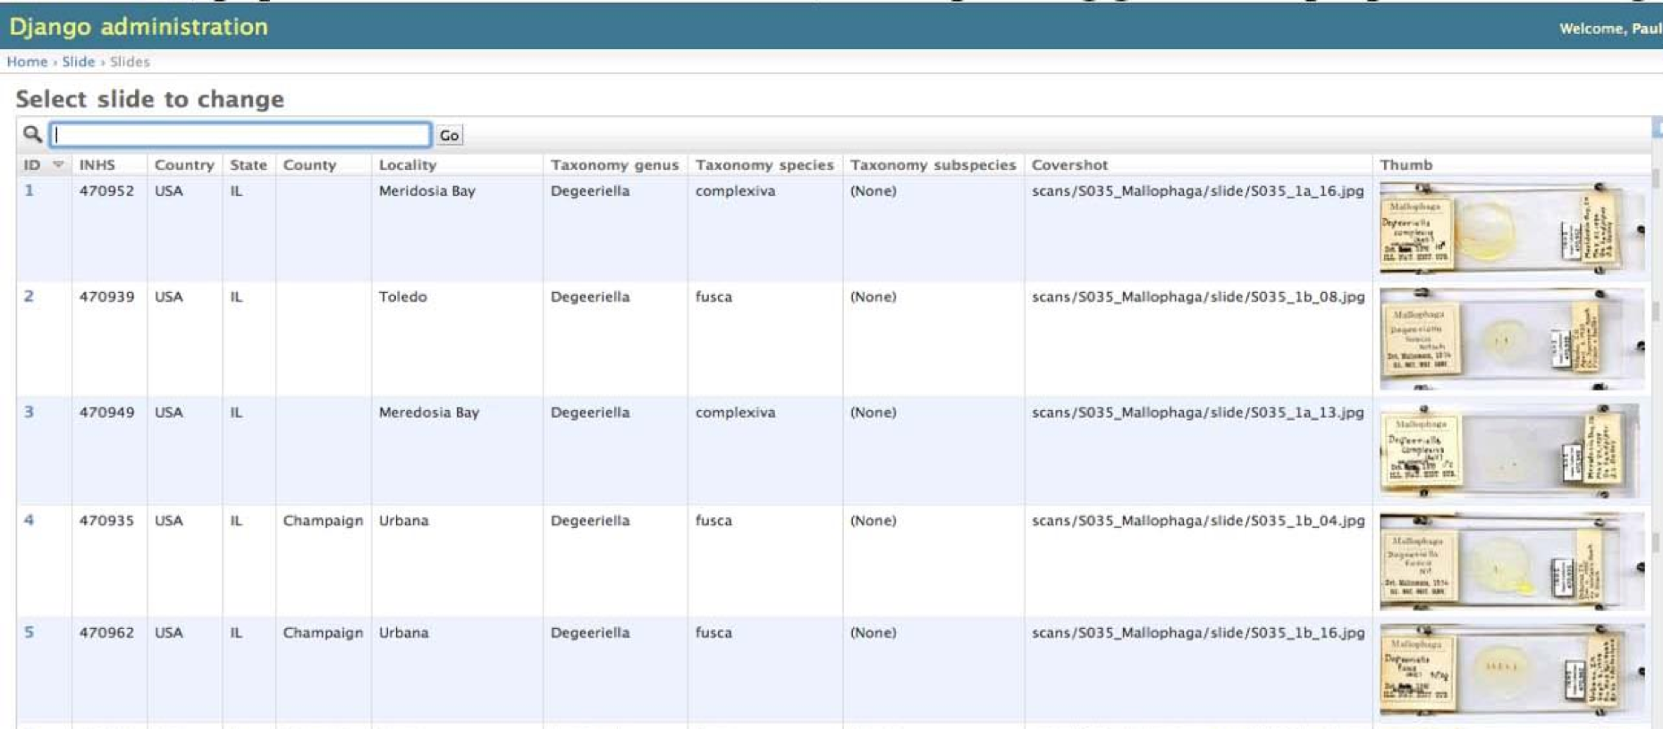
Digitization workflow: slides
place 20 slides face down on clear tray
scan image of tray
segment image using pixel map
individual slide images automatically placed in separate database containers
Semi-automated capture of label data
Notes:
This illustrates the workflow for slide mounted specimens. We first put 20 slides face down on a clear plastic tray. We then capture a high resolution image of the entire tray. We can then use a pixel map of the tray to grab the images of individual slides and place them in separate database containers followed by semiautomated capture of the label data into the appropriate specimen-level database fields. This is the approach being taken for digitizing slides and vials in an ongoing digitization project at INHS by Paul Tinerella and Felipe Soto.

Slide 15
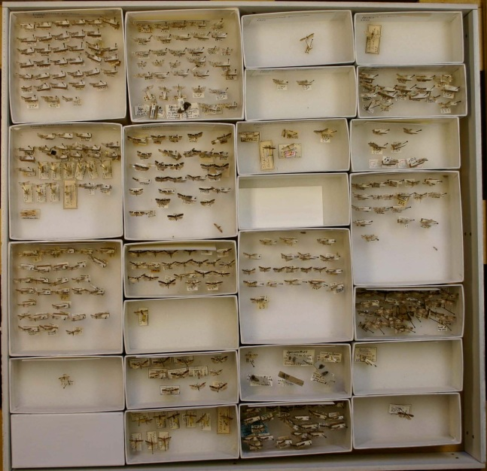
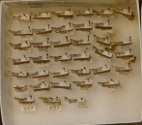
Drawers
capture image of drawer + metadata (location, contents)
2. segment unit trays
(image analysis
software)
3. segment
specimens
4. capture label
data
Notes:
We can use a slightly modified procedure for drawers of pinned specimens. Again we start by capturing an image of the entire drawer. Segmenting the images here becomes a little trickier because each drawer has unit trays in a few standard sizes but in different arrangements. So we’re using a more sophisticated image analysis software system called ImageJ to detect the edges of the trays and segment the drawer into separate images of unit trays and also to segment the image of each unit tray into individual specimens. Once again, these segmented images will be placed in separate database containers and label data will be captured subsequently using a semiautomated process.

Slide 16
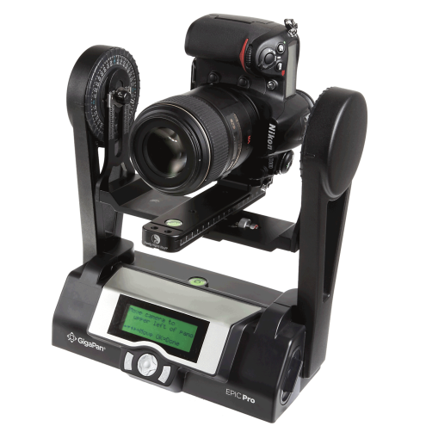
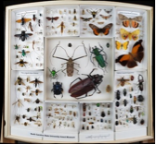
Digitization Workflow Testbed: Gigapan
Robotic gigapixel capture
20-40 high res images/drawer
1-2 mins per drawer
Depends on camera processing speed
Keep original images for future processing, error correction, etc.
Stitching software combines images
~5 mins processing per drawer
Evaluating alternative stitching codes
Hugin - Panorama photo stitcher, parallelizable
Issues
Labels, barrel distortion, stitching errors, single perspective
Notes:
We’re still in the early stages of our project and many details have yet to be worked out with regard to our workflows and IT infrastructure, but with the time I have left, I want to provide at least a few details on these aspects of Invertnet just to provide an overview of our basic approach to digitizing and providing access to invertebrate collections. Our digitization workflow will consist of an initial first pass during which we will capture raw images and metadata for multiple specimens simultaneously. For drawers of pinned specimens, we will image the entire drawer; for slides and vials we will image multiple units simultaneously. We think this approach provides the best chance of meeting the cost target of 10 cents per specimen. The other advantage to this approach is that it will allow us to provide rapid access to entire collections. Although the collections in our network have tens of millions of pinned specimens, these are housed in only about 80,000 drawers. We can image 80,000 drawers in less than a year and once these images are available we can make them available online. If the quality of the image is good enough, information on the individual specimens can be gleaned from the image of the whole drawer; so users of our web portal won’t necessarily have to wait until we capture all the label data from each specimen in order to have access to at least some of that information. The end user of the web portal will be able to browse or search the image archive using the metadata for each collection unit, primarily taxonomy.

Slide 17
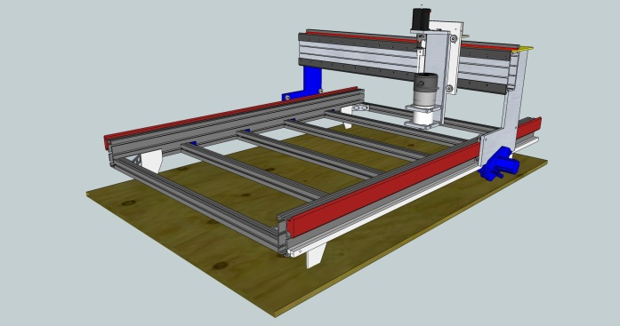
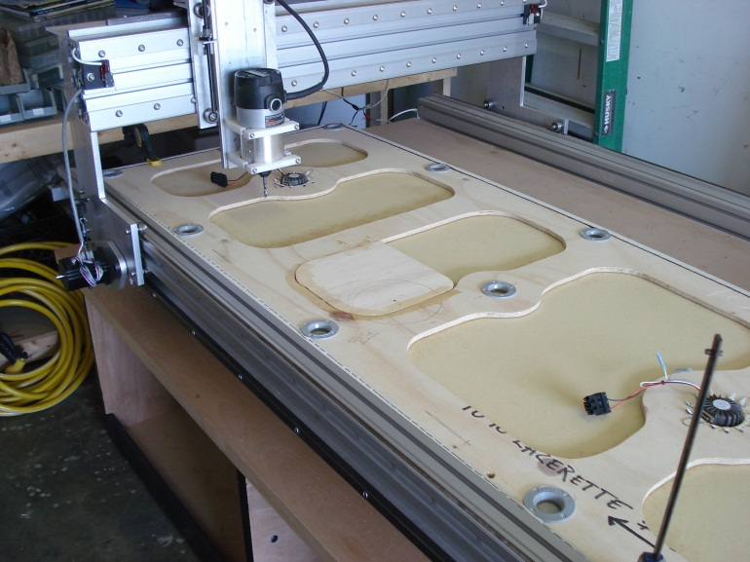
Digitization Workflow Testbed: Custom Camera Positioner
Kit-based 6-axis positioner
Programmable to shoot many angles/perspectives
For 3D reconstructions and label capture
Duplicates Gigapan without distortion
Based on open-source DIY CNC plans/kits + pan/tilt
< $1.5k parts, highly accurate
Open source software
Fully customizable for integration with workflow
Notes:
We’re still in the early stages of our project and many details have yet to be worked out with regard to our workflows and IT infrastructure, but with the time I have left, I want to provide at least a few details on these aspects of Invertnet just to provide an overview of our basic approach to digitizing and providing access to invertebrate collections. Our digitization workflow will consist of an initial first pass during which we will capture raw images and metadata for multiple specimens simultaneously. For drawers of pinned specimens, we will image the entire drawer; for slides and vials we will image multiple units simultaneously. We think this approach provides the best chance of meeting the cost target of 10 cents per specimen. The other advantage to this approach is that it will allow us to provide rapid access to entire collections. Although the collections in our network have tens of millions of pinned specimens, these are housed in only about 80,000 drawers. We can image 80,000 drawers in less than a year and once these images are available we can make them available online. If the quality of the image is good enough, information on the individual specimens can be gleaned from the image of the whole drawer; so users of our web portal won’t necessarily have to wait until we capture all the label data from each specimen in order to have access to at least some of that information. The end user of the web portal will be able to browse or search the image archive using the metadata for each collection unit, primarily taxonomy.

Slide 18
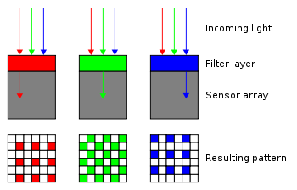
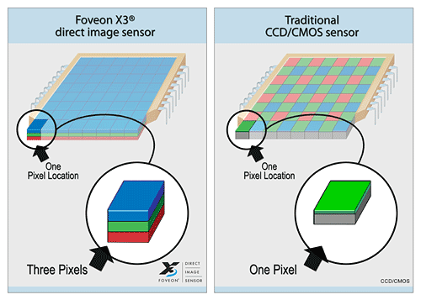
Digitization Workflow Testbed: Cameras
Standard DSLR
Canon EOS 1Ds 11MP, Mark III 21MP, 5D Mark II 21MP
All use bayer filter sensor and demosaicing algorithms
Discards 75% of red/blue and 50% of green
Software estimates the missing values – demosaicing
Errors in color and intensity
Spatial accuracy suffers
Sigma SD15 14 MP direct capture
“Stacked” RGB pixels in silicon
Higher color accuracy
100% of RGB captured
Better spatial accuracy
RGB are aligned – important for 3D reconstructions
Notes:
We’re still in the early stages of our project and many details have yet to be worked out with regard to our workflows and IT infrastructure, but with the time I have left, I want to provide at least a few details on these aspects of Invertnet just to provide an overview of our basic approach to digitizing and providing access to invertebrate collections. Our digitization workflow will consist of an initial first pass during which we will capture raw images and metadata for multiple specimens simultaneously. For drawers of pinned specimens, we will image the entire drawer; for slides and vials we will image multiple units simultaneously. We think this approach provides the best chance of meeting the cost target of 10 cents per specimen. The other advantage to this approach is that it will allow us to provide rapid access to entire collections. Although the collections in our network have tens of millions of pinned specimens, these are housed in only about 80,000 drawers. We can image 80,000 drawers in less than a year and once these images are available we can make them available online. If the quality of the image is good enough, information on the individual specimens can be gleaned from the image of the whole drawer; so users of our web portal won’t necessarily have to wait until we capture all the label data from each specimen in order to have access to at least some of that information. The end user of the web portal will be able to browse or search the image archive using the metadata for each collection unit, primarily taxonomy.

Slide 19
Digitization Workflow Testbed: Stitching Software
Gigapan – Commercial
Creates format for gigapan.org
11 level multi resolution gigapixel image
256x256 tiles at each level
Respectable: 3Gpixels
9 levels -> 65k tile files!
Max 64 Gpixels
11 levels -> 1 Million tile files!
Hugin (http://hugin.sourceforge.net)
Open source
Active community
2011 Google Summer of Code
Parallelizable – I2PC Collaboration
Python programmability for workflow scripting
Notes:
We’re still in the early stages of our project and many details have yet to be worked out with regard to our workflows and IT infrastructure, but with the time I have left, I want to provide at least a few details on these aspects of Invertnet just to provide an overview of our basic approach to digitizing and providing access to invertebrate collections. Our digitization workflow will consist of an initial first pass during which we will capture raw images and metadata for multiple specimens simultaneously. For drawers of pinned specimens, we will image the entire drawer; for slides and vials we will image multiple units simultaneously. We think this approach provides the best chance of meeting the cost target of 10 cents per specimen. The other advantage to this approach is that it will allow us to provide rapid access to entire collections. Although the collections in our network have tens of millions of pinned specimens, these are housed in only about 80,000 drawers. We can image 80,000 drawers in less than a year and once these images are available we can make them available online. If the quality of the image is good enough, information on the individual specimens can be gleaned from the image of the whole drawer; so users of our web portal won’t necessarily have to wait until we capture all the label data from each specimen in order to have access to at least some of that information. The end user of the web portal will be able to browse or search the image archive using the metadata for each collection unit, primarily taxonomy.

Slide 20
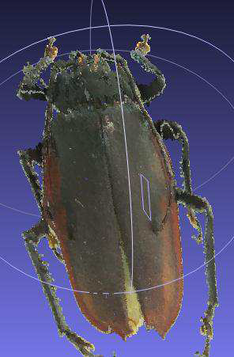
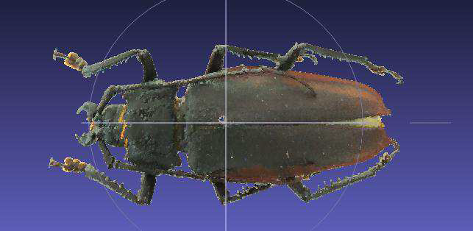
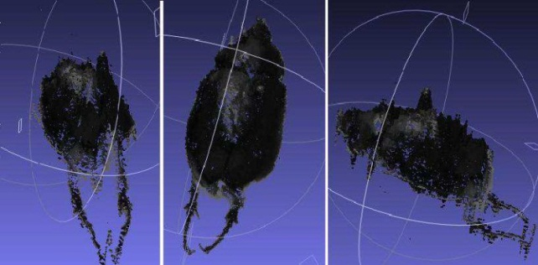
Digitization Workflow Testbed: 3D Reconstruction
Disney research SIGGRAPH 2010
Computes 3D model from multiple images at known positions
Testing of capture positions needed
UIUC I2PC reference algorithm in place
Working on parallelization for performance, optimization for small-scale specimens
Good initial results
Notes:
We’re still in the early stages of our project and many details have yet to be worked out with regard to our workflows and IT infrastructure, but with the time I have left, I want to provide at least a few details on these aspects of Invertnet just to provide an overview of our basic approach to digitizing and providing access to invertebrate collections. Our digitization workflow will consist of an initial first pass during which we will capture raw images and metadata for multiple specimens simultaneously. For drawers of pinned specimens, we will image the entire drawer; for slides and vials we will image multiple units simultaneously. We think this approach provides the best chance of meeting the cost target of 10 cents per specimen. The other advantage to this approach is that it will allow us to provide rapid access to entire collections. Although the collections in our network have tens of millions of pinned specimens, these are housed in only about 80,000 drawers. We can image 80,000 drawers in less than a year and once these images are available we can make them available online. If the quality of the image is good enough, information on the individual specimens can be gleaned from the image of the whole drawer; so users of our web portal won’t necessarily have to wait until we capture all the label data from each specimen in order to have access to at least some of that information. The end user of the web portal will be able to browse or search the image archive using the metadata for each collection unit, primarily taxonomy.

Slide 21
Digitization Workflow: Advantages
Meets cost target of 10 cents/specimen
Provides rapid access to entire digitized collection
Multiple images from different perspectives stitched together for 2D and 3D reconstruction and zoom capability
2D images of multiple units acquired simultaneously then segmented into individual database containers
Notes:
We’re still in the early stages of our project and many details have yet to be worked out with regard to our workflows and IT infrastructure, but with the time I have left, I want to provide at least a few details on these aspects of Invertnet just to provide an overview of our basic approach to digitizing and providing access to invertebrate collections. Our digitization workflow will consist of an initial first pass during which we will capture raw images and metadata for multiple specimens simultaneously. For drawers of pinned specimens, we will image the entire drawer; for slides and vials we will image multiple units simultaneously. We think this approach provides the best chance of meeting the cost target of 10 cents per specimen. The other advantage to this approach is that it will allow us to provide rapid access to entire collections. Although the collections in our network have tens of millions of pinned specimens, these are housed in only about 80,000 drawers. We can image 80,000 drawers in less than a year and once these images are available we can make them available online. If the quality of the image is good enough, information on the individual specimens can be gleaned from the image of the whole drawer; so users of our web portal won’t necessarily have to wait until we capture all the label data from each specimen in order to have access to at least some of that information. The end user of the web portal will be able to browse or search the image archive using the metadata for each collection unit, primarily taxonomy.

Slide 22
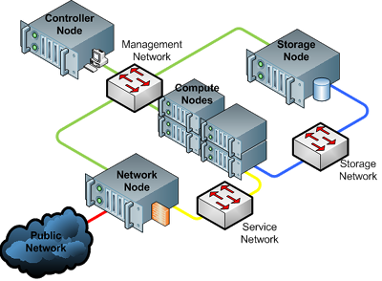
InvertNet Cloud Infrastructure Hardware
OpenStack Cloud infrastructure platform: Storage, Compute, and Image Service
Notes:
Once we start digitizing our collections, we need to provide a robust IT infrastructure to manage all the data we will be capturing, provide access to the data via the internet, and ensure that access to the data is maintained over the long term. To do this, we’re using a system called HUBzero. HUBzero is a cyberinfrastructure platform that was designed specifically to support the kinds of large-scale, massively collaborative scientific research platforms that the ADBC program aims to build. It was originally designed to support a large community of nanotechnology researchers, but has since been adopted by a wide variety of other communities of researchers. I like to think of it as a content management system on steroids. It includes a lot of the same kinds of modules for managing static content that are available in content management systems like Drupal or Joomla, but it also has a number of advanced features like browser-based access to various kinds of databases, visualization and analytical tools, direct integration with systems for archiving and preservation of data, and with high performance computing resources. This becomes important when you’re dealing with gigapixel-scale images and 3D reconstructions that need to be accessed and manipulated in real time. What this means for InvertNet is that we can use HUBzero to build and integrate essentially all of the IT infrastructure necessary for our project. So it will include our digitization workflows, image post-processing, databases, environments for community building and collaboration, analytical tools, developer tools, and tools for education and outreach.

Slide 23
InvertNet Cloud Infrastructure IAAS
OpenStack's Object Storage Service (Swift) is a highly available, distributed, eventually consistent object/blob store which can be used to store lots of data efficiently, safely, and cheaply.
The Compute Service (Nova) is a cloud computing fabric controller, the main part of any IaaS system. Nova can be used to host and manage their own cloud computing systems. Nova can be configured to manage several different hypervisors, but defaults to libvirt/KVM.
The Image Service (Glance) allows for discovering, registering, and retrieving virtual machine images. Glance has a RESTful API that allows querying of VM image metadata as well as retrieval of the actual image. VM images made available through Glance can be stored in a variety of locations from simple file systems to object-storage systems like OpenStack Swift or AWS S3.
Notes:
Once we start digitizing our collections, we need to provide a robust IT infrastructure to manage all the data we will be capturing, provide access to the data via the internet, and ensure that access to the data is maintained over the long term. To do this, we’re using a system called HUBzero. HUBzero is a cyberinfrastructure platform that was designed specifically to support the kinds of large-scale, massively collaborative scientific research platforms that the ADBC program aims to build. It was originally designed to support a large community of nanotechnology researchers, but has since been adopted by a wide variety of other communities of researchers. I like to think of it as a content management system on steroids. It includes a lot of the same kinds of modules for managing static content that are available in content management systems like Drupal or Joomla, but it also has a number of advanced features like browser-based access to various kinds of databases, visualization and analytical tools, direct integration with systems for archiving and preservation of data, and with high performance computing resources. This becomes important when you’re dealing with gigapixel-scale images and 3D reconstructions that need to be accessed and manipulated in real time. What this means for InvertNet is that we can use HUBzero to build and integrate essentially all of the IT infrastructure necessary for our project. So it will include our digitization workflows, image post-processing, databases, environments for community building and collaboration, analytical tools, developer tools, and tools for education and outreach.

Slide 24
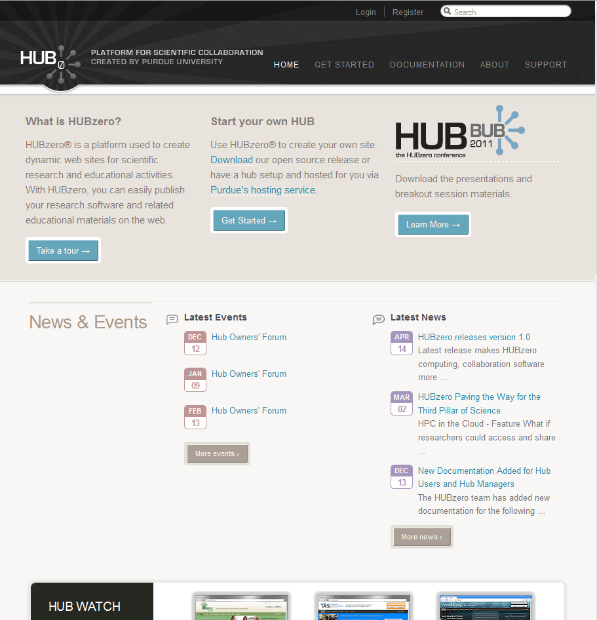
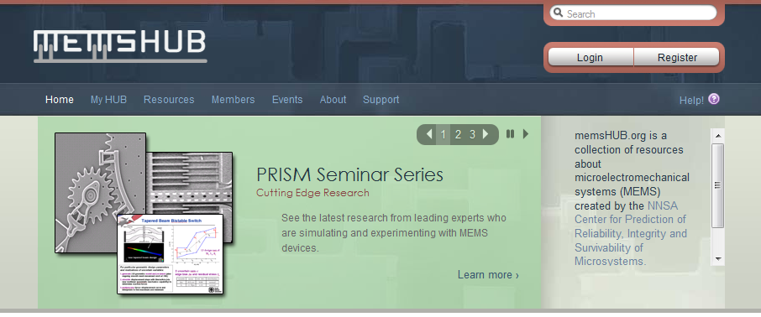
InvertNet Cloud Infrastructure HUBzero
The HUBzero Platform for Scientific Collaboration gives campus IT departments a solution for building online communities supporting both education and research.
Notes:
Once we start digitizing our collections, we need to provide a robust IT infrastructure to manage all the data we will be capturing, provide access to the data via the internet, and ensure that access to the data is maintained over the long term. To do this, we’re using a system called HUBzero. HUBzero is a cyberinfrastructure platform that was designed specifically to support the kinds of large-scale, massively collaborative scientific research platforms that the ADBC program aims to build. It was originally designed to support a large community of nanotechnology researchers, but has since been adopted by a wide variety of other communities of researchers. I like to think of it as a content management system on steroids. It includes a lot of the same kinds of modules for managing static content that are available in content management systems like Drupal or Joomla, but it also has a number of advanced features like browser-based access to various kinds of databases, visualization and analytical tools, direct integration with systems for archiving and preservation of data, and with high performance computing resources. This becomes important when you’re dealing with gigapixel-scale images and 3D reconstructions that need to be accessed and manipulated in real time. What this means for InvertNet is that we can use HUBzero to build and integrate essentially all of the IT infrastructure necessary for our project. So it will include our digitization workflows, image post-processing, databases, environments for community building and collaboration, analytical tools, developer tools, and tools for education and outreach.

Slide 25
InvertNet Cloud Infrastructure nanoHUB.org
nanoHUB.org is the place for computational nanotechnology research, education, and collaboration.
nanoHUB supports collaboration via Workspaces and User groups.
Applications run in the cloud and are accessed through your web browser.
There are Online Presentations, Courses, Learning Modules, Podcasts, Animations, Teaching Materials, and more to help you learn about the simulation programs and about nanotechnology.
Notes:
Once we start digitizing our collections, we need to provide a robust IT infrastructure to manage all the data we will be capturing, provide access to the data via the internet, and ensure that access to the data is maintained over the long term. To do this, we’re using a system called HUBzero. HUBzero is a cyberinfrastructure platform that was designed specifically to support the kinds of large-scale, massively collaborative scientific research platforms that the ADBC program aims to build. It was originally designed to support a large community of nanotechnology researchers, but has since been adopted by a wide variety of other communities of researchers. I like to think of it as a content management system on steroids. It includes a lot of the same kinds of modules for managing static content that are available in content management systems like Drupal or Joomla, but it also has a number of advanced features like browser-based access to various kinds of databases, visualization and analytical tools, direct integration with systems for archiving and preservation of data, and with high performance computing resources. This becomes important when you’re dealing with gigapixel-scale images and 3D reconstructions that need to be accessed and manipulated in real time. What this means for InvertNet is that we can use HUBzero to build and integrate essentially all of the IT infrastructure necessary for our project. So it will include our digitization workflows, image post-processing, databases, environments for community building and collaboration, analytical tools, developer tools, and tools for education and outreach.

Slide 26
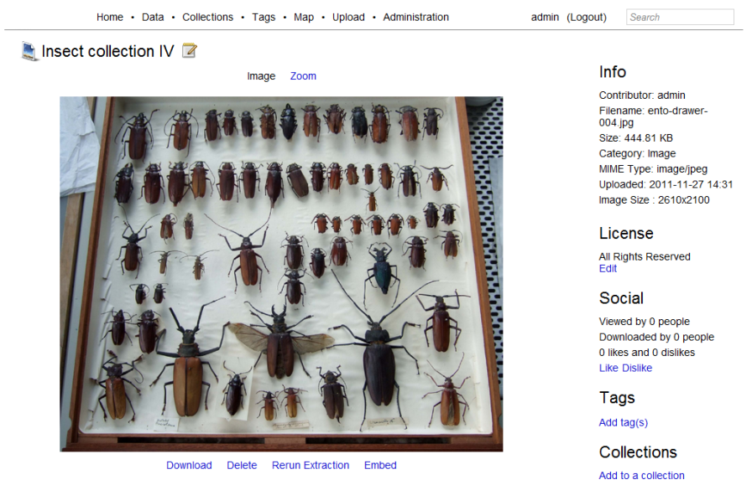
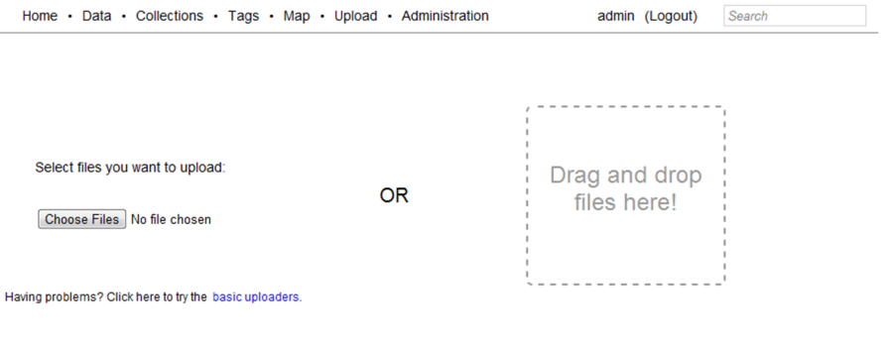
InvertNet Cloud Infrastructure Medici
drag-and-drop upload
extreme zoom capabilities
automated metadata extraction
collection creation
tagging and annotation
commenting
preview and large size image display
metadata search
overlay with Google map if latitude and longitude metadata are embedded in files
portable and open representation of data
manage aggregate collections comprised of distributed sub-collections
provide global persistent identifiers for resources suitable for citation and the ability to export metadata, provenance, tags, etc. in globally understood standard formats
support simple, incremental ingest through web and desktop interfaces and metadata-based browsing in which resources can be organized and filtered not only by collection but by creator, tag, provenance, etc
Notes:
Once we start digitizing our collections, we need to provide a robust IT infrastructure to manage all the data we will be capturing, provide access to the data via the internet, and ensure that access to the data is maintained over the long term. To do this, we’re using a system called HUBzero. HUBzero is a cyberinfrastructure platform that was designed specifically to support the kinds of large-scale, massively collaborative scientific research platforms that the ADBC program aims to build. It was originally designed to support a large community of nanotechnology researchers, but has since been adopted by a wide variety of other communities of researchers. I like to think of it as a content management system on steroids. It includes a lot of the same kinds of modules for managing static content that are available in content management systems like Drupal or Joomla, but it also has a number of advanced features like browser-based access to various kinds of databases, visualization and analytical tools, direct integration with systems for archiving and preservation of data, and with high performance computing resources. This becomes important when you’re dealing with gigapixel-scale images and 3D reconstructions that need to be accessed and manipulated in real time. What this means for InvertNet is that we can use HUBzero to build and integrate essentially all of the IT infrastructure necessary for our project. So it will include our digitization workflows, image post-processing, databases, environments for community building and collaboration, analytical tools, developer tools, and tools for education and outreach.

Slide 27
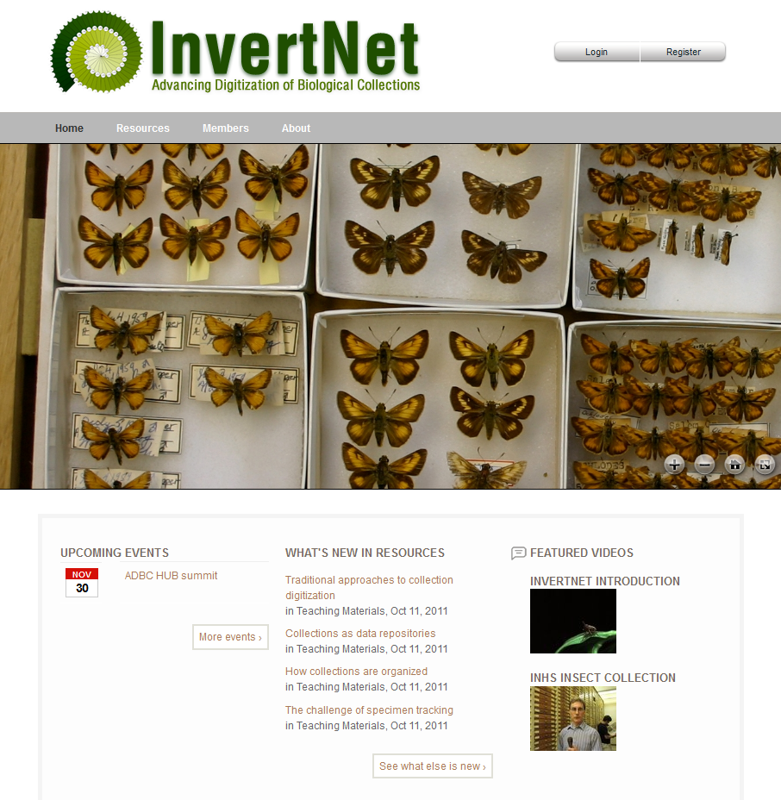
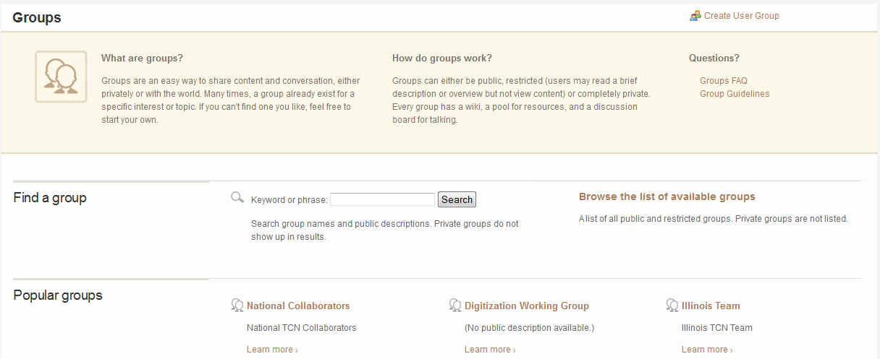
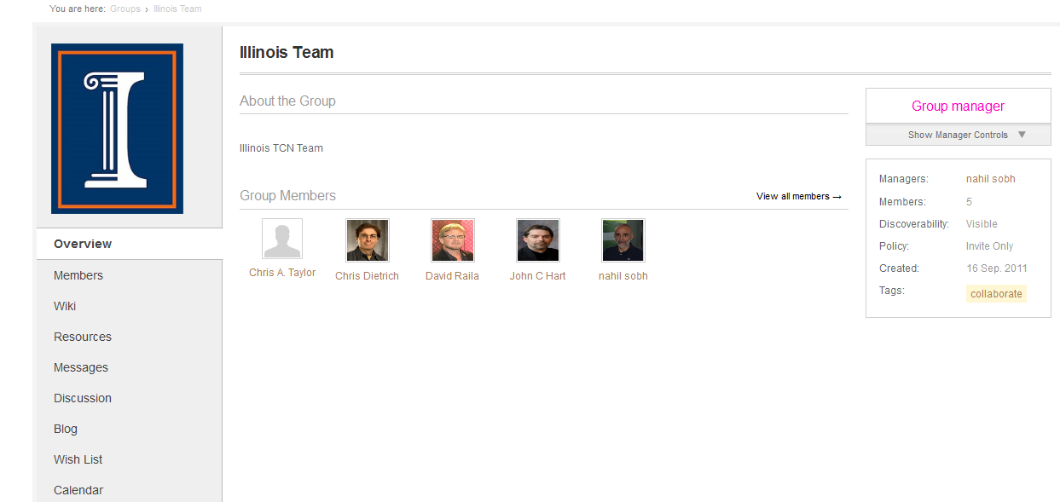
www.InvertNet.org
Notes:
Once we start digitizing our collections, we need to provide a robust IT infrastructure to manage all the data we will be capturing, provide access to the data via the internet, and ensure that access to the data is maintained over the long term. To do this, we’re using a system called HUBzero. HUBzero is a cyberinfrastructure platform that was designed specifically to support the kinds of large-scale, massively collaborative scientific research platforms that the ADBC program aims to build. It was originally designed to support a large community of nanotechnology researchers, but has since been adopted by a wide variety of other communities of researchers. I like to think of it as a content management system on steroids. It includes a lot of the same kinds of modules for managing static content that are available in content management systems like Drupal or Joomla, but it also has a number of advanced features like browser-based access to various kinds of databases, visualization and analytical tools, direct integration with systems for archiving and preservation of data, and with high performance computing resources. This becomes important when you’re dealing with gigapixel-scale images and 3D reconstructions that need to be accessed and manipulated in real time. What this means for InvertNet is that we can use HUBzero to build and integrate essentially all of the IT infrastructure necessary for our project. So it will include our digitization workflows, image post-processing, databases, environments for community building and collaboration, analytical tools, developer tools, and tools for education and outreach.

Slide 28
Challenges
10 gigabit
Storage Private vs. Public
Redundancy
Scalability
High availability
1 gigabit
Network:
Bandwidth Provider
Stitching (raw images) moved
to client side to avoid network
bottlenecks
0.1 gigabit (100 Mbps)
Notes:
Once we start digitizing our collections, we need to provide a robust IT infrastructure to manage all the data we will be capturing, provide access to the data via the internet, and ensure that access to the data is maintained over the long term. To do this, we’re using a system called HUBzero. HUBzero is a cyberinfrastructure platform that was designed specifically to support the kinds of large-scale, massively collaborative scientific research platforms that the ADBC program aims to build. It was originally designed to support a large community of nanotechnology researchers, but has since been adopted by a wide variety of other communities of researchers. I like to think of it as a content management system on steroids. It includes a lot of the same kinds of modules for managing static content that are available in content management systems like Drupal or Joomla, but it also has a number of advanced features like browser-based access to various kinds of databases, visualization and analytical tools, direct integration with systems for archiving and preservation of data, and with high performance computing resources. This becomes important when you’re dealing with gigapixel-scale images and 3D reconstructions that need to be accessed and manipulated in real time. What this means for InvertNet is that we can use HUBzero to build and integrate essentially all of the IT infrastructure necessary for our project. So it will include our digitization workflows, image post-processing, databases, environments for community building and collaboration, analytical tools, developer tools, and tools for education and outreach.

Slide 29
Join Us
Registration is open to all and available now!
Notes:
I’ll close by just reminding you that, although it doesn’t yet have a lot of content, InvertNet.org is up and running. Registration is available and open to all, so I urge you to join us.

Slide 30
Acknowledgements
Collaborators: J. Hart, N. Sobh, O. Sobh, D. Raila, U. Ravaioli, C. Taylor, A. Cognato, G. Courtney, J. Holland, R. Holzenthal, P. Tinerella, P. Johnson, H. Klompen, M. Daly, J. Rawlins, R. Davidson, J. Fetzner, D. Rider, G. Fauske, A. Short, R. Sites, D. Young, J. Zaspel, G. Zolnerowich
Funding: NSF ADBC program

