Slide 1
iDigBio Research Coordination and Scientific Community Outreach
Pamela S. Soltis
Co-PI & Director for Research

Slide 2
Research Questions
How are species distributed in geographical and ecological space?
What is the history of life on Earth?
What factors lead to speciation, dispersal, and extinction?
What are the impacts of climate change likely to be?
What information is needed for effective conservation strategies?

Slide 3
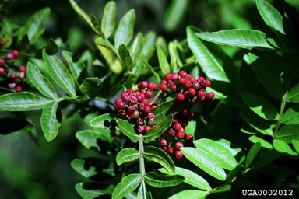
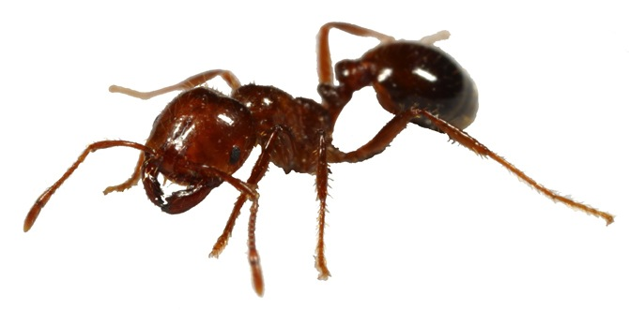
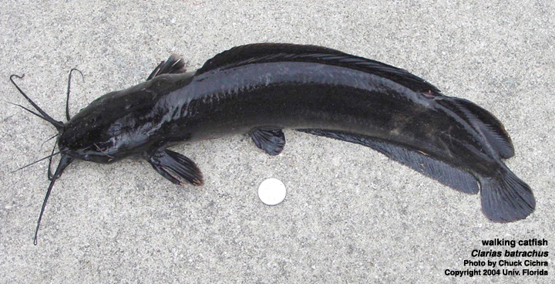
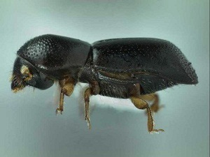
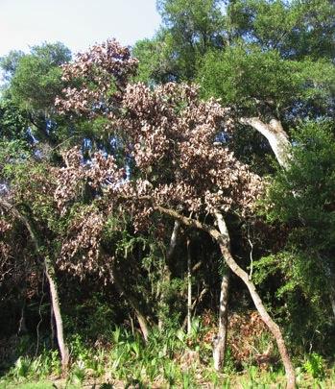
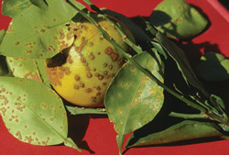
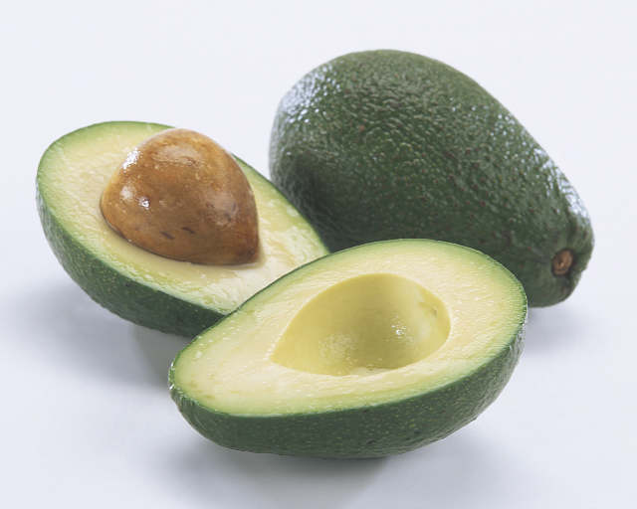
Invasive Species
Where have they been introduced, and how quickly are they spreading?
What is the pattern of spread, and do they covary with other taxa?
What is the effect of climate change on the spread of invasives?

Slide 4
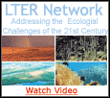
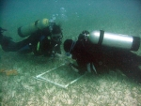
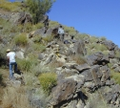
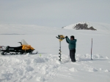
Linking Collections to Ecology
Through collections from LTERs

Slide 5
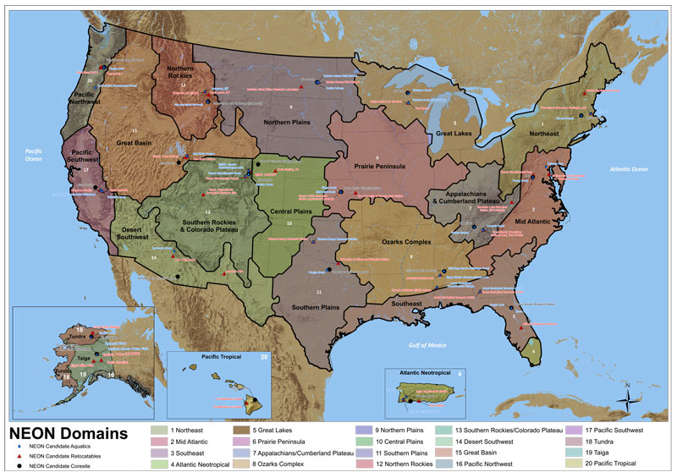
Linking Collections to Ecology
Through NEON
Biological monitoring at sites across USA; collections
Baseline for changes in
species distribution and
abundance over time
National Ecological Observatory Network

Slide 6
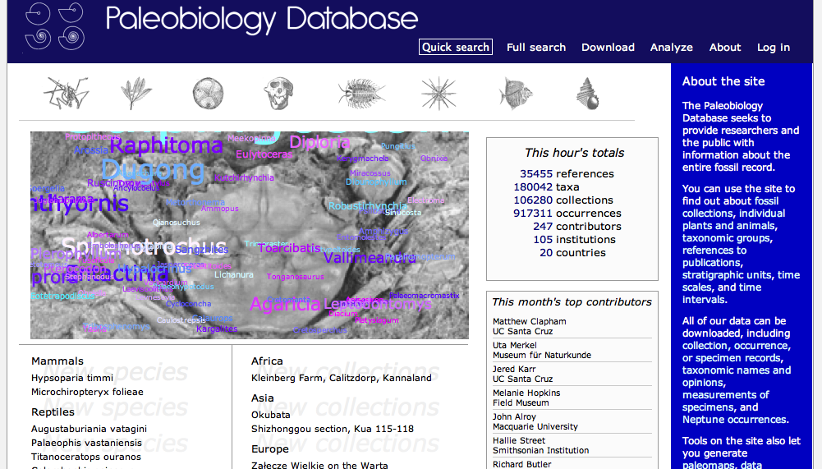
Linking Collections to Paleobiology
Paleobiology Database
(http://paleodb.org/cgi-bin/bridge.pl)

Slide 7
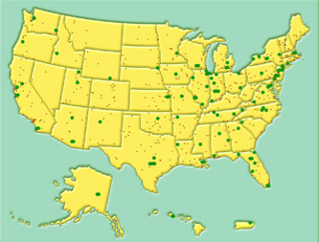
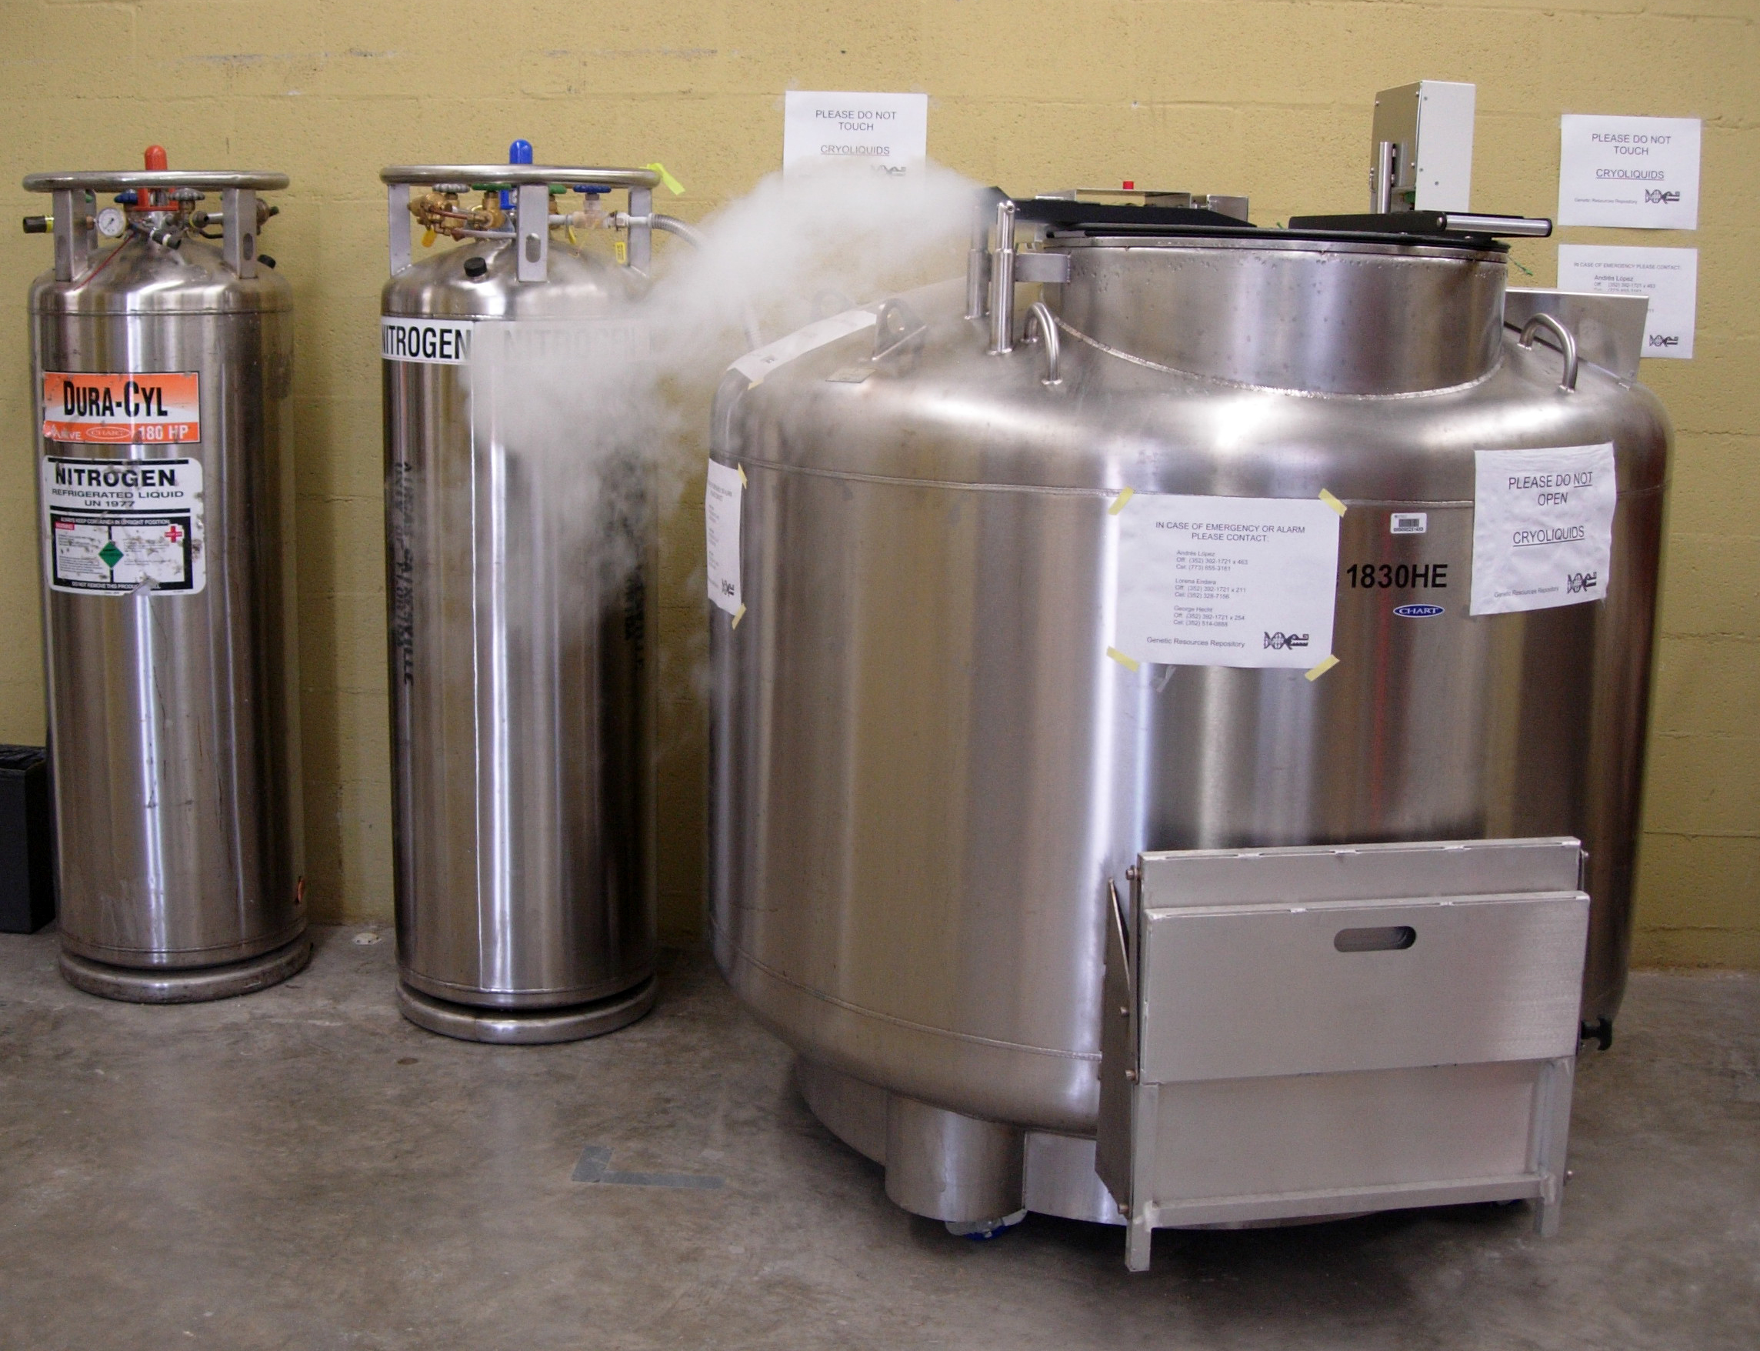
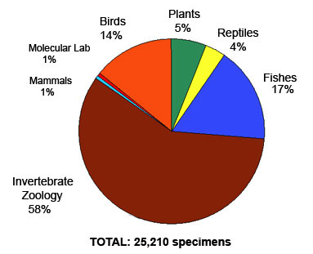
Linking Collections to Genomics
National network of tissue and genetic
resources

Slide 8
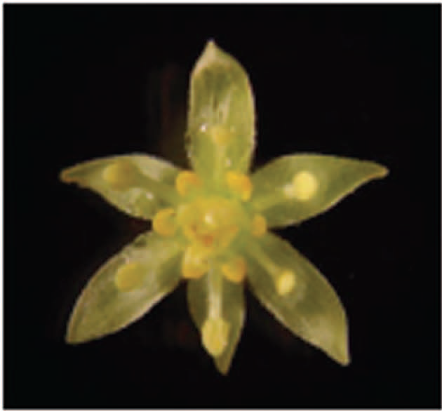
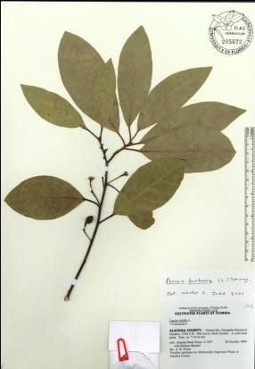
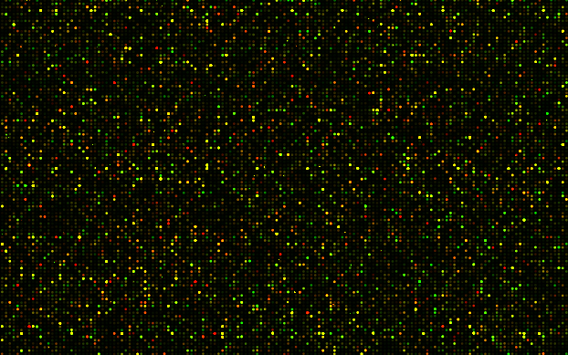
Linking Collections to Genomics
In situ hybridization images:
Linked to voucher specimens and genomic data

Slide 9
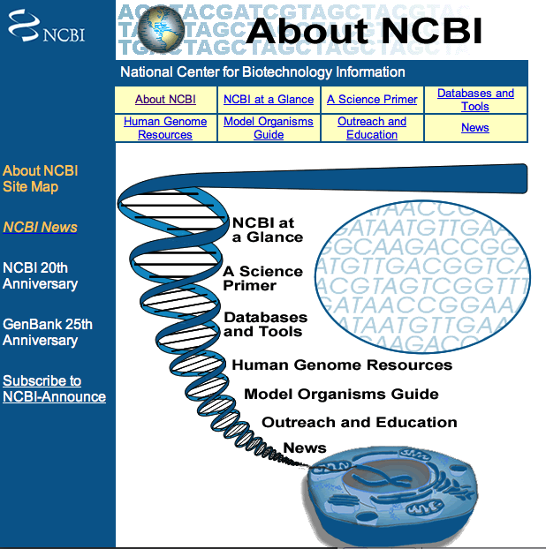
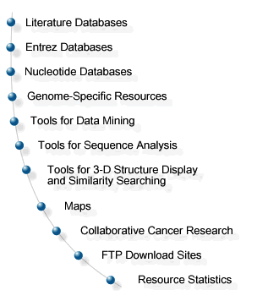
Linking Collections to Genomics
Extend HUB connections to genomics databases

Slide 10
Linking to Living Collections
Botanical gardens, zoos, culture collections

Slide 11
Interactions with Systematics Community and Beyond
Facilitate digitization efforts
Coordinate with other databasing efforts in systematics
Connect to databases outside systematics: ecology to genomics (NEON to GenBank)

Slide 12
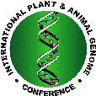
Interactions Fostered Through…
Discussions at national meetings of professional societies (systematics, ecology, evolution, genomics)
Workshops to engage members of systematics community
Workshops to engage members of different communities

Slide 13
Activities to Date
Meetings/symposia with collections community
Botany 2011
BISON
TDWG
Society of Vertebrate Paleontology
Entomological Collections Network
Botany 2012: Symposium and Workshop (A. Mast)
Plans underway for additional workshops

Slide 14
Activities to Date
Discussions with various data repositories:
TreeBASE
Dryad
NEON
GenBank

Slide 15
Goals for the Summit…
Suggestions for collections and research-related workshops and symposia at meetings
Suggestions for interfaces with data repositories to promote integrated research
Volunteers to help coordinate these efforts

