Slide 1
iDigBio Summit meeting
Judith E. Skog
Biological Sciences Directorate
Office of the Assistant Director
Emerging Frontiers Division

Slide 2
Reminders for meeting
How did we get here?
Needs defined
Community strategic plan
NSF program based on policies and gaps
Where are we now?
Implementation plan
What’s next?

Slide 3
Defining the Need
Scientific collections provide proper validation of species including a wealth of ancillary data such as DNA samples and environment/habitat information.
These data provide the baseline from which to begin further biodiversity studies and provide critical information about the existing gaps in our knowledge of life on earth.

Slide 4
Defining the Need
The information in collections is critically needed for a growing number of biodiversity-based studies
To maximize the use of this information, digitizing scientific collections into a resource that can be accessed by the broadest possible community is vital

Slide 5
Result from the Focus Group
Strategic plan for digitizing, imaging, mobilizing collections data for the non-federal collections in the USA completed June 2010
Need a central organization for integration
Need for thematic networks based on research area
Need for regional groups or clade based groups
Assess need for new tools and technologies
At the core are the collections

Slide 6
NSF Program
Community plan outlined program goals
NSF assessed programs to see what was available
Individual collections and regional or clade based activities supported through Collections Improvements program
Tools supported through informatics and instrumentation programs
Two items in plan had no place for funding
The Central coordinating resource for digitization projects
Digitization based on research challenges

Slide 7
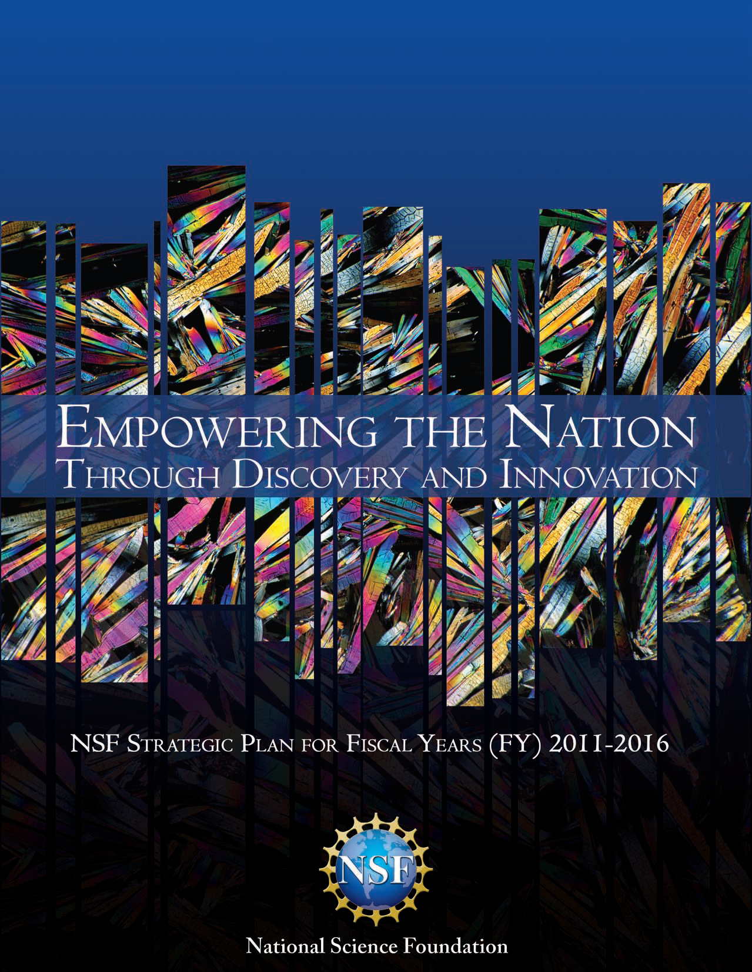
New NSF Strategic Plan
Transform the frontiers emphasizes the seamless integration of research and education as well as the close coupling of research infrastructure and discovery.

Slide 8
America Competes Act
Office of Science and Technology Policy (OSTP), in consultation with relevant federal agencies, develop policies for management and use of federal scientific collections to “improve the quality, organization, access, including online access, and long-term preservation of such collections for the benefit of the scientific enterprise.”

Slide 9
ADBC program
First year established the central resource
Awarded three networks
Next phase is to implement a national networked entity among these four projects and provide a vision for the community strategic plan in the future

Slide 10
Division of Emerging Frontiers
Division devoted to innovative , multidisciplinary projects
Virtual division – works across boundaries and incubates activities
Encourages synergy between disciplines
Promotes networking activities for 21st Century Biology

Slide 11
Where next?
Community cooperation critical – one chance to make it work, but results for research great
Community collaboration should encourage innovations and synergy
Networking and integration critical
U.S. collections – obvious under program
Other like activities (centers, NEON)
Federal collections
International digitization efforts

Slide 12
Sustainability plans
Important to think about the future and how this effort will be sustained
Requires collaborations
Need to show some immediate uses and results for a broader community
Remain true to the job at hand
Must become a critical resource for researchers that is easy, useful, accurate

Slide 13
Stay focused and simple

Slide 14
Future?
o
s
C
m
o
s

