Slide 1
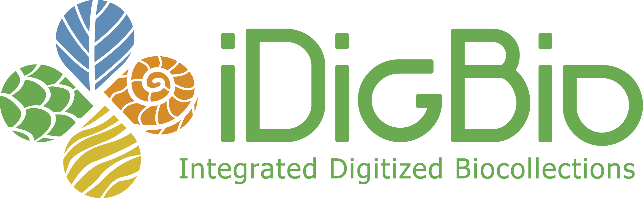
the hub for
Advancing Digitization of Biological Collections (ADBC)

Slide 2
University of Florida & Florida State University
University of Florida
Pamela Soltis, Bruce McFadden, Jose Fortes, Larry Page
Florida State University
Greg Riccardi

Slide 3
University of Florida
Larry Page, Jose Fortes, Pamela Soltis, Bruce McFadden, Renato Figueiredo, Reed Beaman, Andrea Matsunaga, Alex Thompson, Matthew Collins, Jason Grabon, Shari Ellis, Kevin Love, Betty Dunkel, Kate Rachwal, Cathleen Bester
Florida State University
Greg Riccardi, Austin Mast, Marcia Mardis, Gil Nelson, Casey McLaughlin, Deb Paul, Guillaume Jimenez

Slide 4
ADBC
The enormous amount of information in biological collections is inaccessible to most potential users.
The goal of ADBC is to remove this inaccessibility by putting
information online so that researchers, educators, students,
environmentalists, and policymakers will have access.

Slide 5
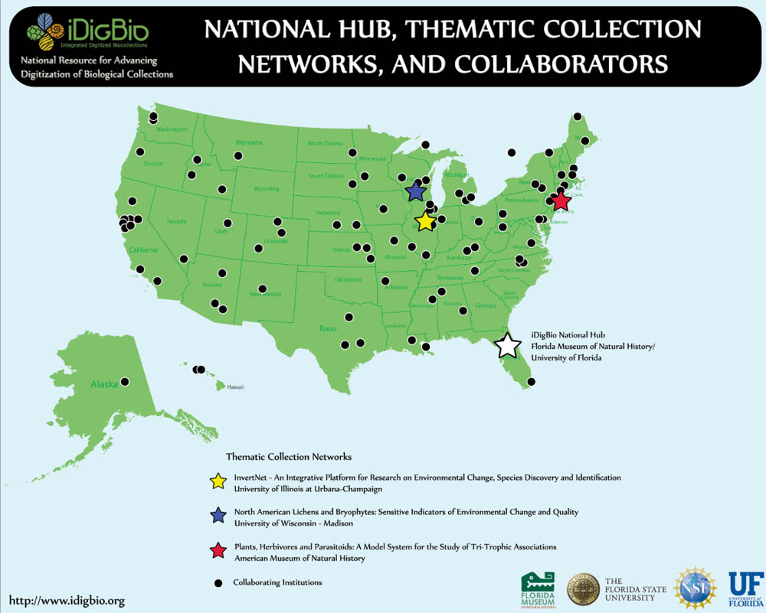

Slide 6
Mission of iDigBio:
To make ADBC a success.

Slide 7
Vision of iDigBio: Two Primary Outcomes
iDigBio is the primary source for information from biological collections
information from biological collections reaches
users as seamlessly and as usefully as possible
value of biological collections is understood and
appreciated

Slide 8
Vision of iDigBio: Two Primary Outcomes
2. iDigBio is the source for information on standards and best practices for digitization of biological collections,
and digitization becomes routine in all institutions with biological collections

Slide 9
How do we accomplish that?
This meeting will get us started
- TCNs and the HUB
- collections-oriented biologists and IT experts
identify our priorities (individually and
collectively), the problems, and the solutions

Slide 10
The IT solutions:
will get us to 2nd base…..knowing how to digitize

Slide 11
The IT solutions:
will get us to 2nd base…..knowing how to digitize
3rd base is to complete digitization

Slide 12
The IT solutions:
will get us to 2nd base…..knowing how to digitize
3rd base is to complete digitization
Home…

Slide 13
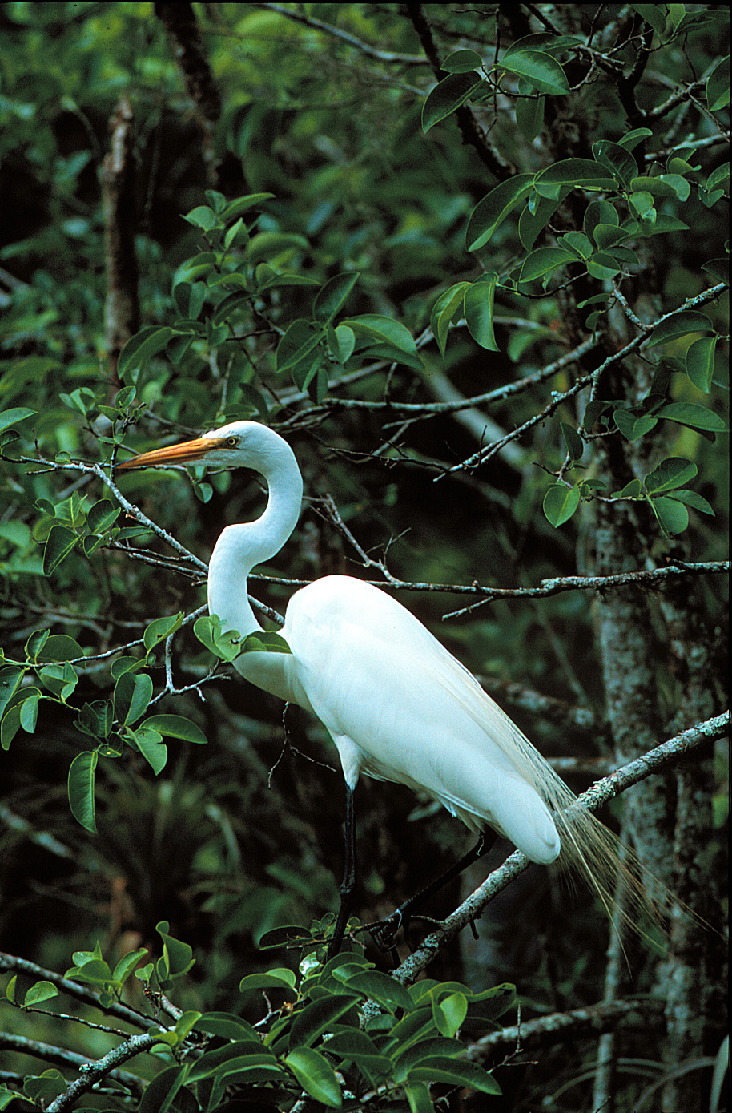
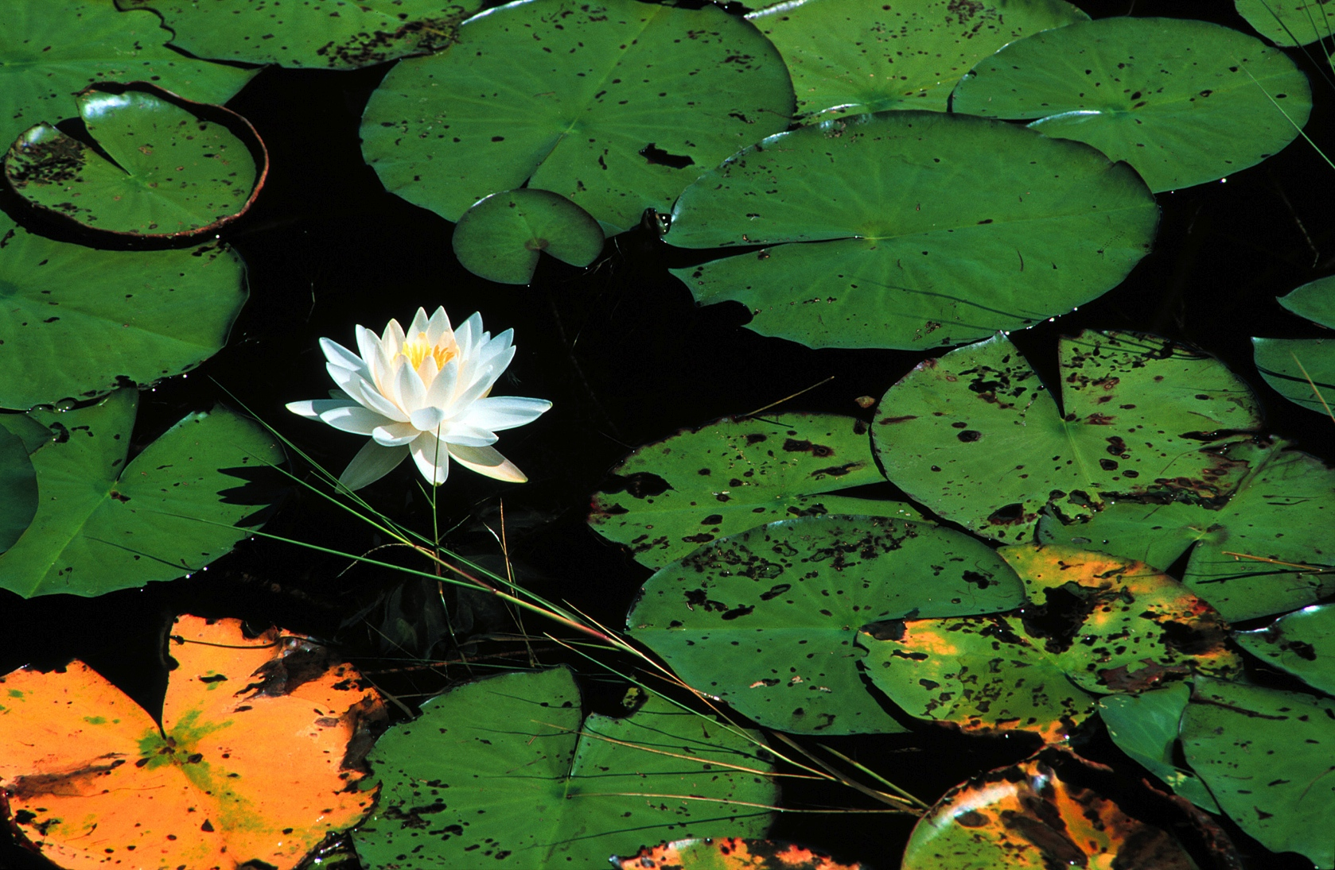
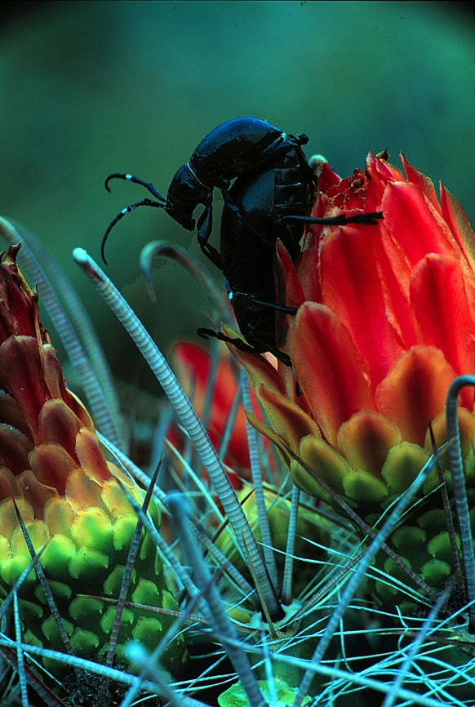
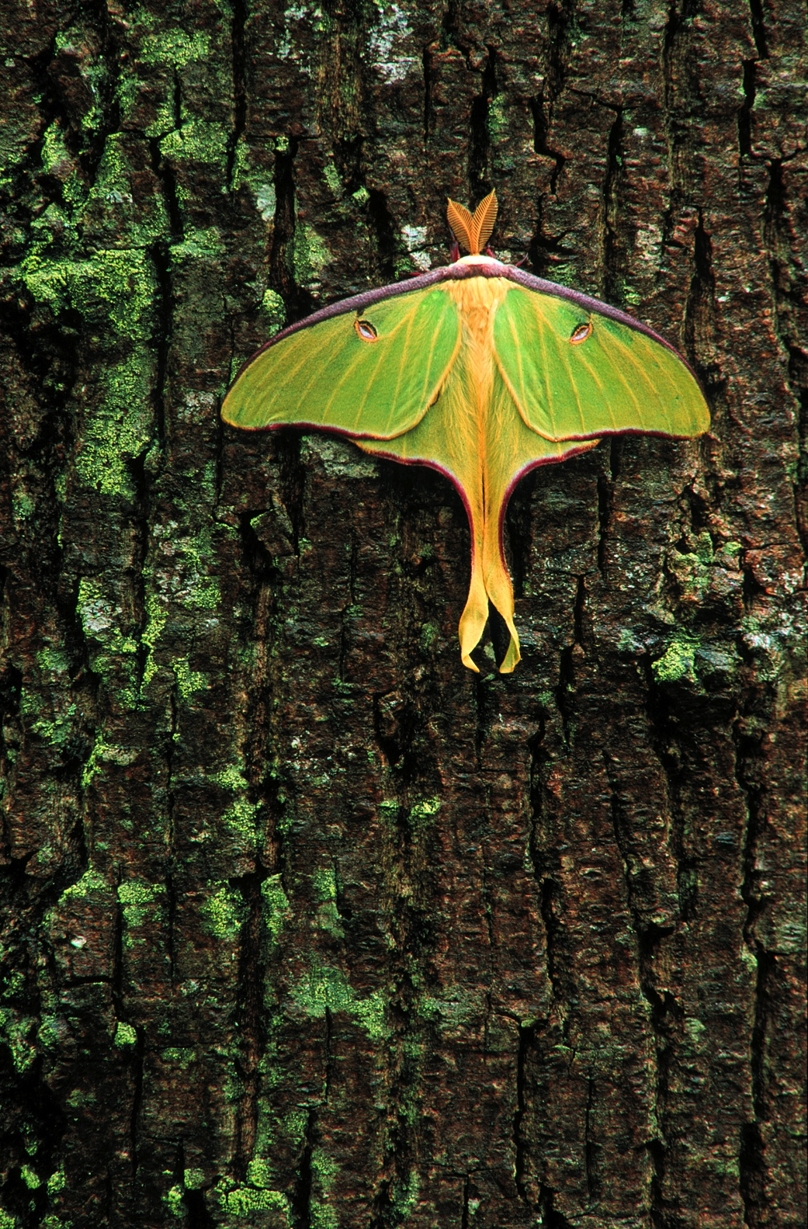
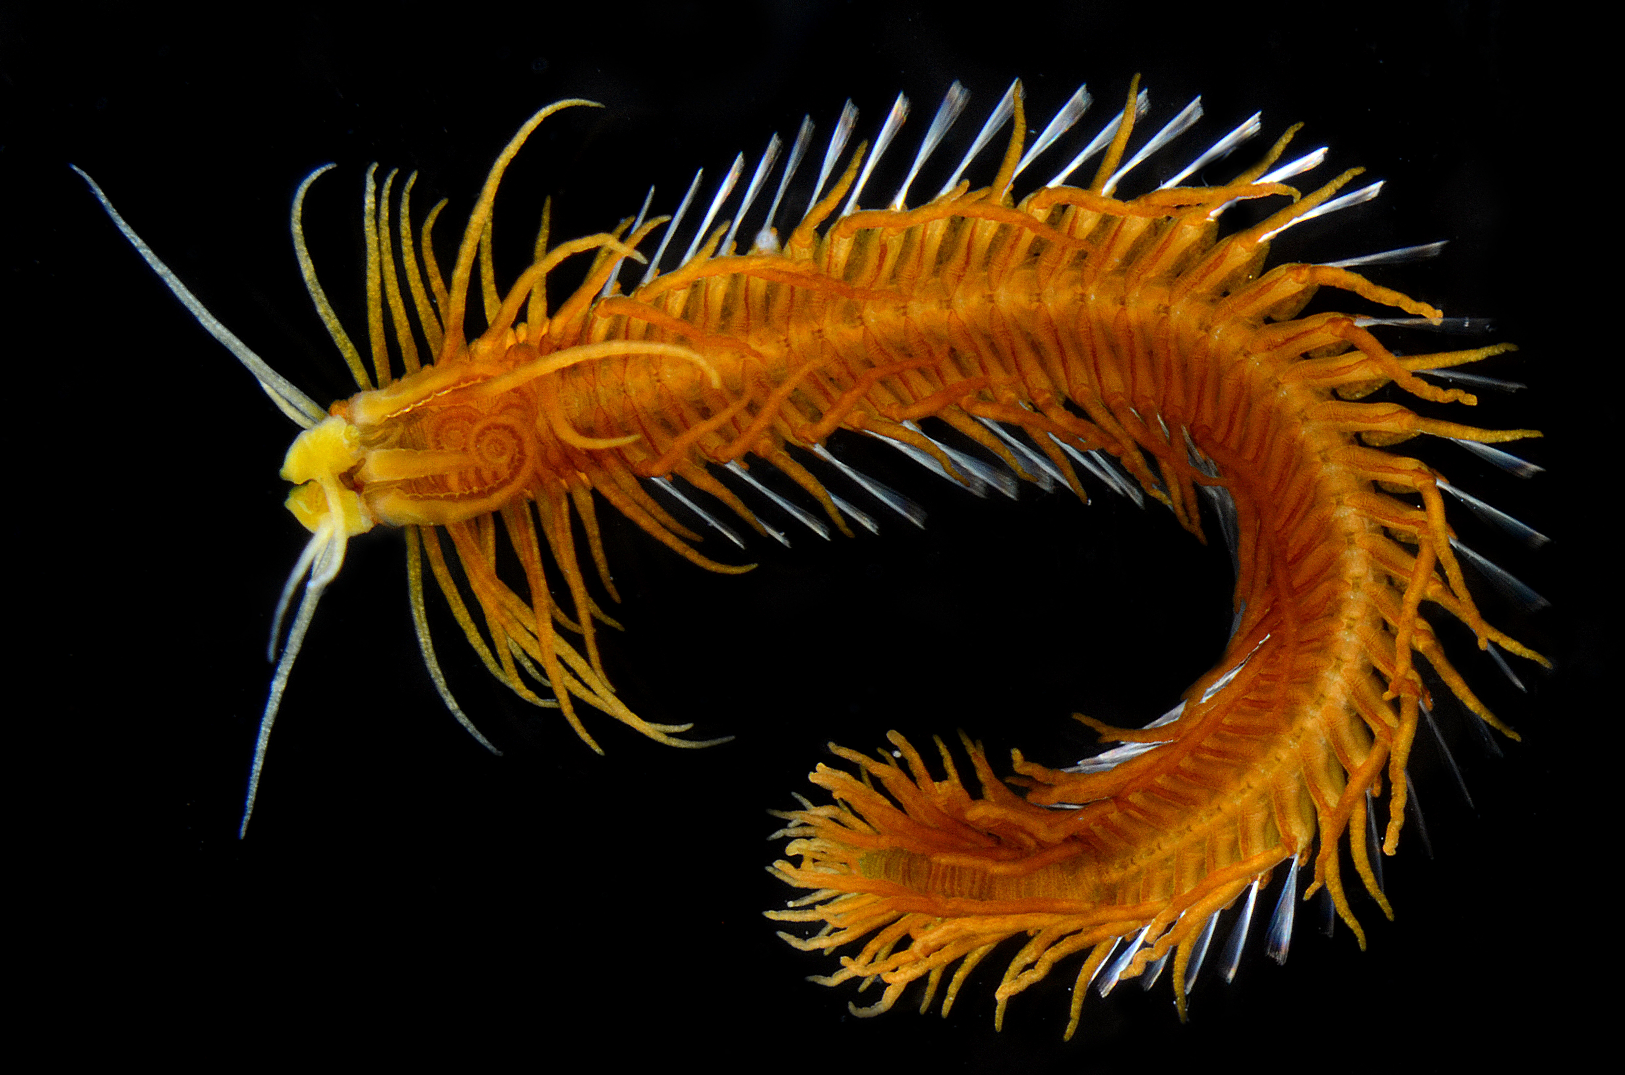
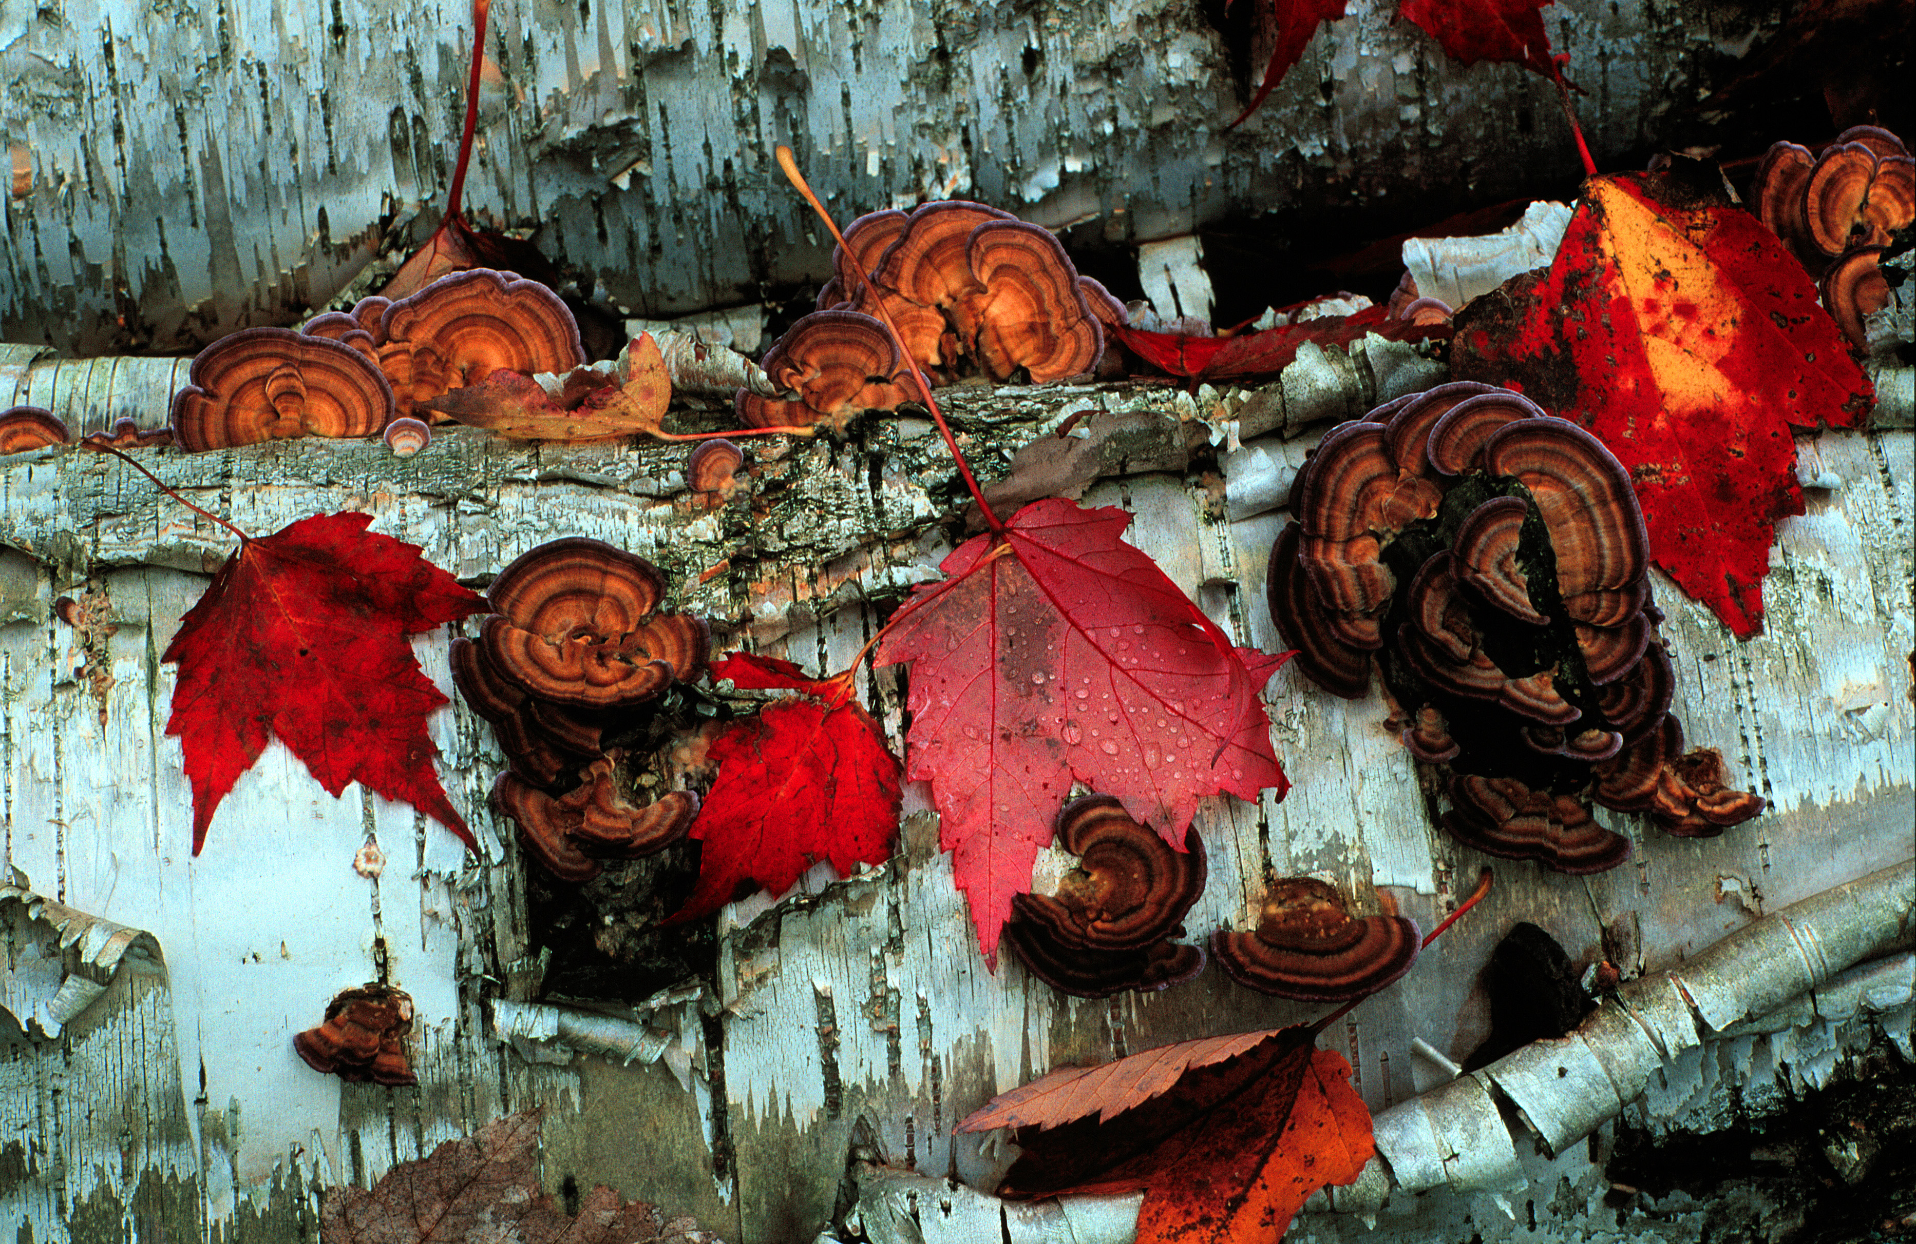
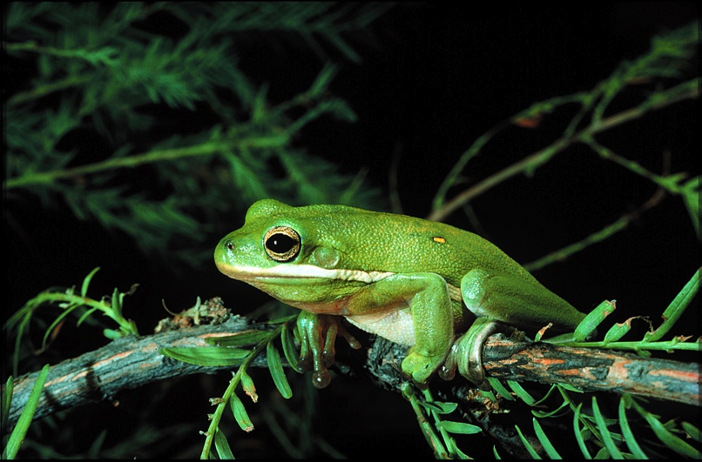
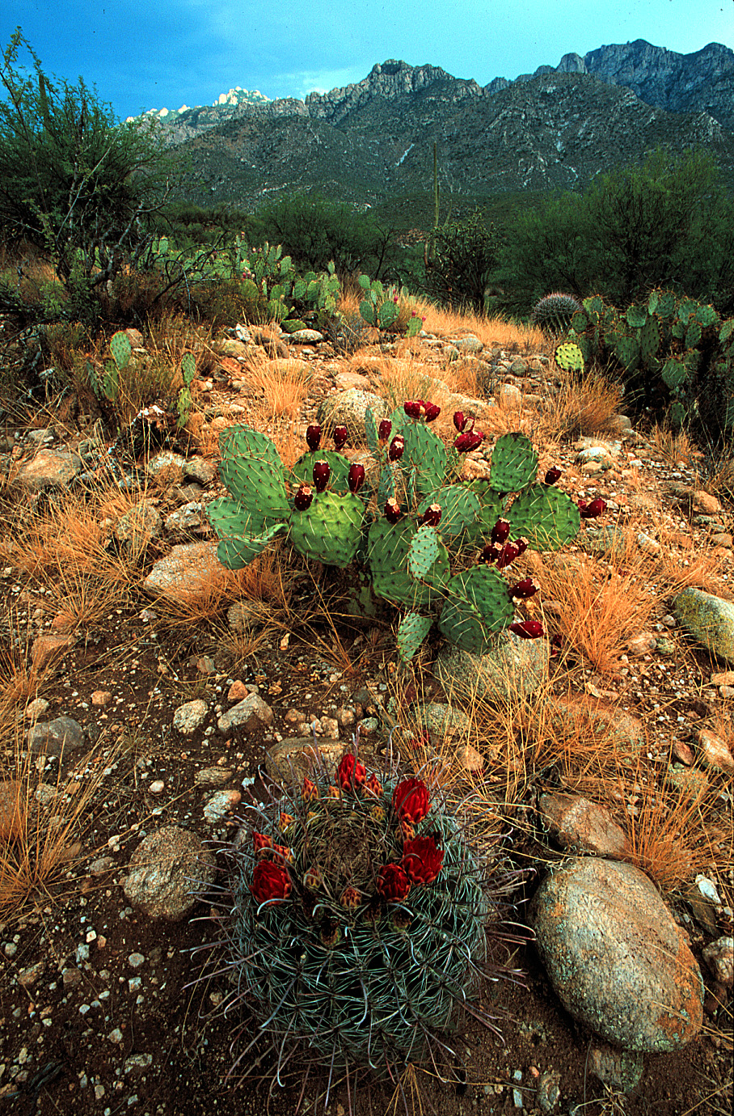
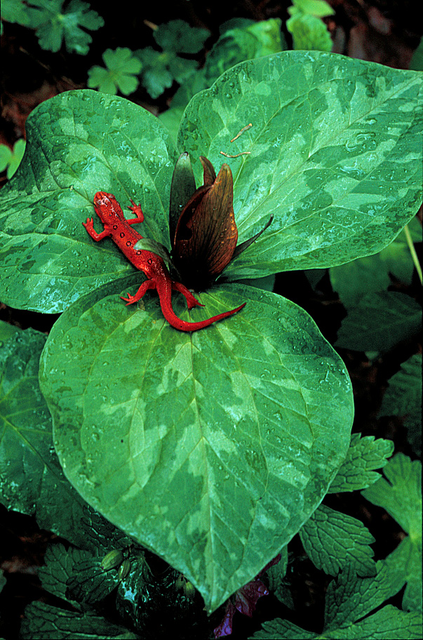
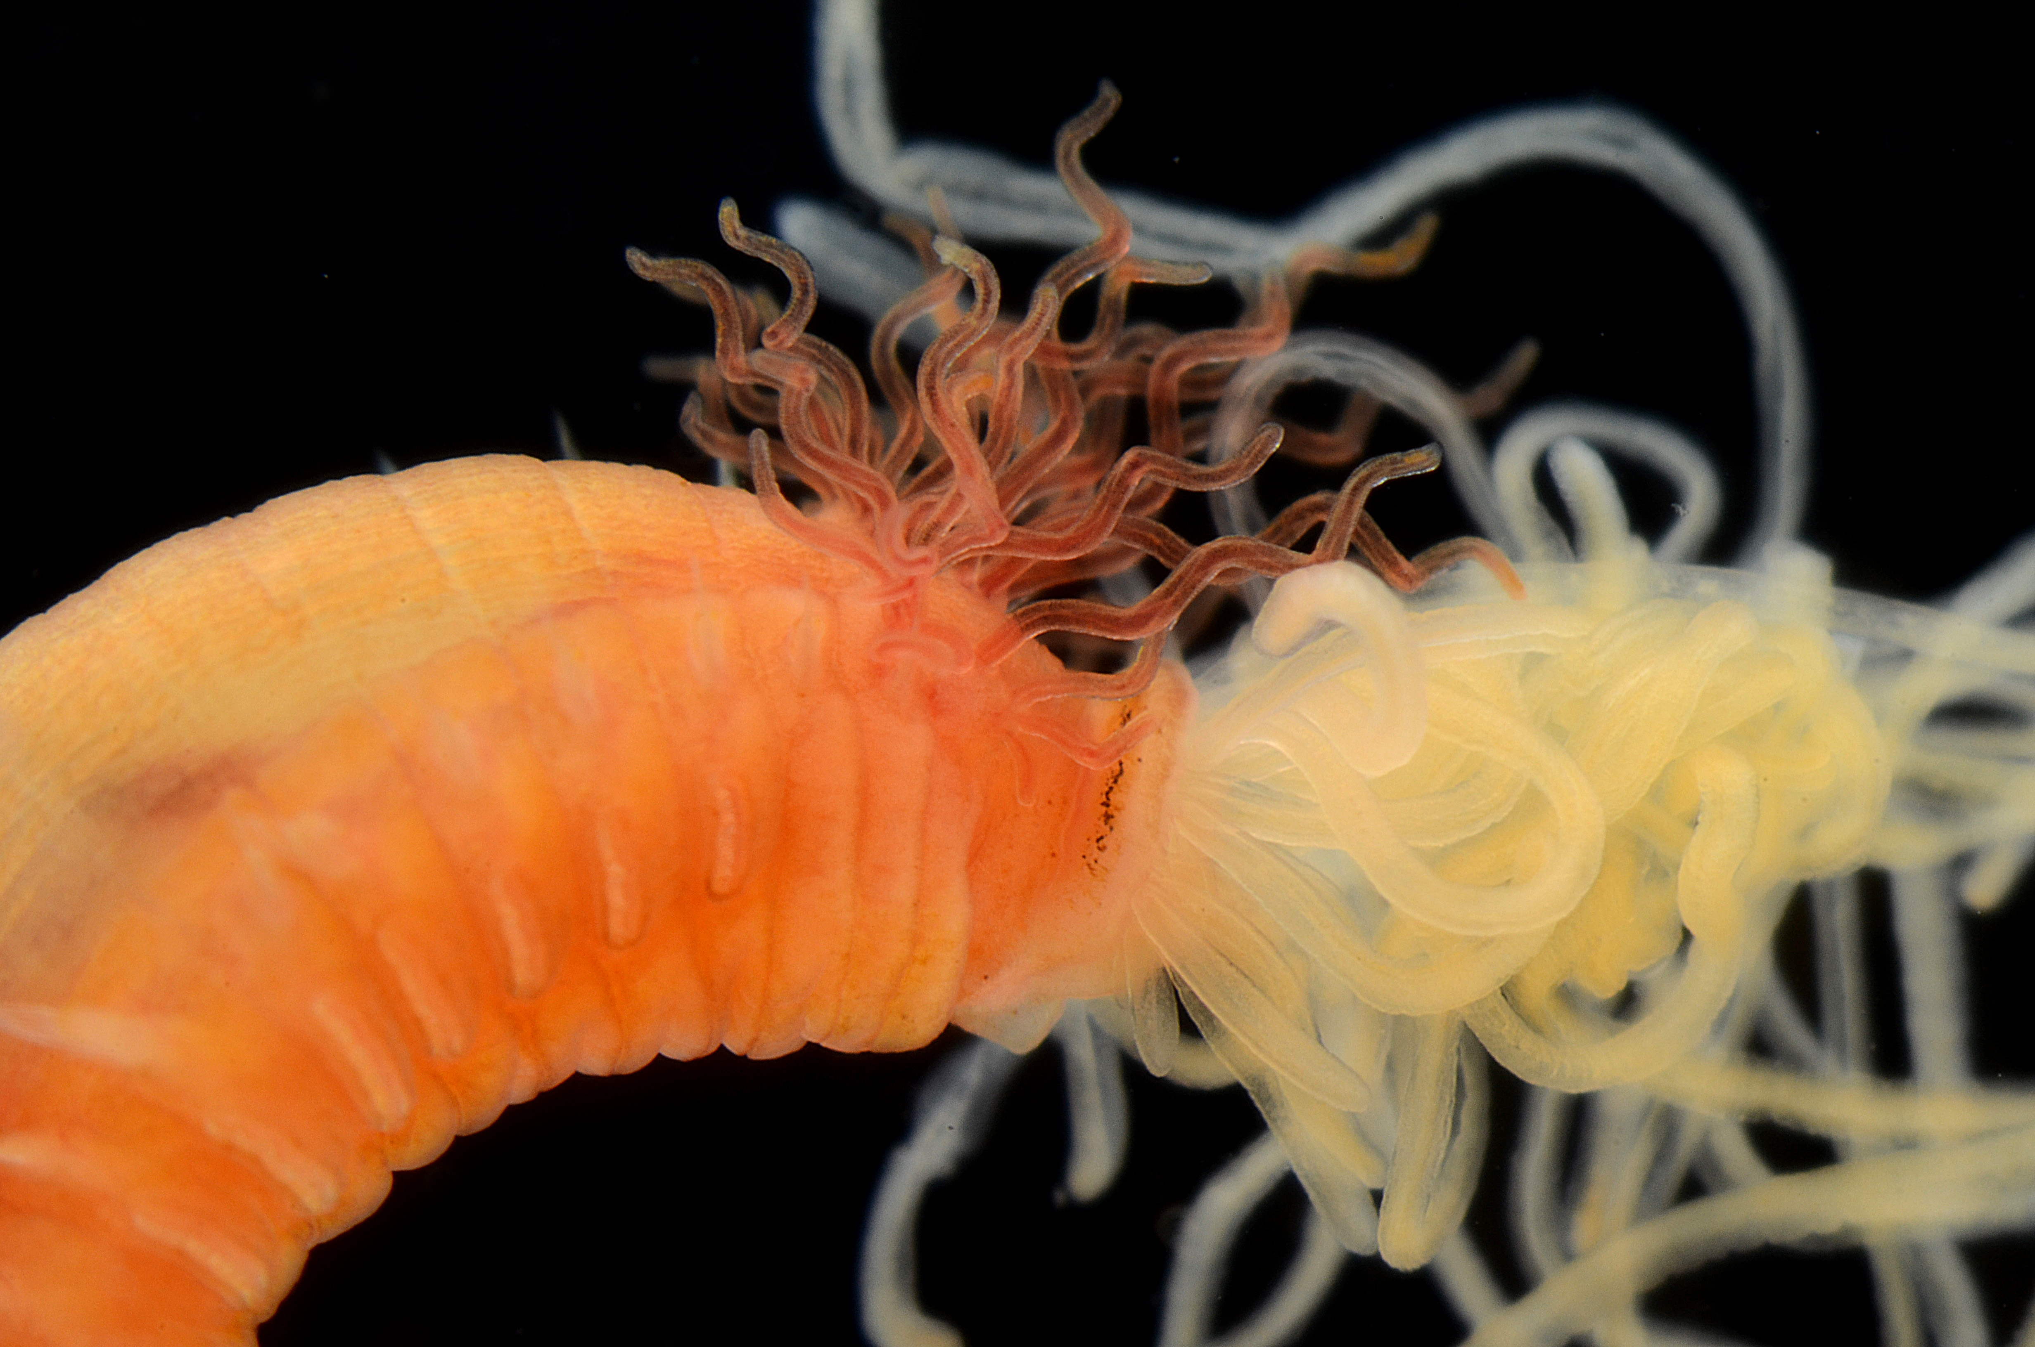
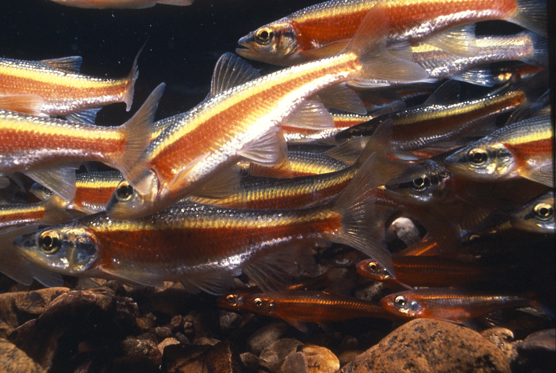
BIODIVERSITY

Slide 14
‘Grand Challenges’
in science and in society

Slide 15
‘Grand Challenges’
in science and in society
- large and complex problems

Slide 16
“… grand challenge efforts seek to drastically
alter the boundaries of existing knowledge,
established disciplines and available capabilities.”
Susan J Winter, National Science Foundation
Brian S Butler, University of Pittsburgh
Journal of Information Technology (2011) 26, 99–108

Slide 17
Examples of grand challenges
Description Articulation Outcome
Calculate Longitude British Parliament (1714) Development of sextants,
new clock design,
astronomical maps 1700s and 1800s
Achieve Cold Fusion Nuclear Physicists, 1950s not yet
Malaria Eradication WHO (1955–1969) DDT, program abandoned in 1969
Grand Unified Field Einstein, etc. Theoretical: Quantum Gravity, String Theory
Empirical: Large Hadron Collider
Land a Man on Moon Kennedy (1961) and NASA Apollo moon landings (1969–1972)
Eliminate Small Pox WHO (1967) Widespread vaccination; last wild case
documented in 1979
Map Human Genome Biologists, DOE, NIH (1985–2006) Mapped 2006

Slide 18
BIODIVERSITY
Stop the Escalating Extinction of Life

Slide 19
BIODIVERSITY
Reduce the Rate of Extinction of Life

Slide 20
ADBC
Address the Biodiversity Crisis in two significant ways:
Provide access to information that much more clearly and directly documents the value of biodiversity to humans
Document the value of biological collections as a primary source of that information

Slide 21
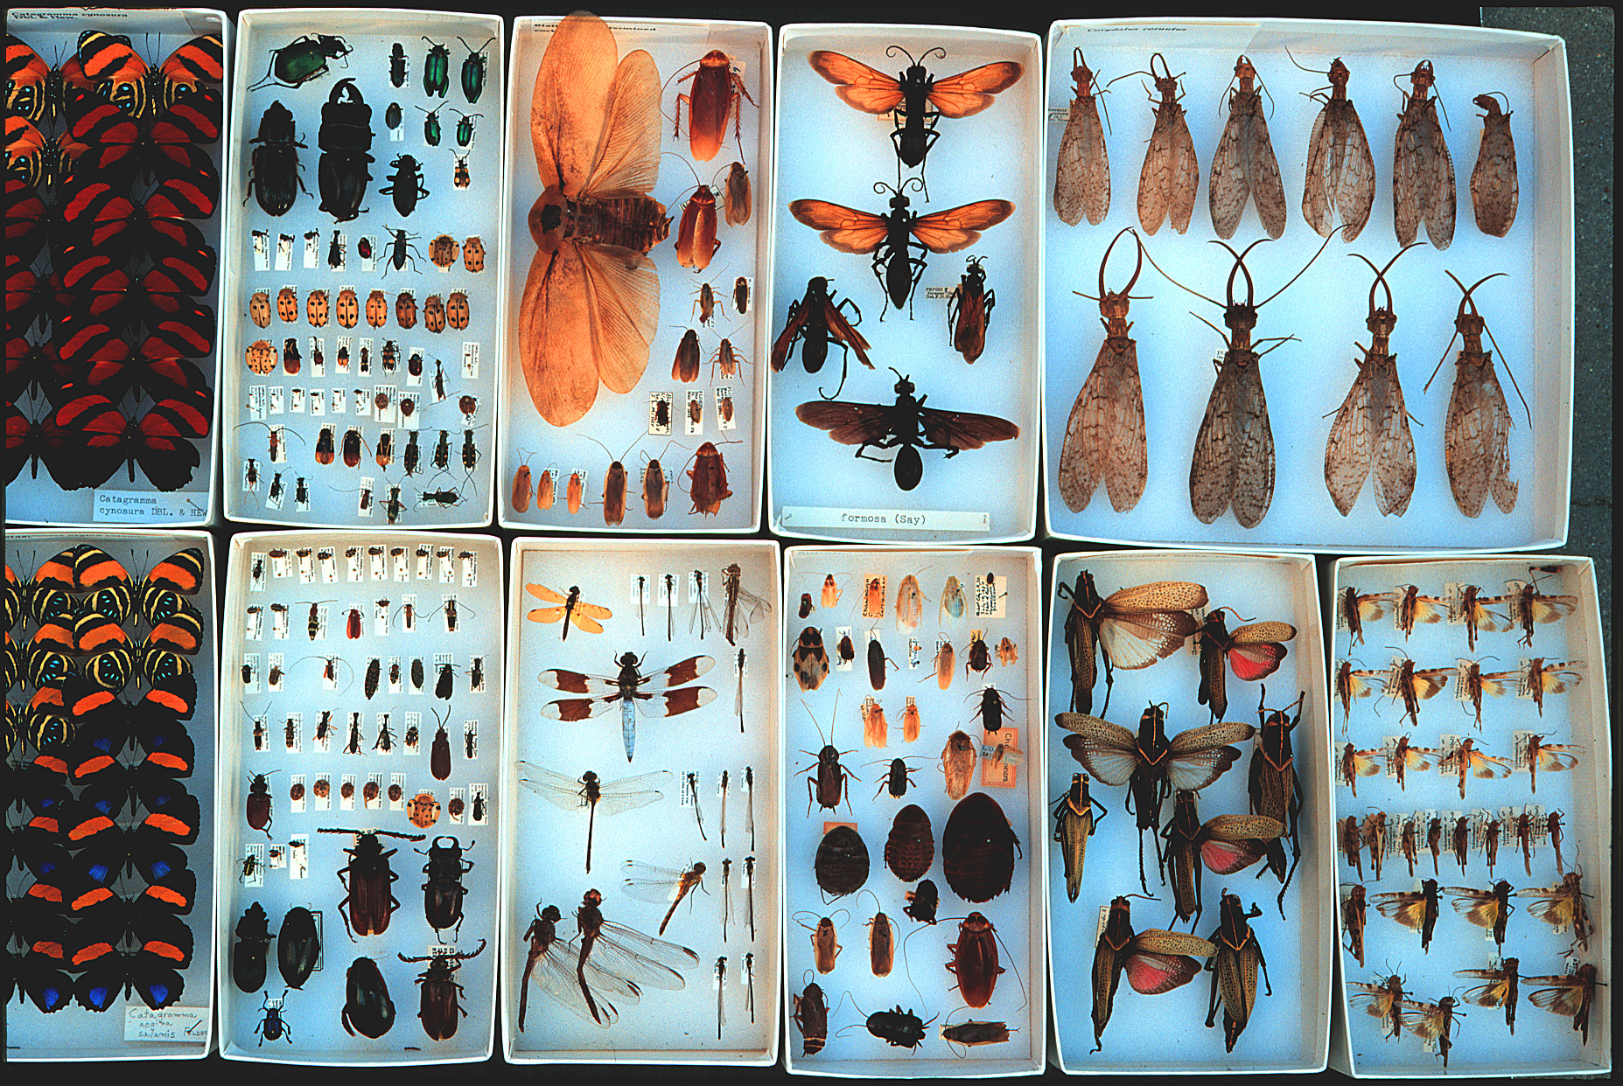
Biodiversity
Collections: Specimens, Observations, DNA
1 billion
specimens
in U.S.
Environmental Policy
Management, Use,
Appreciation, Protection
Understanding
Appreciation

Slide 22
Biodiversity
Collections: Specimens, Observations, DNA
1 billion
specimens
in U.S.
Environmental Policy
Management, Use,
Appreciation, Protection
Research
Education
Outreach
Understanding
Appreciation

Slide 23
Biodiversity
Collections: Specimens, Observations, DNA
Digitization
Validation
Synthesis
Databases
Images
Collections Computational Cloud
GBIF, BISON, VertNET, InvertNet
Environmental Policy
Management, Use,
Appreciation, Protection
New Discoveries
Research
Education
Outreach
Understanding
Appreciation

Slide 24
“…grand challenges must be perceived as having
the potential to significantly impact not only multiple
Academic fields, but also community, national,
or international concerns such as competitiveness,
security, economic development or well-being. ”
Susan J Winter & Brian S Butler (2011) 26, 99–108

Slide 25
Human heath and safety Homeland security International trade Conservation planning Prevention of wildlife trafficking Sustaining ecosystems Land use planning Invasive species predictive models Discovery and exploration Climate change Emerging infection diseases Management of agricultural pests Biological control Identification of disease vectors Forensic science Bioprospecting for new medicines, foods, and fibers

Slide 26
Collections: Specimens, Observations, DNA
Human heath and safety Homeland security International trade Conservation planning Prevention of wildlife trafficking Sustaining ecosystems Land use planning Invasive species predictive models Discovery and exploration Climate change Emerging infection diseases Management of agricultural pests Biological control Identification of disease vectors Forensic science Bioprospecting for new medicines,
foods, and fibers
What are the barriers?
New Discoveries
Research
Education
Outreach
Understanding
Appreciation

Slide 27
Collections: Specimens, Observations, DNA
Human heath and safety Homeland security International trade Conservation planning Prevention of wildlife trafficking Sustaining ecosystems Land use planning Invasive species predictive models Discovery and exploration Climate change Emerging infection diseases Management of agricultural pests Biological control Identification of disease vectors Forensic science Bioprospecting for new medicines,
foods, and fibers
Digitization
What are the barriers?
Data have been inaccessible
New Discoveries
Research
Education
Outreach
Understanding
Appreciation

Slide 28
Collections: Specimens, Observations, DNA
Human heath and safety Homeland security International trade Conservation planning Prevention of wildlife trafficking Sustaining ecosystems Land use planning Invasive species predictive models Discovery and exploration Climate change Emerging infection diseases Management of agricultural pests Biological control Identification of disease vectors Forensic science Bioprospecting for new medicines,
foods, and fibers
Digitization
What are the barriers?
Systematists lack an effective voice
New Discoveries
Research
Education
Outreach
Understanding
Appreciation

Slide 29
American Arachnological Society American Bryological & Lichenological Society American Fern Society American Malacological Society American Ornithologists' Union American Society for Microbiology American Society of Ichthyologists and Herpetologists American Society of Mammalogists American Society of Parasitologists American Society of Plant Taxonomists American Society of Primatologists Botanical Society of America
California Botanical Society Cooper Ornithological Society Crustacean Society Entomological Society of America Helminthological Society of Washington International Society of Protistologists Lepidopterists' Society Mycological Society of America Paleontological Society Phycological Society of America Society for Integrative & Comparative Biology Society for Study of Amphibians & Reptiles Society of Nematologists Society of Systematic Biologists Society of Vertebrate Paleontology

Slide 30
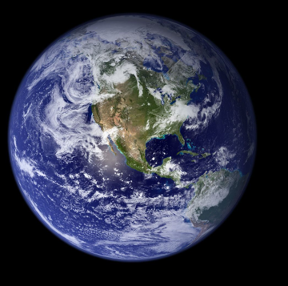
Ad Hoc AIBS Committee
• As a result of meetings of CollectionsWeb and NSF’s “Future Directions for Systematics and Biodiversity”, a common theme emerged: the systematics community lacks a united voice.
• The Ad Hoc AIBS Committee was formed at the request of systematists to propose a long-term mechanism to promote a shared agenda of systematic biologists.
• Charged with assessing if AIBS is the best organization to work with the biodiversity-related science community to develop and advance a unified policy.
Mary Liz Jameson

Slide 31
NSCA: The Natural Science Collections Alliance is a Washington, D.C.-based nonprofit association that supports natural science collections, their human resources, the institutions that house them, and their research activities for the benefit of science and society.
- headquartered in AIBS

Slide 32
Biodiversity
Collections
ADBC
NSCA
Collection Support
AIBS
One Voice
USGS
BISON

Slide 33
BIODIVERSITY
Thank you, and let’s get to 2nd base!
Photos: M. Jeffords
& G. Paulay

