Slide 1
iDigBio Management and Progress
David Jennings
iDigBio Project Manager
NSF Visit to iDigBio
May 7, 2014

Slide 2

Project Organization
Cyber-infrastructure (Fortes)
Serving the Research Community (Soltis)
Digitization (Riccardi)
Administration (Page)
Education & Outreach (MacFadden)

Slide 3
Project Oversight
Executive Committee
Steering Committee
Internal Advisory Committee
External Advisory Board
NSF Program Officers
PIs
Project Manager
PIs
Project Manager
TCNs/PENs
Project Director
Senior Personnel
Project Director
Project Manager
Biodiversity Informatics Manager

Slide 4
Strategic Plan
Define project mission, vision, & horizon
Define project organization & oversight
Establish high-level roadmaps for each domain
Perform Environmental Scan (SWOT Analysis)
Planning for Sustainability

Slide 5
Environmental Scan
 | POSITIVE | NEGATIVE
INTERNAL | Strengths – iDigBio has… Successfully engaged with the collections community, particularly through workshops and working groups Developed a vast repository of resources information Optimized digitization protocols and workflows Actively reduced barriers to digitization Demonstrated strong leadership and management Developed partnerships and collaborations, including significant synergy with TCNs, networking, and building community | Weaknesses – iDigBio has… Non-intuitive website navigation and inconsistent arrangement of resources Minimal data in specimen portal Inconsistent internal communication Insufficient involvement of smaller collections and institutions Insufficient success in promoting diversity and including under-represented groups Lack of explicitly defined of project leadership evaluation plans

Slide 6
Environmental Scan
 | POSITIVE | NEGATIVE
EXTERNAL | Opportunities – iDigBio should… Highlight research uses of data Develop digitization standards and encourage compliance Advocate for greater digitization funding and formation of cooperative groups across institutions and projects Coordinate efforts across institutions, disciplines, and agencies to bridge initiatives and facilitate networking Integrate directly with collection management software and tools Capture “dark data” from both large and small institutions Collaborate with key existing projects, such as Global Biodiversity Information Facility (GBIF) and Biodiversity Information Serving Our Nation (BISON) | Threats – iDigBio should… Develop a strategy for financial sustainability to reduce dependence on federal funding Develop a strategy for long-term storage and maintenance of its cyberinfrastructure, metadata and images Be mindful of its extremely broad project scope, which includes a vast array of collaborations and partnerships

Slide 7
Implementation Plan
Affirm project mission, vision, organization, & governance
Define project scope
Define project team, roles, & responsibilities
Identify project milestones, objectives, & strategies
Establish procedures for management of risk, change, quality, & communication

Slide 8
Project Milestones

Slide 9
Internal Feedback

Slide 10
Key iDigBio Accomplishments
Digitization Resources
https://www.idigbio.org/wiki/index.php/Digitization_Resources
Workshops and Training
https://www.idigbio.org/wiki/index.php/IDigBio_Workshops
Working Groups
https://www.idigbio.org/wiki/index.php/IDigBio_Working_Groups
Collaboration & TCN Support
https://www.idigbio.org/wiki/index.php/TCN_Resources
Cyberinfrastructure
  Website upgrade www.idigbio.org
  Portal upgrade www.idigbio.org/portal New version just released!
  Data & media ingestion
  https://www.idigbio.org/wiki/index.php/Data_Ingestion_Report
  https://www.idigbio.org/portal/publishers

Slide 11
External Advisory Board Feedback
The EAB was pleased with iDigBio’s progress:
  Valuable service & role as digitization clearinghouse
  iDigBio workshops & symposia highly valued
  Strong focus on digitization & cyberinfrastructure
Recommendations:
  Consider requirements needed for taxonomic hierarchy
  Consider our dual role in organizing geospatial data and the higher value role as a metadata catalog for materials
  Serve iDigBio data to GBIF
iDigBio is currently working to rotate EAB membership

Slide 12
Overall Community Feedback
What grade would you give iDigBio in moving forward national digitization efforts?

Slide 13
Workshops and Training
 | Total Number of Workshops, Summits, & Symposia | Total Number of Participants | Number of Unique Participants | Number of Unique Institutions
Fiscal Year 1 | 5 | 175 | 128 | 65
Fiscal Year 2 | 12 | 394 | 282 | 160
Fiscal Year 3 | 21 | 702 | 487 | 219
OVERALL | 38 | 1271 | 710 | 309

Slide 14
Workshop Demographics

Slide 15
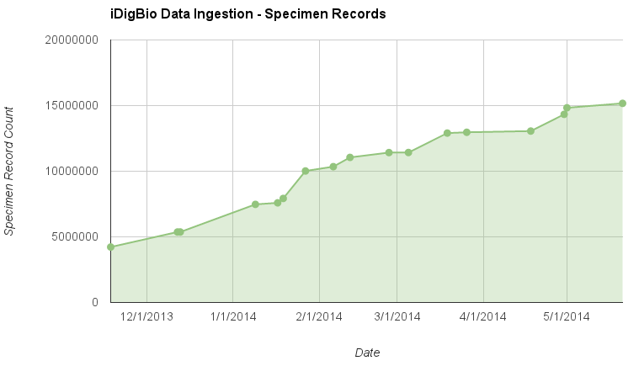
Data Ingestion: 15,621,986 Specimen Records

Slide 16
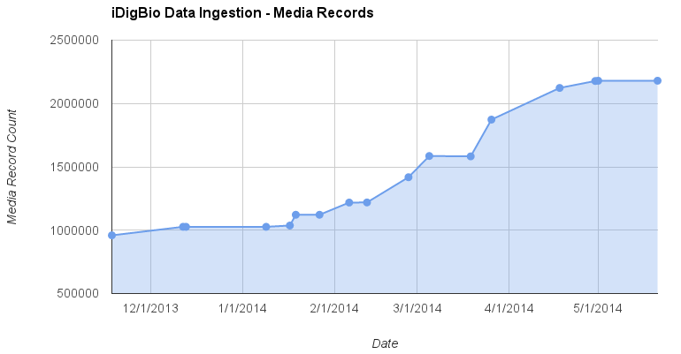
Data Ingestion: 2,385,568 Media Records

Slide 17
Community Feedback

Slide 18
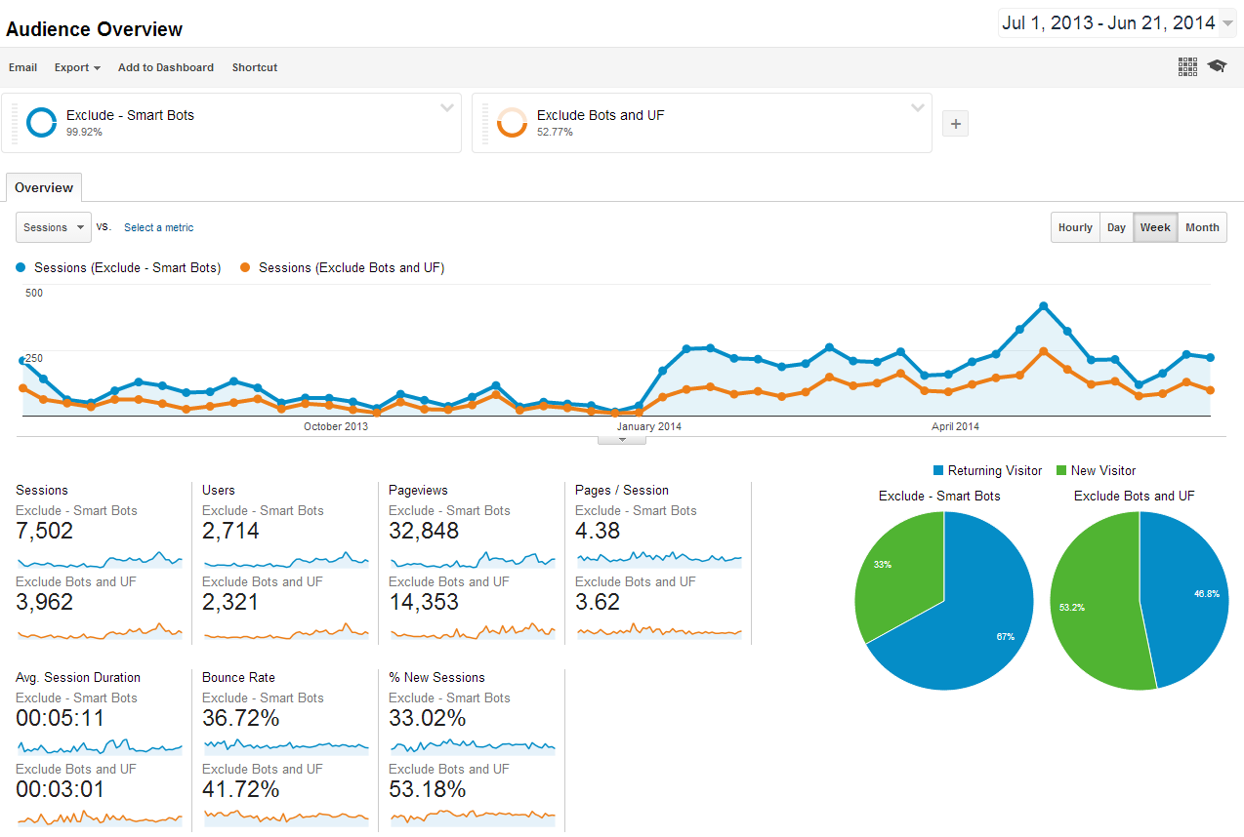
Portal Traffic

Slide 19
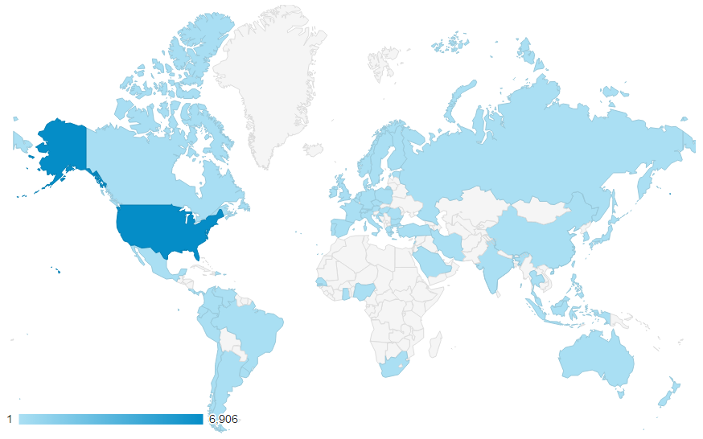
Portal Reach

Slide 20
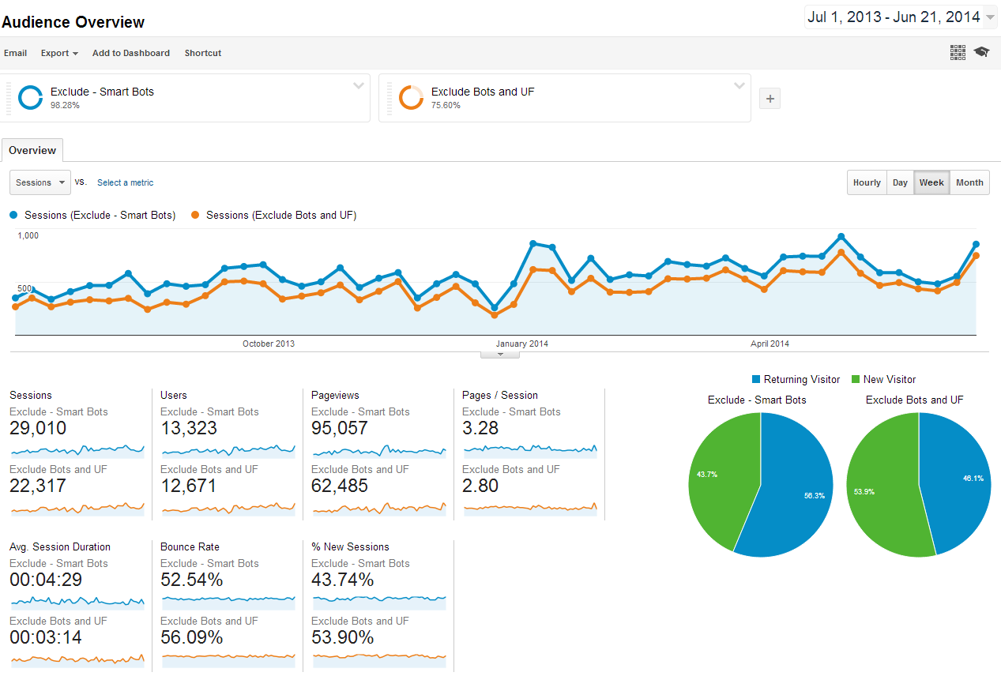
Website Traffic

Slide 21
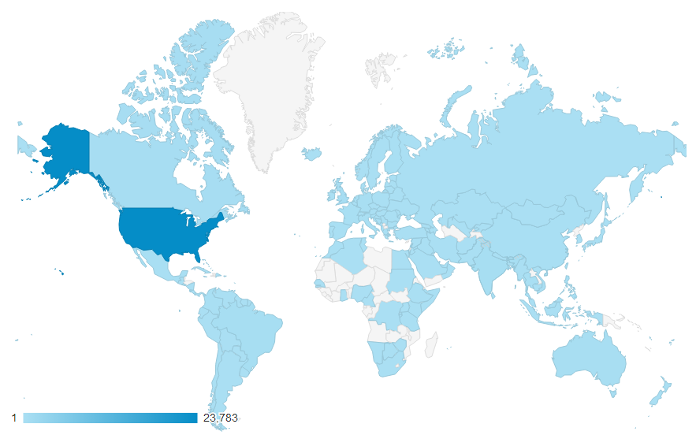
Website Reach

Slide 22
Community Feedback

Slide 23
Collaboration – Adobe Connect
 | FY1 | FY2 | FY3
Total Users | 40 | 65 | 192
Total Hosts | 12 | 26 | 38
Distinct Meeting Rooms | 37 | 62 | 75
Total Meeting Hours | 768 | 4,429 | 7,522
Total Host Hours | 304 | 2,182 | 2,737
Peak Concurrent Users | 22 | 44 | 102
System Storage Consumption (GB) | 11.4 | 19.2 | 55.7
Meeting Storage Consumption (GB) | 23.9 | 21.7 | 28.4

Slide 24
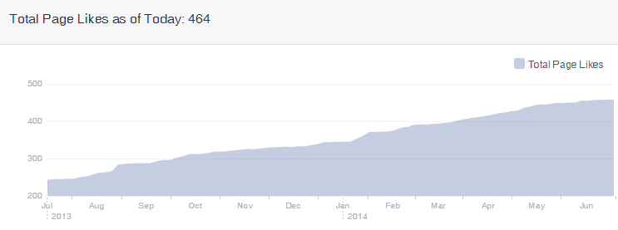
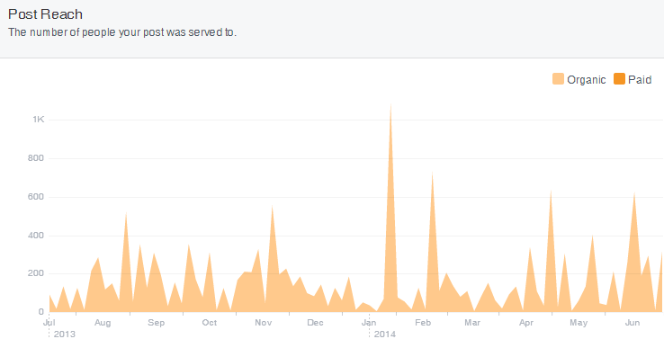
Social Media – Facebook

Slide 25
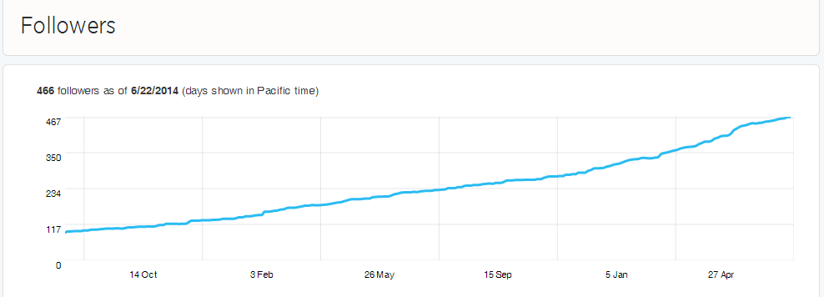
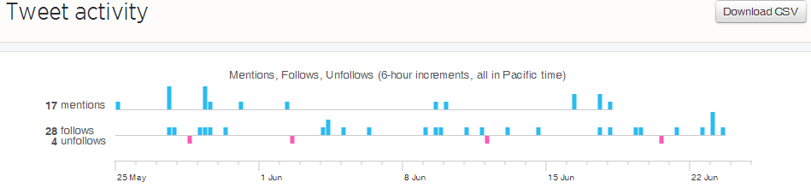
Social Media – Twitter

Slide 26
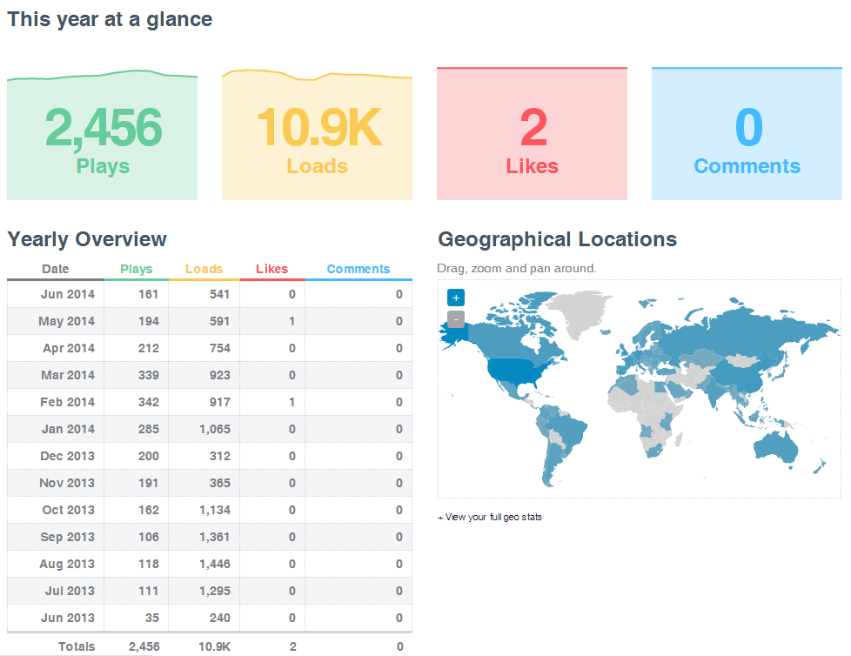
Social Media – Vimeo

Slide 27
Community Feedback

Slide 28
Community Feedback

