Slide 1
Research Goals for Year 4
Link specimen records to GenBank accessions through vouchers
Encourage use of iDigBio data by community
Encourage contribution of data
Consider development of US Virtual Herbarium portal using iDigBio data and API
Develop plan for integrated analytical framework with Open Tree of Life, Lifemapper, Arbor, etc.
Develop plan for workbench for managing and analyzing data

Slide 2
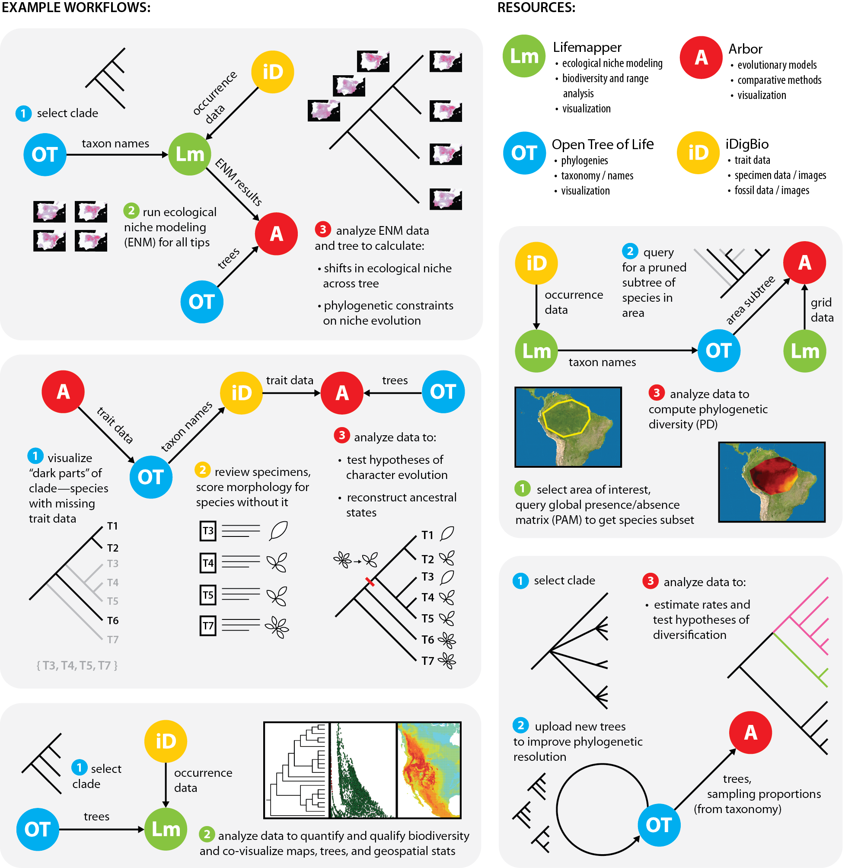
Connecting Trees, Specimens, Tools
Notes:
Several possible use cases involving specimen data, trees, and applications are illustrated here.

