Slide 1
Sharing Data
#idigtorch
Data Extraction and Identifiers
24 May 2014
TORCH VIII + iDigBio Digitization Workshop
Deborah Paul, on Twitter @idbdeb @idigbio
Sul Ross State University, Alpine, Texas
Notes:
http://www.tagxedo.com/artful/f0bf2d1fc7a84a26
Collecting, Publishng, Using, Reusing Data
revisualization
decisions / opportunities / options
enhanced / curated data
data quality / data enhancement / data discovery
the big picture
GUIDS and associated identifiers
a common language
data export - data import
data management skills (biodiversity informatics)
where to share
everywhere
We look forward to your input & your data!

Slide 2
Care and feeding of (clean) data
Fit-for-research-use-data
(Getting data into your database)
Getting the data out of your database
“Mapping” your data to standard terms
Your objects need identifiers
Semi-automated data-sharing
What to expect – data feedback
data quality issues
data enhancement
It’s a partnership
we are all custodians of these new digital resources
we are care-takers of the data, stewards
integral to care of the physical specimens

Slide 3
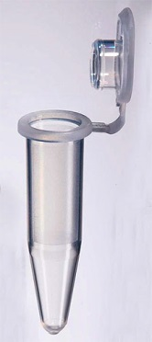
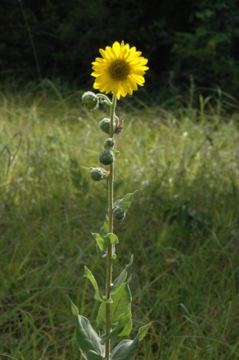
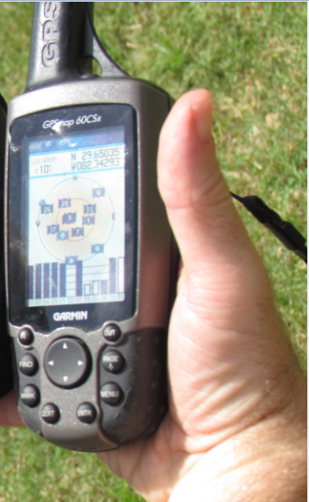
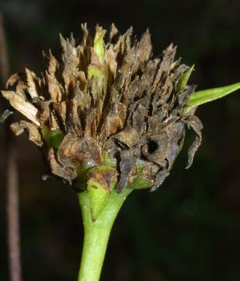
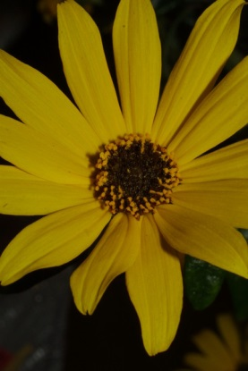
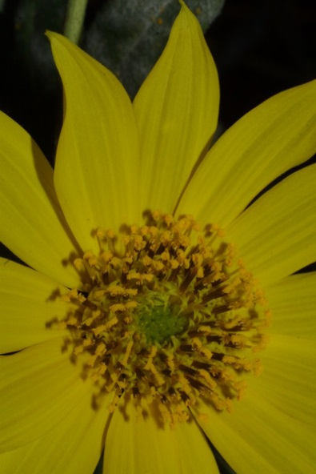
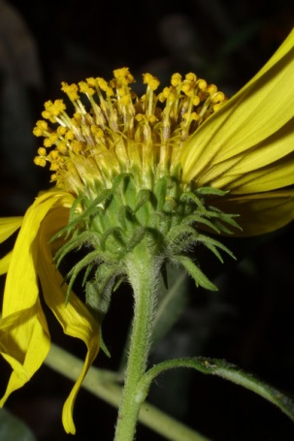
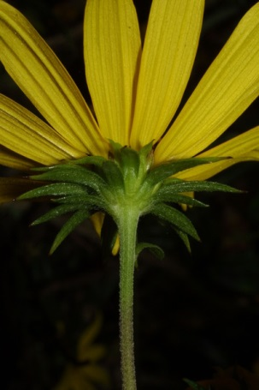
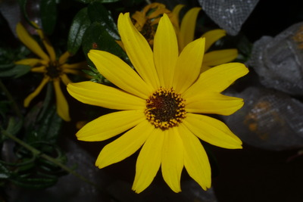
Collecting Data
Notes:
Trend > proactive digitization (no more legacy data).
Legacy practices
traditional data
New trends
absence data
richer metadata provided / wanted / needed
born digital
Best practices
storing
mapping
sharing
Expectations
annotation ontology example
researcher collects data
organizes it for their purpose (publishing)?
or not
non-standard metadata
non-standard file formats, file-naming, packaging
user file system
unique
sometimes enigmatic?
http://www.morphbank.net/?id=551005
http://herbarium.bio.fsu.edu/view-specimen.php?RecordID=22924
Mast, A. R., A. Stuy, G. Nelson, A. Bugher, N. Weddington, J. Vega, K. Weismantel, D. S. Feller, and D. Paul. 2004 onward (continuously updated). Database of Florida State University's Robert K. Godfrey Herbarium. Website http://herbarium.bio.fsu.edu/ [accessed 06 December 2013].
http://www.morphbank.net/?id=817663
http://www.morphbank.net/?id=816417
http://www.morphbank.net/?id=817662
http://bioimages.vanderbilt.edu/ind-baskauf/43875
Vanderbilt University, Nashville, Davidson County, Tennessee, US Click on these geocoordinates to load a map showing the location: 36.14528°, -86.80106° Coordinate uncertainty about: 20 m
http://www.morphbank.net/?id=817661
http://www.morphbank.net/?id=817673
http://www.morphbank.net/?id=817674
http://www.morphbank.net/?id=820776

Slide 4
Identifiers are like Elvis, … or Drosophila melanogaster

Slide 5
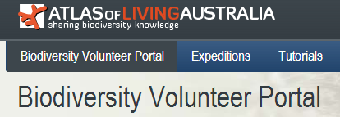
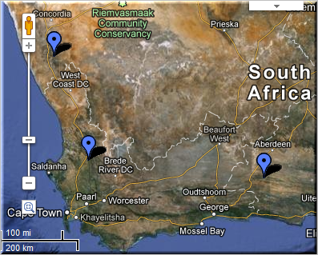
FilteredPUSH
GenBank
Identifiers
Kepler Kurator
D I S C O V E R L I F E
Cladistics ®
Notes:
Sharing Data.
GUIDs are the Key
specimen database
aggregators / portals – iDigBio, GBIF, EOL
ontologies- BioPortal
publications
maps
databases – GenBank, BOLD
provider websites – a museum may have their own portal
data repatriation, enhancement – Filtered PUSH
data cleaning / cleansing – Kepler Kurator, Google Refine
provider sites – http://herbarium.bio.fsu.edu
consortium websites through portals: http://symbiota.org/tiki/tiki-index.php?page=Data+Nodes
SERNEC, North American Bryophyte and Lichen Consortia, SEINet
Revisualization - discovery
Unforseen errors revealed
Taking it in stride
Opportunities, Benefits, Decisions
Specify’s Scatter-Gather-Reconcile (SGR)
duplicates found
dataset for checking is increasing in size
example, at least 50% dupes
lending credence to the skeletal dataset concept
Filtered PUSH (works with Specify, Symbiota and Morphbank)
finding dupes
the benefits of shared datasets
lending credence to the skeletal dataset
finding annotations (determinations, general comments)
to import or not to import

Slide 6
Identifier types
Content-rich identifiers contain information
Simple identifier, attached to specimen
Number stamped on band: 1154
Catalog number
Compound identifier: globally unique
Darwin core triple (institution, collection, catalog number)
(BOTF, finch, 1154)
URI (uniform resource identifier): internet friendly
http://beaks.org/finch/1154
Content-free identifiers
Cannot be parsed, remembered or typed
urn:uuid:40c842c9-c04c-489a-b20e-d84bfc16dedd6

Slide 7
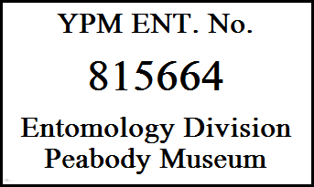
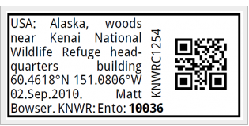
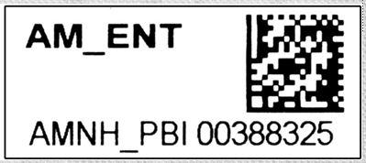
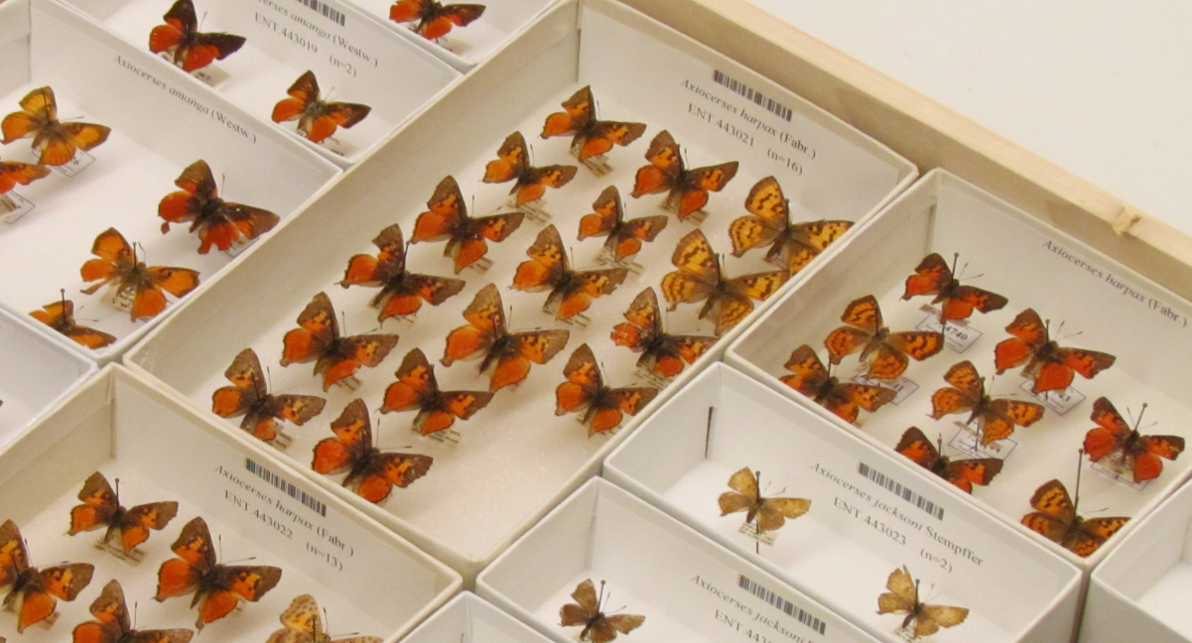
Notes:
identifiers slide – they are (already) going everywhere
example: your multiple jobs (job identifier), but only one ssn for reporting income to IRS

Slide 8
Identifying Objects
urn:uuid:b1495230-ac34-42ea-b6b7-7af8b9f1b212
Add column to data record for a globally unique, persistent identifier.
UUID or GUID does not have to appear on the specimen itself.
Resolver
http://www.talltimbers.org/museum.html#Birds:279
urn:uuid:3Ab1495230-ac34-42ea-b6b7-7af8b9f1b212

Slide 9
Maintaining and Sharing Identifiers
apply a given id to only one object ever
if something happens and that object no longer exists in the physical collection –
never reassign the identifier to another object in the collection
missing numbers do not matter
(share the ones you know about)
Now that we have identifiers … what next?
Notes:
For more on GUIDs for upload to iDigBio,
see our suggestions / policy at:
https://www.idigbio.org/sites/default/files/iDigBio-GUID-Statement20MAR2012.pdf
For more about how GUIDs will make all of this work for us
See biscicol
http://biscicol.blogspot.com/2012/08/the-biscicol-project-team-has-had-busy.html

Slide 10
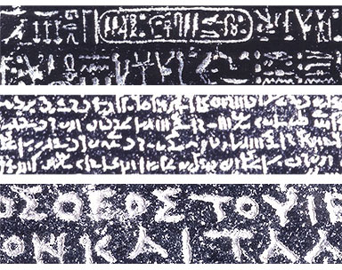
Sharing requires standard terms
My field notes?
Your field notes?
map to a standard!
http://www.britishmuseum.org/images/rosettawriting384.jpg
Notes:
Why darwin core / georeferencing standards?
http://prezi.com/iib3pqk-kyd-/curators-workbench/
Why care about standards? What do they have the potential to accomplish?
Collection Managers are doing what they need to do – for themselves, their collections.
When we share, we need standards.
Data becomes useful for others / other purposes.
a common vocab is required
Feedback and Attribution become possible.
The collection gets used, more, increasing the value of the collection.
indirect, subtle
Putting identifiers on specimens --- makes more useful to others.
consistency is important!

Slide 11
Sharing Requires Standard Terms
Darwin Core Location Terms
higherGeography
waterbody, island, islandGroup
continent, country, countryCode, stateProvince, county, municipality
locality
minimumElevationInMeters, maximumElevationInMeters, minimumDepthInMeters, maximumDepthInMeters
Darwin Core Event Terms
habitat
Darwin Core Geological Context
group, formation, member, bed, …
Notes:
These are darwin core concepts. Standard terms. Data relevant to many of these fields is regularly found on our herbarium labels and in field notebooks.
It is the information in these that we will use to generate a numerical description of the collecting event locality – in other words, a georeference.
http://rs.tdwg.org/dwc/terms/#dcterms:Location
http://rs.tdwg.org/dwc/terms/#Event
http://rs.tdwg.org/dwc/terms/habitat
dcterms:Location
locationID | higherGeographyID | higherGeography | continent | waterBody | islandGroup | island | country | countryCode | stateProvince | county | municipality | locality | verbatimLocality | verbatimElevation | minimumElevationInMeters | maximumElevationInMeters | verbatimDepth | minimumDepthInMeters | maximumDepthInMeters | minimumDistanceAboveSurfaceInMeters | maximumDistanceAboveSurfaceInMeters | locationAccordingTo | locationRemarks | verbatimCoordinates | verbatimLatitude | verbatimLongitude | verbatimCoordinateSystem | verbatimSRS | decimalLatitude | decimalLongitude | geodeticDatum | coordinateUncertaintyInMeters | coordinatePrecision | pointRadiusSpatialFit | footprintWKT | footprintSRS | footprintSpatialFit | georeferencedBy | georeferencedDate | georeferenceProtocol | georeferenceSources | georeferenceVerificationStatus | georeferenceRemarks
GeologicalContext
geologicalContextID | earliestEonOrLowestEonothem | latestEonOrHighestEonothem | earliestEraOrLowestErathem | latestEraOrHighestErathem | earliestPeriodOrLowestSystem | latestPeriodOrHighestSystem | earliestEpochOrLowestSeries | latestEpochOrHighestSeries | earliestAgeOrLowestStage | latestAgeOrHighestStage | lowestBiostratigraphicZone | highestBiostratigraphicZone | lithostratigraphicTerms | group | formation | member | bed

Slide 12
Darwin Core Standard
Darwin Core (often abbreviated to DwC) is a body of data standards which function as an extension of Dublin Core for biodiversity informatics applications, establishing a vocabulary of terms to facilitate the discovery, retrieval, and integration of information about organisms, their spatiotemporal occurrence, and supporting evidence housed in biological collections. It is meant to provide a stable standard reference for sharing information on biological diversity[1]
Does Darwin Core cover every field possible? – No
Don’t panic! There are extensions and other standards.
http://rs.tdwg.org/dwc/terms/

Slide 13
From the Label, Notebook, …
mapping
field notes / Excel
your database field
darwin core
41 05 54S
121 05 34W
WGS84
2 mi. NE Tlh. on Ctrville Rd.
Tallahassee, 2.5 miles NE on Centerville Road.
frequent
Wakulla.
in moist roadside depression, …
lat or latitude
lon or long or longitude
datum or notes or …
loc or location or collectorLocality or …
abundance
county
hab or habitatDescription or …
verbatimLatitude
verbatimLongitude
verbatimSRS
verbatimLocality
locality
(abundanceAsPercent)
county
habitat
Note
Notes:
(SRS) = Spatial Reference System
This slide emphasizes the vocabulary one might encounter during the digitization process. The fact that a label on a herbarium sheet, a field in your database, and the darwin core term for sharing data about that concept – might be the same, or very different. It is important to understand that the (Darwin Core) concepts have definitions – and to put in a field, only what is supposed to go into it. It is important when mapping your database to a standard, that the mapping is correct. This is important when we share data so that we have confidence about what is contained and “mashed up” from many sources into one database.

Slide 14
Data Mapping & Export
Herbarium A
barcode
collectorNumber
collector
Herbarium B
accessionNumber
collectorNum
collectedBy
Darwin Core
catalogNumber
recordNumber
recordedBy
All mapped up and ready to go – now what?
Data Export Example.
How do you get your data out of your database?
Schema Mapper tool
Data Exporter tool > creates a temporary table in your database
Data Exporter > tab-delimited text file for import into IPT
Install IPT, Register at GBIF using the IPT
Use the text file with the IPT for upload to GBIF, some mapping may be required
Publish your data
Extensions for more data types: e.g. Audubon Core for Media files
Notes:
http://www.slideshare.net/nielsklazenga/specify-6byandybentley-2

Slide 15
Data Export
General users download occurrence data from search page as Darwin Core CSV files or raw Symbiota
Data managers
create backup file as a compressed set of Symbiota CSV files (occurrences, determination history, and image links)
IPT instances are set up for the portals on the Symbiota servers (Lichens, Bryophytes, SCAN, MycoPortal, SCNet).
each collection can choose to send data to GBIF themselves or
via the portal.
Future: Symbiota
automated packaging of data as Darwin Core archive files.
Control panel, collection managers refresh the DwC archive whenever they wish.
the ability to turn on or off publishing.
Notes:
From Ed Gilbert
General data users can download occurrence data from the search page as Darwin Core CSV files or raw Symbiota
Data managers can save a backup file as a compressed set of Symbiota CSV files (occurrences, determination history, and image links)
We (Symbiota) have setup IPT instances for the portals on the Symbiota servers (lichens, bryophytes, SCAN, and MycoPortal). We are now going to ask each collection if they want us to publish their data to GBIF in their name. Collections that are already publishing their data on their own will not be published again through the portal.
Future: Symbiota will have the built-in capability of packaging data as Darwin Core archive files. Through the control panel, collection managers will have the ability to refresh the DwC archive whenever they wish. They will also have the ability to turn on or off publishing.

Slide 16
Data Export
Each NHM client
initial mapping process with EMu staff
mapping to DwC 1.2 (aka v2)
use Automated Export to create desired file
CSV
text
Crystal Report
use DwC CSV file with IPT to create DwC-A file
DwC-A file is shared with GBIF
GBIF – harvests periodically

Slide 17
One Pathway to sharing?
Discoverability
Identifiers are key
Metadata is key
for use / re-use / re-purpose
Data in more than one place
+ Aids discoverability
- Can be a issue to track
Identifiers help
Dataset identifiers too

Slide 18
More Ways to Share Data
Thematic Collection Networks (TCNs)
have data ready to share?
fits a current TCN theme?
Partners to Existing Networks (PENs)
join the effort
Through an existing portal or repository
Symbiota
Many portals to choose from
VertNet
Morphbank
GBIF
Help is everywhere!

Slide 19
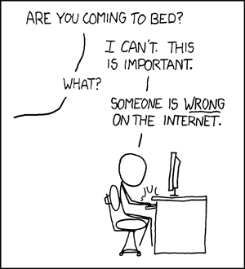
http://imgs.xkcd.com/comics/duty_calls.png

Slide 20
Sharing Brings Opportunities, Benefits, Decisions
Revisualization - discovery
Unforseen errors / relationships revealed
Recent Morphbank – SERNEC Symbiota Portal example
Taking it in stride
Specify’s Scatter-Gather-Reconcile (SGR)
duplicates found
dataset for checking is increasing in size
example, at least 50% dupes
lending credence to the skeletal dataset concept
Filtered PUSH (works with Specify, Symbiota and Morphbank)
finding dupes
the benefits of shared datasets
enhancing the skeletal (or short) record
finding annotations (determinations, general comments)
to import or not to import
More Loans, Exposure for your collection, $

Slide 21
Where do the standard terms come from?
Biodiversity Information Standards (TDWG)
formerly known as
Taxonomic Databases Working Group (TDWG)
began 1985
Our Mission
Develop, adopt and promote standards and guidelines for the recording and exchange of data about organisms
Promote the use of standards through the most appropriate and effective means and
Act as a forum for discussion through holding meetings and through publications
Notes:
http://www.tdwg.org/activities/
https://mbgserv18.mobot.org/ocs/index.php/tdwg/2013/schedConf/presentations

Slide 22
Identifiers
Lots of uncertainty in community
What form of identifiers, what services to provided, etc.
We need to
Emphasize identification of specimens and other objects
Help providers to see value of specimen identifiers
Remove obstacles to adoption
E.g. validate and advocate standard practice in collections management
Move forward in spite of problems
Current suggestion
UUID as basis of identifier
URI with embedded UUID
urn:uuid:f47ac10b-58cc-4372-a567-0e02b2c3d47
ark:/87286/B2/f47ac10b-58cc-4372-a567-0e02b2c3d479

Slide 23
Conclusions
IF we want to provide, and use fit-for-research data, then
Must have identifiers for objects
Especially occurrences
Must have agreement on properties (standard terms)
Must have strategy for representing relationships
In provider databases
In repositories
In transit

Slide 24
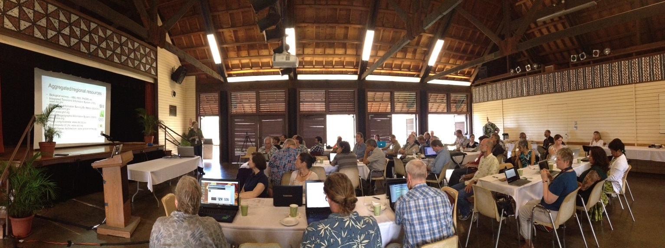
At iDigBio, we look forward to your continued input.
We need your voices.
Our planet needs the fit-for-use data.
Please Share Yours
Notes:
Database modification to store more identifiers
Community practice for collections to
Share
Store
Publish
Researcher practice to
Create
Share
Store
Publish
Standards best practices for everyone
Goals
Use <-> Re-use
Linked Data (aka the Semantic Web)
Discoverability
Expect more data
Inspect the data
caveat emptor
Annotate
your expertise, your voice
Biodiversity Data Journal
Publish directly to GBIF
…
Identifiers
Data set level
Record set level

