Slide 1
Herbarium Digitization
Overview and Guide to Resources
24 May 2014
TORCH VIII + iDigBio Digitization Workshop
Deborah Paul, on Twitter @idbdeb
Sul Ross State University, Alpine, Texas

Slide 2
Biodiversity Digitization: Ultimate Goals
Output level:
An abundance of scientifically useful and accessible data.
Constituency level:
High quality exposure of the content and value of scientific collections.
Improvement level:
Collaboration and workflow sharing across the collections community (worldwide).
Notes:
useful:=fitness, robustness, usability, discoverability, elucidation, new knowledge

Slide 3
Digitization Decision Making
Global Needs and Policies
Local Policies and Decisions
Specific Workflows
What to digitize?
Can we digitize every bit of data associated with each object?
Skeleton records?
How to decide?

Slide 4
Balancing the long view with the short view: The local decision
Long view
Short view
How does an institution develop doable, effective, and sustainable strategies for balancing long term goals with short term constraints, including a commitment to implementing future enhancements?
Pressures mitigating the long view
So much data, so little time.
Collections are not getting smaller (proactive vs. legacy).
Funding agencies have high output/low cost expectations.
We only have 3 years to get this done (sustainable models?).
All of our data and all of our specimens are important.
Let’s just use the images!
We’ll do the minimum now and enhance it later (inside track).
Notes:
See the long view as our goal; see the short view only as a set of constraints, not as an end

Slide 5
Future tools favoring the short view
OCR, NLP, and ICR (handwriting analysis) improvements.
Automated image analysis for data extraction.
Data mining of labels.
Robotic technologies, conveyor belts, etc.
Improvements in discovery/capture/use of duplicates.
Improvements in voice recognition and other data entry technologies.
Post-digitization tools for curation and quality control.
Field data capture.

Slide 6
Digitization Continua/Decision Points
Outside Track
Inside Track
Current tools
Maximum fitness
High cost/specimen
Efficiency
Digital protocols
Image everything
Ancillary materials
Evolving workflows
Potential future tools
Maximum output
Low cost/specimen
Speed
Traditional practices
Image nothing
Specimens only
Static workflows
Image exemplars
Notes:
Here is a non-exhaustive list of global continua. Left column represents the outside track, right column, the inside track. This is not a set of continua of good and evil. Our challenge is to find balances in our workflows that ensure an appropriate level of affordable quality now that anticipates future tool enhancements.

Slide 7
Long view Short View
Facilitators
Facilitators
Emphasize fitness for use
Robust datasets
Data validation/cleaning
Integrated quality control
Integrated georeferencing
Intensive curation
Record historical annotations
Staff specialization
Small collection
Emphasize images
High quality images
Emphasize output
Spartan datasets
Defer validation/cleaning
Deferred/minimum quality control
Deferred georeferencing
Deferred or cursory curation
Record current determination
Staff generalization
Large collection
Emphasize data
Low quality images
Robust
Spartan
Notes:
Again, left column largely represents the outside track, right, inside track.

Slide 8
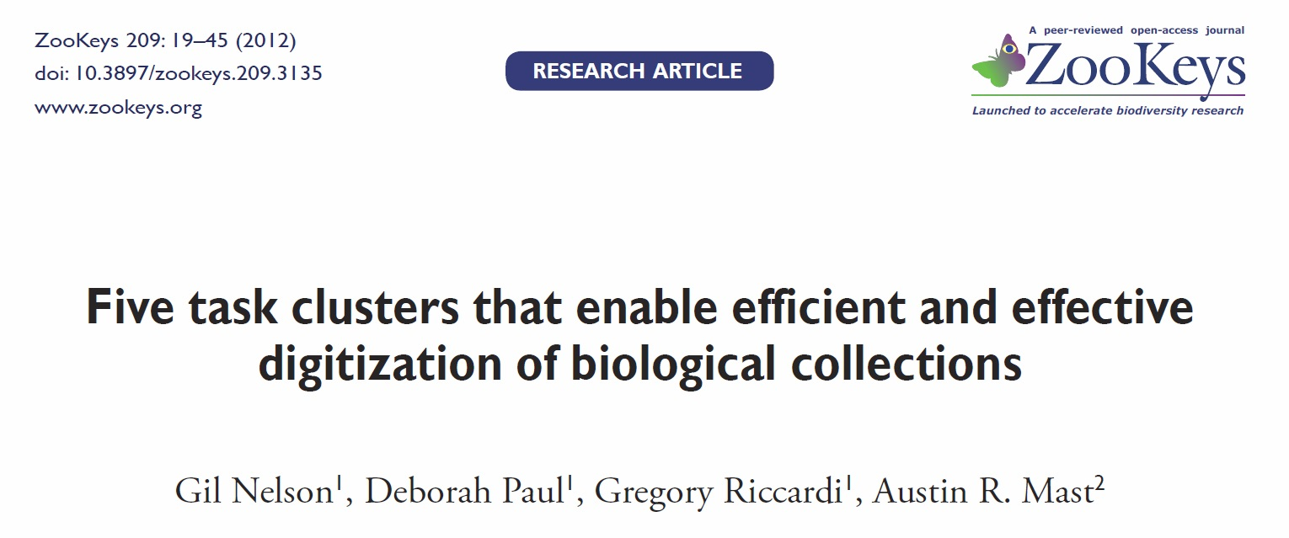
Establishing a Baseline
Find out what is going on in digitization
Benchmarking
Grounded Theory
Survey
Notes:
Link to Paper: http://www.pensoft.net/inc/journals/download.php?fileId=4794&fileTable=J_GALLEYS

Slide 9
KEY Clusters
Image Capture
Georeferencing
Image Processing
Pre-digitization Curation or
Staging
Personnel
Data Capture
Image / Data Storage
Biodiversity Informatics Manager
Written
Workflows

Slide 10
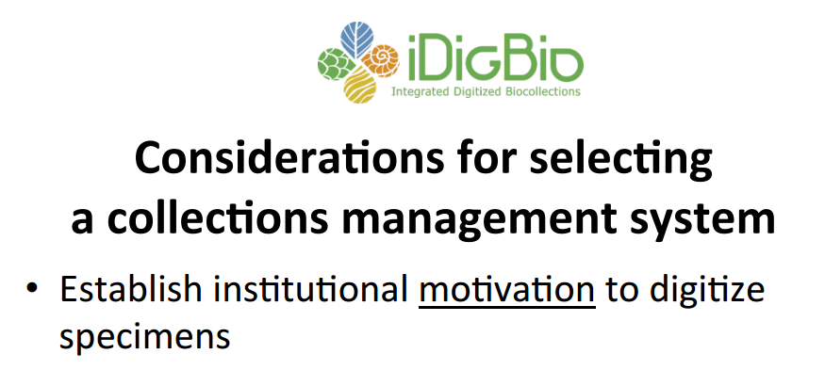
What database? What suits best?
by Joanna McCaffrey, Digitizing Plant Specimens Workshop, 2012

Slide 11
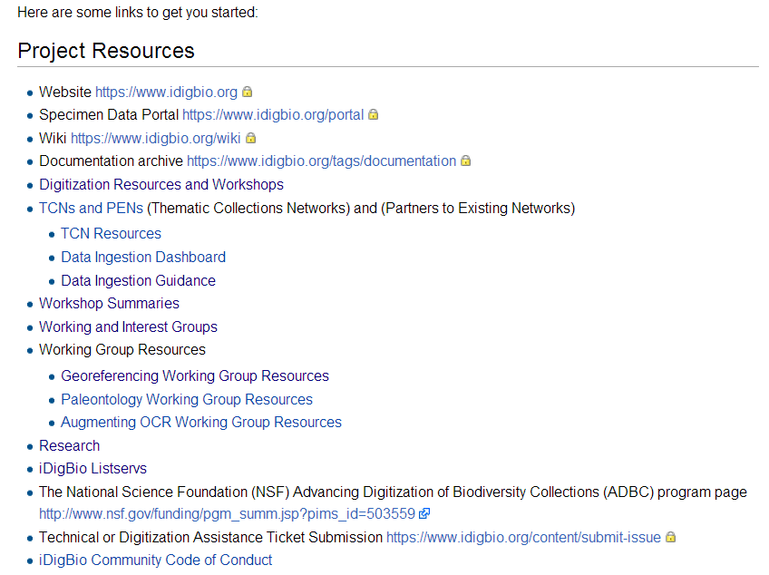
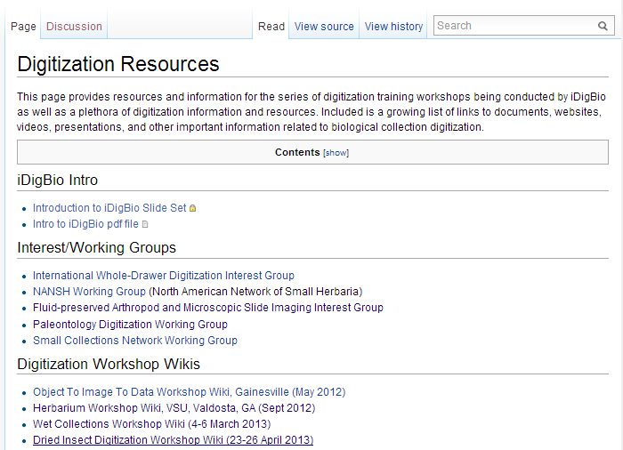
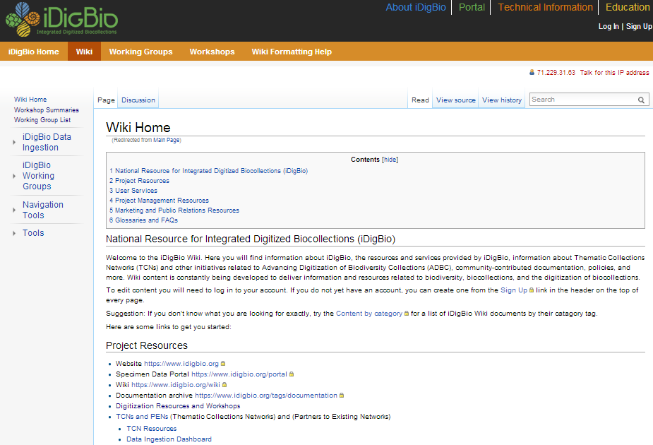
Website – Portal - Wiki
www.idigbio.org/wiki
Digitization
Workflows and Protocols
Flat things
Quick Start

Slide 12
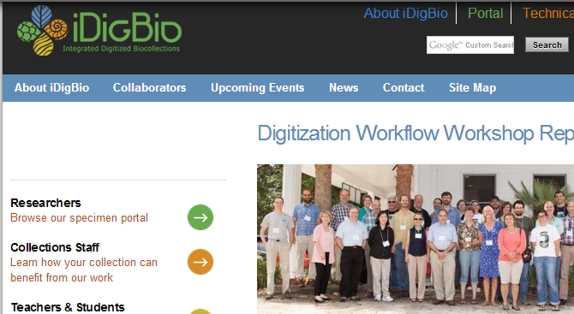
Developing Robust Object to Image to Data Workflows (DROID)
Workshop design collaborative
Scientific Software Innovation Institutes
Yale Peabody Museum
Biodiversity Institute, KU
iDigBio

Slide 13
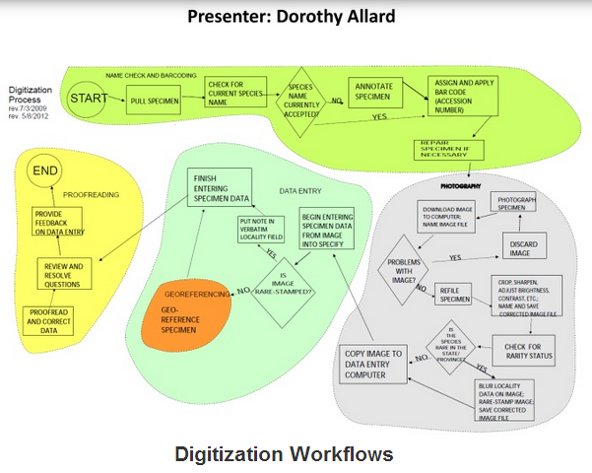
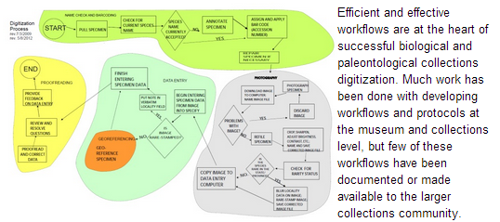
DROID 1: Flat Things
Your Input
Notes:
https://www.idigbio.org/content/digitization-workflows
Posted To Collaborative Workflows Page Linked to the Digitization Resources Wiki

Slide 14
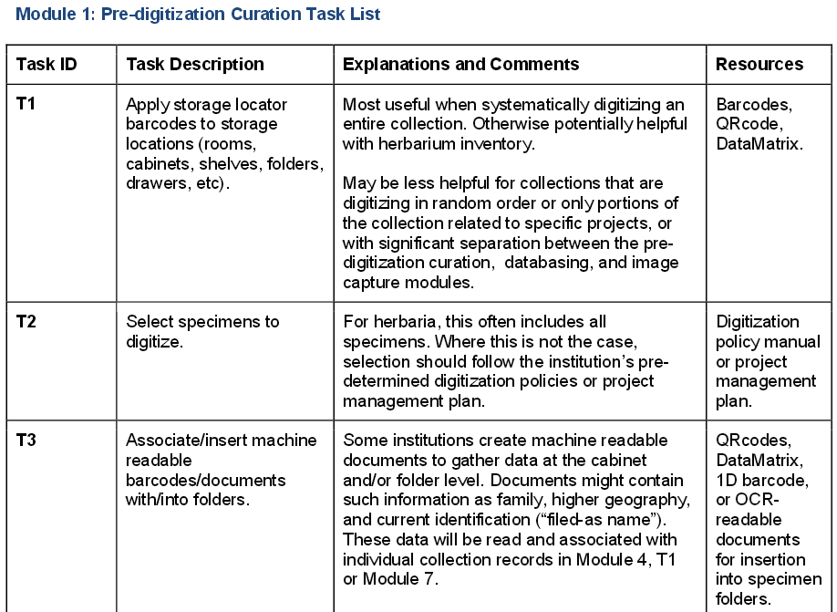
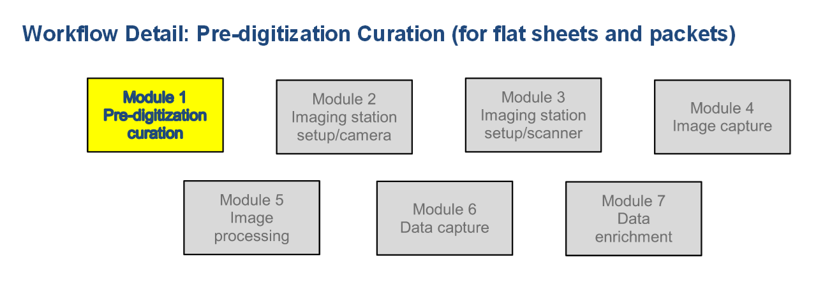
DROID II – Pinned Things
Notes:
https://www.idigbio.org/sites/default/files/sites/default/files/Module_1_Pre-digitization_Curation_Tasks_0.pdf
for Flat things

Slide 15
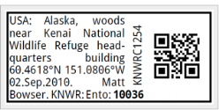
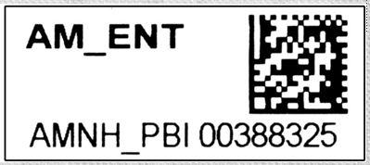
Predigitization Curation, AKA Staging
Personnel
Activities
taxonomic judgment
personnel management
uses standard references
keen observational skills
specimen-handling skills
select specimens to image
Determination/annotation
(a professional)
Data verification
(a professional)
Drawer/cabinet organization
(trained techs)
Re-pinning
(trained techs)
Barcode application
(trained techs)
Not all steps require a professional
Curation is a potential bottleneck

Slide 16
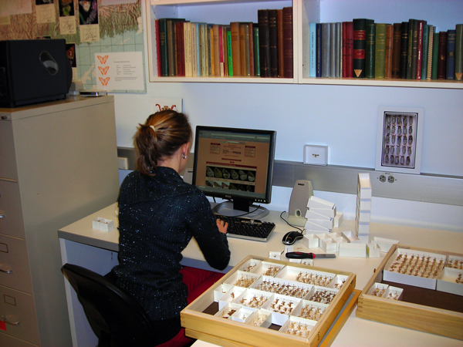
Predigitization (unanticipated) Benefits
inspect /repair / specimen damage (ipm)
collection health,
inventory collection,
re-pin / remount specimens
replenish / replace preservatives
attach a unique identifier
(most often a 1- or 2-D barcode)
to a specimen, container, or cabinet,
discover important but
unknown, lost, or dislocated holdings
(e.g. those owned by other institutions or the federal government),
update nomenclature and taxonomic interpretation,
reorganize the cabinets, cases, trays, and containers,
vet type specimens, and
select exemplars for digitization / imaging
Notes:
Collections managers reported that pre-digitization curation
and staging also provides unanticipated benefits, including
opportunities to: (see slide)
inspect /repair / specimen damage collection health (route to conservation),
inventory collection,
re-pin / remount specimens and replenish / replace preservatives in containers,
specimen ipm,
attach a unique identifier (most often a 1- or 2-D barcode) to a specimen, container, or cabinet,
discover important but previously unknown, lost, or dislocated holdings (e.g. those owned by other institutions or the federal government),
update nomenclature and taxonomic interpretation,
reorganize the contents of cabinets, cases, trays, and containers, especially when these are the units of digitization,
vet type specimens, and
select exemplars for digitization / imaging, when that approach is appropriate.

Slide 17
Data Capture
Discipline-specific training or interest is often not particularly important
Data Capture is a potential bottleneck
Personnel
Process
Accurate
Efficient
Focused
Tolerant of tedium
Productive
Speedy
Oriented toward improving process
Keyboarding
Voice capture
OCR
QC
Data extraction
Barcode value extraction
Data import
Source Documents
Data Import Issues
Specimens/labels
Images
Ledgers/catalogs
Field notebooks
Monographs
Source
Internal (legacy)
External
Data quality/trust
Data format
Transformation/field mapping
Post-import cleanup and quality control
Importance of written protocols

Slide 18
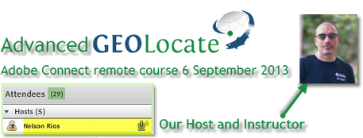
Georeferencing Working Group (GWG)
Current Resources
Train-the-Trainers (TTT) I and II
Online Workshop Resource
Human Resources
Workforce Training
listserve
http://vimeo.com/idigbio
http://vimeo.com/idigbio/albums
Ongoing Work
online training materials,
Webinars
Georef Workflows Help
Georef Workshop Protocols
Facilitating Georef Workshops
http://www.georeferencing.org

Slide 19
Review I
Global decisions
Deciding to digitize (Digitization Maturity)
Funding
Information, Library Science, Museum Studies
Funding (IMLS, CLIR)
Expertise
Partners
Deciding what to digitize
Choosing collection management software
Benchmarking – best practices discovery, group by Digitization task clusters
Predigitization curation
Data Capture
(Imaging)
Personnel
Georeferencing

Slide 20
Review II
Developing robust object-to-image-to-data workflows (DROID)
Benefits of digitization
Importance of written protocols
Creating, managing workflows and protocols
Feedback
Sharing yours (DROID)
Data from specimens or data from images?
Workflow and data entry efficiency (bottlenecks)
(Barcodes)
The planet, needs the data.

Slide 21
To and our Sul Ross State hosts,
Thank you!

