Slide 1
Overview of iDigBio Resources
Website, Portal, Wiki
Workshops, Working Groups, Listservs, TCNs
24 May 2014
TORCH VIII + iDigBio Digitization Workshop
Deborah Paul, on Twitter @idbdeb
Sul Ross State University, Alpine, Texas

Slide 2
Overview
Organizational View
Website
Portal
Wiki
Workshops, Webinars, Co-located Events
Upcoming, Your Input
Working Groups
Listservs
TCNs
Notes:
NIBA: Networked Integrated Biocollections Alliance
ADBC: Advancing Digitization of Biodiverstiy Collections

Slide 3
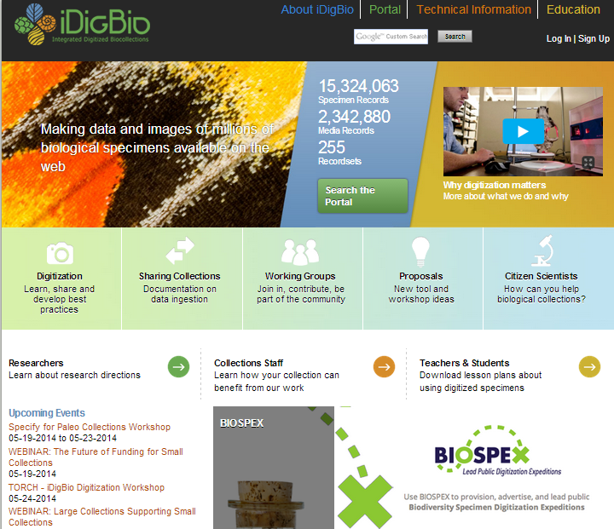
Website – Portal - Wiki
Sign Up
www.idigbio.org
Events!

Slide 4
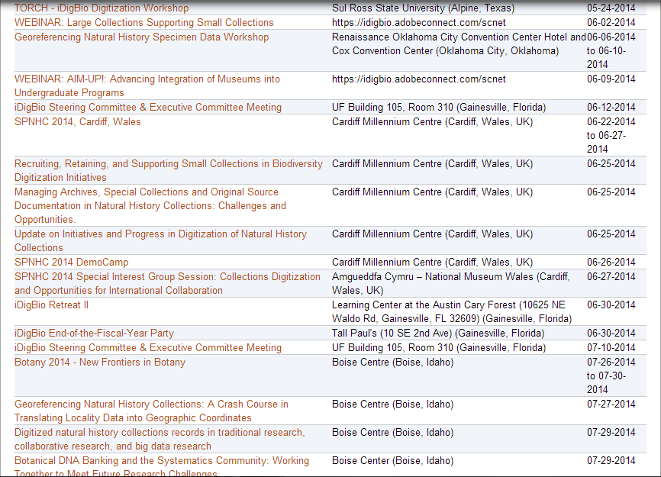
Opportunities
Upcoming iDigBio Workshops, Symposiums, Webinars, …
https://www.idigbio.org/outreach-events-sidebar

Slide 5
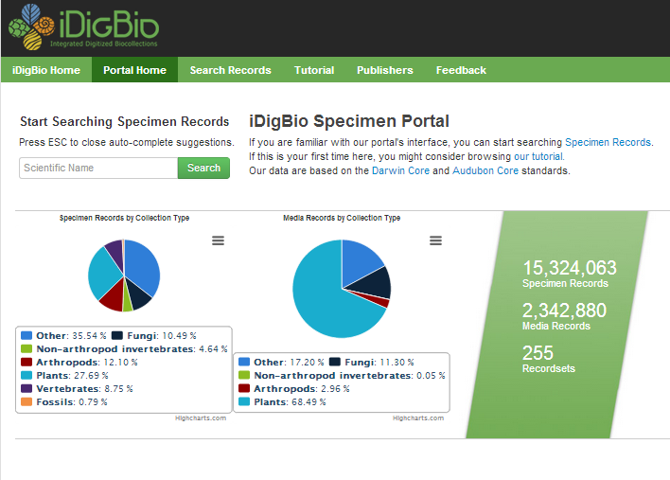
Website – Portal - Wiki
Your data here
www.idigbio.org/portal

Slide 6
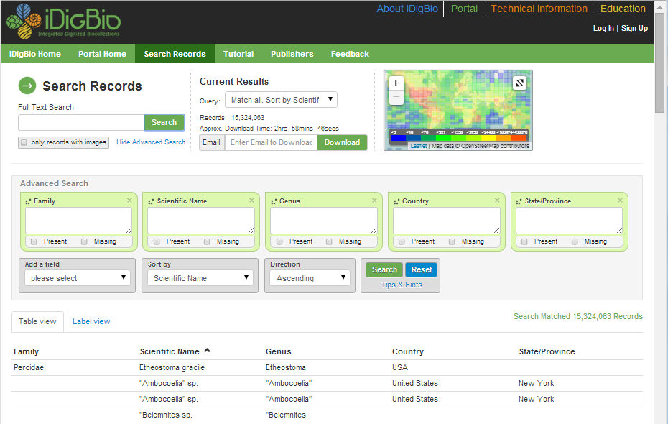
Portal

Slide 7
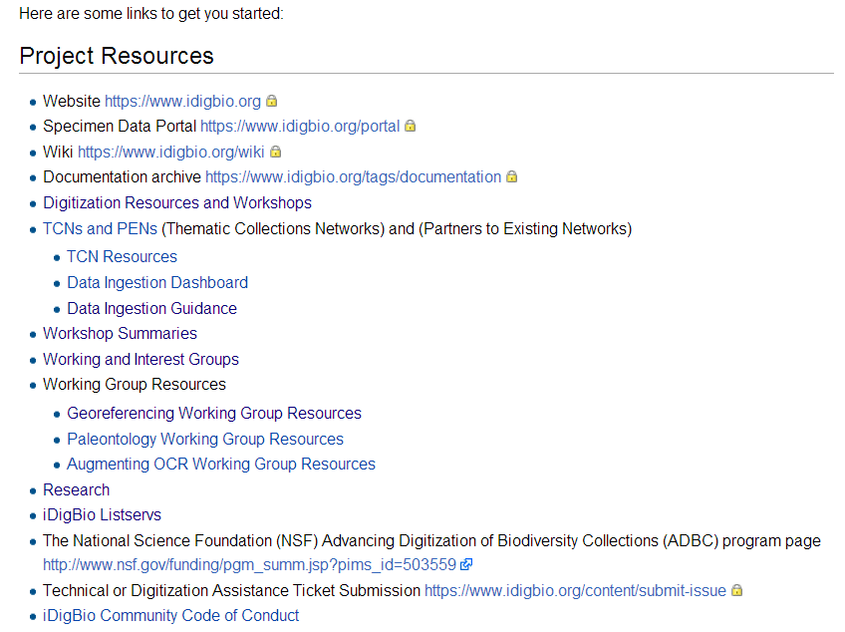
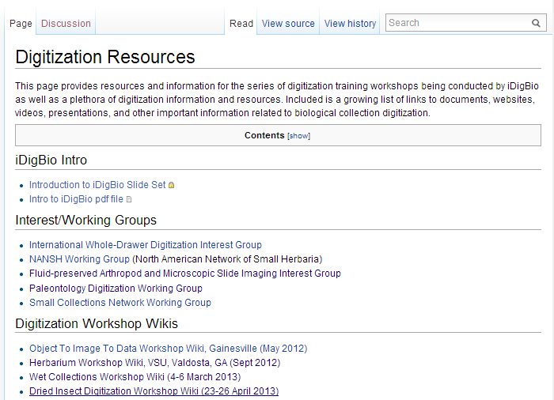
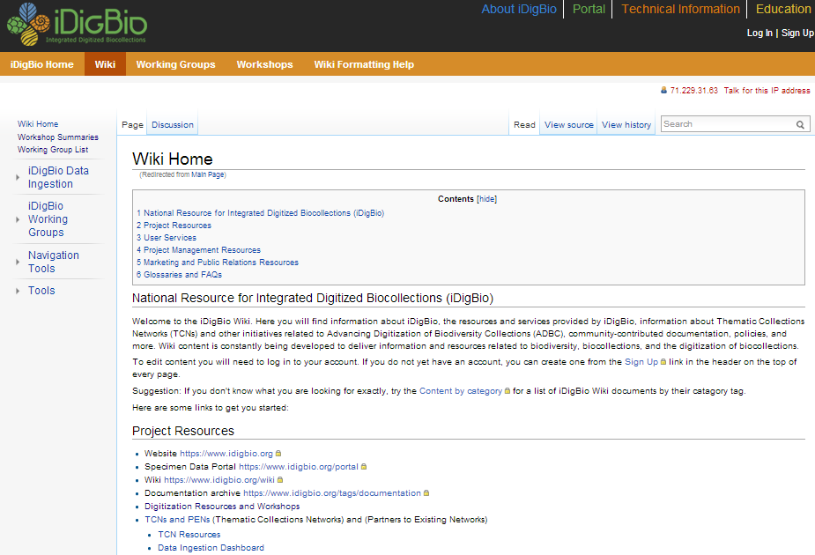
Website – Portal - Wiki
www.idigbio.org/wiki
Digitization
Flat things
Quick Start

Slide 8
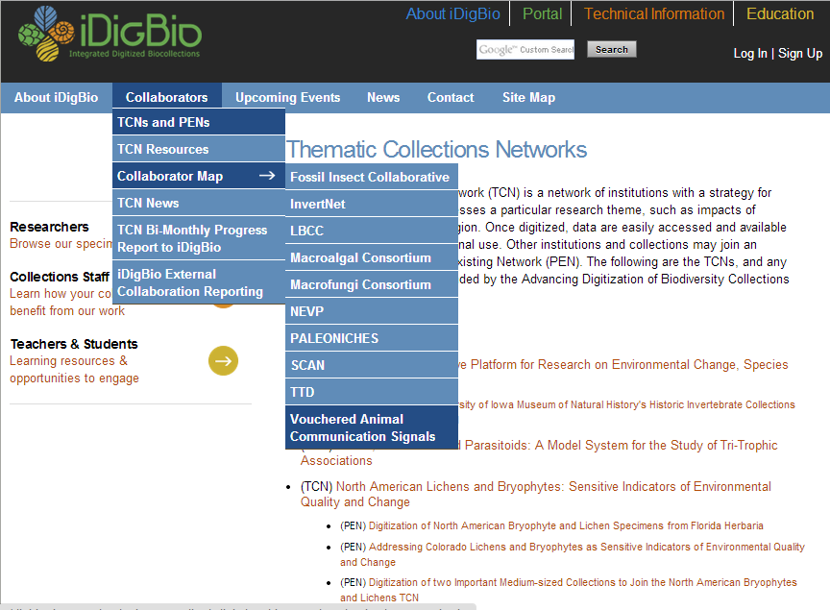
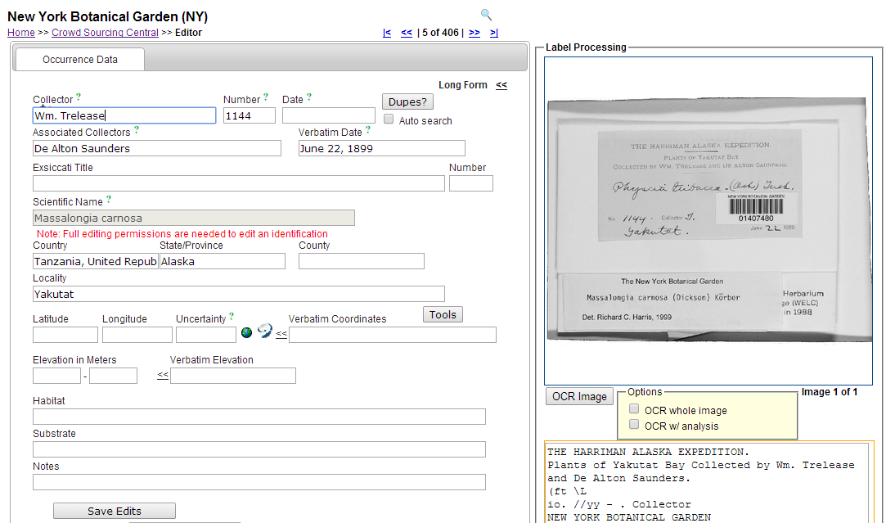
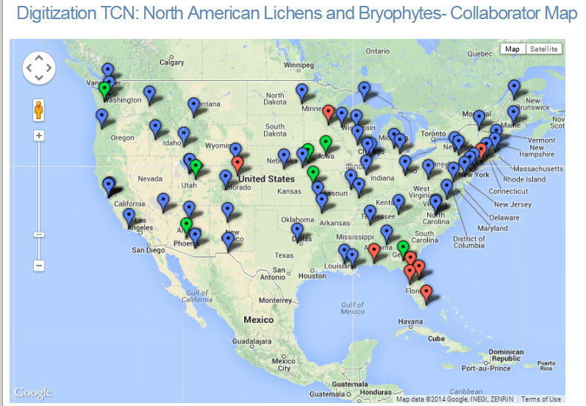
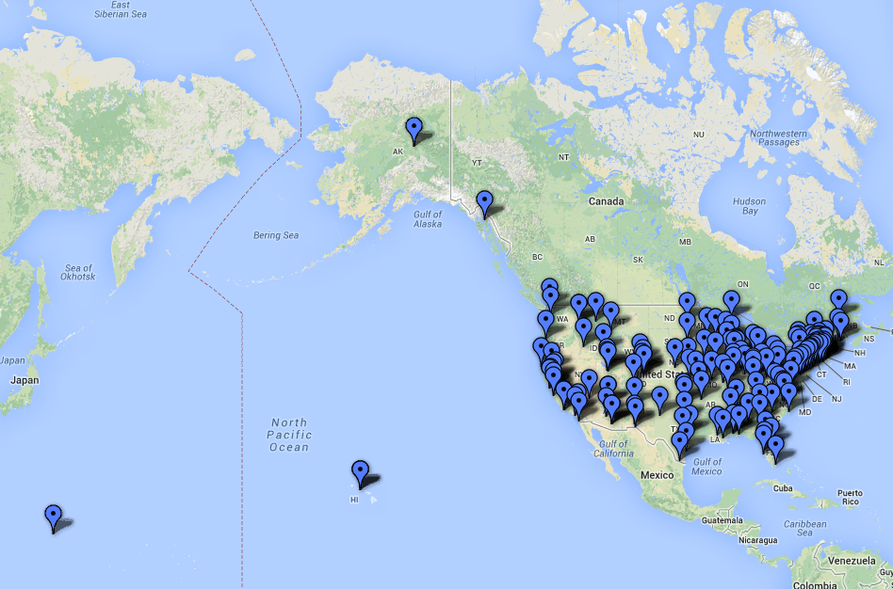
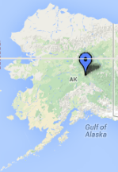
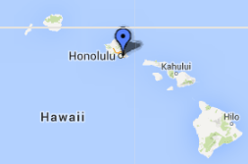
Thematic Collection Networks (TCNs)
To date: 10 TCNs, + PENs, 160+ participating institutions, 50 states

Slide 9
Ten Thematic Collections Networks (TCNs) and 7 Partner to Existing Networks (PENs)
InvertNet: An Integrative Platform for Research on Environmental Change, Species Discovery and Identification (Illinois Natural History Survey, University of Illinois) http://invertnet.org
Plants, Herbivores, and Parasitoids: A Model System for the Study of Tri-Trophic Associations (American Museum of Natural History) http://tcn.amnh.org
North American Lichens and Bryophytes: Sensitive Indicators of Environmental Quality and Change (University of Wisconsin – Madison) http://symbiota.org/nalichens/index.php http://symbiota.org/bryophytes/index.php
Digitizing Fossils to Enable New Syntheses in Biogeography - Creating a PALEONICHES-TCN (University of Kansas)
The Macrofungi Collection Consortium: Unlocking a Biodiversity Resource for Understanding Biotic Interactions, Nutrient Cycling and Human Affairs (New York Botanical Garden)
Mobilizing New England Vascular Plant Specimen Data to Track Environmental Change (Yale University)
Southwest Collections of Arthropods Network (SCAN): A Model for Collections Digitization to Promote Taxonomic and Ecological Research (Northern Arizona University) http://hasbrouck.asu.edu/symbiota/portal/index.php
Fossil Insect Collaborative: A Deep-Time Approach to Studying Diversification and Response to Environmental Change
Collaborative Research: Digitization TCN: Developing a Centralized Digital Archive of Vouchered Animal Communication Signals
The Macroalgal Herbarium Consortium: Accessing 150 Years of Specimen Data to Understand Changes in the Marine/Aquatic Environment

Slide 10
iDigBio Working Groups
Augmenting OCR (aOCR)
Biodiversity Informatics Management (BIM)
Cyberinfrastructure (CYWG)
Developing Robust Object to Image to Data (DROID1, 2, 3)
Education and Outreach (E&O)
Georeferencing (GWG)
International Whole-Drawer Digitization Interest Group
Minimum Information Standards, Authority Files, & Semantics (MISC)
North American Network of Small Herbaria (NANSH)
Paleo Digitization (Paleo)
Public Participation in Digitization (CitSci)
Sustainability (swg)

Slide 11
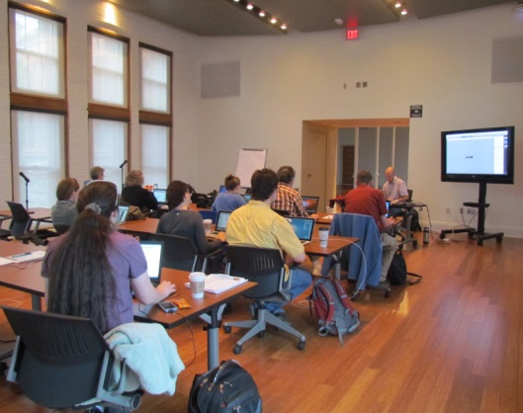
Digitization training workshops 21 Workshops, 691 people (Fiscal Year 2013-2014)
Resources
Developing Robust Object-Image-Data Workflows (DROID 1, May 2012)
Herbarium digitization (Valdosta State, September 2012)
Augmenting OCR Hackathon (Ft. Worth, February 2103)
Fluid-preserved collections digitization (U. Kansas, March 2013)
Dried insect collections digitization (Field Museum, April 2013)
Collections digitization (West Virginia, ASB, April 2013)
Georeferencing Train-the-Trainers (iDigBio, Gainesville, August 2103)
Imaging fluid-preserved invertebrates (U. Michigan, September 2013)
Paleontology digitization (Yale Peabody Museum, September 2013)
Small herbarium digitization (Florida State University, December 2013)
CitScribe Hackathon (iDigBio, Gainesville, December 2013)
Broadening diversity in the biodiversity sciences (January, 2014)
Education and Outreach (iDigBio, Gainesville, January 2014)
Original source materials digitization (Yale Peabody, March 2014)
Digitization in the South Pacific (Honolulu, March 2014)
Recruiting and Retaining Small Collections in Digitization (Mt. Pleasant, MI, April 2014)
Paleo Imaging Workshop (Austin, TX, April 2014)
Specify for Paleo Workshop (U. Kansas, May 2014)
TORCH + iDigBio Digitization Workshop (Sul Ross State U., May 24th 2014)
Notes:
In March 2012, the Steering Committee established a series of preparation-specific digitization training workshops focused on helping collections managers get started with and/or enhance local digitization programs, all to be held at host institutions.

Slide 12
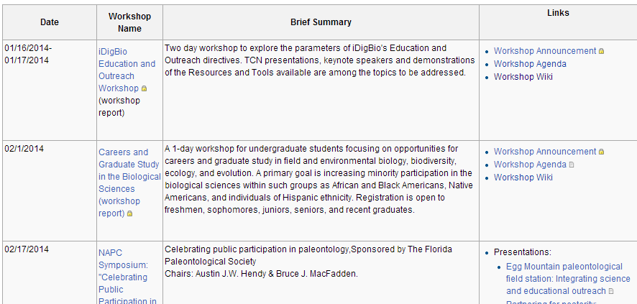
Our past, present, and future Workshops
Benefit from the past
Participate in the present
Focus the future – Propose a workshop
https://www.idigbio.org/wiki/index.php/IDigBio_Workshops

Slide 13
iDigBio Listservs
Stay informed
iDigBio
Augmenting OCR
Biodiversity Informatics Managers
Citizen Science and Crowdsourcing
Cyberinfrastructure WG
Digitization
Georeferencing WG
International Whole-Drawer Digitization Interest Group
Invert Imaging Interest Group
Paleo Digitization WG
Small Collections Network
Experience
Materials
Focus
https://www.idigbio.org/wiki/index.php/IDigBio_Listservs

Slide 14
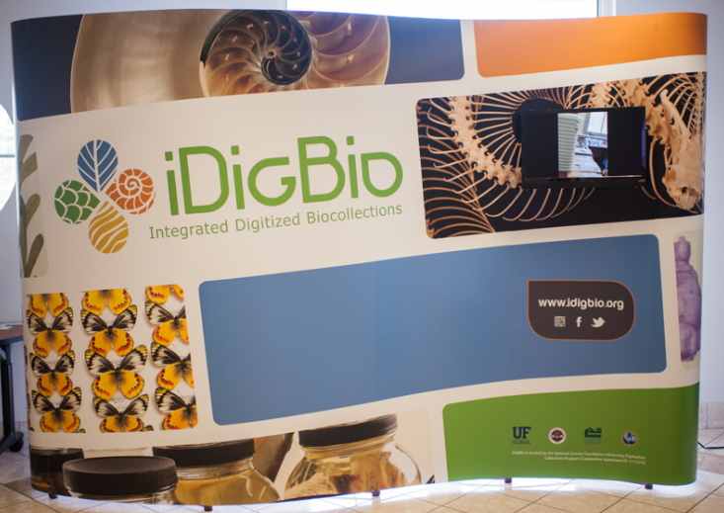
End of this talk, but just the beginning…

