Slide 1


Exposing Data from Small Collections:
Mobilization
common questions and solutions
Deb Paul @idbdeb – Florida State University
Richard K. Rabeler – University of Michigan
SPNHC2014 - Cardiff
Notes:
This talk is in question / answer format. It is intended to focus on very common questions – asked over-and-over again at many meetings. Most of the time, these are questions asked by digitization novices who are just beginning to think about databasing and possibly imaging their collections. There are certainly more steps in mobilization than are covered in this talk. For more resources, contact iDigBio, see our iDigBio Bibliography, and the cited resources in this talk – for starters.

Slide 2

“If you are not getting your data to GBIF, you might as well not exist.”
What this comment means to us!!
What can we do to “exist”?
Mobilize data in the 21st century
Notes:
How to get started?
Where do I begin?
- there are various ways to accomplish this
- often daunting for a small collection
- comments here are aimed at making this more likely.

Slide 3
Main Questions
1. What is mobilization?
2. What do I need to do to get my data ready for mobilization?
3. How do I mobilize my data once it’s ready?
Notes:
http://kmbeing.com/2011/01/17/data-information-knowledge-wisdom-and-the-difference-between-information-exchange-knowledge-mobilization/

Slide 4
1. What is mobilization?

Slide 5
concept by G. Riccardi
Data Provider Catalog
Manage data
Export
GBIF
iDigBio
BISON
Taxonomy
species ranges
outlier discovery
new species
gaps in collecting
relationships
predictive niche models
collector maps…
possibilities
User

Slide 6
2. What do I need to do to get my data ready for mobilization?

Slide 7
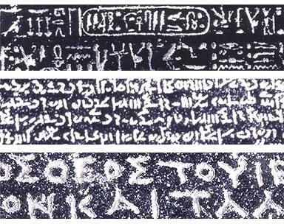
Mobilization requires standard terms
My data?
Your data?
map to a standard!
http://www.britishmuseum.org/images/rosettawriting384.jpg
Notes:
Why darwin core / georeferencing standards?
http://prezi.com/iib3pqk-kyd-/curators-workbench/
Why care about standards?
What do they have the potential to accomplish?
Collection Managers are doing what they need to do – for themselves, their collections.
When we share, we need standards.
Data becomes useful for others / other purposes.
a common vocab is required
Feedback and Attribution become possible.
The collection gets used, more, increasing the value of the collection.
indirect, subtle
Putting identifiers on specimens --- makes more useful to others.
consistency is important!

Slide 8
So what is standardization exactly? What do I need to do?
Data needs standardization
  use Darwin Core (dwc)
  controlled values (e.g. holotype, lectotype,…)

Slide 9
So what is standardization exactly? What do I need to do?
Data needs standardization
  use Darwin Core (dwc)
  controlled values (e.g. holotype, lectotype,…)
  date formats, encoding, …
  taxonomy

Slide 10

So what is standardization exactly? What do I need to do?
Data needs standardization
  use Darwin Core (dwc)
  controlled values (e.g. holotype, lectotype,…)
  date formats
  taxonomy
How do I migrate to standards?
  Consult experts at iDigBio or GBIF or US GBIF node …
  Make changes to current practices
BIS (TDWG)
Notes:
TDWG

Slide 11
What data must I have?
What is missing from my data?
  Minimum data field content
    What, where, when, (who)
Should my data be georeferenced?
  Yes, enables lots of research
  Validation
Dupes

Slide 12

What are my georeferencing options?
inline, automated, by the crowd
  For example,
Find georeferenced duplicates
Locality services
If done outside of the database, via a portal, for example
  plan for re-integration

Slide 13
Who is going to enter / validate / georeference the data?
This is an opportunity! (Monfils, Harris)…
  Students
  Volunteers
  Curatorial Assistants
  Collection Managers
  Curators
  Researchers
  Citizen Scientists (all of us!)
to quote Kari, “…it’s a matter of time.”

Slide 14
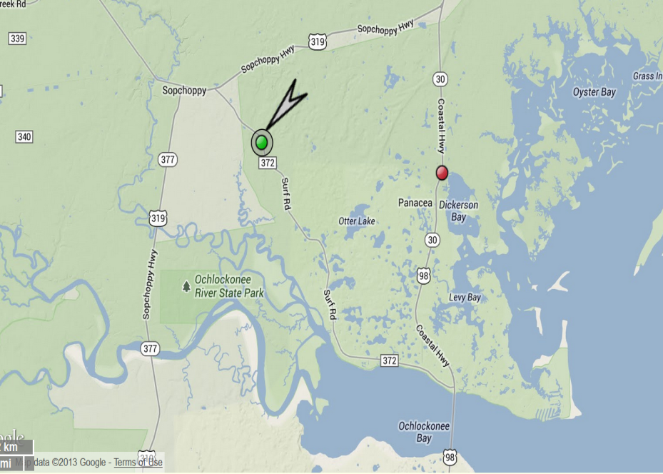

What about sensitive locality data?
Don’t share sensitive data
  Aim for due diligence
  Software can help, for example:
Do manage the time / effort for this
  Consider:
    Duplicate conundrum
    Collector numbers
    Publications, Google
Think about a public education strategy

Slide 15

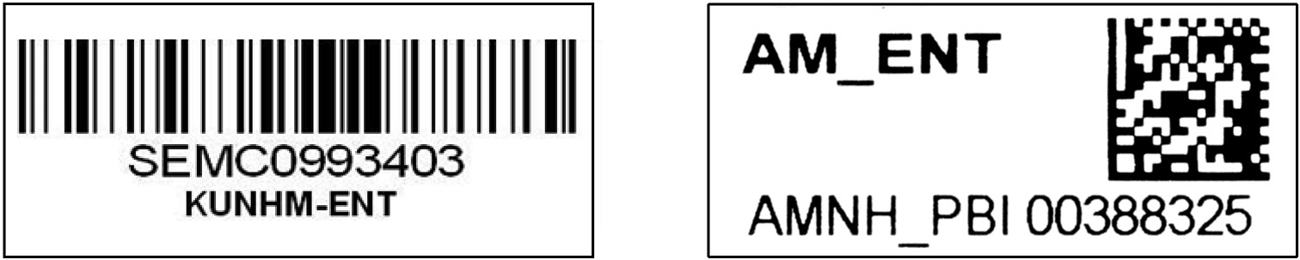
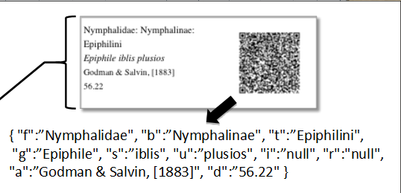
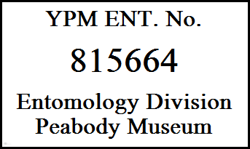
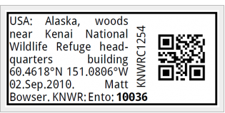
What about barcodes? Do I need them? What are my options?
Barcodes facilitate automation
  Managing connection between specimens, media and database records
You don’t have to have them, but …

Slide 16
What do bar codes do?
simplify:
  image file naming
  image processing, validation, and tracking
  loan queries
  specimen tracking
  automated processing / sharing
Notes:
Many options
1-D, 2-D
do put identifier in the barcode
do Not put taxon name in barcode matrix
can be a UUID, can be a darwin core triplet
in essence they are like a catalog number
234234234
institutioncode:collectioncode:234234234
q-r code (2-D matrix)
urn:uuid:f47ac10b-58cc-4372-a567-0e02

Slide 17
Which kind of barcodes do I use?
Many options
  1-D, 2-D
  do put identifier in the barcode
  do Not put taxon name in barcode matrix
  can be a UUID, can be a darwin core triplet
in essence they are like a catalog number
  234234234
  institutioncode:collectioncode:234234234
  q-r code (2-D matrix)
    urn:uuid:f47ac10b-58cc-4372-a567-0e02b2c3d47

Slide 18
I've heard of the need for my data (and media) to have "unique identifiers", but I don't know much about them. What are they good for? For my simple data set, who would assign them (and how)?
Globally unique identifiers for specimens and media are key for citation and feedback
Notes:
Assignment by you, the provider, is best.
Using the KISS method - assign a UUID to every specimen you have (these do NOT Have to be on the physical specimen). You can use your catalog / accession number to track your physical specimen in-house, as usual. But when providing a dwc:occurrenceID (a globally unique identifier for the specimen is best and this would be a UUID). Other identifiers will work, even the darwin core triple (BEST Practice is to register with grbio to insure your triplet will be unique).
It is easy to set up databases to have a UUID and to add a column with these if needed.
All bits need these (Specimens, sub-samples of the specimen, taxonomic identifications, georeferences, ...)

Slide 19
I've heard of the need for my data (and media) to have "unique identifiers", but I don't know much about them. What are they good for? For my simple data set, who would assign them (and how and to what)?
Don’t panic! It’s easy.
Globally unique identifiers for specimens and media are key for citation and feedback
Best if provider (you!) assigns these
  assign a UUID to every specimen (and media) you have
    Universal Unique Identifier
  urn:uuid:f47ac10b-58cc-4372-a567-0e02b2c3d47
Notes:
Assignment by you, the provider, is best.
Using the KISS method - assign a UUID to every specimen you have (these do NOT Have to be on the physical specimen). You can use your catalog / accession number to track your physical specimen in-house, as usual. But when providing a dwc:occurrenceID (a globally unique identifier for the specimen is best and this would be a UUID). Other identifiers will work, even the darwin core triple (BEST Practice is to register with grbio to insure your triplet will be unique).
It is easy to set up databases to have a UUID and to add a column with these if needed.
All bits need these (Specimens, sub-samples of the specimen, taxonomic identifications, georeferences, ...)

Slide 20
Do unique identifiers have to be on the physical object?
Back to this in a bit…
  No.
  They are stored in the database.
  But when providing data, a dwc:occurrenceID that is a globally unique identifier for the specimen is best and this would be a UUID.

Slide 21
Where do I get UUIDs? Do I have to use them?
Some do this now
It is easy to set up databases to have a UUID and to add a column with these if needed.
  easy to create them, get them from the web
Other identifiers will work, including the Darwin Core triple
  BEST Practice: register with GRBio to insure your triple will be unique. (grbio.org)
All bits need these
Notes:
(Specimens, sub-samples of the specimen, taxonomic identifications, georeferences, ...)s

Slide 22
How do I choose a database, or collection management software?
Guidelines exist to help you decide
  Considerations for Selecting a Collections Management System (Joanna McCaffrey, 2012)
  Digitisation: A strategic approach for natural history collections. Canberra, Australia, CSIRO (Bryan Kalms, 2012)
  Initiating a Collection Digitisation Project (Frazier, Wall, Grant 2008)
  Your community

Slide 23
3. How do I mobilize my data once it’s ready?
So, your data is entered, cleaned up, standardized, georeferenced, validated what next?
  or wait! Does it all have to be done before you mobilize it? No!
    Trend: Minimal / Skeletal Data Records
    Result: Need to develop robust strategies for completing / enhancing records

Slide 24





I work at a small collection and have a data set in Excel and want to get it exposed to GBIF. What are my options?
Not a database
Excel
All roads lead to GBIF

Slide 25
Could I do something similar with an Access or FileMaker Pro database?
Yes.

Slide 26
I've heard of the IPT, what is it? What can it do for me?
IPT is Integrated Publishing Toolkit (IPT)
Software to help you make and enable you to share a tidy, standardized, dataset
Darwin Core Archive (at its simplest)
  occurrence data
  meta.xml
  eml.xml
You can install it yourself, Your IT staff can set it up, You can use someone else’s IPT
  ask them!
Media data, Genomic data, OCR output, …
  UUIDs are key
Notes:
You can install the IPT software on your local machine in your office. (it's easy).
Export data from your database (CSV file will do).
Upload that file to the IPT.
Map (match) your fields to darwin core.
Fill out form with metadata about you and your collection (IMPORTANT for Data Discovery - not trivial).
Add image, genomic,taxonomic, other data if desired.
IPT then creates DwC-A file.
You put the DwC-A file in a public directory like Drop Box.
You tell GBIF / iDigBio / etc the http: URL to that file and they copy that file and upload to their database.
If you put a new version of your dataset in the Drop Box, you notify them you've done that an they update.
(or you can set up an “RSS” feed).

Slide 27

Is there a "best place" to put my data?
Everywhere.
  Facilitate data discovery, data use, data re-use, data enhancement.
  Expect enhanced data.
  Expect feedback about data issues.
    (errors, typos, formatting, georeference issues, taxonomy issues,...)
  Ask where your data is going
Notes:
IPT is public
Register

Slide 28
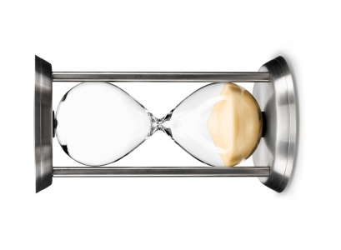
What about funding?
libraries (IMLS, …)
foundations
  seek to establish a relationship with foundations whose missions, while perhaps different from yours, may overlap to benefit both of you
collaborations
your university
include students (undergraduates)
  can bring funding opportunities

Slide 29
What about large collections? Do they have this all figured out?
Some do, some don’t, …
Those that do (small and large) – can help
  Expertise sharing
  Pain points (oops!)
  Documentation
  Software?...

Slide 30





More questions?
Let’s continue the conversation!
See you Friday…
  SPNHC 2014 Special Interest Group Session: Collections Digitization and Opportunities for International Collaboration, 11 AM
Diolch yn fawr!

