Slide 1
Best Practices for Data Entry and Data Manipulation
For Global Discoverability
Managing NHC Data
Amber Budden, DataONE
Edward Gilbert, Symbiota
September 15 – 17, 2015
Arizona State University (ASU)
Biodiversity Knowledge Integration Center (BioKIC)
Brought to you by: Tri-Trophic TCN, DataONE, ASU, iDigBio, Symbiota, and NCEAS

Slide 2
Topics
Best Practices for Creating Data Files
Data Entry Options
Data Manipulation Options
CC image by JISC on Flickr

Slide 3
Desired outcomes
Recognize inconsistencies that can make a dataset difficult to understand and/or manipulate
Describe characteristics of stable data formats and list reasons for using these formats
Identify data entry tools
Identify validation measures that can be performed as data is entered
Describe the basic components of a relational database

Slide 4
Goals of Data Entry
Create data sets that are:
Valid
Organized to support ease of use
CC image by Travis S on Flickr

Slide 5
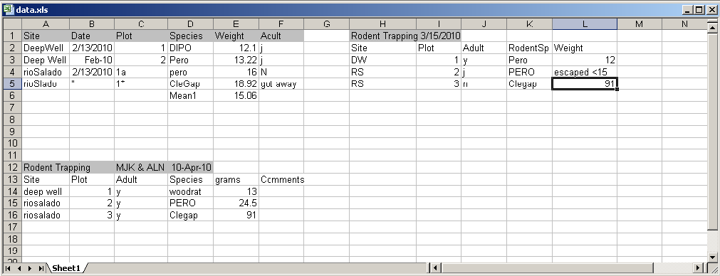
Example: Poor Data Entry
Inconsistency between data collection events
Location of Date information
Inconsistent Date format
Column names
Order of columns

Slide 6
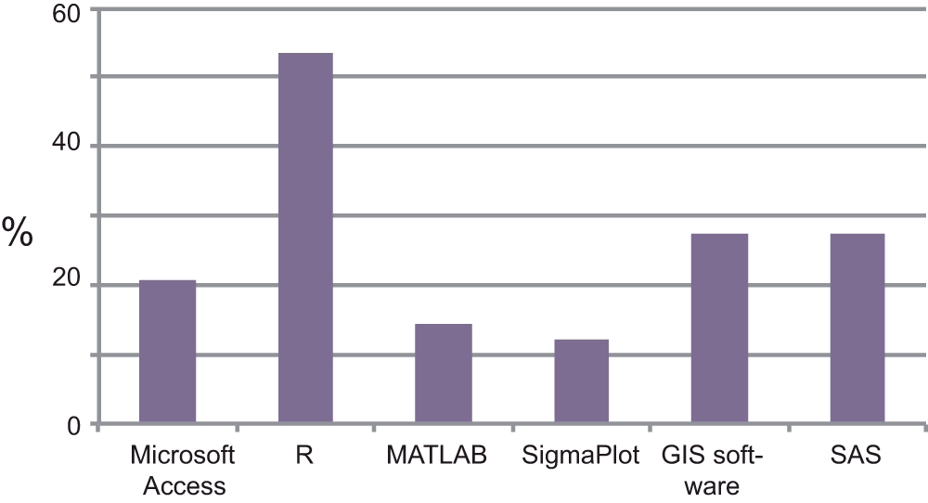
Software used in addition to Excel

Slide 7
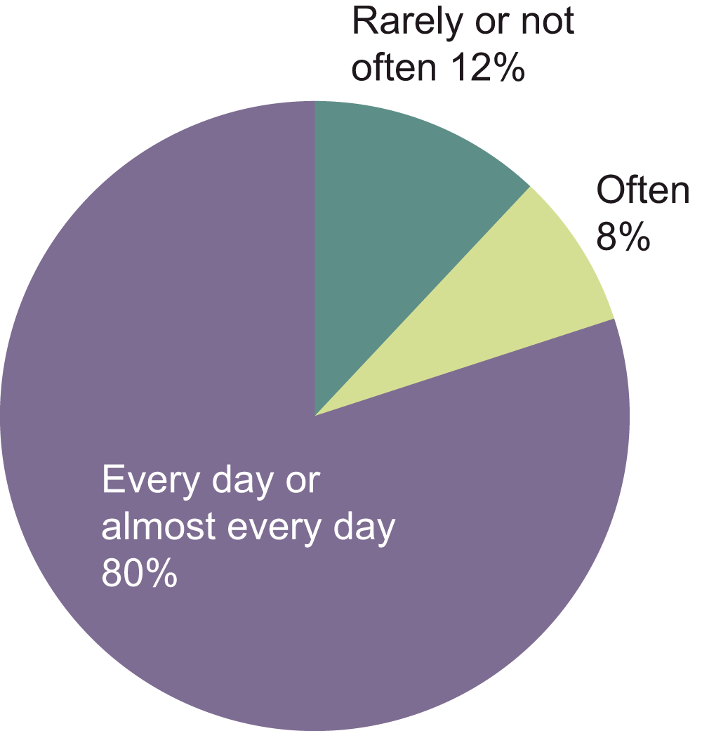
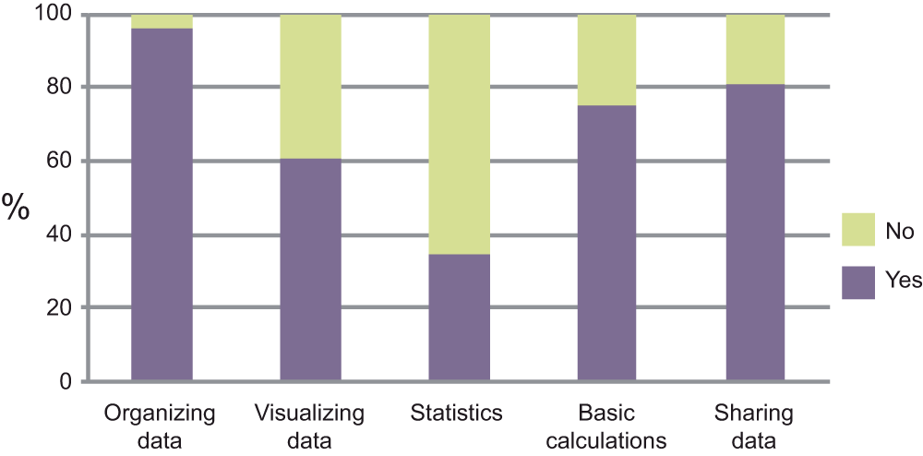
Frequency and Purpose of Excel use

Slide 8
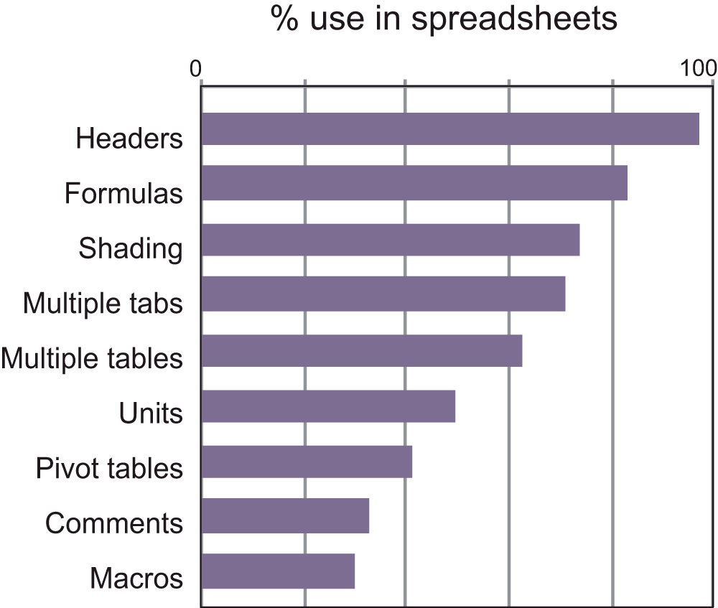
Practices when using Excel

Slide 9
Example: Poor Data Entry
Inconsistency between data collection events
Different site spellings, capitalization, spaces in site names—hard to filter
Codes used for site names for some data, but spelled out for others
Mean1 value is in Weight column
Text and numbers in same column – what is the mean of 12, “escaped < 15”, and 91?

Slide 10
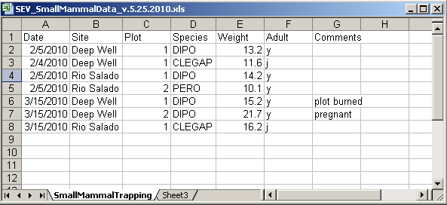
Best Practices
Columns of data are consistent:
only numbers, dates, or text
Consistent Names, Codes, Formats (date) used in each column
Data are all in one table, which is much easier for a statistical program to work with than multiple small tables which each require human intervention

Slide 11
Best Practices
Create descriptive column names without spaces or special characters
Soil T30 → Soil_Temp_30cm
Species-Code → Species_Code (avoid using -,+,*,^ in column names. Some software may interpret these symbols as an operator)
Use a descriptive file name. For instance, a file named SEV_SmallMammalData_v.5.25.2010.csv indicates the project the data is associated with (SEV), the theme of the data (SmallMammalData) and also when this version of the data was created (v.5.25.2010). This name is much more helpful than a file named mydata.xls.

Slide 12
Best Practices
Missing data
Preferably leave field empty (NULL = no value)
In numeric fields, use a distinct value such as 9999 to indicate a missing value
In text fields, use NA (“Not Applicable” or “Not Available”)
Use Data flags in a separate column to qualify missing value
Date | Time | NO3_N_Conc | NO3_N_Conc_Flag
20081011 | 1300 | 0.013
20081011 | 1330 | 0.016
20081011 | 1400 |  | M1
20081011 | 1430 | 0.018
20081011 | 1500 | 0.001 | E1
M1 = missing; no sample collected
E1 = estimated from grab sample

Slide 13
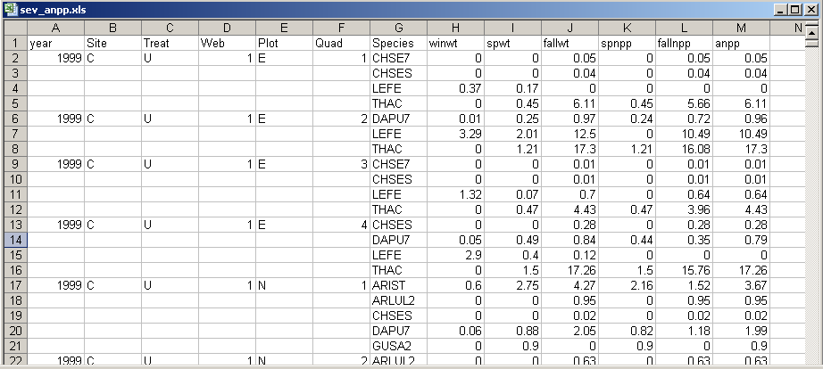
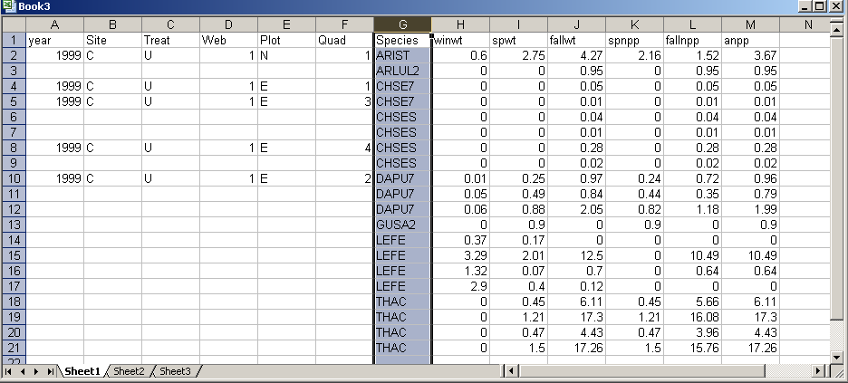
Best Practices
Enter complete lines of data
Sorting an Excel file with empty cells is not a good idea!

Slide 14
Best Practices
For the long term, store data in a consistent format that can be read well in to the future and that can be used by any application now or in the future
Appropriate file types include:
Non-proprietary: Open, documented standard
Common usage by research community: Standard representation (Unicode aka UTF-8)
Unencrypted
Uncompressed (DwC-A zip files)
CSV (comma seperated) for tabular data
txt

Slide 15
References
Best Practices for Preparing Environmental Data Sets to Share and Archive. September 2010. Les A. Hook, Suresh K. Santhana Vannan, Tammy W. Beaty, Robert B. Cook, and Bruce E. Wilson. http://daac.ornl.gov/PI/BestPractices-2010.pdf
Wieczorek et al (2012) Darwin Core: An Evolving Community-Developed Biodiversity Data Standard PLoSONE, 7:1, e29715

Slide 16
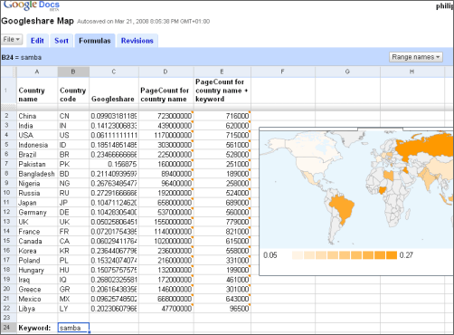
Data Entry Tools
Googledocs Forms
Spreadsheets

Slide 17
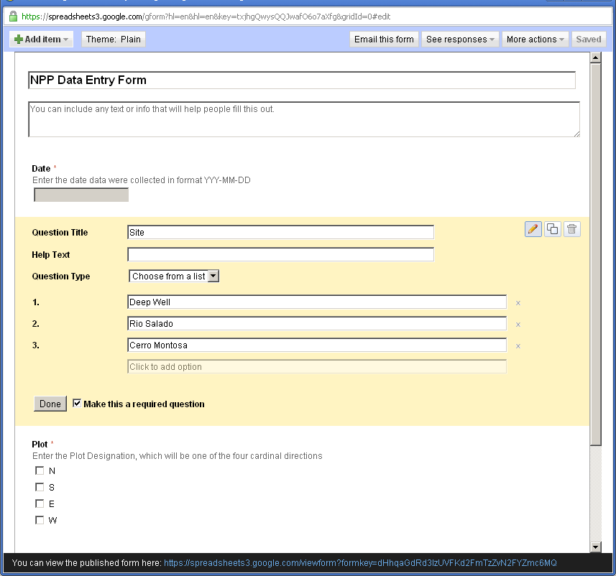
Googledocs Forms

Slide 18
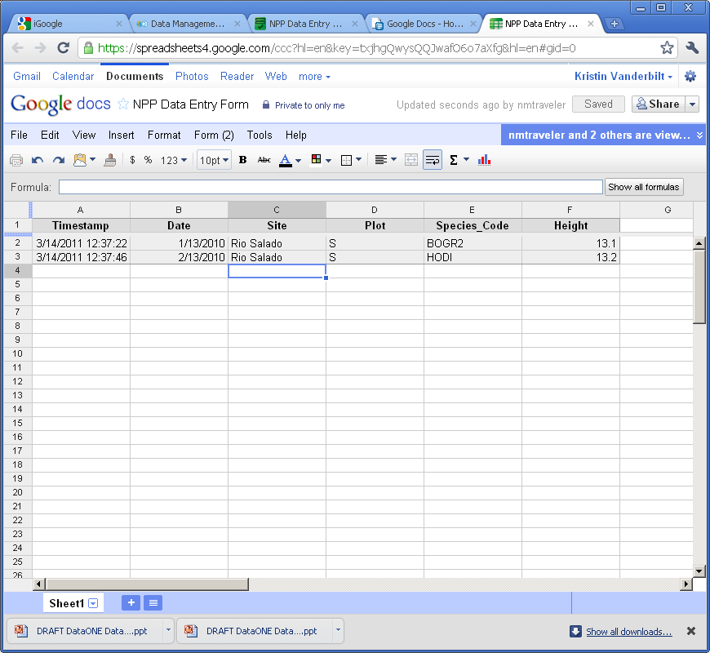

Slide 19
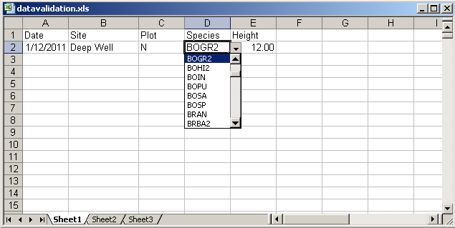
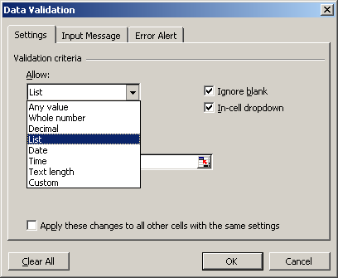
Data Entry Tools: Excel

Slide 20
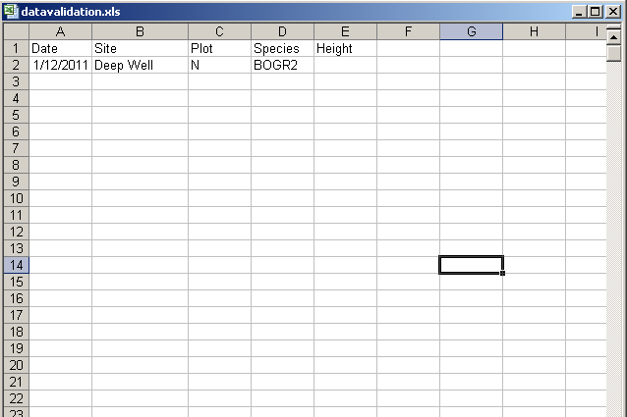
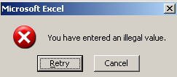
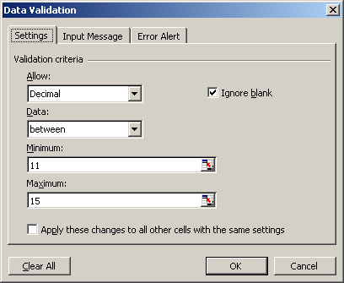
Excel: Data Validation
20

Slide 21
Spreadsheet vs. Relational Database
Great for charts, graphs, calculations
Flexible about cell content type—cells in same column can contain numbers or text
Lack record integrity--can sort a column independently of all others)
Easy to use – but harder to maintain as complexity and size of data grows
Easy to query to select portions of data
Data fields are typed – For example, only integers are allowed in integer fields
Columns cannot be sorted independently of each other
Steeper learning curve than a spreadsheet

