Slide 1
General Concepts and Best Practices: DLC, Data Modeling, Relational Databases
For Global Discoverability
Managing NHC Data
Amber Budden, DataONE
Edward Gilbert, Symbiota
September 15 – 17, 2015
Arizona State University (ASU)
Biodiversity Knowledge Integration Center (BioKIC)
Brought to you by: Tri-Trophic TCN, DataONE, ASU, iDigBio, Symbiota, and NCEAS

Slide 2
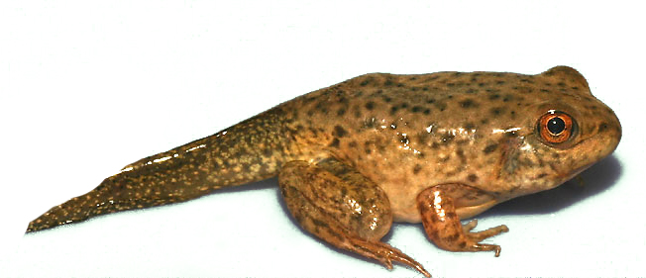
The Data Life Cycle

Slide 3
Assure
Preserve
Discover
Integrate
Analyze
Plan
Describe
Collect

Slide 4
Assure
Preserve
Discover
Integrate
Analyze
Plan
Describe
Collect

Slide 5
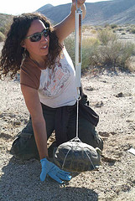
Assure
Preserve
Discover
Integrate
Analyze
Plan
Describe
Collect

Slide 6
Assure
Preserve
Discover
Integrate
Analyze
Plan
Describe
Collect

Slide 7
Plan
Description of the data that will be compiled and how the data will be managed and made accessible throughout its lifetime
Collect
Observations are made either by hand, with sensors or other instruments and the data are placed into a digital form
Assure
The quality of the data are assured through checks and inspections
Describe
Data are accurately and thoroughly described using the appropriate metadata standards
Preserve
Data are submitted to an appropriate long-term archive (i.e. data center)
Discover
Potentially useful data are located and obtained, along with the relevant information about the data (metadata)
Data from disparate sources are combined to form one homogeneous set of data that can be readily analyzed
Integrate
Analyze
Data are analyzed

Slide 8
Plan
Description of the data that will be compiled and how the data will be managed and made accessible throughout its lifetime
TUE
Collect
Observations are made either by hand, with sensors or other instruments and the data are placed into a digital form
TUE
Assure
The quality of the data are assured through checks and inspections
WED
Describe
Data are accurately and thoroughly described using the appropriate metadata standards
TUE
Preserve
Data are submitted to an appropriate long-term archive (i.e. data center)
THU
Discover
Potentially useful data are located and obtained, along with the relevant information about the data (metadata)
THU
Data from disparate sources are combined to form one homogeneous set of data that can be readily analyzed
Integrate
TUE
Analyze
Data are analyzed
WED

Slide 9
Data Modeling

Slide 10
Relational Databases

