Slide 1
Digitization Workflows and Processes
Katja Seltmann, TTD-TCN, AMNH
Deborah Paul, iDigBio
Managing NHC Data for Global Discoverability
September 15 – 17, 2015

Slide 2
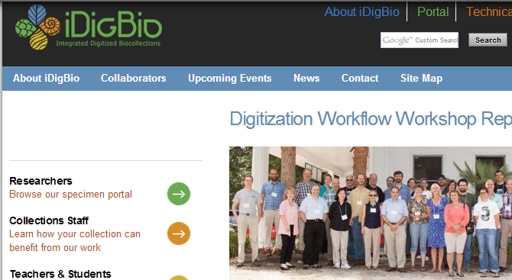
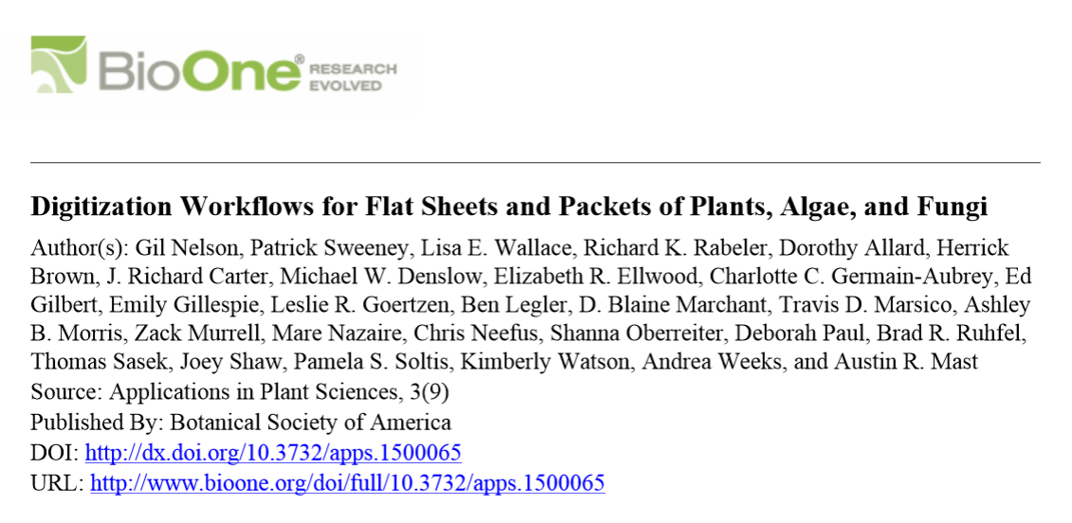
Developing Robust Object to Image to Data Workflows (DROID)
Workshop
design
collaborative
Scientific Software Innovation Institutes
Yale Peabody Museum
Biodiversity Institute, KU
iDigBio
New Workflows Paper is out!

Slide 3
Getting Started: Digitization Decision Making
Global Needs and Policies
Local Policies and Decisions
Specific Workflows
What to digitize? How to prioritize?
Can we digitize every bit of data associated with each object?
Skeletal (minimal) records?
How to decide?

Slide 4
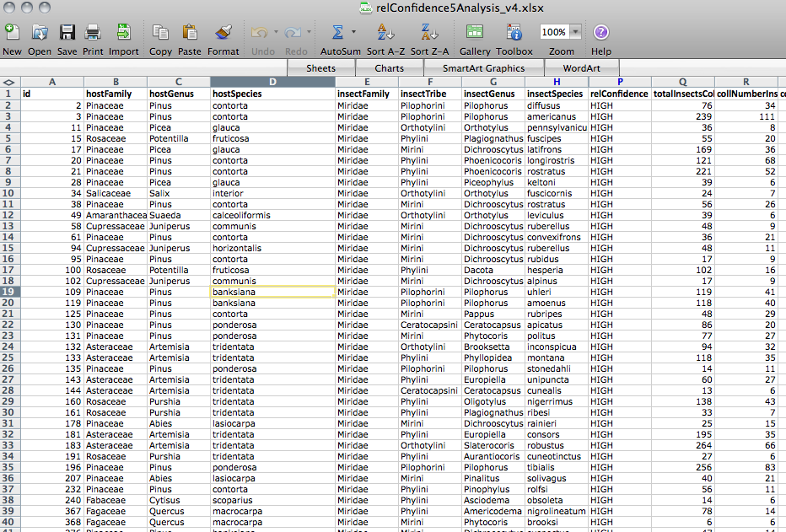
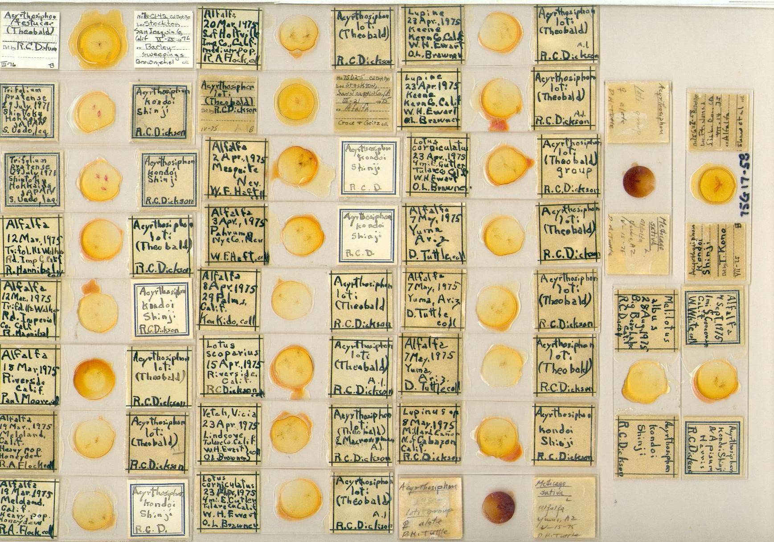
Workflow = Iterative task at any scale:
Small and big tasks

Slide 5
Getting Started: Balancing the long view with the short view: The local decision
Long view
Short view
How does an institution develop doable, effective, and sustainable strategies for balancing long term goals with short term constraints, including a commitment to implementing future enhancements?
Pressures mitigating the long view
So much data, so little time.
Collections are not getting smaller (proactive vs. legacy).
Funding agencies have high output/low cost expectations.
We only have 3 years to get this done (sustainable models?).
All of our data and all of our specimens are important.
Let’s just use the images!
We’ll do the minimum now and enhance it later (inside track).
Notes:
See the long view as our goal; see the short view only as a set of constraints, not as an end

Slide 6
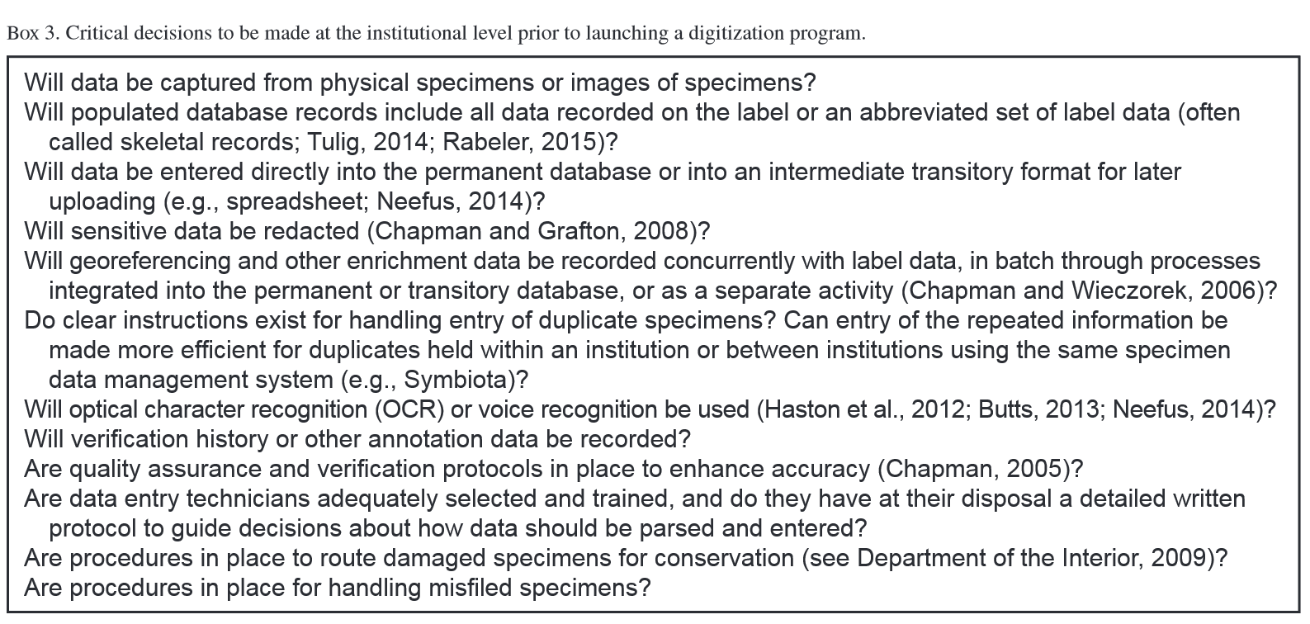
Getting Started: Decisions at the institutional level before digitization
New Workflows Paper…
http://www.bioone.org/doi/pdf/10.3732/apps.1500065

Slide 7
Where will you enter and store data? What suits best?
Considerations for selecting a collection management system
by Joanna McCaffrey
Digitizing Plant Specimens Workshop, 2012

Slide 8
Examples from Flat Sheets and Packets Working Group - Vascular and Non-vascular Plants
Module 1 Pre-digitization Curation Tasks
Module 2 Selecting Components for an Imaging Station
Module 3 Imaging Station Setup Camera/Copy Stand
Module 4 Imaging Station Setup Light box
Module 5 Image Station Setup Scanner
Module 6 Imaging
Module 7 Image Processing
Module 8 Organizing and Implementing a Public Participation Imaging Blitz
Module 9 Image Archiving
Module 10 Selecting a Database
Module 11 Data Capture
Module 12 Organizing and Implementing a Public Participation Transcription Blitz
Module 13 Georeferencing
Module 14 Proactive Digitization

Slide 9
Common Workflows: workflows: image-to-data, specimen-to-data, field-to-database, to-the-web methods and tools: skeletal records, crowd-sourcing, OCR/NLP, georeferencing, metadata

Slide 10
KEY Clusters
Image Capture
Georeferencing
Image Processing
Pre-digitization Curation or
Staging
Personnel
Data Capture
Image / Data Storage
Biodiversity Informatics Manager
Written
Workflows

Slide 11
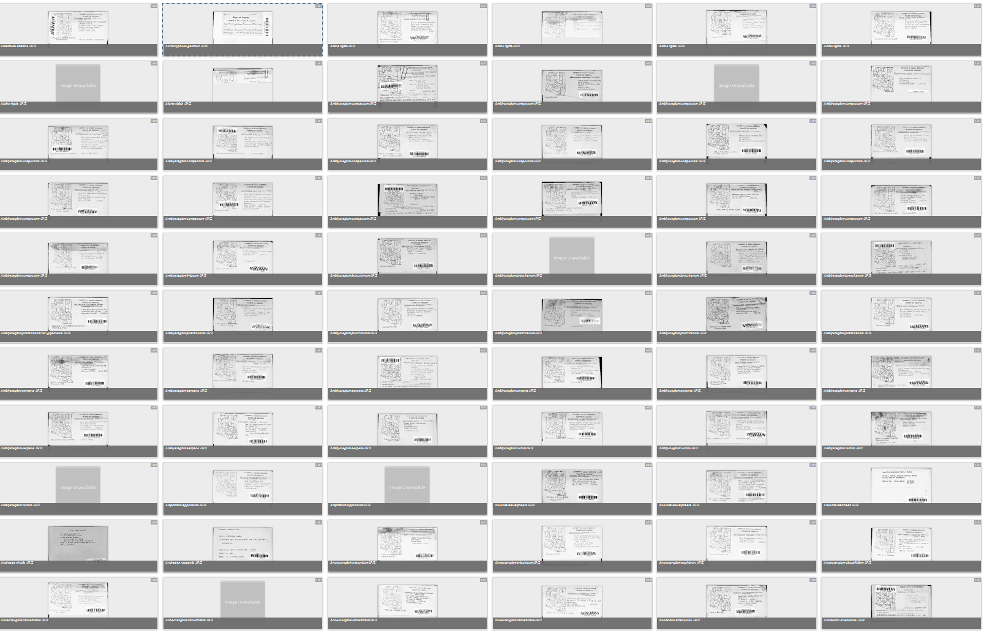
Object to Image to Data (to Web) aka DROID

Slide 12
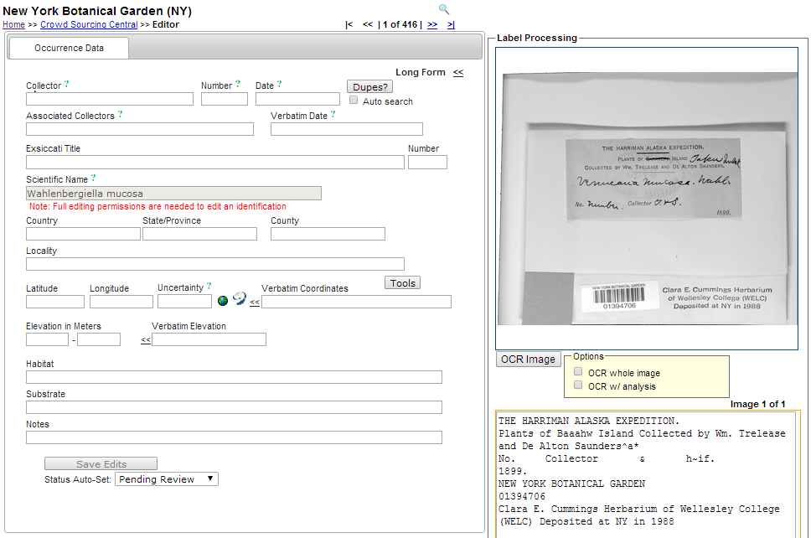
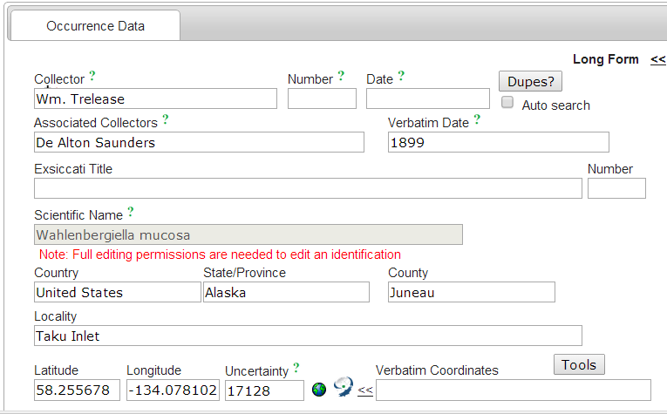
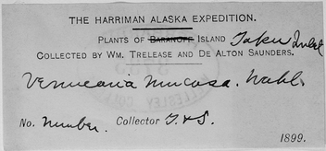
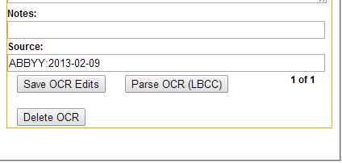

Slide 13
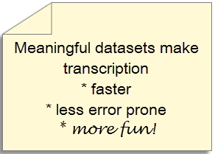
Optical Character Recognition Output in a digitization workflow – Searching and Sorting
SEARCH image data
Use Machine Learning and
Natural Language Processing on OCR output
find sheets with !handwriting
find the labels in the images
find labels from a given collector, a given place
group sheets / labels by language
group sheets for data entry and georeferencing
group sheets for crowd-sourced transcription
group sheets for researchers

Slide 15
The herbaria at the Royal Botanic Garden Edinburgh (RBGE) and The New York Botanical Garden (NY) use a similar recently developed workflow:
Capture minimal data for each specimen
(e.g. barcode, geographic region, and the taxon name on the specimen folder).
Capture high quality digital images of each specimen
Process images with ABBYY® OCR software
Develop and/or use software tools to search OCR text output and sort the images/data based on principal data elements (e.g. by collector and country)
Sort image/data to enable faster data capture & higher accuracy by data transcriptionists, including duplicate record matching.
(and happy data transcribers!).
Notes:
Who is using OCR?
NYBG
RBGE
RBGK
LBCC
Smithsonian (SALIX)

Slide 16
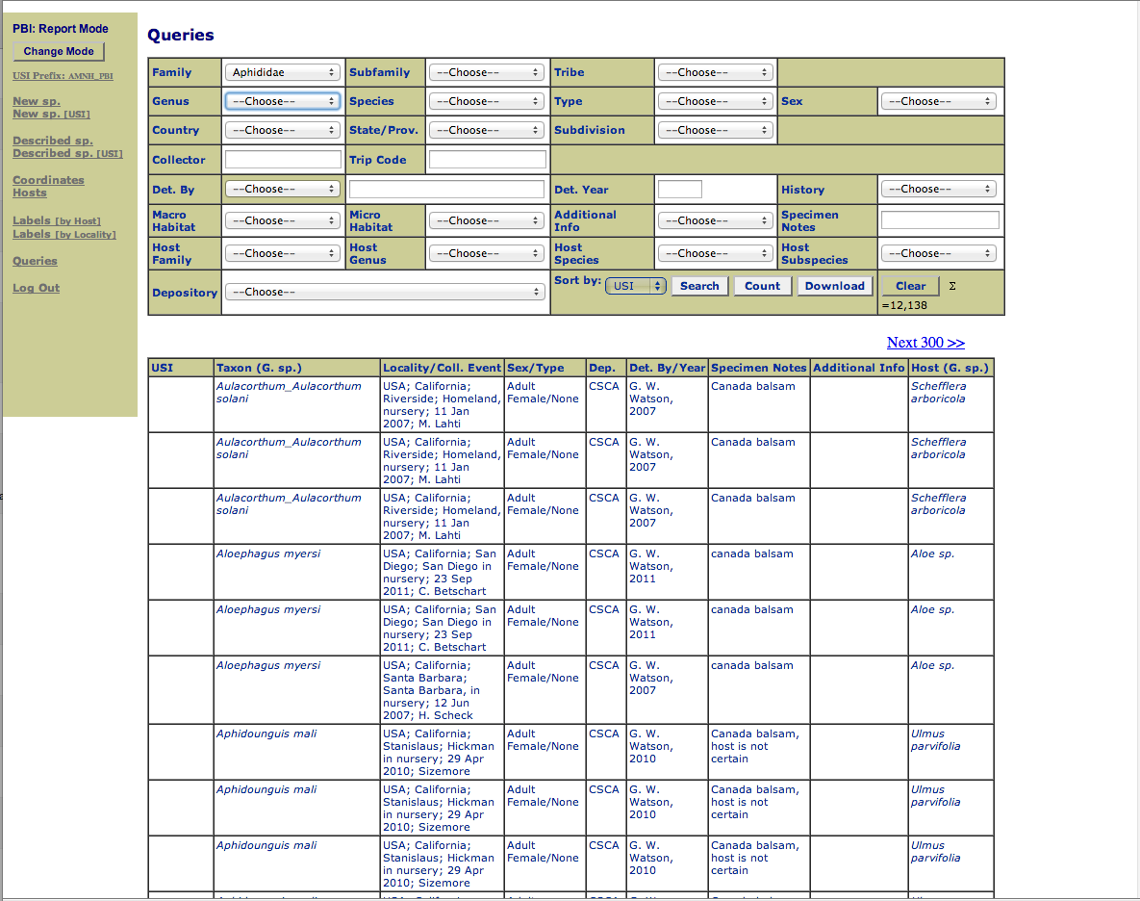
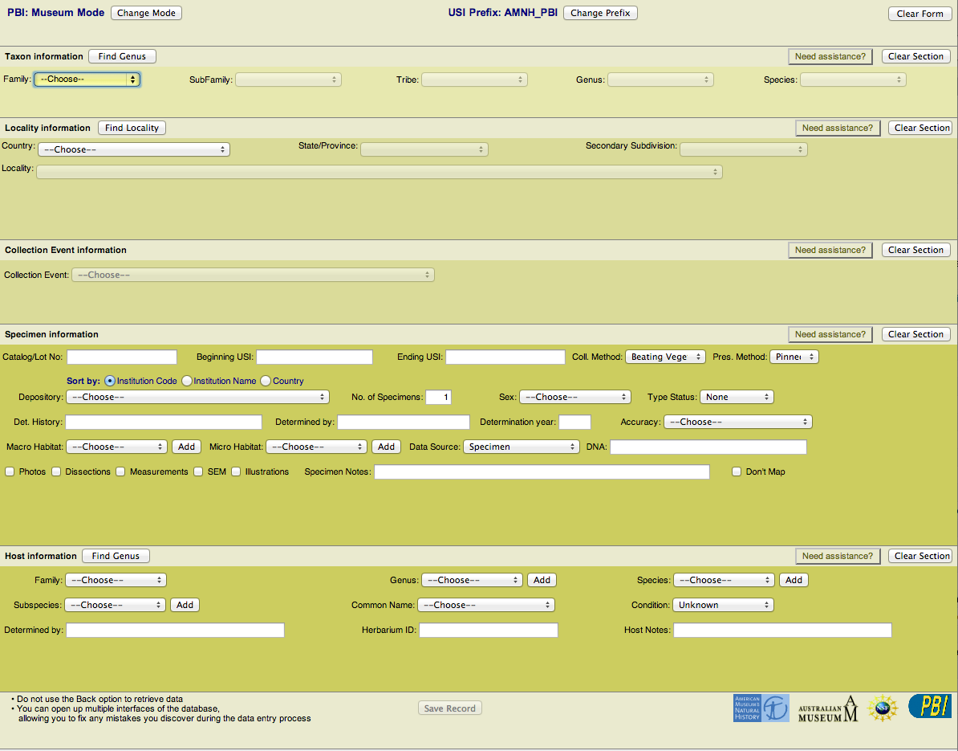
Specimen to Data (to Web)
look at specimen to view data
exemplar images?
enter data in database
no image of label
Pro
Faster access to rich data (not skeletal)
Con
harder to QC data, must go find specimen in collection if there is data in question

Slide 17
Field to Database (to Web): Are plans in place to prevent new legacy data?

Slide 18
Methods, tools, processes

Slide 19
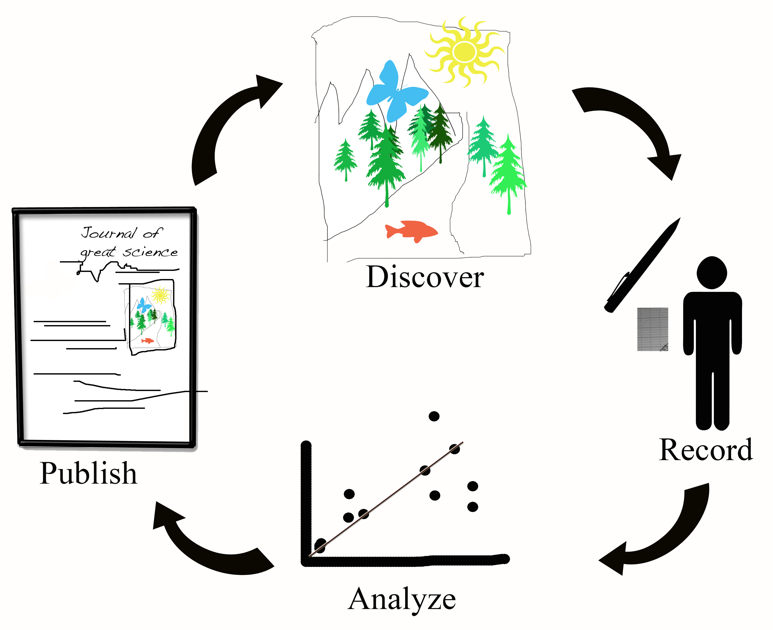
Preventing new legacy data
Try Biocode Field Information Management System (FIMS)
See Field to Freezer: Low tech collecting; high quality data.
(Shelley James, iDigBio)
Your method?

Slide 20
Georeferencing NHC specimen data
from the field vs. legacy data
skills, tools, methods, expertise
TTT123, Georeferencing Working Group (GWG)
time
“it depends”
hints
grouping data
using familiarity
feedback from aggregators

Slide 21
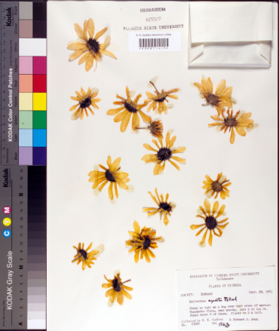
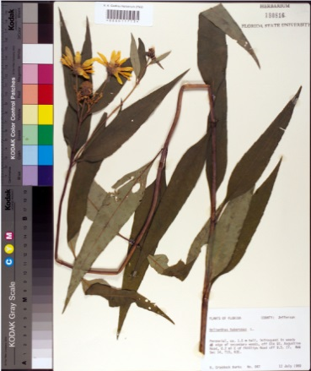
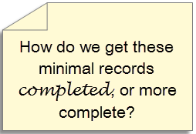
Minimal (Skeletal) Data Capture
Trend
“filed as” name
higher geography
barcode
image
all sheets in folder get the same initial data
only the barcode differs
filed as name
Biological collection data capture: a rapid approach using curatorial data
Notes:
Biological collection data capture: a rapid approach using curatorial data
Read this to get an idea of the current trend in digitizing minimal records to start.

Slide 22
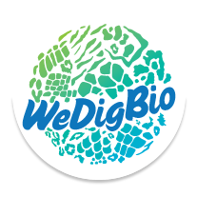
Crowd-sourcing, students, staff, volunteers, …
What to use, what are the options?
What to expect?
How long might it take?
What about data quality?
Check out !

Slide 23
Export and Update
Getting the data to an aggregator.
what are your options?
how does it work?
Specify
Symbiota
others, …
Planning for data enhancement feedback

Slide 24
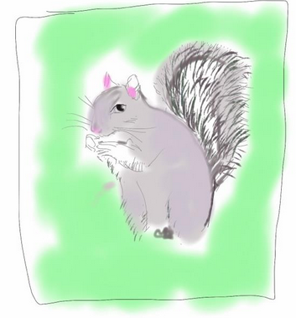
Workflow Optimization: How to keep track and record your progress

Slide 25
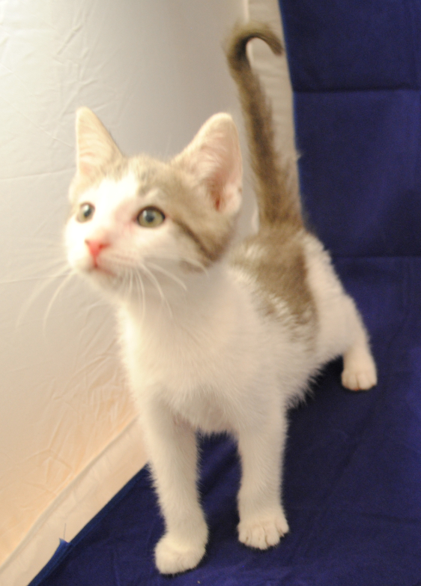
Setting goals:
Discuss goals around specimen data capture.
Goal: Specimen data capture $1/specimen
Goal: Calculate efficiency

Slide 26
List evaluation metrics:
Evaluation metric:
Metric: Data capture speed
Metric: Cost per specimen
When to evaluate? How to keep track of those evaluations? Share process and retain flexibility. How does this modify your data management plan?

Slide 27
Benefits of Open and Online Documentation:
Increase communication:
Method: Presentations at Meetings
Method: iDigBio working groups
Method: Google Docs
Helps overcome challenges
Challenge: “Institutional impediments”
Challenge: “Organizing technical knowledge”

Slide 28
Next, Digitization-Workflows-in-Action Collections Tours
Insect Collection
Herbarium
Symbiota stations
Form 3 groups
Bring your questions
Share your observations
…

