Slide 1
Data Standards for Data Sharing: Darwin Core and Beyond… Making Your Data and Media Discoverable.
Debbie Paul, iDigBio Digitization Specialist
Edward Gilbert, Symbiota Developer
Katja Seltmann, Developer, AMNH, TTD-TCN, NCEAS
Managing NHC Data Workshop, ASU Sept 15 – 17, 2015

Slide 2
Overview of Data Standards
You have the power
What are standards?
Why do we need them?
Where do they come from?
Can anyone contribute to biodiversity data standards development
What are some examples?
Common themes

Slide 3



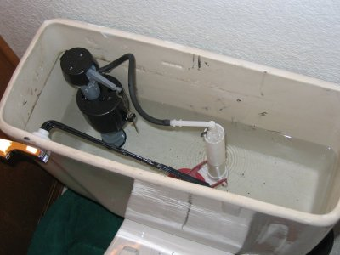
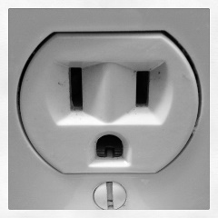





Standards?
HTML
All kinds of standards
Data sharing standards
Notes:
ASTM International, Nonprofit organization
ASTM International, known until 2001 as the American Society for Testing and Materials, is an international standards organization that develops and publishes voluntary consensus technical standards ...

Slide 4

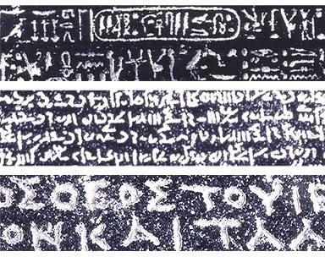
Why do we need standards?
My data?
Your data?
map to a standard!
http://www.britishmuseum.org/images/rosettawriting384.jpg
Notes:
http://prezi.com/iib3pqk-kyd-/curators-workbench/
Why care about standards? What do they have the potential to accomplish?
Collection Managers are doing what they need to do – for themselves, their collections.
When we share, we need standards.
Data becomes useful for others / other purposes.
a common vocab is required
Feedback and Attribution become possible.
The collection gets used, more, increasing the value of the collection.
indirect, subtle
Putting identifiers on specimens --- makes more useful to others.
consistency is important!

Slide 5
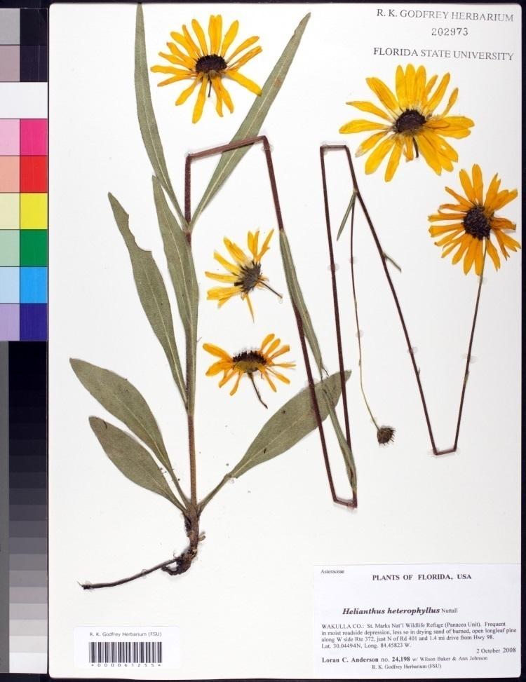
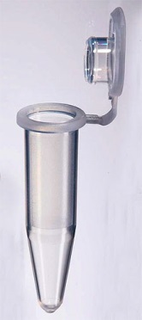
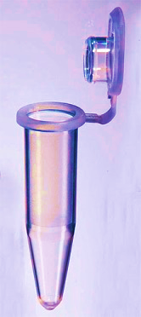
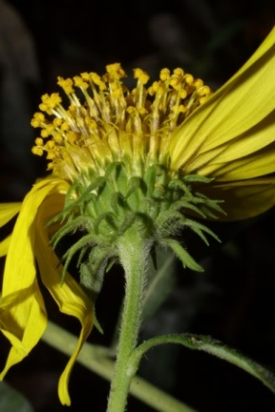
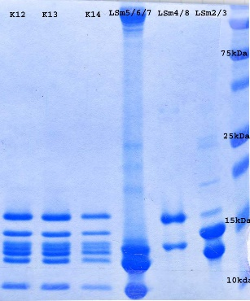
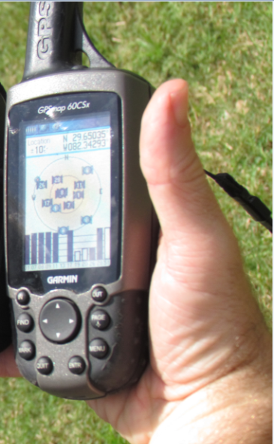

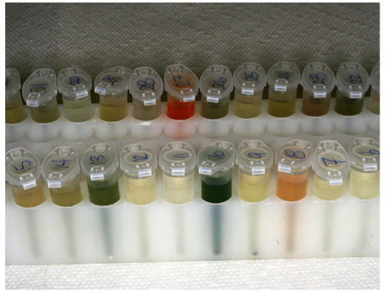
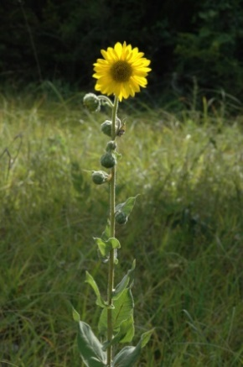

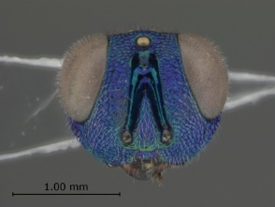
One specimen, sample, video, image or observation, so many kinds of data
Determination 1
Determination 3
Determination 2
IDENTIFIERS ARE THE KEY
Notes:
http://www.morphbank.net/?id=551005
http://herbarium.bio.fsu.edu/view-specimen.php?RecordID=22924
Mast, A. R., A. Stuy, G. Nelson, A. Bugher, N. Weddington, J. Vega, K. Weismantel, D. S. Feller, and D. Paul. 2004 onward (continuously updated). Database of Florida State University's Robert K. Godfrey Herbarium. Website http://herbarium.bio.fsu.edu/ [accessed 06 December 2013].
http://www.morphbank.net/?id=135233
Defined and Registered with GBIF registry
Allow extension while retaining compatibility
Extensions are optional data files linked to core
A row in an extension file always references the core id corresponding to a taxon or taxon occurrence

Slide 6


Labels: values
Identified by: Roman S. Wielgus
Collected by: Roman S. Weilgus; Dalie Wielgus
Date identified: 1968
Catalog number: ASUHIC0080642
Sex: female
Institution code: ASU
Collection code: ASUHIC
Decimal Latitude: 34.7198786
Georeferenced by: Jean-Batiste Quirino
…
Globally Unique Identifiers
e20d9229-4dfc-41c8-be05-afa7b40245a3
urn:catalog:CAS:IZ:25668
6fdb535e-d43d-40c7-a387-e60c07cec5d1
urn:lsid:biosci.ohio-state.edu:osuc_occurrences:OSUM__Birds__B__13589
http://ucjeps.berkeley.edu/cgi-bin/new_detail.pl?RSA460997&related=yes

Slide 7

What are our relevant standards? Where do they come from?

Slide 8

Biodiversity Data Standards
ABCD Access to Biological Collection Data
DwC Darwin Core
DwC-A Darwin Core Archive
NCD Natural Collection Descriptions
AC Audubon Media Core
…
www.tdwg.org
Notes:
TDWG is the volunteer international body where the standards related to biodiversity data are discussed and agreed. There is a set of procedures that the suggested standards have to go through before they are approved and implemented. You are welcome to join!

Slide 9

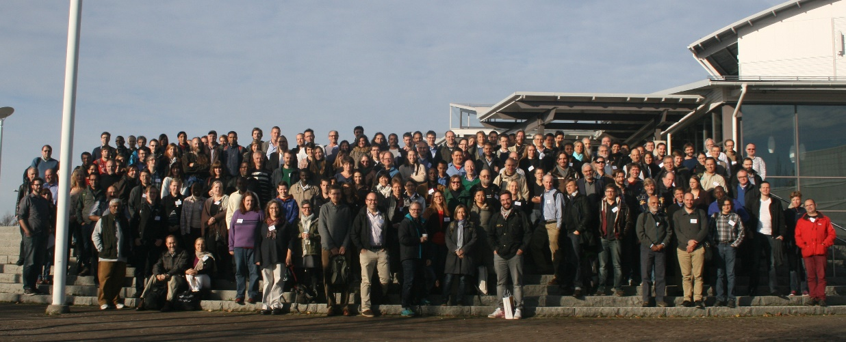
Where do standards come from?
Committees
TDWG
Darwin Core
Uses other existing standards when possible
ISO
Dublin Core
EML
Controlled Vocabularies and Ontologies
Finding standards that fit your data
You can join in!

Slide 10
Examples of relevant biodiversity standards?

Slide 11
Some examples of standards used for sharing biodiversity data
Darwin Core
Audubon Media Core
Material Sample Core and GGBN Extensions
Ecological Metadata Language (EML)

Slide 12
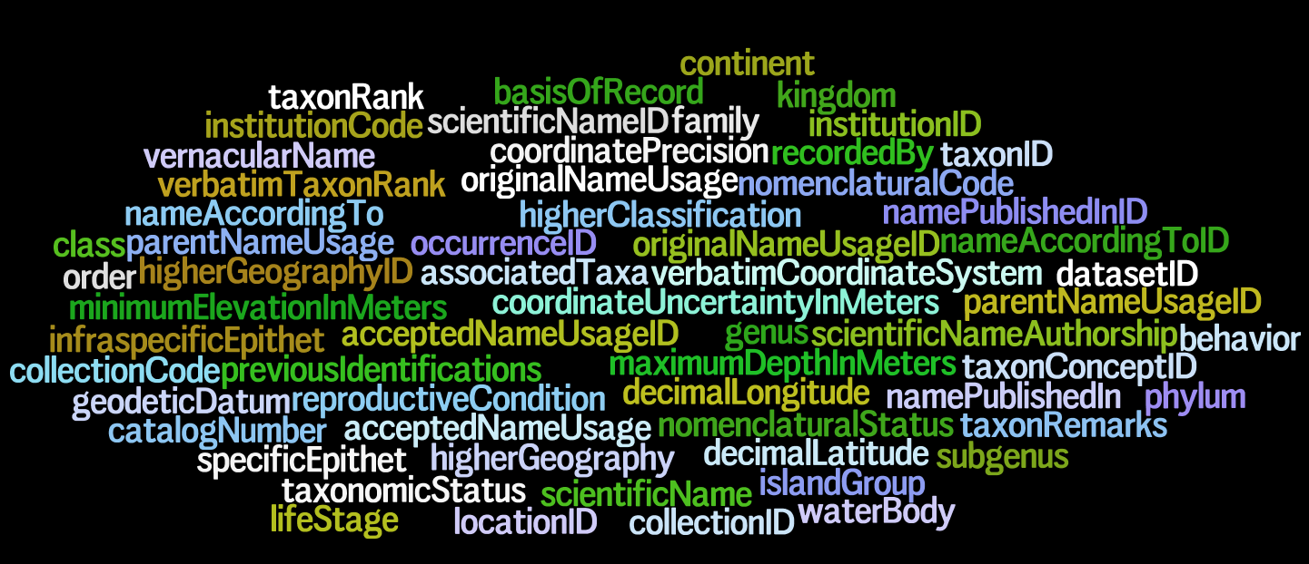
Biodiversity Data Standards: Darwin Core (DwC)
higherClassification
coordinatePosition
specificEpithet
geodeticDatum
collectionCode
taxonConceptID
taxonRank
collectionCode: The name, acronym, coden, or initialism identifying the collection or data set from which the record was derived. Examples: "Mammals", "Hildebrandt", "eBird".
Notes:
Darwin Core – a glossary of terms
DwC is a defined set of terms with their definitions
From Alberto Gonzalez slides.

Slide 13
Darwin Core Fields and Categories
DwC Categories
Record Level (19)
Occurrence (19)
Organism (7)
Material Sample (1)
Event (15)
Location (44)
Geological Context (18)
Identification (8)
Taxon (33)
http://rs.tdwg.org/dwc/terms/index.htm
Record Level
dcterms:type | dcterms:modified | dcterms:language | dcterms:license | dcterms:rightsHolder | dcterms:accessRights | dcterms:bibliographicCitation | dcterms:references | institutionID | collectionID | datasetID | institutionCode | collectionCode | datasetName | ownerInstitutionCode | basisOfRecord | informationWithheld | dataGeneralizations | dynamicProperties
Notes:
From Laura Russell’s slides at IPT Workshop at iDigBio.

Slide 14
What about standards for sharing information about your data?
(Why would we need this?)

Slide 15
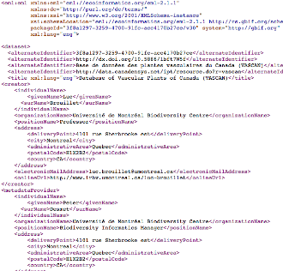
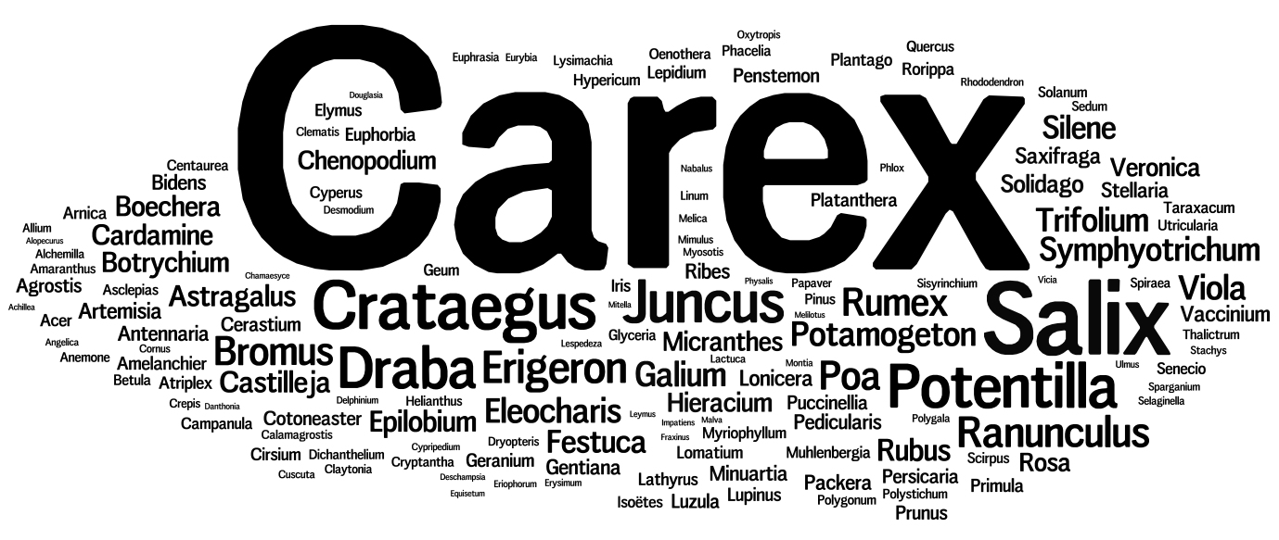

Metadata. We need it. What is it?
« A set of data that describes and gives information about other data »
Unstructured
Structured
Notes:
Metadata can take many forms.
One person’s metadata is another’s data.
Traditionally, metadata can be unstructured (such as a collection of keywords) or structured documents (such as XML with schema), which may include controlled vocabularies.
(slide from David Shorthouse at Canadensys).

Slide 16
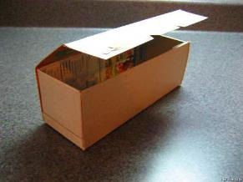
Why Metadata?
“If data are LEGO bricks, then metadata are the shiny box and instructions. They enable users to discover your dataset and assess its relevance for their particular needs, so it pays off investing some time providing them.”
From Canadensys (http://www.canadensys.net/publication/data-publication-guide)
Notes:
(slide from David Shorthouse at Canadensys).

Slide 17
Ecological Metadata Language (EML)
Basic Metadata Title || Description || Metadata Language || Resource Language || Type || Subtype
Resource Contact First Name Last Name Position Organization Address City State Country Postal Code Phone Email Home Page
Resource Creator First Name Last Name Position Organization Address City State Country Postal Code Phone Email Home Page
Metadata Provider First Name Last Name Position Organization Address City State Country Postal Code Phone Email Home Page
Geographic Coverage Global coverage (true or false) || West || East || South || North || Description
Taxonomic Coverage Description || Taxa (Scientific Name, Common Name, Rank ||
Temporal Coverage Temporal Coverage Type || Start Date || End Date
Keywords biodiversity informatics, data standards, collecting, apps,
Associated Parties First Name Last Name Position Organization Address City State Country Postal Code Phone Email Home Page
Project Data Title || Personnel First Name || Personnel Last Name || Personnel Role || Funding || Study Area Description || Design Description
Sampling Methods Study Extent || Sampling Description || Quality Control || Step Description
Citations Citation Identifier || Resource Citation || Bibliography
Collection Data Collection Name || Collection Identifier || Parent Collection Identifier || Specimen preservation method
Curatorial Units Method type || Between || Unit Type (Ex. units include skins, sheets, pins, boxes, jars)
External links ` Resource Homepage
Additional Metadata Hierarchy level || Date Published || Resource logo URL || Purpose || IP Rights || Additional Information
Alternative Identifiers
Notes:
The classes and the related fields (well, labels really) listed here from the EML standard are just a subset of a very detailed standard developed by ecologists to share ecological biodiversity data effectively. This set of terms is taken from those included for use by those who put together a data-sharing format known as a Darwin Core Archive (DwC-A). A Darwin Core Archive includes not only data, but also an EML file that includes the above information “about the data.”

Slide 18
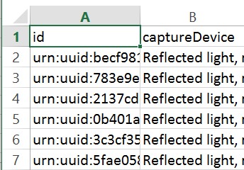




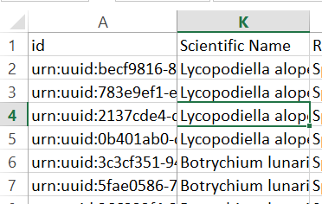
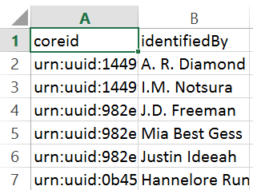
Using the IPT software Inside the DwC-A you are creating…
One format for sharing data, a DwC-Archive
samplemultimedia.txt
(extension)
describes
extends
XML
describes
meta.xml
describes
sampleoccurrence.txt
(core)
extends
eml.XML
Determination 1
Determination 2
eml.xml
metadata about the dataset, collection and contact information
Determination n
sampledeterminations.txt
(extension)
Notes:
Using http://rs.tdwg.org/dwc/terms/guides/text/index.htm#coreTag as a guide, this diagram shows what is inside the DwC-A file being created at this workshop.
After David Shorthouse presented workshop section 1C titled What are the metadata? Participants logged in to their own instance of the IPT and filled out the form providing information about the dataset and collection that houses the specimens and holds the data. This metadata includes information about what’s being shared (the dataset) and the taxonomic / geographic / temporal scope of the dataset, who is responsible and can be contacted for more information about the dataset, as well as other potential information about any sampling methods used, and relevant citations related to the dataset. All of this information (see the following 12 categories) goes into the eml.xml file. EML is a data standard for sharing this type of information and the acronym stands for Ecological Metadata Language.
1. Basic Metadata
2. Geographic Coverage
3. Taxonomic Coverage
4. Temporal Coverage
5. Other Keywords
6. Associated Parties
7. Project Data
8. Sampling Methods
9. Citations
10. Collection Data
11. Physical Data
12. Additional Metadata
Next, Laura provided background for the next step: How to create a resource in the IPT in the section: 1D. Theory: publishing with the IPT data sources where she discussed issues of data quality, character encoding, and mapping, including a discussion of the different core types. Participants again logged in to follow along and map the data found in the sampleoccurrence.txt file. This is the core file in this example. The coreid, becomes the dwc:occurrenceID and is the identifier that links other files (image data, determination data, etc) back to the core file. The sampleoccurrence.txt file contains plant data, some of it is real, some of it customized for this example.
After this, the next step is to add the determination (aka verification, identification) history data, and lastly the multimedia data. To do this, each extension data set will need to be checked for data issues (data quality, standardization, enhancement), then the extension fields will need to be added in the IPT to the resource, the relevant text file uploaded to the IPT, followed by mapping. For these examples, there are very few errors in the samplemultimedia.txt and sampledeterminations.txt files.
Note that the meta.xml file is created for you by the IPT tool. There are other online tools that can help you do this in addition to the IPT (the dwc-a assistant). The meta.xml file contains the name of each file inside the zipped DwC-A file, and shows all the fields (elements, properties, column headers) inside each file, noting in which column a particular field appears.
(zipper is clip art from http://morgainea.deviantart.com/)

Slide 19
What about standards for sharing media information?

Slide 20
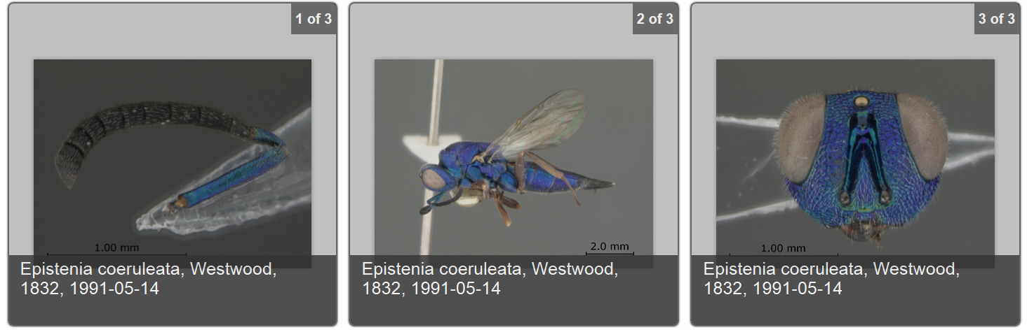

Audubon Media Description
Sharing media
What’s in the image, recording, video?
Who took the photo, made the recording, created the SEM, CT scan?
Is the media under copyright? Or is it public domain?
Where can more / different formats of the media resource be found?
Notes:
See more about these images at https://www.idigbio.org/portal/mediarecords/b9dc0746-e2b8-4bae-a301-b20b054f9117
Management
Attribution
Agents
Content Coverage
Geography
Temporal Coverage
Taxonomic Coverage
Resource Creation
Related Resources
Service Access Point
aka the Audubon Core
Vocabularies to represent metadata for biodiversity multimedia resources and collections.
Purpose is to represent information that will help to determine whether a particular resource or collection is fit for some particular biodiversity science application before acquiring the media.
Vocabularies address such concerns as the
management of the media and collections,
descriptions of their content,
their taxonomic, geographic, and temporal coverage, and the
appropriate ways to retrieve, attribute and reproduce them.
Link: http://terms.tdwg.org/wiki/Audubon_Core_Term_List

Slide 21
Using the IPT software Inside the DwC-A you are creating…
One format for sharing data, a DwC-Archive
samplemultimedia.txt
(extension)
describes
extends
XML
describes
meta.xml
describes
sampleoccurrence.txt
(core)
extends
eml.XML
Determination 1
Determination 2
eml.xml
metadata about the dataset, collection and contact information
Determination n
sampledeterminations.txt
(extension)
Notes:
Using http://rs.tdwg.org/dwc/terms/guides/text/index.htm#coreTag as a guide, this diagram shows what is inside the DwC-A file being created at this workshop.
After David Shorthouse presented workshop section 1C titled What are the metadata? Participants logged in to their own instance of the IPT and filled out the form providing information about the dataset and collection that houses the specimens and holds the data. This metadata includes information about what’s being shared (the dataset) and the taxonomic / geographic / temporal scope of the dataset, who is responsible and can be contacted for more information about the dataset, as well as other potential information about any sampling methods used, and relevant citations related to the dataset. All of this information (see the following 12 categories) goes into the eml.xml file. EML is a data standard for sharing this type of information and the acronym stands for Ecological Metadata Language.
1. Basic Metadata
2. Geographic Coverage
3. Taxonomic Coverage
4. Temporal Coverage
5. Other Keywords
6. Associated Parties
7. Project Data
8. Sampling Methods
9. Citations
10. Collection Data
11. Physical Data
12. Additional Metadata
Next, Laura provided background for the next step: How to create a resource in the IPT in the section: 1D. Theory: publishing with the IPT data sources where she discussed issues of data quality, character encoding, and mapping, including a discussion of the different core types. Participants again logged in to follow along and map the data found in the sampleoccurrence.txt file. This is the core file in this example. The coreid, becomes the dwc:occurrenceID and is the identifier that links other files (image data, determination data, etc) back to the core file. The sampleoccurrence.txt file contains plant data, some of it is real, some of it customized for this example.
After this, the next step is to add the determination (aka verification, identification) history data, and lastly the multimedia data. To do this, each extension data set will need to be checked for data issues (data quality, standardization, enhancement), then the extension fields will need to be added in the IPT to the resource, the relevant text file uploaded to the IPT, followed by mapping. For these examples, there are very few errors in the samplemultimedia.txt and sampledeterminations.txt files.
Note that the meta.xml file is created for you by the IPT tool. There are other online tools that can help you do this in addition to the IPT (the dwc-a assistant). The meta.xml file contains the name of each file inside the zipped DwC-A file, and shows all the fields (elements, properties, column headers) inside each file, noting in which column a particular field appears.
(zipper is clip art from http://morgainea.deviantart.com/)

Slide 22
What about standards for sharing genomics data?
Great! Now I know how to share
Metadata (EML)
Specimen Data (DwC)
Media Data (Audubon)
But I have lots of genomics data!
What to do?

Slide 23

Global Genome Biodiversity Network (GGBN) extensions: require a Material Sample Core
The category of information pertaining to the physical results of a sampling (or subsampling) event. In biological collections, the material sample is typically collected, and either preserved or destructively processed. Created 2 Apr 2014 with all Simple Darwin Core ratified terms.
GGBN Amplification Extension
GGBN DNA Cloning Extension
GGBN Gel Image Extension
GGBN Loan Extension
GGBN Material Sample Extension
GGBN Permit Extension
GGBN Preparation Extension
GGBN Preservation Extension
Notes:
See more about these images at https://www.idigbio.org/portal/mediarecords/b9dc0746-e2b8-4bae-a301-b20b054f9117
For GGBN info see http://ggbn.org/

Slide 24
Using the IPT software Inside the DwC-A you are creating…
One format for sharing data, a DwC-Archive
samplemultimedia.txt
(extension)
describes
extends
XML
describes
meta.xml
describes
sampleoccurrence.txt
(core)
extends
eml.XML
Determination 1
Determination 2
eml.xml
metadata about the dataset, collection and contact information
Determination n
sampledeterminations.txt
(extension)
Notes:
Using http://rs.tdwg.org/dwc/terms/guides/text/index.htm#coreTag as a guide, this diagram shows what is inside the DwC-A file being created at this workshop.
After David Shorthouse presented workshop section 1C titled What are the metadata? Participants logged in to their own instance of the IPT and filled out the form providing information about the dataset and collection that houses the specimens and holds the data. This metadata includes information about what’s being shared (the dataset) and the taxonomic / geographic / temporal scope of the dataset, who is responsible and can be contacted for more information about the dataset, as well as other potential information about any sampling methods used, and relevant citations related to the dataset. All of this information (see the following 12 categories) goes into the eml.xml file. EML is a data standard for sharing this type of information and the acronym stands for Ecological Metadata Language.
1. Basic Metadata
2. Geographic Coverage
3. Taxonomic Coverage
4. Temporal Coverage
5. Other Keywords
6. Associated Parties
7. Project Data
8. Sampling Methods
9. Citations
10. Collection Data
11. Physical Data
12. Additional Metadata
Next, Laura provided background for the next step: How to create a resource in the IPT in the section: 1D. Theory: publishing with the IPT data sources where she discussed issues of data quality, character encoding, and mapping, including a discussion of the different core types. Participants again logged in to follow along and map the data found in the sampleoccurrence.txt file. This is the core file in this example. The coreid, becomes the dwc:occurrenceID and is the identifier that links other files (image data, determination data, etc) back to the core file. The sampleoccurrence.txt file contains plant data, some of it is real, some of it customized for this example.
After this, the next step is to add the determination (aka verification, identification) history data, and lastly the multimedia data. To do this, each extension data set will need to be checked for data issues (data quality, standardization, enhancement), then the extension fields will need to be added in the IPT to the resource, the relevant text file uploaded to the IPT, followed by mapping. For these examples, there are very few errors in the samplemultimedia.txt and sampledeterminations.txt files.
Note that the meta.xml file is created for you by the IPT tool. There are other online tools that can help you do this in addition to the IPT (the dwc-a assistant). The meta.xml file contains the name of each file inside the zipped DwC-A file, and shows all the fields (elements, properties, column headers) inside each file, noting in which column a particular field appears.
(zipper is clip art from http://morgainea.deviantart.com/)
-----------------------
For the Field to Database Workshop.
In this slide for GGBN (I think). The central, “core” file will be “Material Sample” and will contain information about samples of specimens. Samples for genomic research. The related data about the DNA and germplasm material will be shared in the extensions. The information about the related vouchered museum specimens will be in the Resource Relationship Extension. Globally unique identifiers, for the specimens, for the samples, are key to making this work.

Slide 25
standards

Slide 26

Common Themes
You have the power to
extend the life, usefulness, and discoverability of NHC data
plan ahead, stop legacy data proliferation
think globally
use standards, identifiers!
manage data for long term
The long tail of data
help the standards community
data organization (classes / grouping)
data standards facilitate data use / re-use
Keeping concepts separate
Using standard data formats
locality data
collector data
Notes:
Host associations
Paleo – locality data
Georeferencing / Data Validation

Slide 27

Data and Metadata. It’s about discovery and data re/use. It’s about feedback and accountability. It’s about credit and attribution. Make sure your data’s not under a rock.
data
data
data

Slide 28
Let’s map some data to Darwin Core terms…

