Slide 1
#nhcdata @idigbio
http://idigbio.adobeconnect.com/nhcdata
Wiki ~ it’s yours
Google Doc

Slide 2
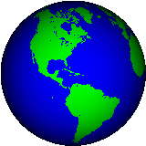
Welcome to: Managing Natural History Collections Data for Global Discoverability
For Global Discoverability
Managing NHC Data
Deborah Paul, on Twitter @idbdeb
Amber Budden, DataONE
September 15 – 17, 2015
Arizona State University (ASU)
Biodiversity Knowledge Integration Center (BioKIC)
Brought to you by: Tri-Trophic TCN, DataONE, ASU, iDigBio, Symbiota, and NCEAS

Slide 3
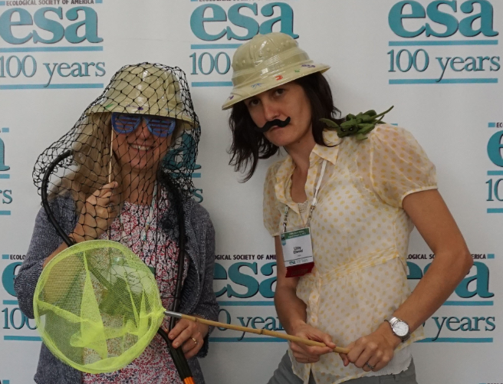
Logistics
Wiki http://tinyurl.com/nhcdata
Connecting (wired / wireless)
Adobe Connect
http://idigbio.adobeconnect.com/nhcdata
Notes / Questions – google doc
Nico Franz and Edward Gilbert
Our Local Hosts and contacts for local logistics
Desert Botanic Gardens trip
Insect collecting (Wed night optional)
On Twitter
@iDigBio @taxonBytes @idbdeb @irene_moon

Slide 4
iDigBio – Integrated Digitized Biocollections
ADBC, BCON (NIBA), iDigBio, and the TCNs
10 year effort to digitize and mobilize the scientific information associated with vouchered specimens held in U.S. research collections (Larry Page – PI)
Project Management (PM) and PM skills development (David Jennings)
Cyberinfrastructure
needs (Jose Fortes et al.)
Effective digitization standards, workflows, and training (Greg Riccardi et al.)
Develop research use cases and collaborations (Pam Soltis et al.)
Education and outreach (Bruce McFadden et al.)
Plan for long-term sustainability* of the national digitization effort

Slide 5
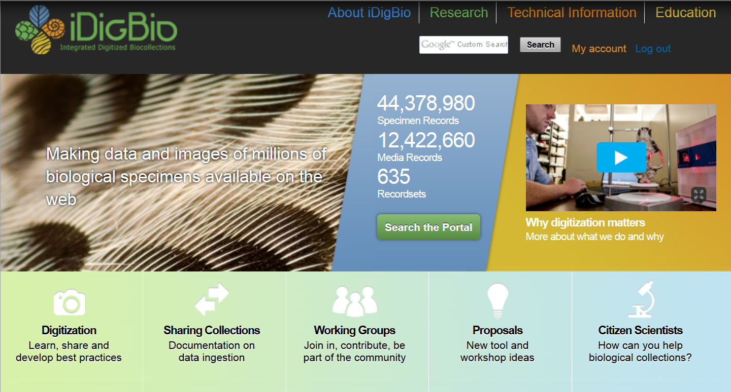
Research Focus
Workflows
https://www.idigbio.org
@iDigBio
Notes:
iDigBio is a 10 year effort to kick-start robust digitization of specimen data, including transcription, imaging, and georeferencing. Our goal is to speed access to data for scientists and educators and support reproducible research.

Slide 6
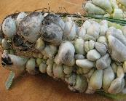
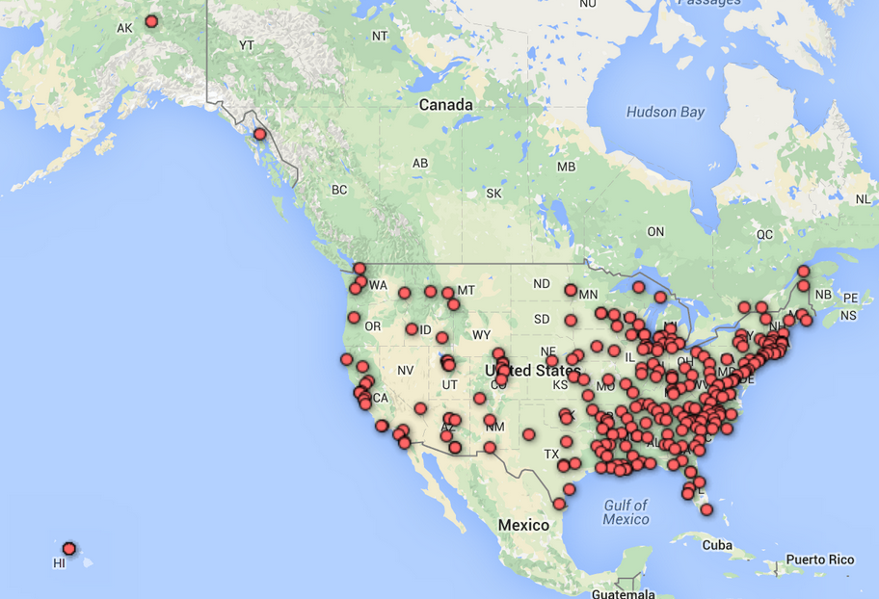
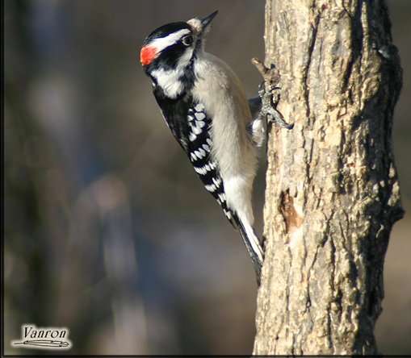
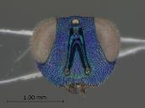
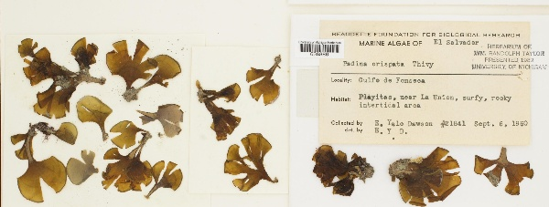
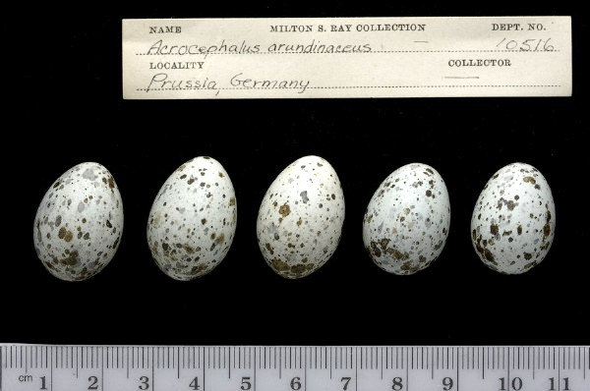
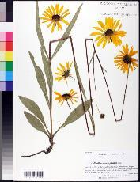
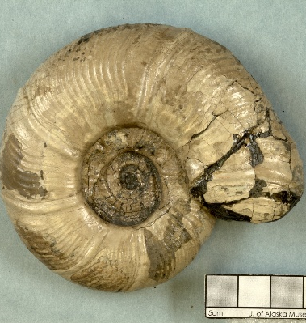
15 Thematic Collection Networks (TCNs)
Notes:
Well over 280 groups are actively transcribing records, imaging specimens, and capturing animal behavior videos and sounds, to provide scientists with easy access to robust fit-for-research-use data. [12 sec]
268 institutions in over 15 tcns + pens
35 data contributors over 635 record sets
Where does the data come from? Collectors of course, and then into collections databases, and out into the world’s aggregators making data accessible worldwide.
Have other collaborators or contacts been involved? (as of April 2015)
2000 characters maximum
Institutions collaborating in TCNs and PENs (268): https://www.idigbio.org/content/collaborating-institutions
Current iDigBio data contributors (35) publishing over 434 datasets: https://www.idigbio.org/portal/publishers
Datasets in the process of being ingested by iDigBio: https://www.idigbio.org/wiki/index.php/Data_Ingestion_Report
o Datasets ingested since 1/1/2015 (31)
o Datasets at some stage of active mobilization (69)

Slide 7
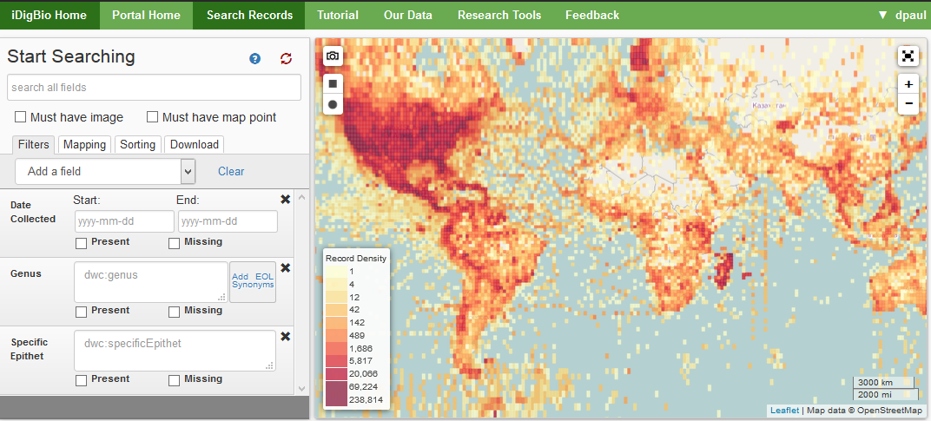
44,693,475+
www.idigbio.org/portal/search
Notes:
You can access this data at iDigBio. With data from across the globe, you can search over 40 million specimen records, and over 11 million media records. Anyone can freely download and use data of interest.
Portal
API
Data feedback
12,360,093 Media Records
635 Recordsets

Slide 8
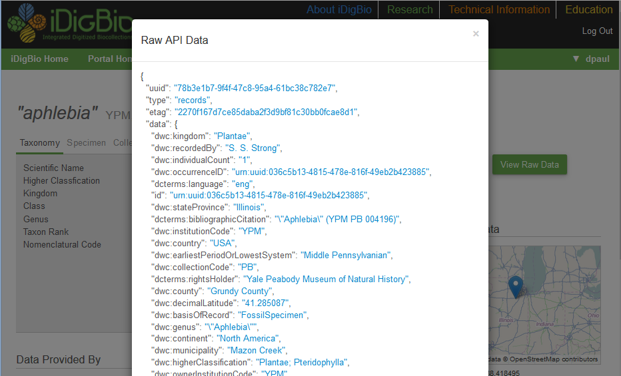
Got Data Skills? Use the iDigBio API
Please join our list at idigbio-api-users-l@lists.ufl.edu
Notes:
You can access the data through our portal, and through our API. We enhanced the API at a recent hackathon. Through the programmatic interface you can access iDigBio’s data rapidly, and get just what you are looking for.

Slide 9
Once digitized, why share? Several important reasons:
your data is aggregated with a lot more data
is accessible to many more people (including potential funders, collaborators)
enhanced by aggregator scripts
you can do more / new things with your data with aggregator tools and methods
data quality checks improve your data
off-site copy of your data
*please share methods too!

Slide 10
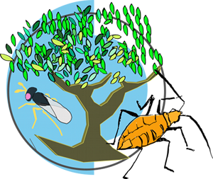
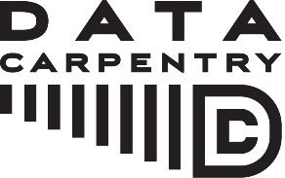
Our Vision

Slide 11
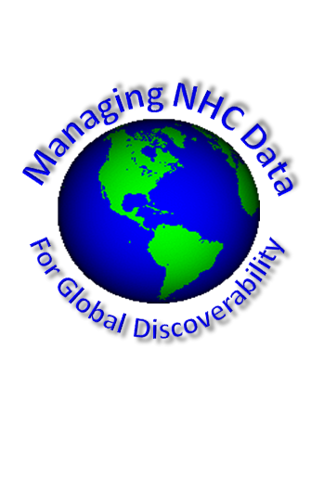
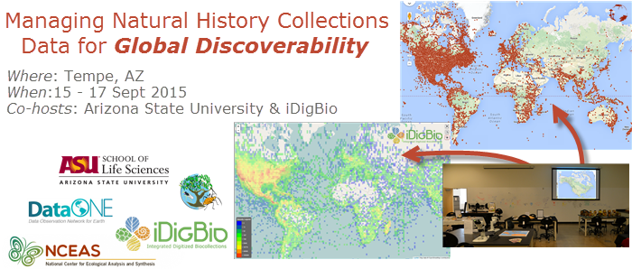
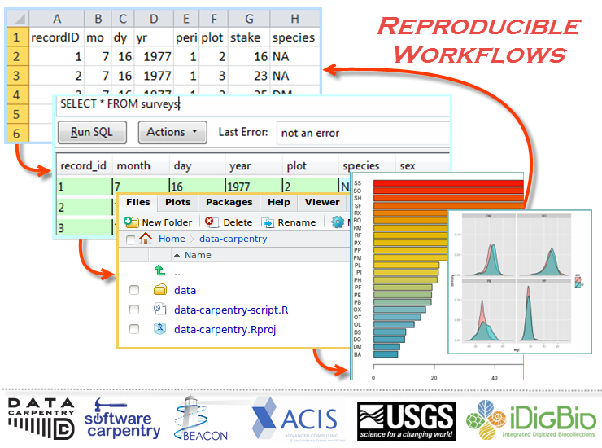
Biodiversity Informatics Workshop Series 1 - 4
Notes:
The F2DB workshop was the third in a series of four workshops, conceived by iDigBio and the Tri-Trophic TCN, and collaboratively developed by iDigBio, TTD-TCN, USGS-BISON, GBIF, VertNet, Canadensys, NCEAS, ASU, Data Carpentry, Software Carpentry, ACIS, and DataONE. From a data-life-cycle point-of-view, at this workshop we focused on the origination of specimen data, the collecting event, and the standardization of that collected field data to make sure the data are suitable for upload into any database.
Across domains, there is the realization that we have a biodiversity informatics skills and knowledge gap. These workshops are just four, of many different groups who are addressing these needs. Until these gaps are addressed effectively at the undergraduate level, we’ll continue to need these types of workshops, webinars, and online courses. If you have an interest in the recently funded RCN UBE group called QUBES, Matt Collins was at their first meeting, and Deb was at their community input meeting, prior to QUBES funding.

Slide 12
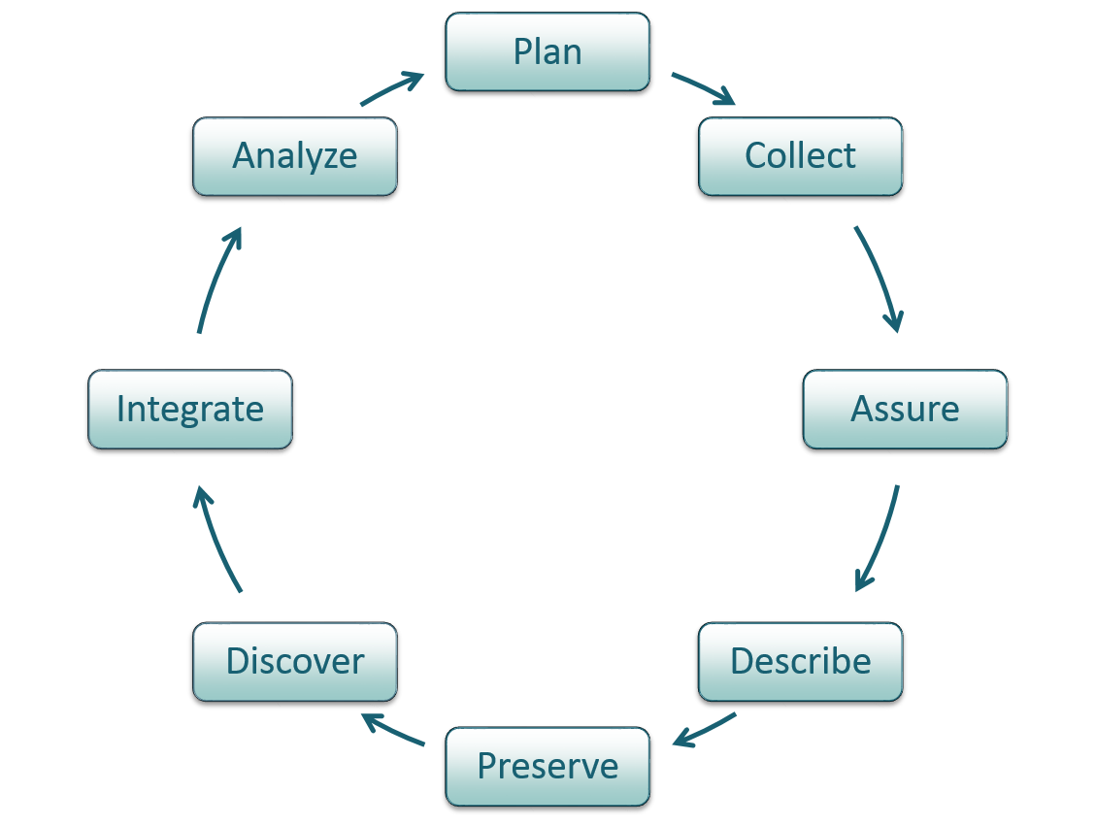
Goals
Introduction to data management
Introduction to data models and relational databases
Enhance your knowledge of NHC relevant data standards
You become ambassadors for data standards and data standards development in your own institution
Introduction to steps in NHC Data Sharing
Digitization best practices and where to find materials and help
Increased awareness of tools and methods that support efficient digitization and data sharing, including when/where to use them
More about how to standardizing data and improve and extend that data
Best practices for data / metadata and publishing datasets
Introduction to data publishing and copyright/ intellectual property rights issues
Big picture data flow (the data life cycle)
Know the benefits of data sharing
An enhanced grasp of a greater network, the global landscape

Slide 13
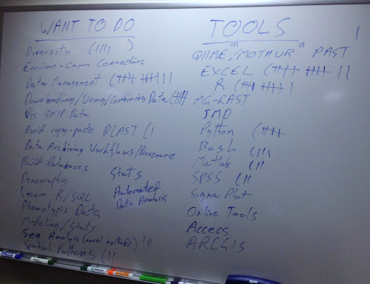
A quick survey
?
What do you want to be able to do (with data)?
What tools do you currently use?
Notes:
How do you document / track progress?
What’s your current data challenge/s?

