Slide 1
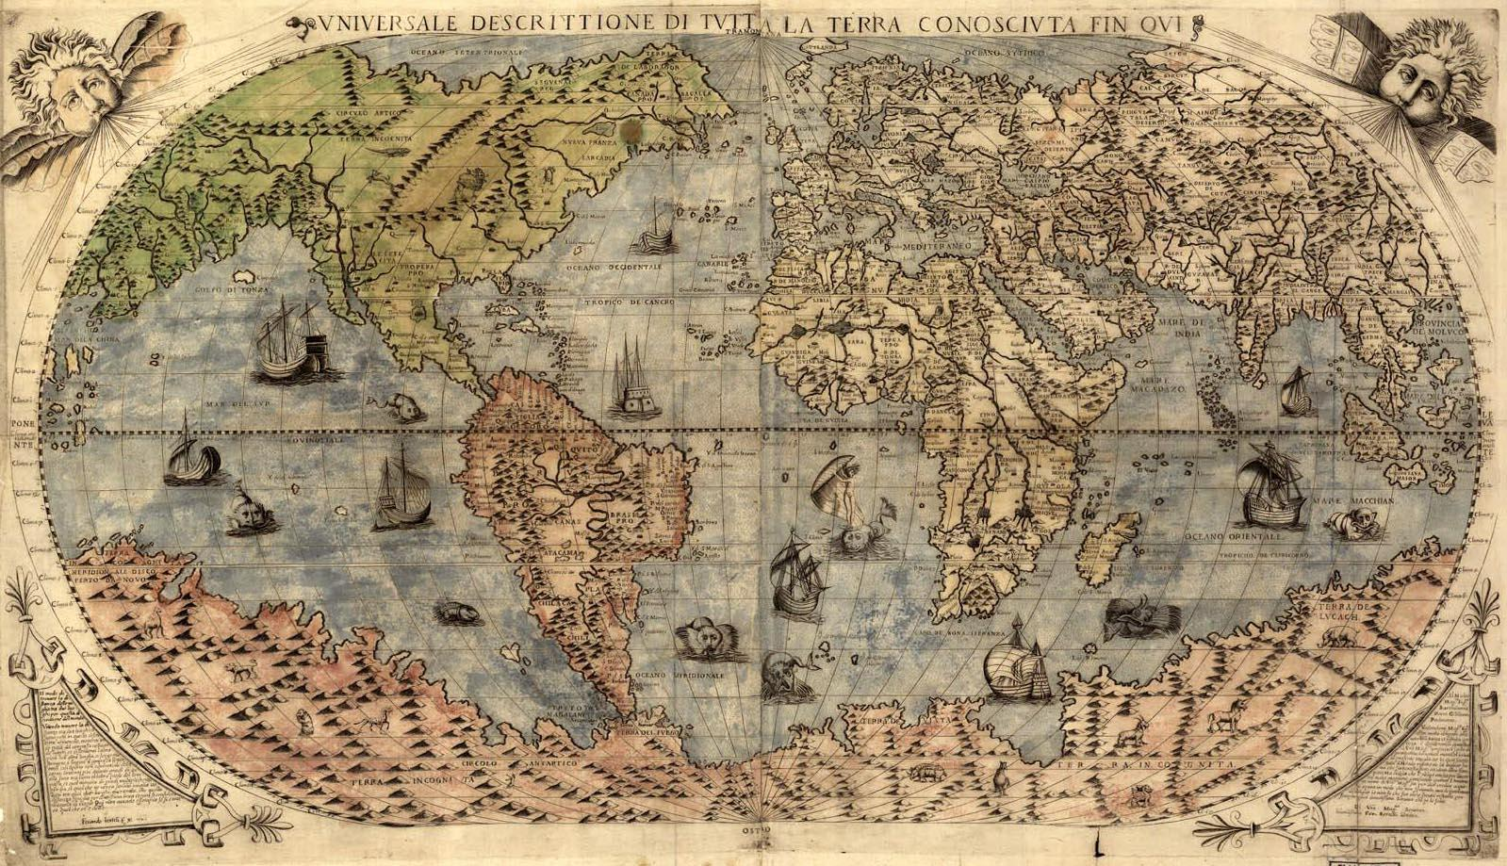

Georeferencing Natural History Collections Data:
The GEOLocate Project
Nelson E. Rios

Slide 2
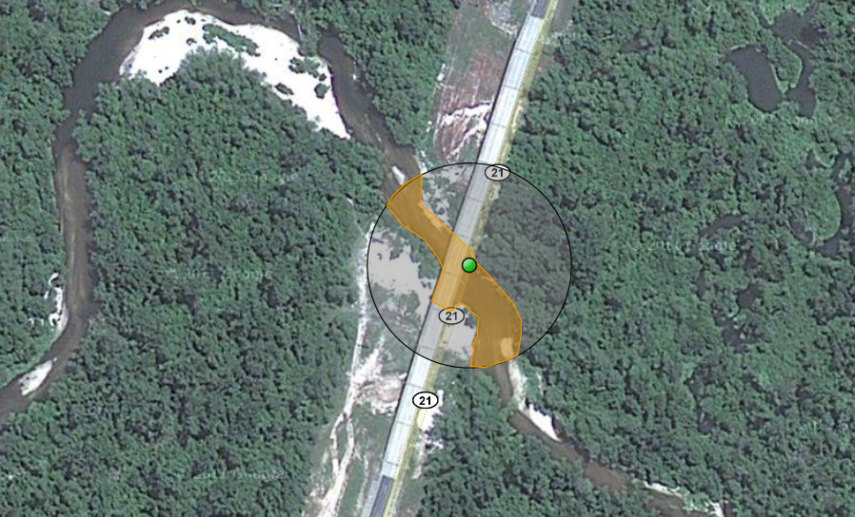
What is Georeferencing
pushepatapa creek, trib. to pearl river, 7.8 miles north of bogalusa at hwy 21; Washington; LA; USA
latitude: 30.88797
longitude: -89.83601
uncertainty radius: 48m
uncertainty polygon: 30.88823,-89.83641, 30.88815,-89.83634, 30.88808,-89.83622…

Slide 3
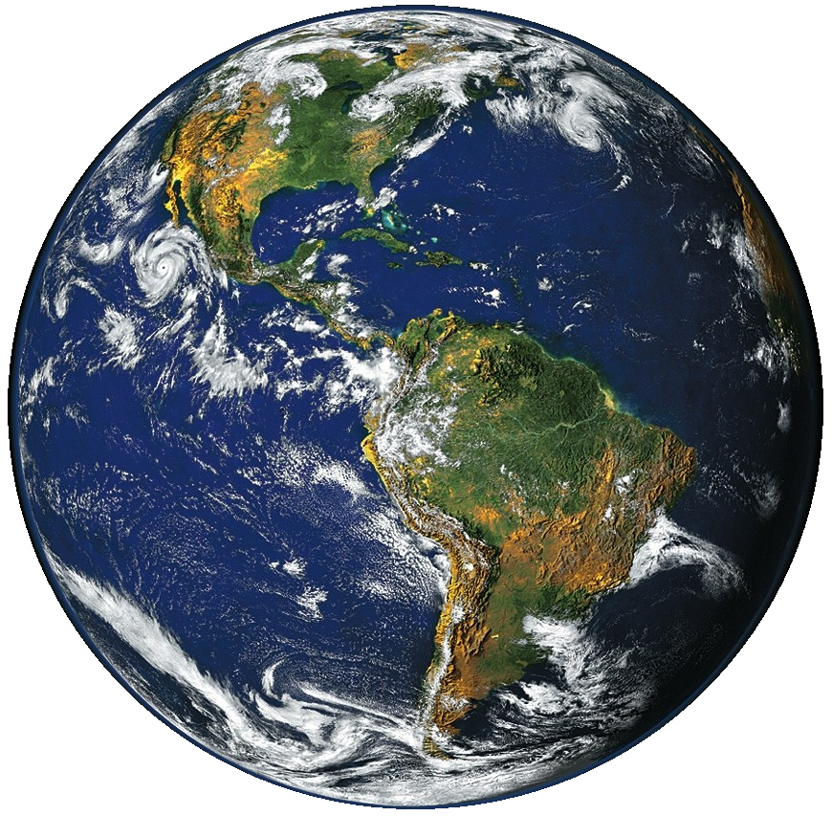
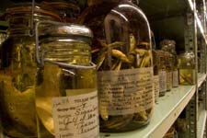
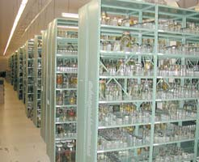
3 billion specimens with ½ billion collecting events

Slide 4
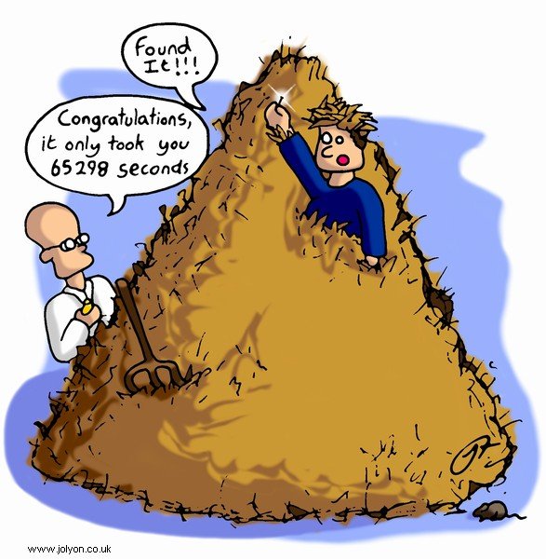
Traditional Methods

Slide 5

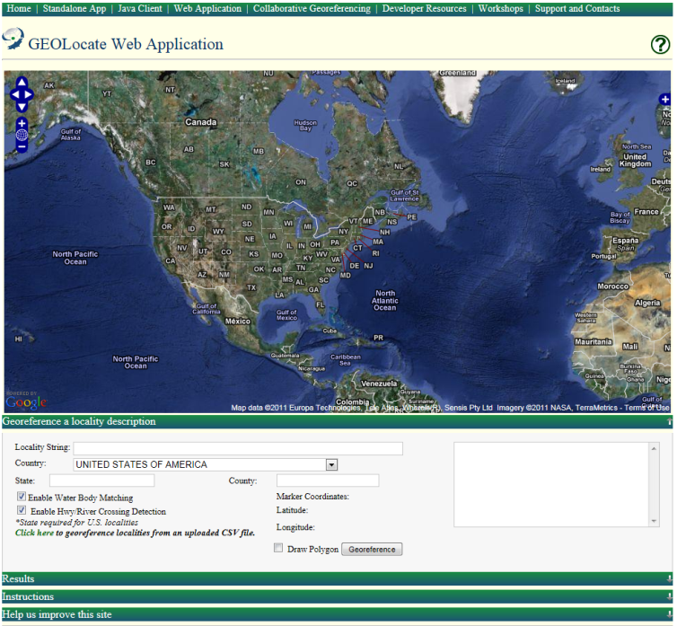
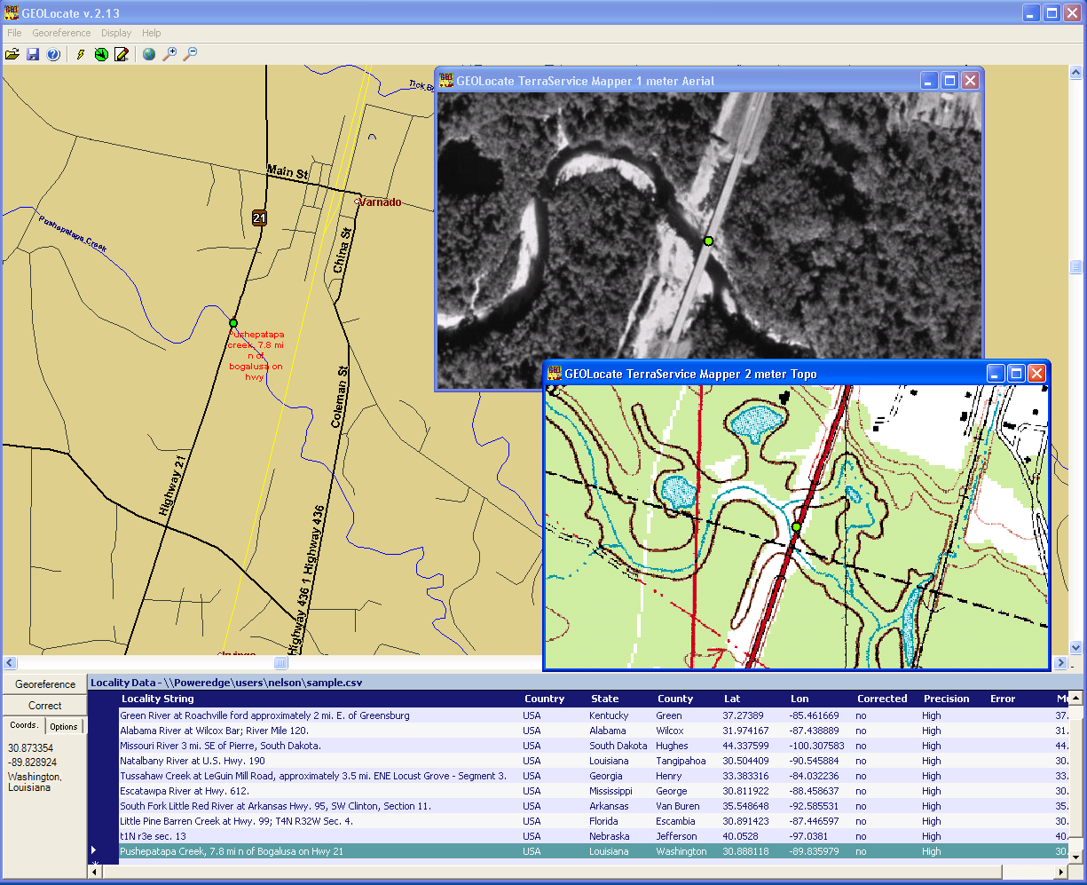
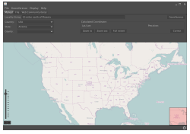
Software & services for georeferencing of natural history collections data
automated georeferencing
verification & correction
multi-lingual
kml export
interoperability
soap & rest api
batch processing
training
geographic visualization
google, bing, openstreet, wms
uncertainty determination
collaborative georeferencing

Slide 6
Typical GEOLocate Workflow
pushepatapa creek, trib. to pearl river, 7.8 miles north of bogalusa at hwy 21; Washington; LA; USA
Data Entry &
Preparation
1
Automated
Processing
Georeferencing Algorithm
2
Manual
Verification
Visualize, verify & adjust output coordinates & uncertainties
3
latitude: 30.88797
longitude: -89.83601
uncertainty radius: 48m
uncertainty polygon: 30.88823,-89.83641, 30.88815,-89.83634, 30.88808,-89.83622…

Slide 7
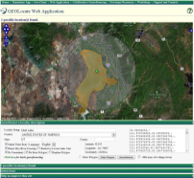
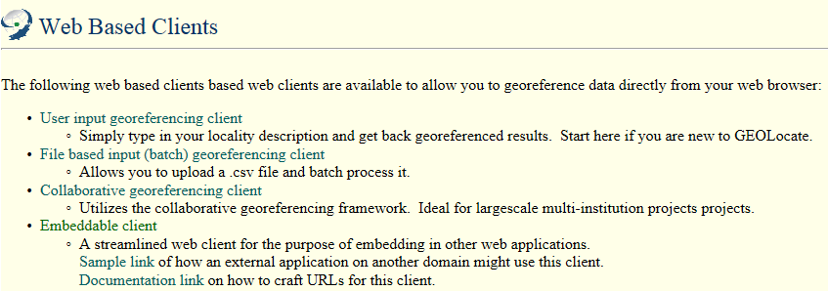
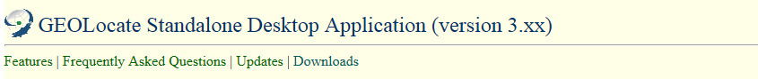
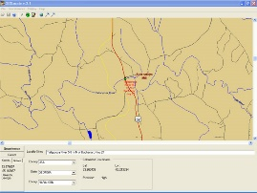
Options: Web vs. Desktop?

Slide 8
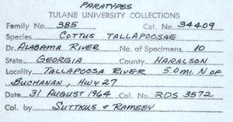
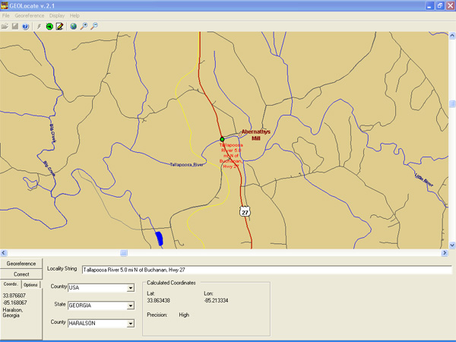
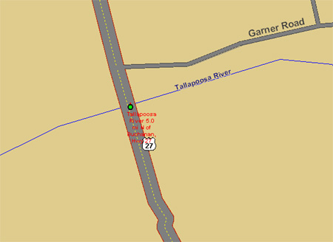
Georeferencing Example: Desktop App

Slide 9
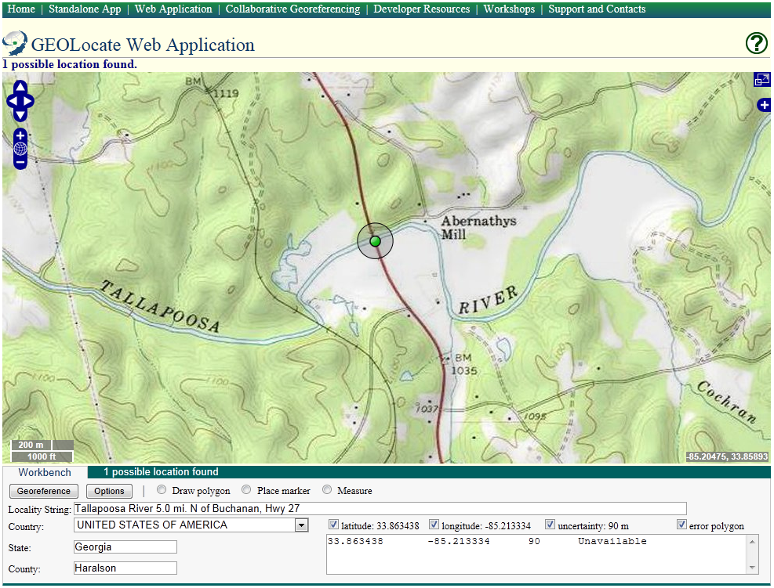

Slide 10
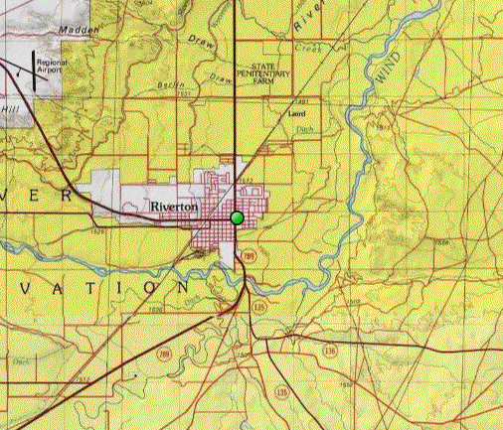
Algorithm Performance
Versus Known U. S. Localities
 | % Found | Mean Dist. Off | Standard Error
GEOLocate | 95% | 6.1 km | 2.1 km
6 km

Slide 11
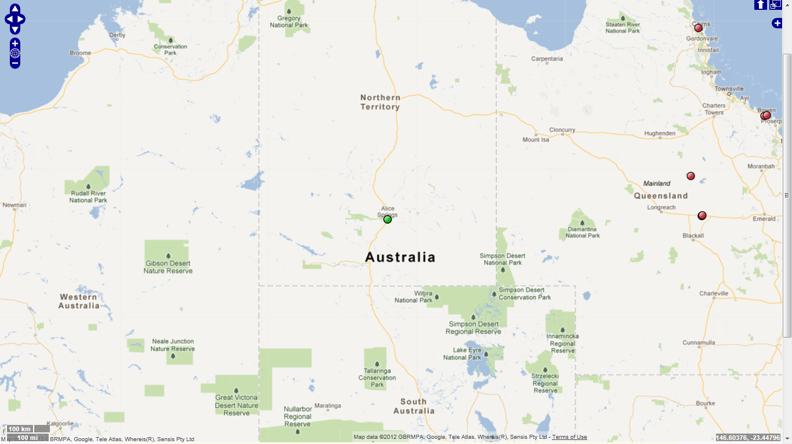
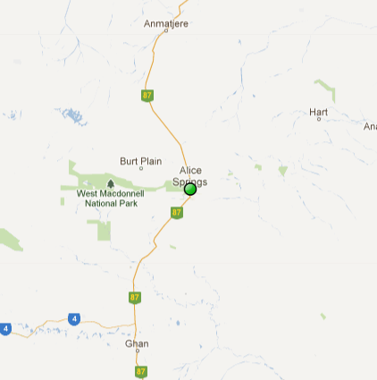
Algorithm Performance
Versus Known Australian Localities
 | % Found | Mean Dist. Off | Standard Error
GEOLocate | 86 97% | 796 218 km | 154 48 km
796 km
218 km

Slide 12
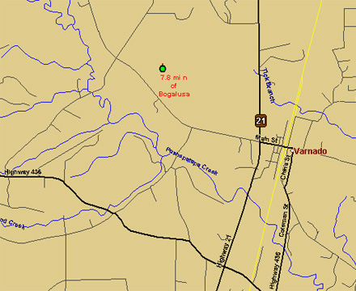
Verification & Adjustment of Automated Outputs
Computed coordinates are displayed on digital maps
Manual verification of each record
Drag and drop correction of records

Slide 13
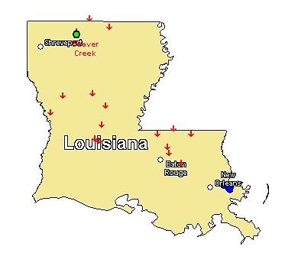
Multiple Result Handling
Caused by duplicate names, multiple names & multiple displacements
Beaver Creek;
Louisiana; USA
Results are scored and most “accurate” result assigned to active marker (green)
All results are recorded and displayed as static markers (red)

Slide 14
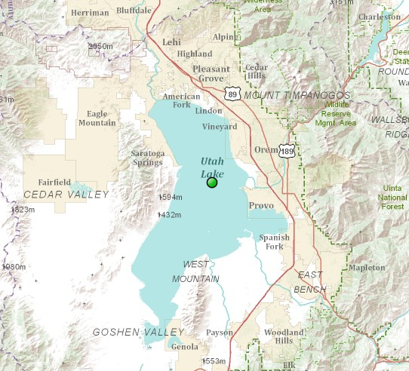
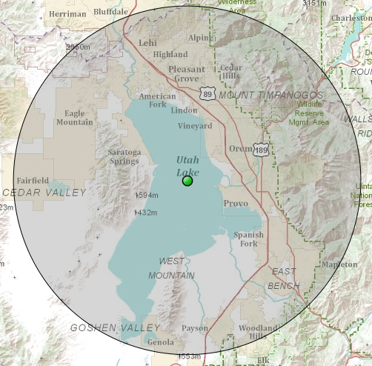
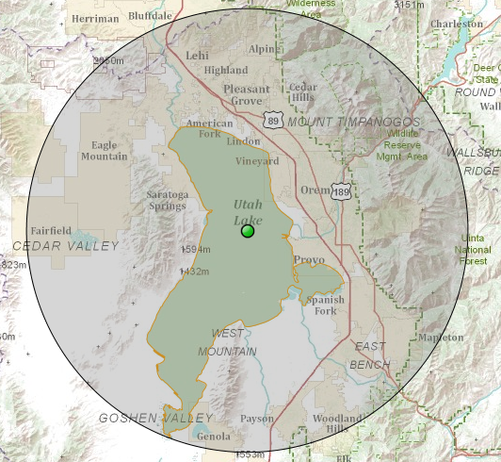
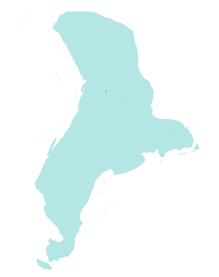
Measuring Uncertainty
Point
Point & Radius
Point, Radius & Polygon

Slide 15
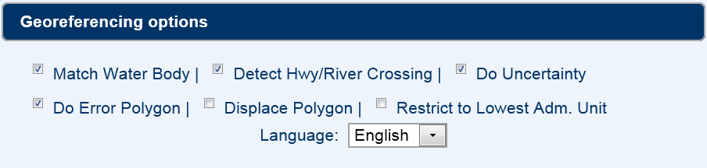
My Creek at Hwy 1
My Creek
7 miles North of
7 miles North of
Mythical Place
Mythical Place
Detect Hwy/
River Crossing
Match Water Body

Slide 16
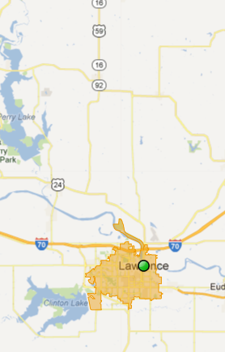
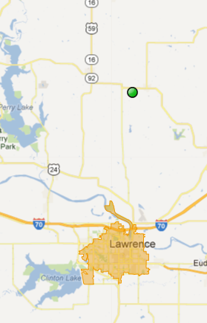
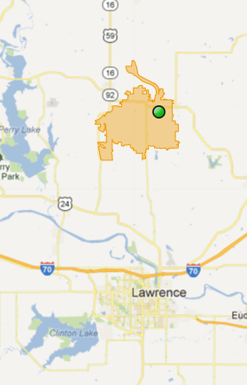
Generating Polygons:
Lawrence, KS
15 mi N of Lawrence, KS
no displacement
15 mi N of Lawrence, KS
displaced polygon

Slide 17
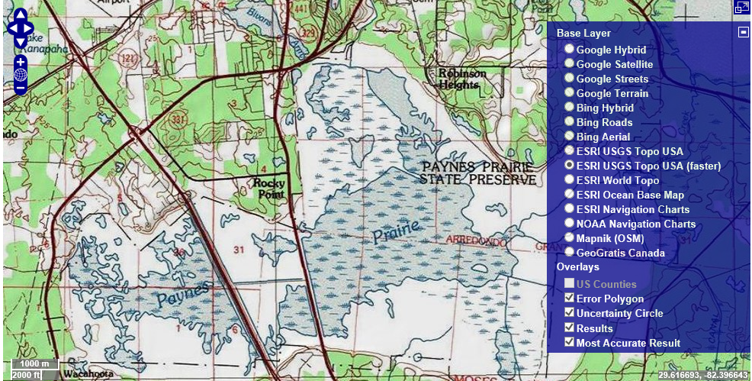


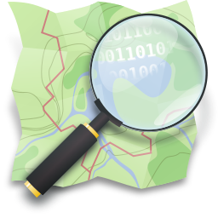


Visualization: Base Layers

Slide 18
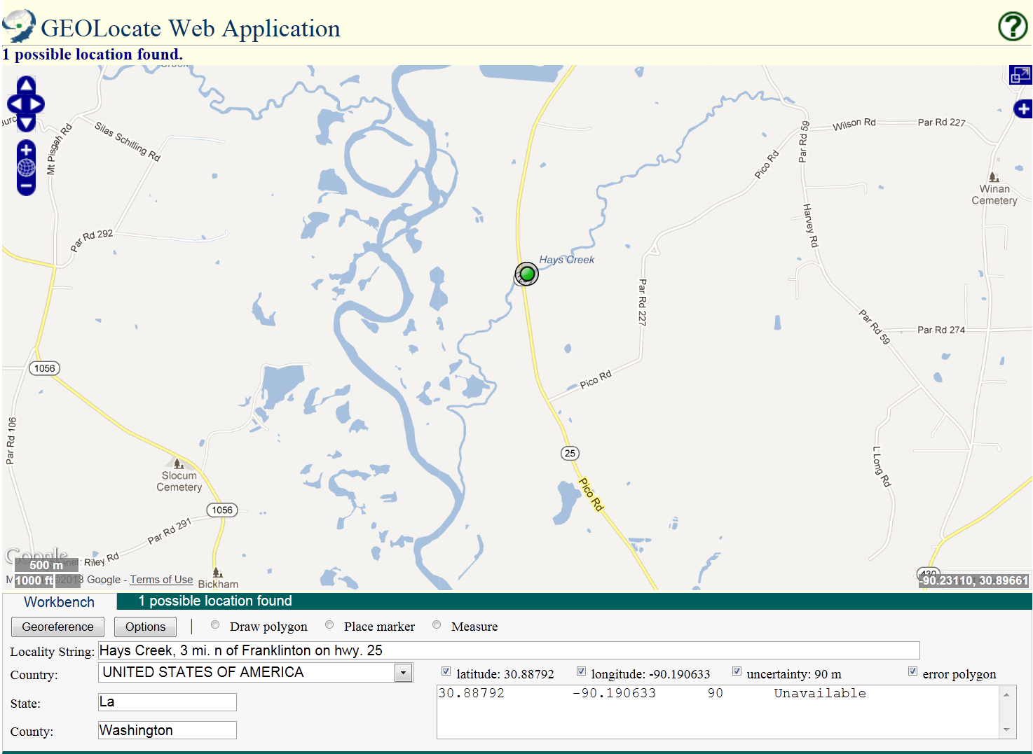
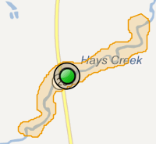
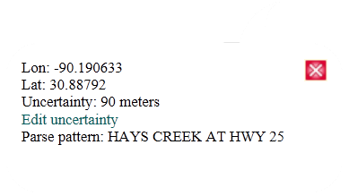
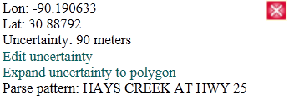
Core Features

Slide 19
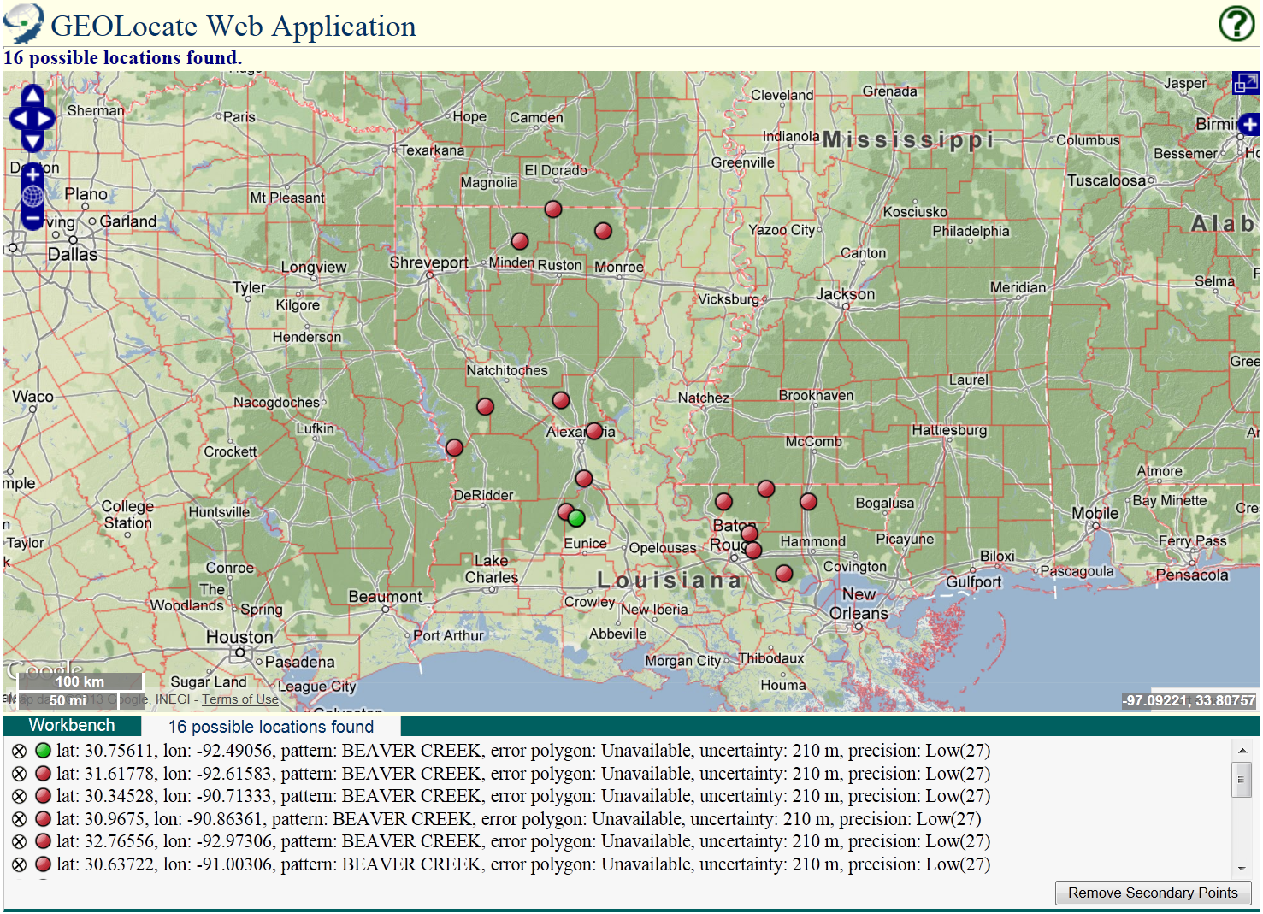
Evaluating Results
Beaver Creek; LA; USA

Slide 20
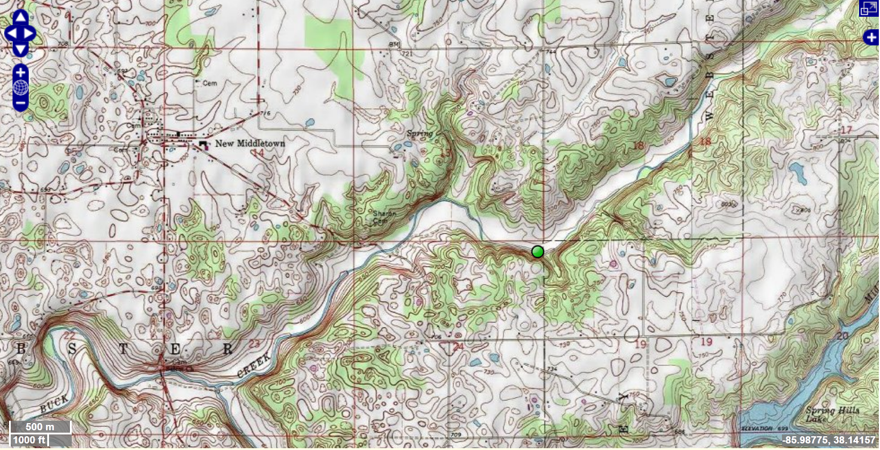
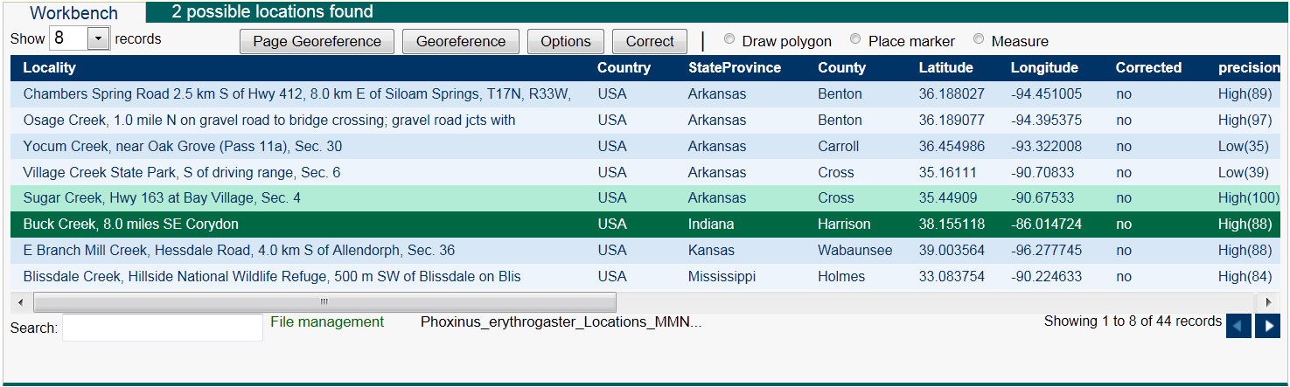
Batch Georeferencing

Slide 21
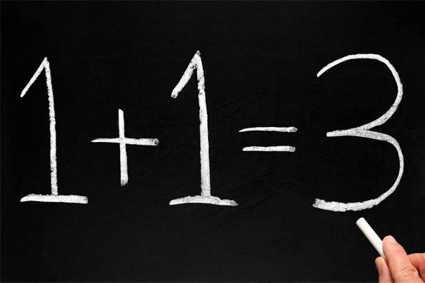
Collaborative georeferencing
Increased output by take advantages similarities across collections
Distribution of workloads to appropriate expertise

Slide 22
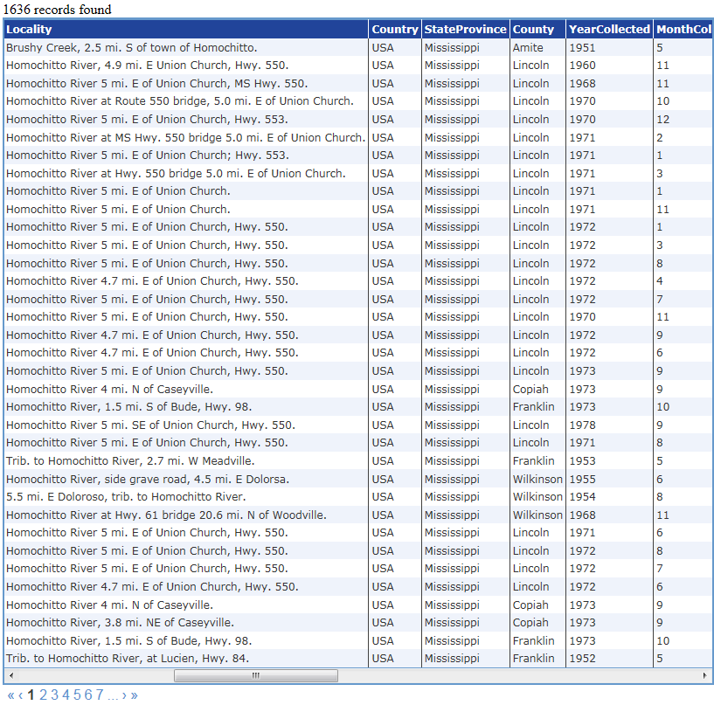
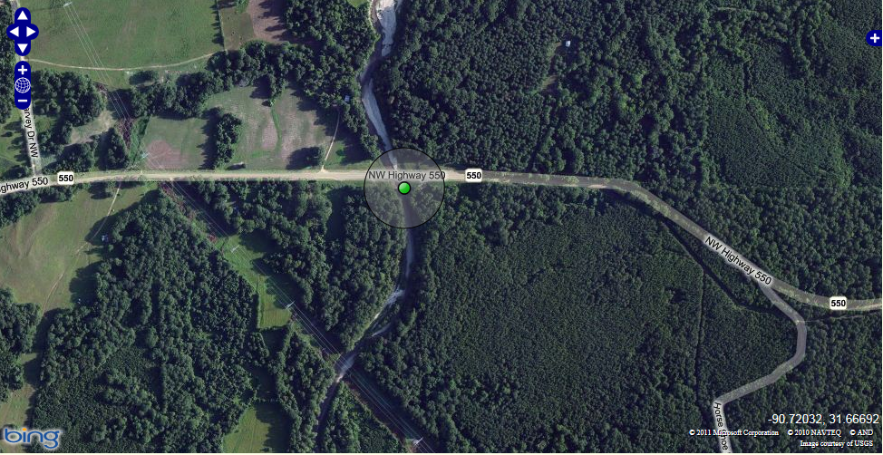
Collaborative Georeferencing: Sharing Data
Corrected 22 collecting events,
approx. 200 specimen records

Slide 23
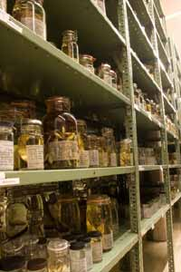
Collaborative Georeferencing Performance
2100 randomly selected collecting events from the Tulane University fish collection were imported and georeferenced using the collaborative georeferencing framework
33% were duplicates
30% more related by similarity index
2100
782
63% reduction in effort overall

Slide 24
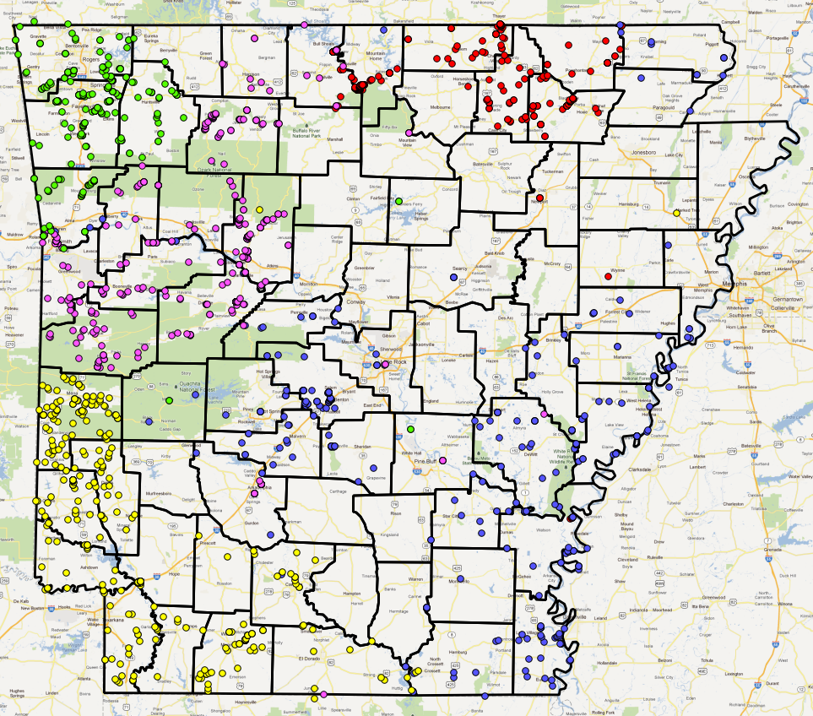
Distributing Workloads

Slide 25
Organizational Units
Community
Community
Data sources
Data sources
Users
Data sources
Data sources
Community
Community

Slide 26
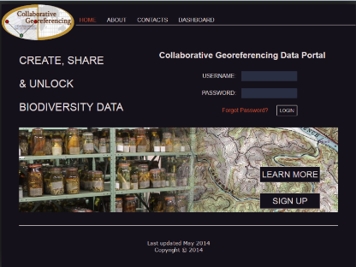
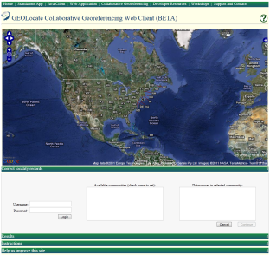
Collaborative Georeferencing within GEOLocate
CSV Upload
Remote
Data Source
Community
&
Data Management
Cache Update Web
Service
CoGe Web Portal
Application
Data Retrieval Web
Service
Data Store
Correction
&
Verification
Insert Correction Web
Record Processor
Service
Georeferencing Web
CoGe Client Application
Service

Slide 27
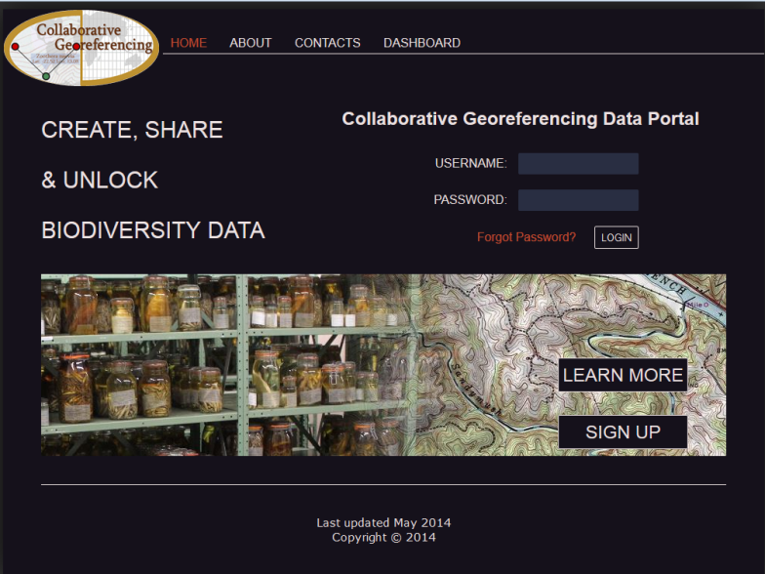
Collaborative Georeferencing Management Portal

Slide 28
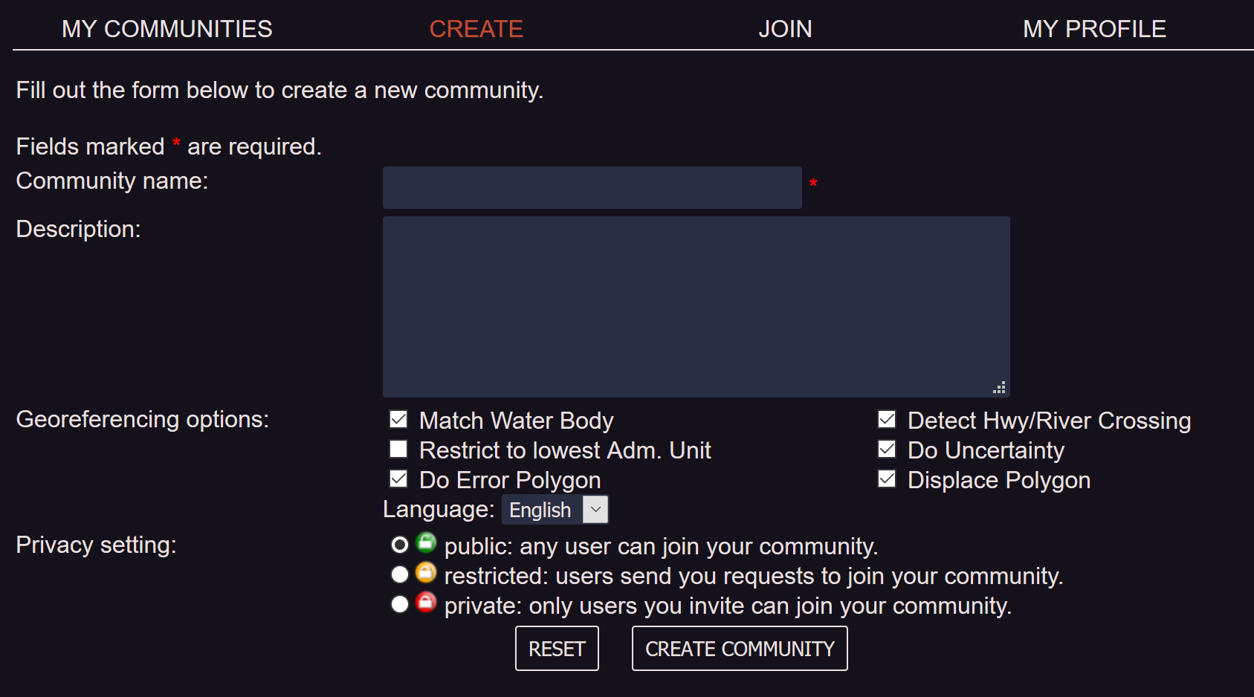
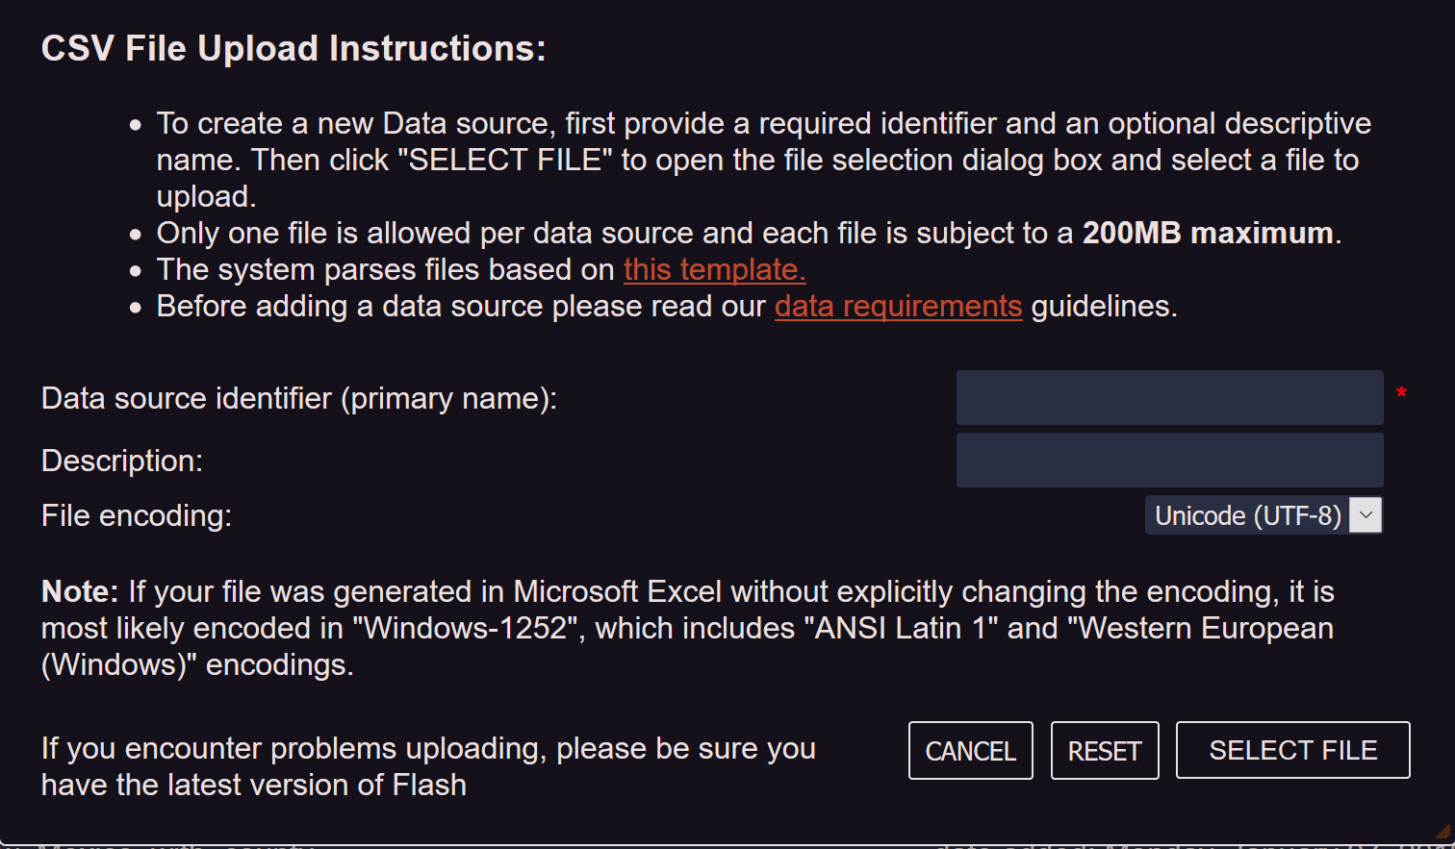
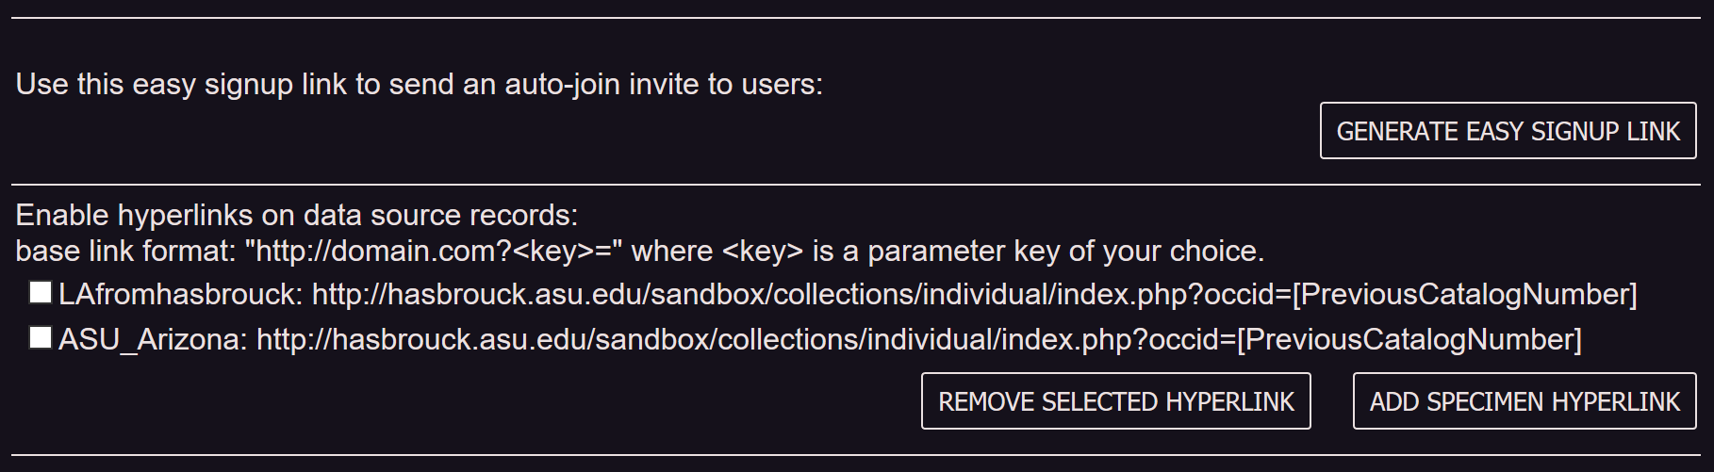
Georeferencing Communities
Create
Communities
Data Sources
Add New Users & Link Out

Slide 29


User Management: Task Assignment
Assign all records from Kenya to
experts on East African regions

Slide 30

Monitoring & Managing
Progress

Slide 31

Data Repatriation

Slide 32



Slide 33

Utilizing and Reviewing Past Work
ON WORKBENCH:
Lake Winnipesaukee in Blackey Cove & outlet Lake Kanasatka, Merrimack Watershed, 0.75 mi E of Center Harbor, elev 504; United States; New Hampshire; Carroll;

Slide 34







Interoperability
Webservices
  SOAP
  JSON
  GeoJSON
Web Client
Arctos

Slide 35


Slide 36


Slide 37


Slide 38


Application Services: Web Client APIs
URL API for user input & lightweight web clients
Lightweight client, specifically designed for embedding into other web applications.
  Two way communication between web sites uses JavaScript postMessage()
  Compatible with all modern browsers:
IE 8.0+
Firefox 3.0+
Safari 4.0+
Chrome 1.0+
Opera 9.5+

Slide 39

Arctos

Slide 40


Slide 41


Slide 42


Slide 43


Excel
http://www.museum.tulane.edu/geolocate/web/WebGeoref.aspx?
v=1&Country=USA&State=LA&County=Washington&Locality=Bogalusa&georef=run

