Slide 1
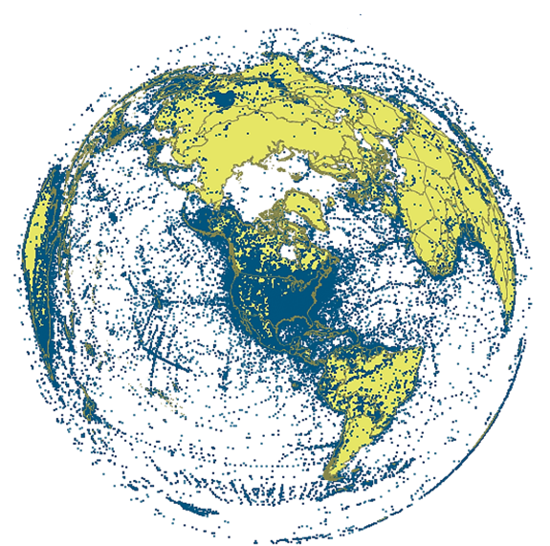
Engaging the Group in Georeferencing Using GEOLocate
Nelson Rios
&
Henry L. Bart Jr.
Tulane University Biodiversity Research Institute

Slide 2
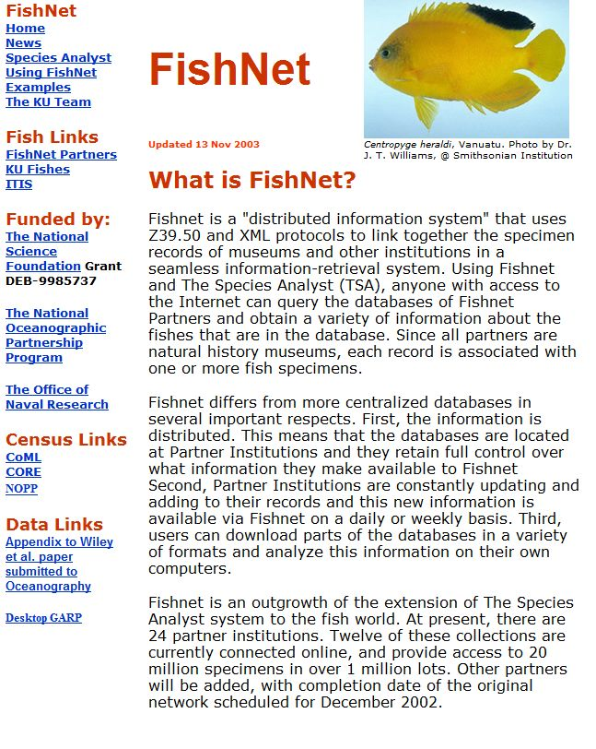
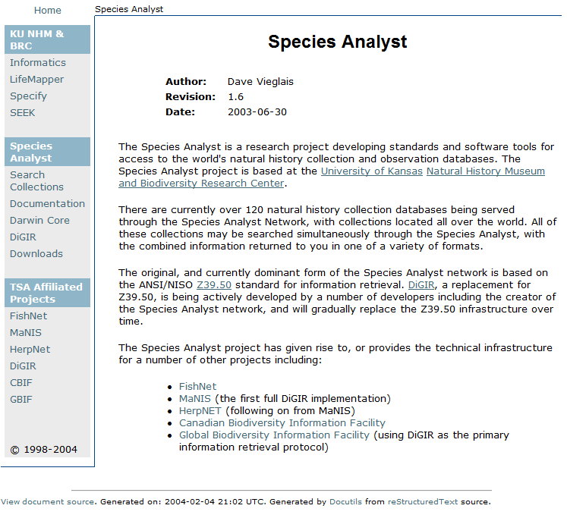
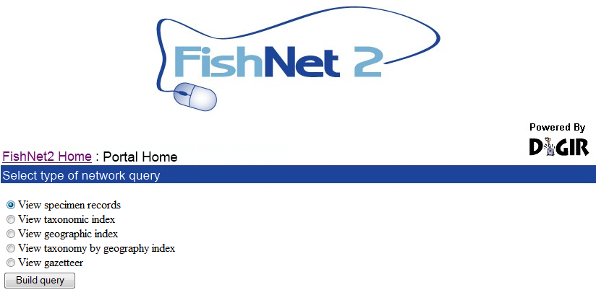
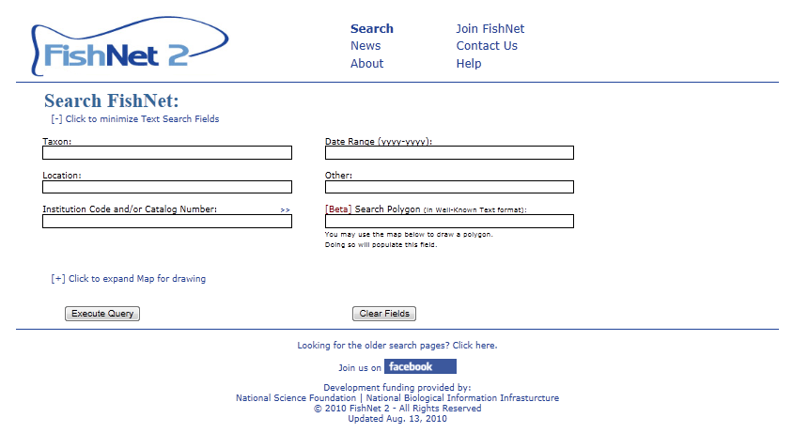
Background
1999: Creation of original FishNet Network
Z39.50 protocol for sharing data
Search via Species Analyst (distributed query model)
2005: FishNet 2 created
Transition to DiGIR Protocol
Search via DiGIR Portal (distributed query model)
2010: FishNet 2 (centralized query model)
Harvesting of DiGIR, DwCA, IPT, Static Spreadsheets
Search via FishNet 2 Portal (centralized query model)
2012-2016: Portal & data expansion and enhancement

Slide 3
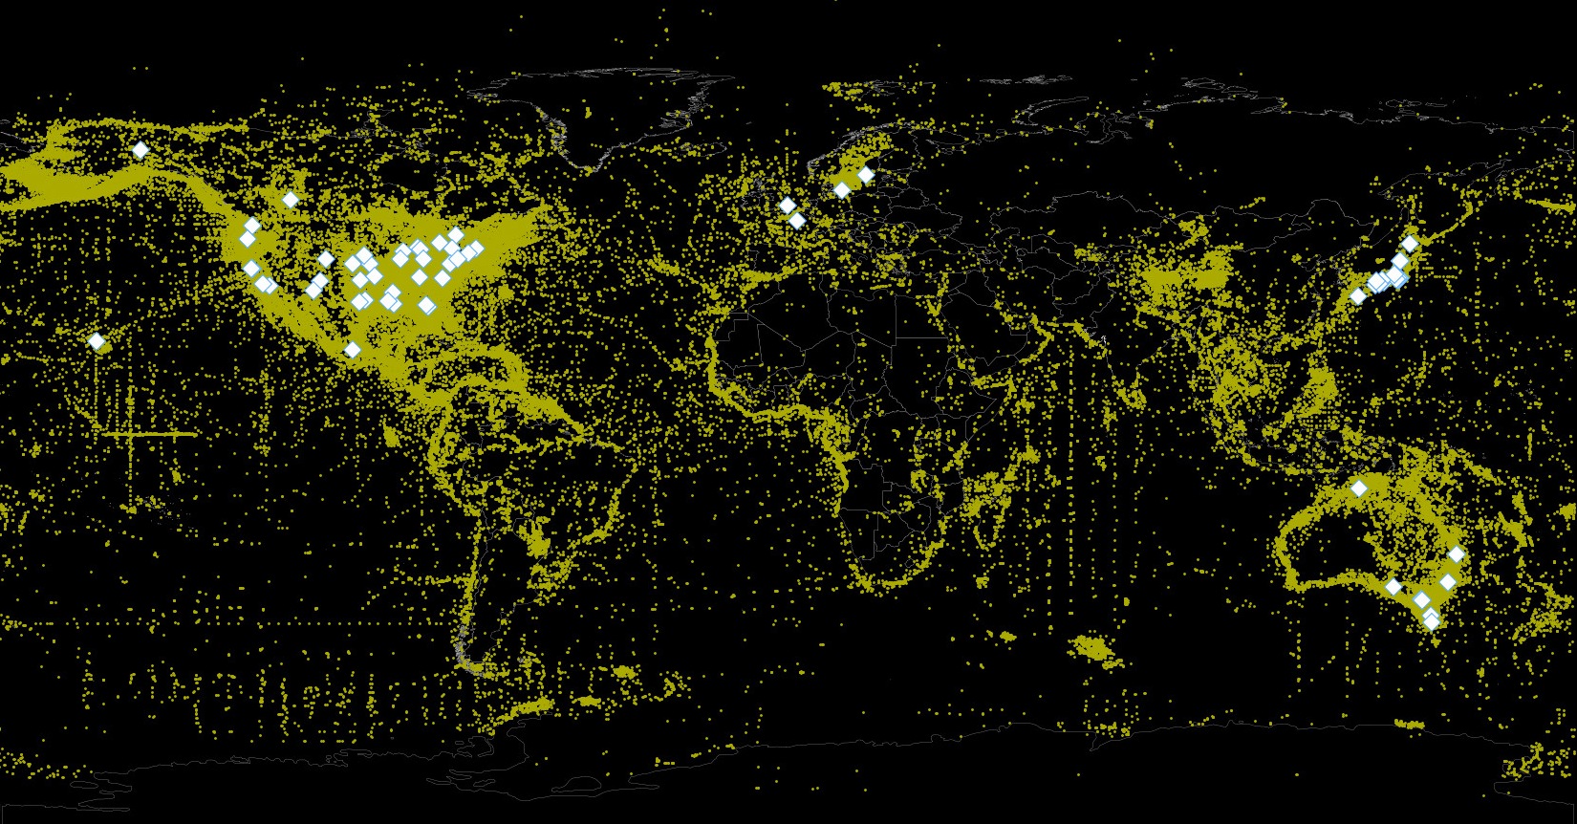
FishNet 2
global network
71 data providers
3.7 million lots
35+ million specimens
57% georeferenced

Slide 4
Objectives
To expand the number of records within FishNet to approximately 4 million lots representing over 30 million specimens
To georeference all "georeferencable" records lacking geographic coordinates
To repatriate results to source data providers
321,102 collecting events representing 1,568,695 specimen lots have been identified for georeferencing from FishNet

Slide 5
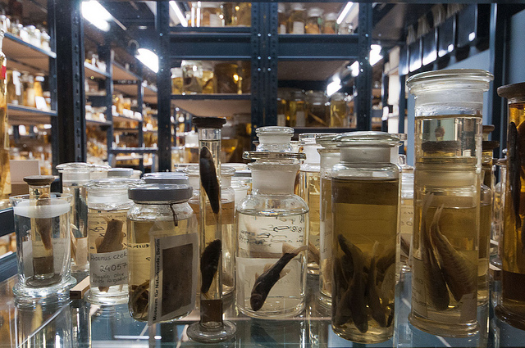
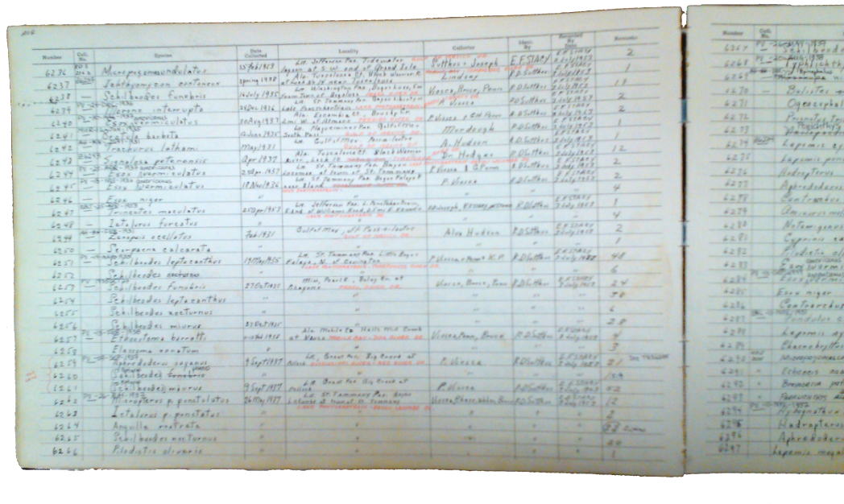
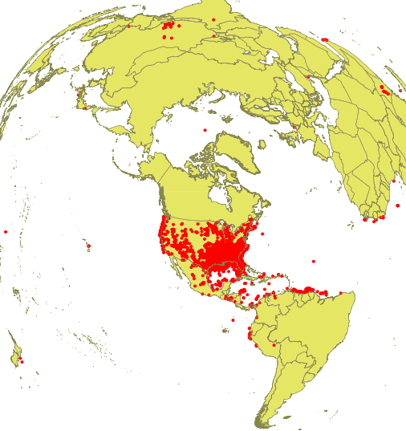
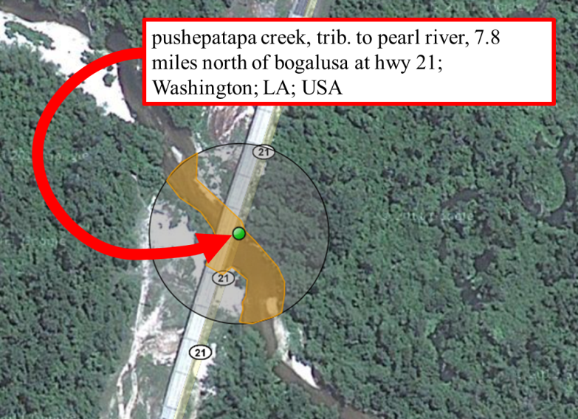
Georeferencing FishNet
250,000 collecting events
18 months
12 technicians
12+ volunteers
GEOLocate
Collaborative
Crowdsourcing

Slide 6
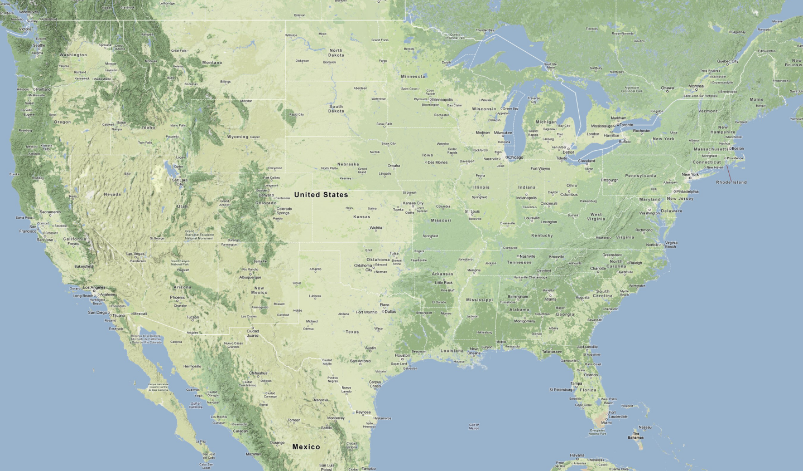
The Dirty Dozen

Slide 7
Workflow
Harvest data by Institution from FishNet
Standardize higher geographies
Partition into regional datasets
Upload to data portal
Assign datasets to technicians
GEOLocate
Review results
Repatriate

Slide 8
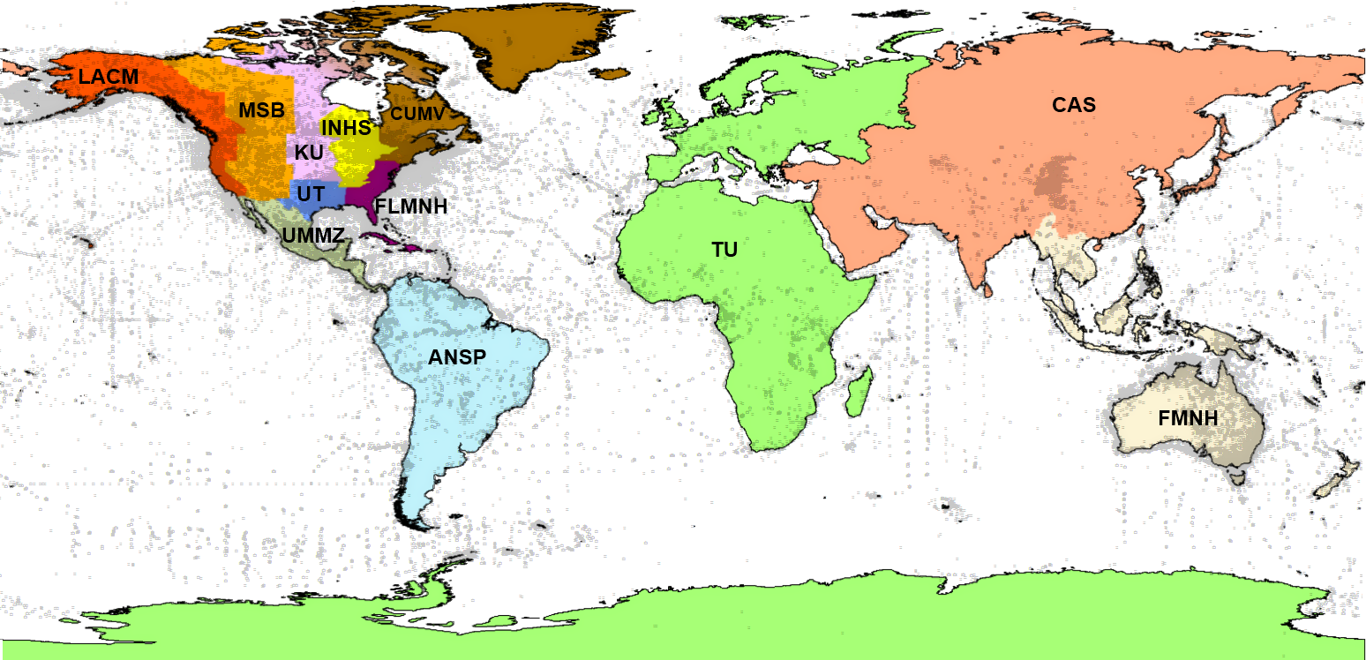
Preliminary Assignments

Slide 9
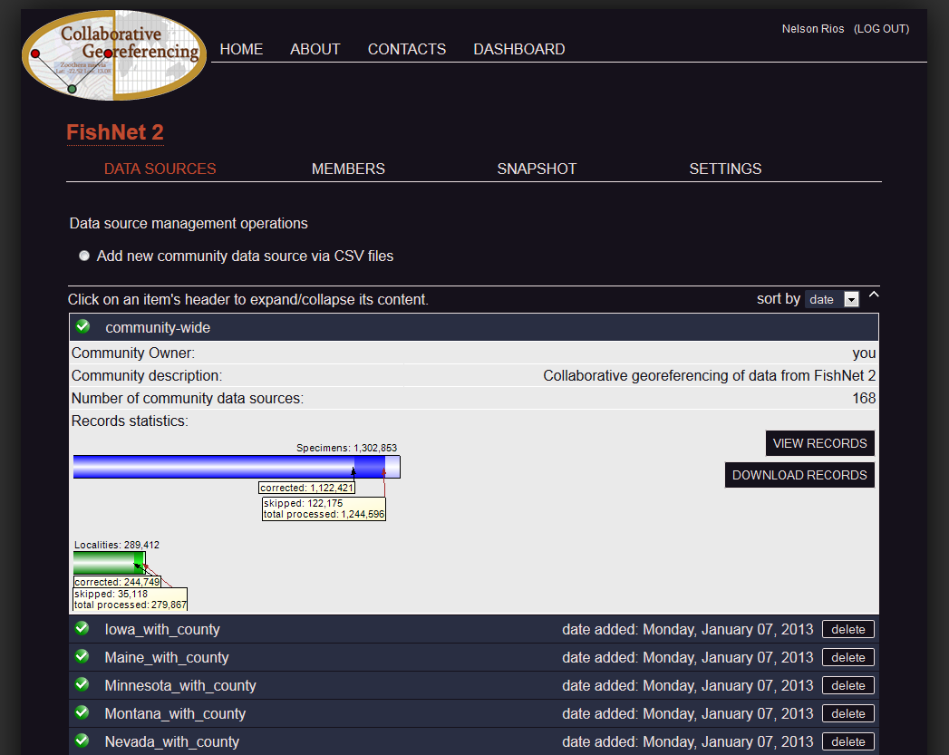
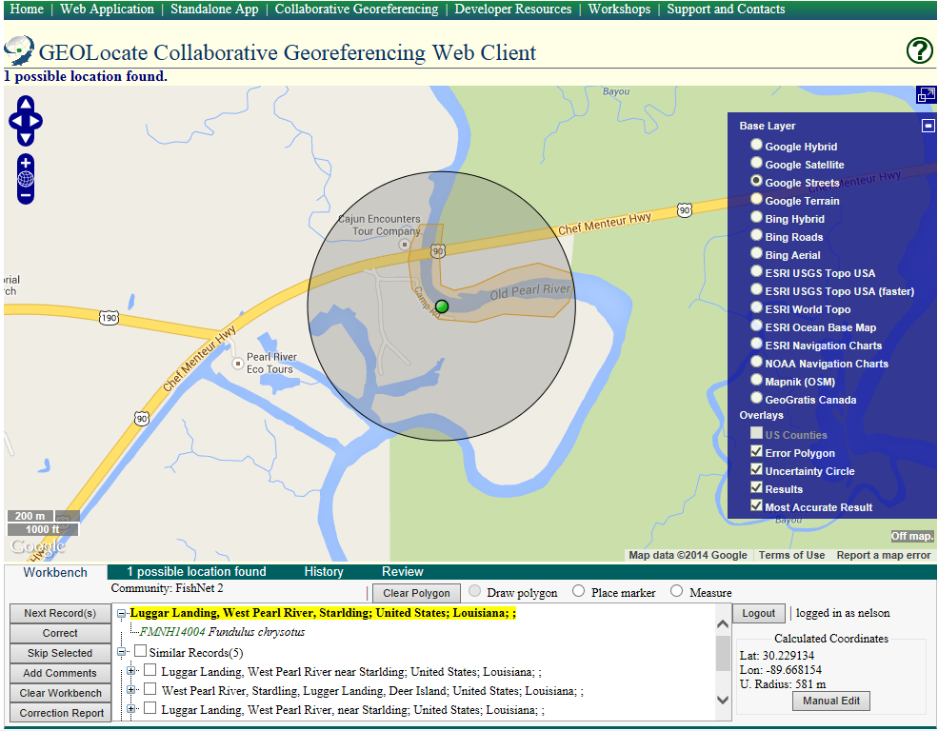
Georeferencing
GEOLocate Collaborative Georeferencing (CoGe) framework.
Each record was automatically georeferenced, evaluated by project technicians and either corrected or skipped to produce a final result.
Skipped records represent those records lacking sufficient information for adequate georeferencing by a technician.
Technicians were asked to provide comments on each skipped record, explaining why the record was skipped.

Slide 10
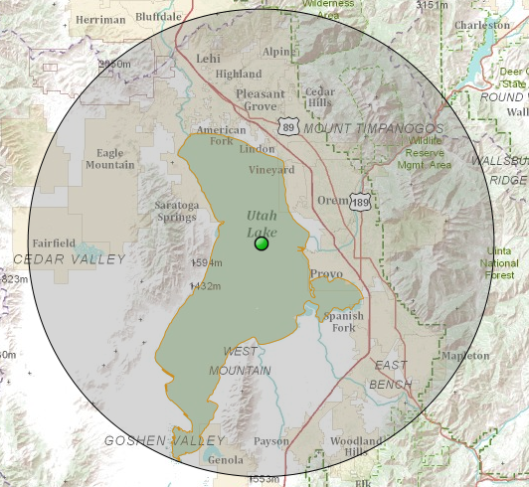
Georeferencing
Each corrected record minimally contains a corrected latitude/longitude and a radius of uncertainty in meters.
Additionally, technicians were encouraged to specify polygons (for example along the courses of rivers) to further refine the level of uncertainty anytime the uncertainty radius significantly overestimated uncertainty.
Polygons
about 85% of the corrections included user-generated polygons

Slide 11
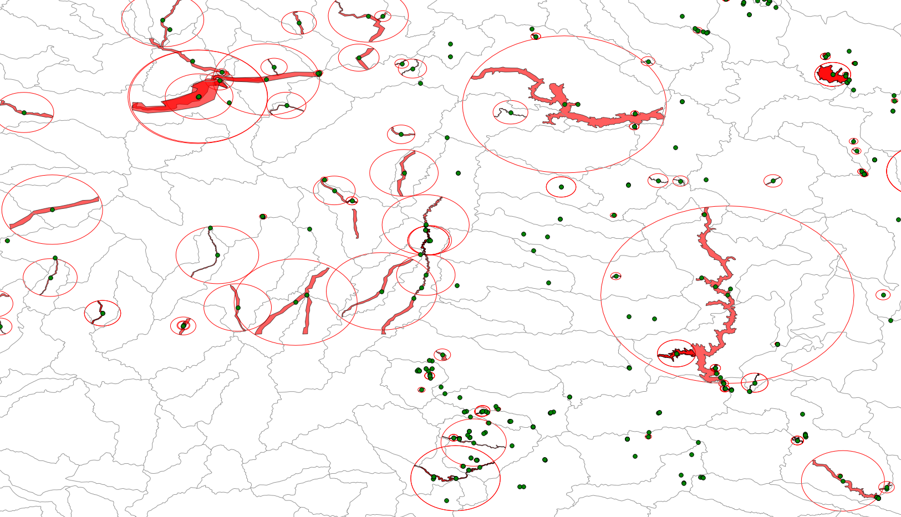
Georeferencing Output
Base Map - 1:2M 8-Digit HUCs

Slide 12
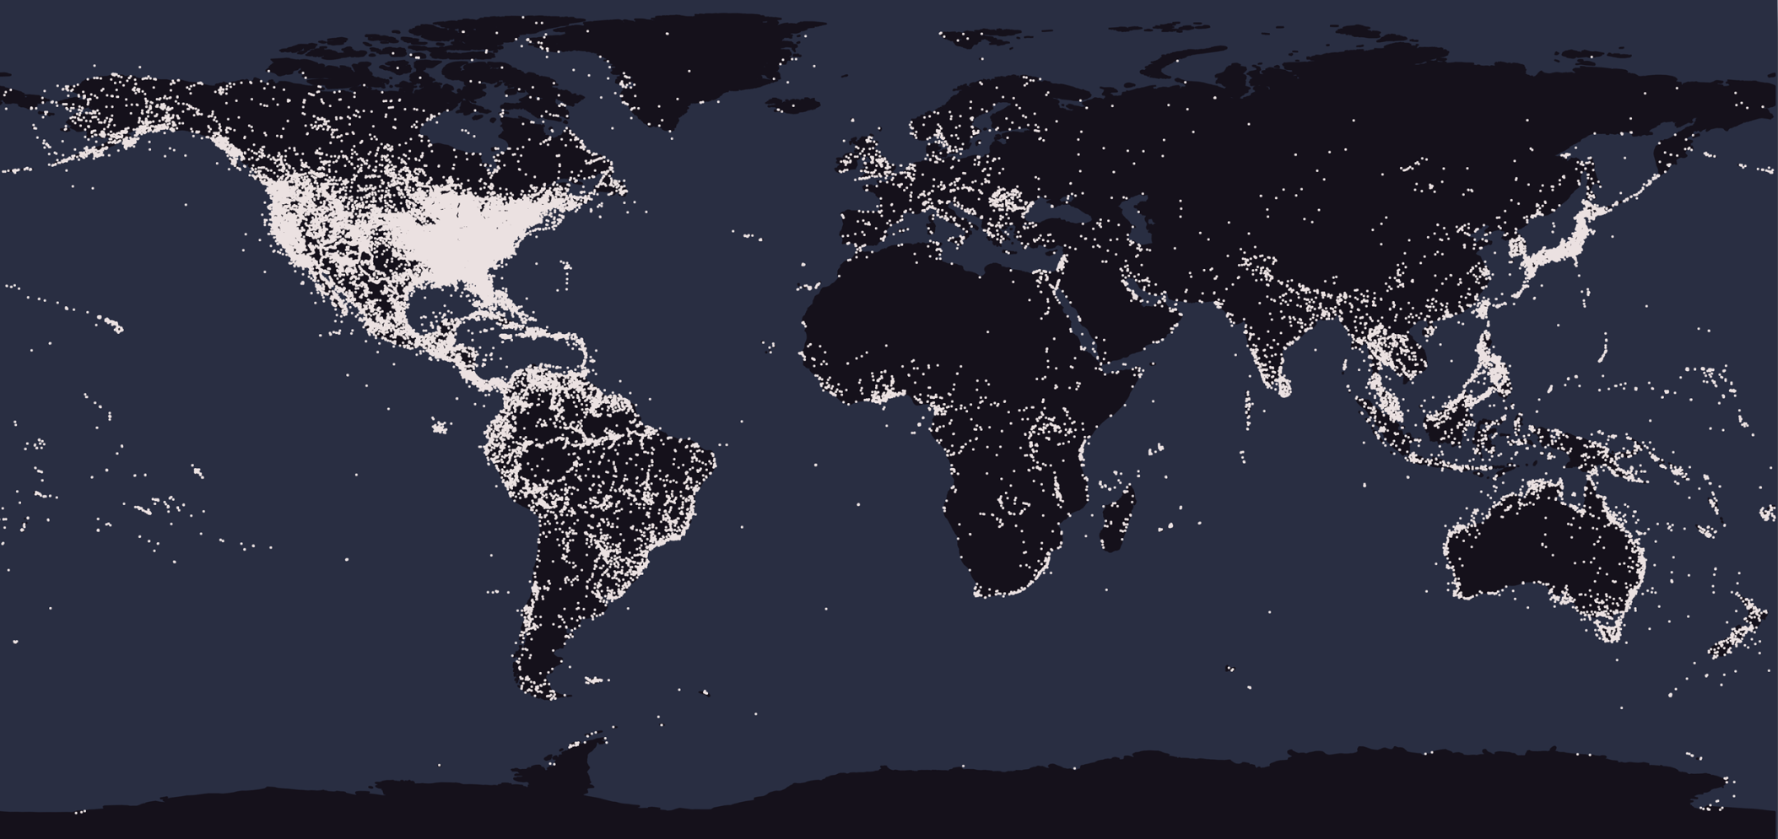
Results
“Corrected”
247,479 localities (88%)
1,172,360 specimen lots
“Skipped”
34,720 localities (12%)
126,881 specimen lots
Total Verified
282,199 localities
1,299,241 specimen lots
113% of project goal

Slide 13
11 January – 14 October 2013

Slide 14
11 January – 14 October 2013

Slide 16
Increasing Research Capacity
State | FishNet 2 | Since CoGe | New
NY | 5% | 90% | 48%
IL | 24% | 90% | 35%
WA | 27% | 86% | 14%
OH | 41% | 80% | 14%
TN | 42% | 87% | 22%
Dramatic increase in georeferenced localities
Substantial increase in “new” georeferenced localities (i.e. those more than 1km from other localities previously georeferenced and included in FishNet 2)

Slide 17
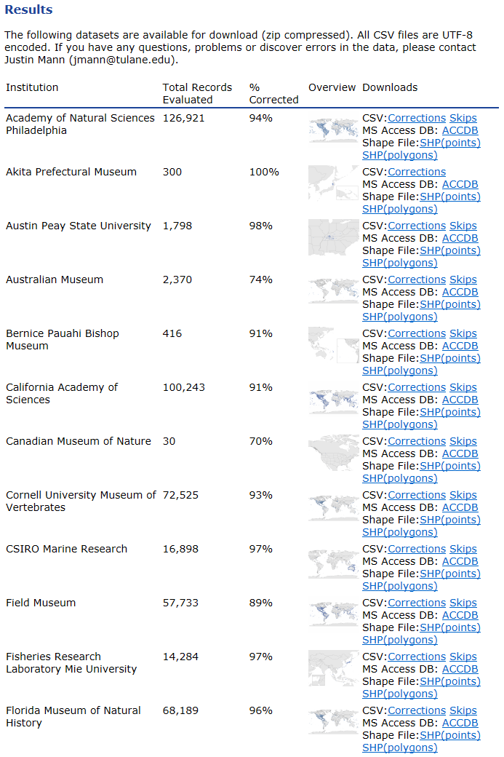
Repatriation
Project wide results were subdivided into institutional datasets and made available via the FishNet website on January 13, 2015.
For each institution, an overview map was generated and results provided in multiple formats:
UTF-8 encoded comma separated values (CSV)
Microsoft Access Database (ACCDB)
ESRI Shapefiles (SHP)
We are also working with specific institutions, as requested, to produce data-files with additional identifiers and/or formatting to further aid integration of results.
The Specify Project is providing integration services for collections using Specify.

Slide 18
SERNEC Georeferencing

Slide 19
Acknowledgements
Institutional Collaborators
Georeferencing Technicians
Andy Bentley
Dave Catania
Michael Doosey
Rick Feeney
Bill Fink
John Friel
Dean Hendrickson
Amy McCune
John Lundberg
Douglas Nelson
Larry Page
Luiz Rocha
Rob Robins
Mark Sabaj
Leo Smith
Alexandra Snyder
Chris Taylor
Christine Thacker
Tom Turner
Mark Westneat
Ed Wiley
Diego Barroso
Melissa Casarez
Paul DeSalles
Justin Grubich
Mariangeles Arce Hernandez Estella Hernandez
Benito Lorenzo
Theresa Lorraine McInnes
Laura Porturas
Megan Roberson
Michelle Vanderwel
Rachel Vinsel
Katy Wichman
INHS & TU Student Volunteers
www.fishnet2.net
www.museum.tulane.edu/coge
www.museum.tulane.edu/geolocate
This material is based in part upon work supported by the National Science Foundation under Grant Numbers DBI–0852141and DBI-1202953. Any opinions, findings, and conclusions or recommendations expressed in this material are those of the author(s) and do not necessarily reflect the views of the National Science Foundation.

