Slide 1
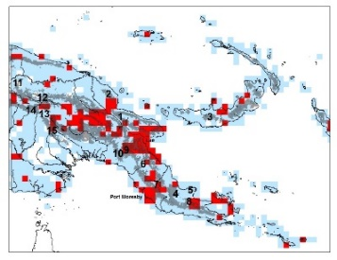
Researcher #1 – your name, photo, ORCID (if you have one)
Your research in a sentence. Determining biodiversity hotspots and data deficient localities within PNG.
For your research you need: (mark all that apply)
date (time) data
place data
taxon data
Do you georeference data?
Do you give or attempt to give your georeferences back to the data provider?
If you are researcher, do you use the polygon / uncertainty data? Or x if you don’t.
If you are a collection / data manager do you create polygons?
What is the biggest issue you run into when georeferencing? Localities that no longer exist, different spellings for same place, moving villages.
Share an idea you have for what would make georeferencing better / faster. Availability of more, vetted gazetteers
X
X
X

