Slide 1
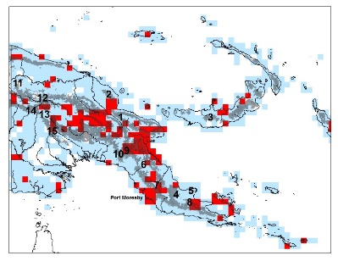
Collection / Data Manager #1 – your name, photo, ORCID (if you have one)
Your georeferencing work in a sentence. I use GEOLocate and teach others to use GEOLocate inside Symbiota to georeference herbarium specimen data, including polygons.
Do you georeference data? Teach others to georeference?
Do you update your database with researcher-provided georeferences? x
As a collection / data manager do you create polygons / uncertainty data?
What is the biggest issue you run into when georeferencing? The time it takes to find places.
Share an idea you have for what would make georeferencing better / faster. A streamlined workflow that makes it easy to check to see if a locality has already been georeferenced.

