Slide 1
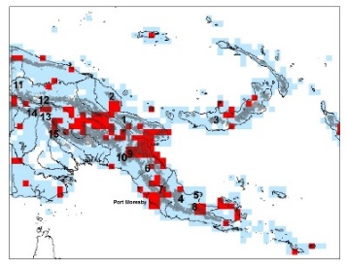
Researcher Edward Davis, ORCID 0000-0002-0918-5852
Your research in a sentence. Understanding the way species geographic ranges change in response to changing environment.
For your research you need: (mark all that apply)
date (time) data (Geologic time)
place data
taxon data
Do you georeference data? Yes, from literature.
Do you give or attempt to give your georeferences back to the data provider? No
If you are researcher, do you use the polygon / uncertainty data? No
If you are a collection / data manager do you create polygons? No
What is the biggest issue you run into when georeferencing? Localities that are obscured in publications and must be requested from researchers/museums.
Share an idea you have for what would make georeferencing better / faster. Machine learning using vetted georeferenced datasets.
X
X
X

