Slide 1
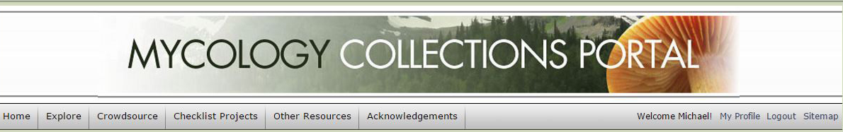
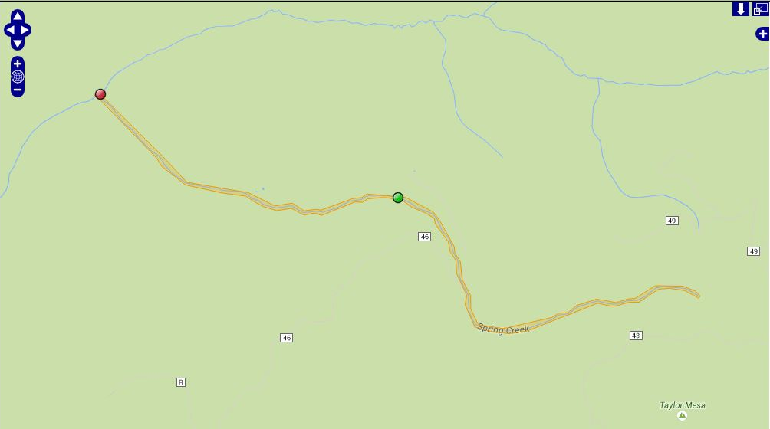
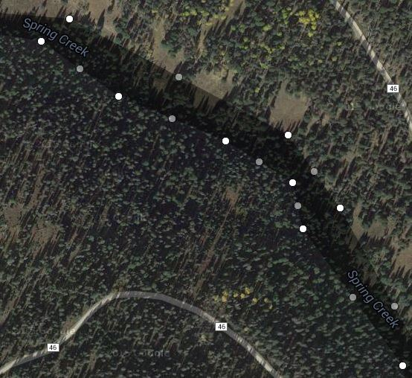
The Polygon Method
[ Georeferencing using GEOLocate in Symbiota ]
Mike Yost | MaCC Project Assistant

Slide 2
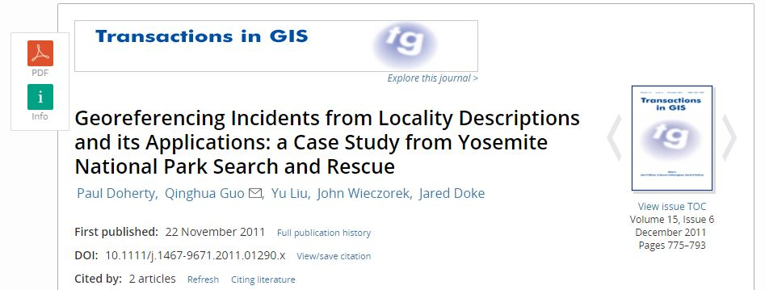
Polygons are Peerless!
Polygons greatly increase utility of georeferencing data by decreasing uncertainty area.
2011 case study showed the polygon method, as compared to the point-radius method, reduced uncertainty of several localities at Yosemite National Park by up to 99.5 percent!

Slide 3
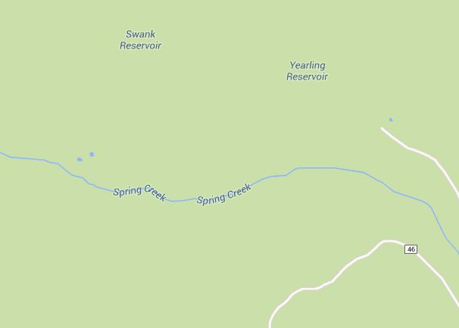
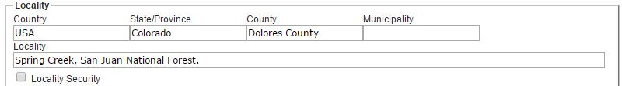
Spring Creek, San Juan National Forest
Point-radius method: Place georeferencing point at midpoint of Spring Creek, with uncertainty radius encompassing entire length of creek.

Slide 4
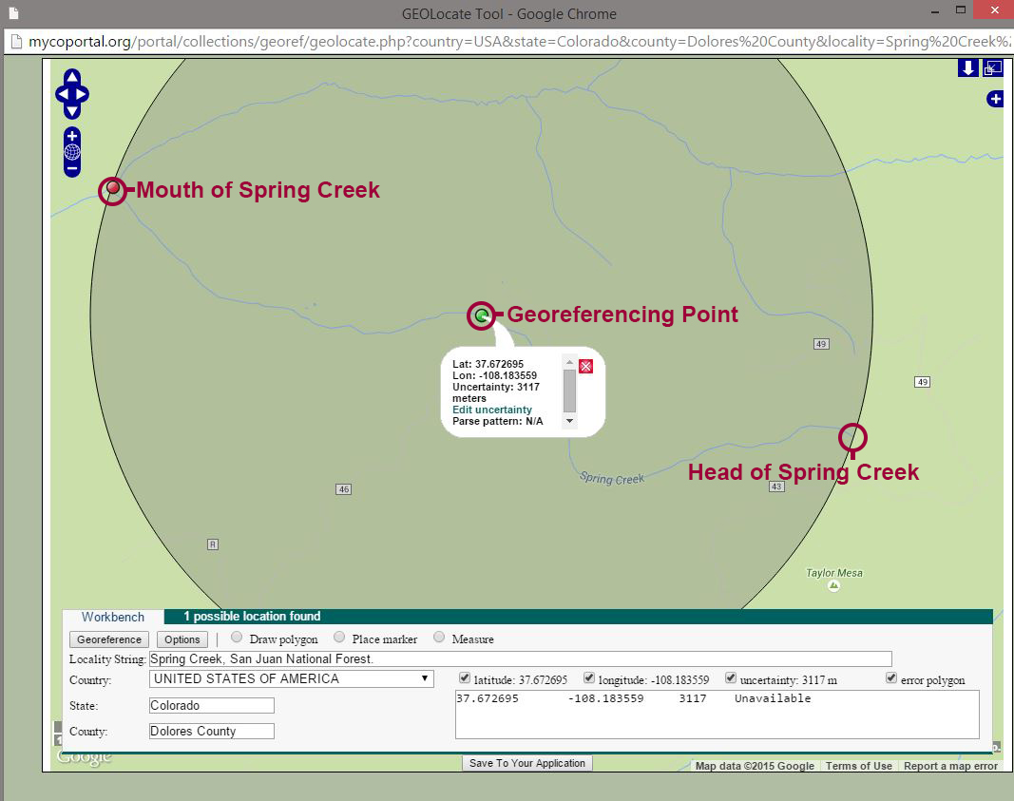

Slide 5
Spring Creek, San Juan National Forest
Georeferencing point is placed at midpoint of Spring Creek, with uncertainty radius extending northwest to mouth at Stoner Creek and southeast to creek head.
Latitude: 37.672695 Longitude: -108.183559 Uncertainty: 3117 meters
HOWEVER: There’s a large area of uncertainty that not only encompasses other creeks, but also Forest Road 46 to the south.

Slide 6
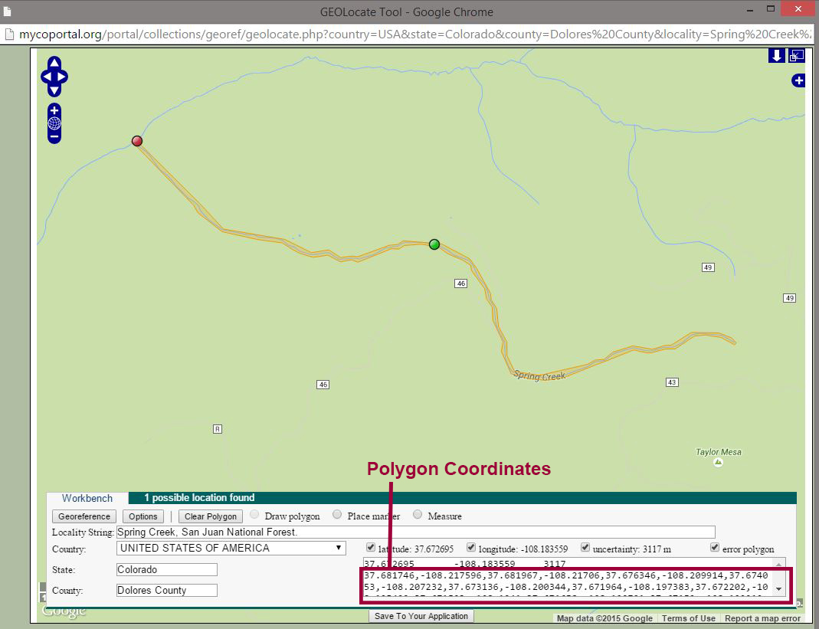

Slide 7
Spring Creek, San Juan National Forest
Latitude: 37.672695
Longitude: -108.183559
Uncertainty: 3117 meters
Polygon: 37.681746,-108.217596, 37.681967,-108.21706, 37.676346,-108.209914,37.674053,-108.207232,37.673136,-108.200344,37.671964,-108.197383,37.672202,-108.195409,37.671523,-108.1941,37.671658,-108.192791,37.67159,-108.192212,37.67261,-108.188671,37.672694,-108.187684,37.673017,-108.187105,37.672728,-108.18277,37.671404,-108.179616,37.670571,-108.178865,37.668329,-108.177299,37.66782,-108.177256,37.667005,-108.176612,37.665425,-108.176419,37.664032,-108.175475,37.662809,-108.175453,37.661433,-108.174617,37.661059,-108.171634,37.661076,-108.171827,37.662062,-108.16642,37.662435,-108.165604,37.662486,-108.164617,37.663132,-108.163609,37.663692,-108.161377,37.66359,-108.160583,37.663387,-108.159188,37.663709,-108.157858,37.66376,-108.157064,37.664881,-108.154811,37.664847,-108.151743,37.664406,-108.150284,37.663947,-108.149769,37.663794,-108.149983,37.66444,-108.151464,37.664661,-108.153245,37.664576,-108.154446,37.663421,-108.156614,37.663404,-108.157794,37.663098,-108.15921,37.663064,-108.159746,37.663336,-108.16127,37.662435,-108.164102,37.662028,-108.165476,37.66089,-108.169059,37.660635,-108.17114,37.660805,-108.173115,37.661229,-108.175003,37.663217,-108.176097,37.664032,-108.175904,37.665951,-108.177041,37.66714,-108.177127,37.667854,-108.177749,37.668771,-108.177964,37.670334,-108.179402,37.67086,-108.179552,37.671336,-108.180517,37.671845,-108.182062,37.672474,-108.183178,37.672711,-108.185109,37.672593,-108.186976,37.672287,-108.187556,37.672304,-108.188435,37.671115,-108.192169,37.671336,-108.192877,37.671149,-108.194122,37.671743,-108.195538,37.67154,-108.19719,37.671913,-108.198714,37.672202,-108.1994,37.67283, -108.200645,37.673119,-108.203348,37.673815,-108.207361,37.675497,-108.210086,37.676176,-108.21058,37.681848,-108.21751,37.681746,-108.217596

Slide 8
Caveats to Consider
Efficacy vs. Specificity
Polygons are a more precise representation of location.
However, polygons require more time to complete.
Additional Server Space
Large polygons mean numerous vertices, which can potentially create lag.
Lag can sometimes crash browser when editing polygons.
Some Localities are Dynamic
Creeks and streams don’t stay put.
Base Layers
Google Maps is a great resource, but has limitations.
USGS Topo maps and Google Maps don’t always correspond.
Zoom
The closer you zoom in, the more detailed the polygon.
The closer you zoom, the longer it takes to draw polygon.

Slide 9
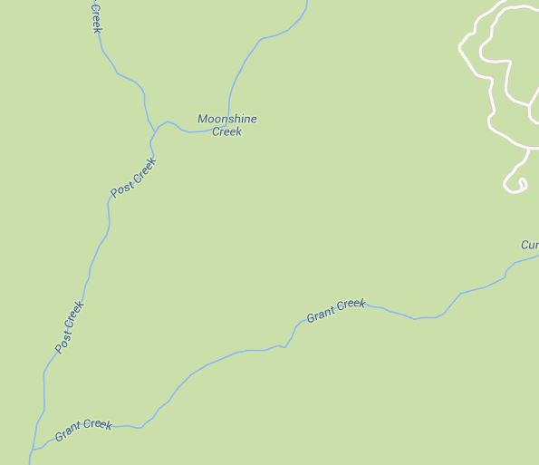
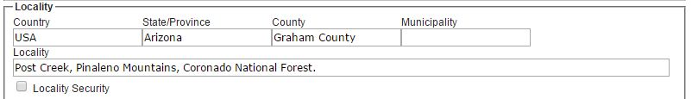
Post Creek, Coronado National Forest, AZ

Slide 10
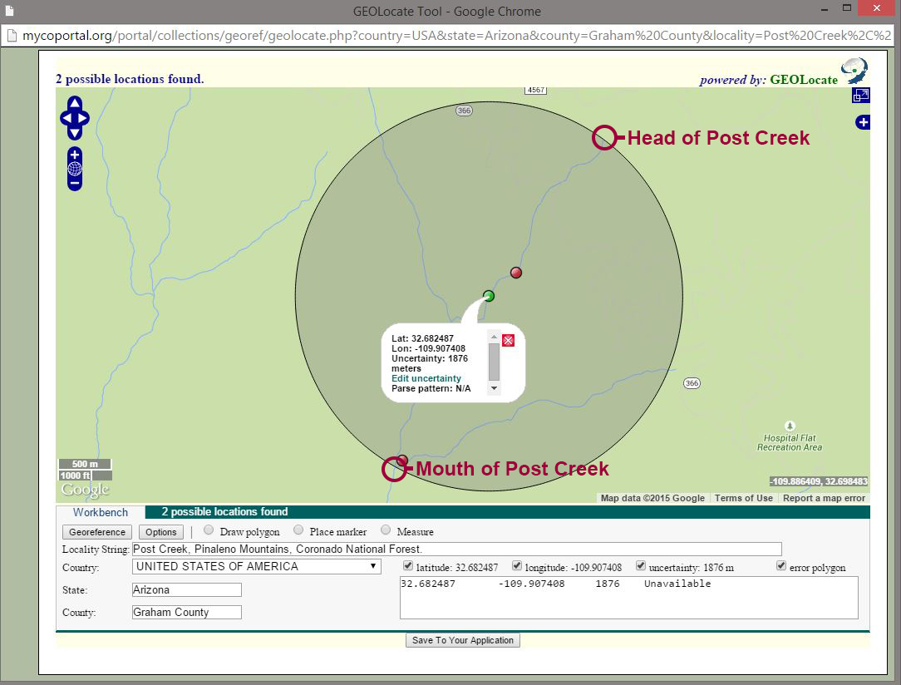

Slide 11
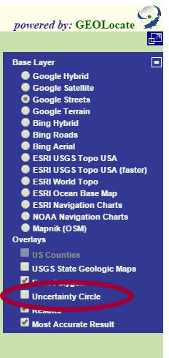
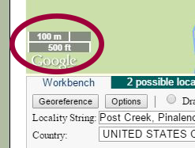
Set Zoom and Remove Uncertainty
Zoom set to 100m (500ft.)
Remove Uncertainty Radius

Slide 12
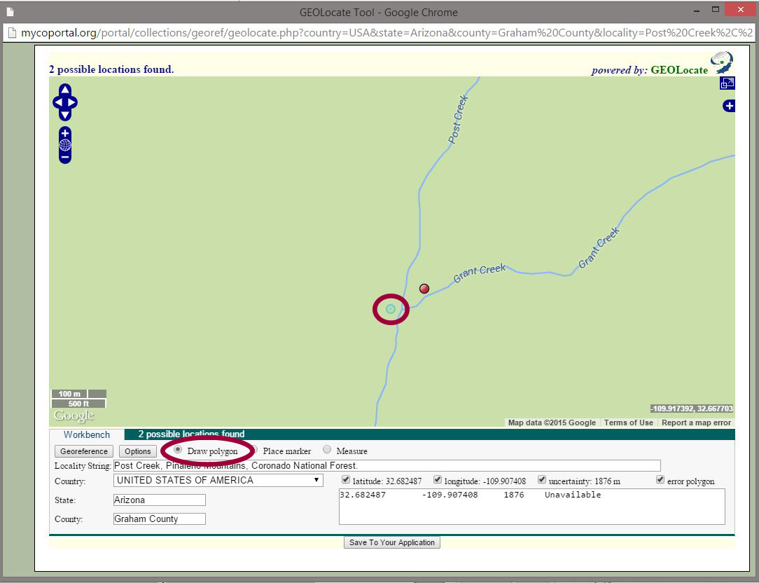

Slide 13
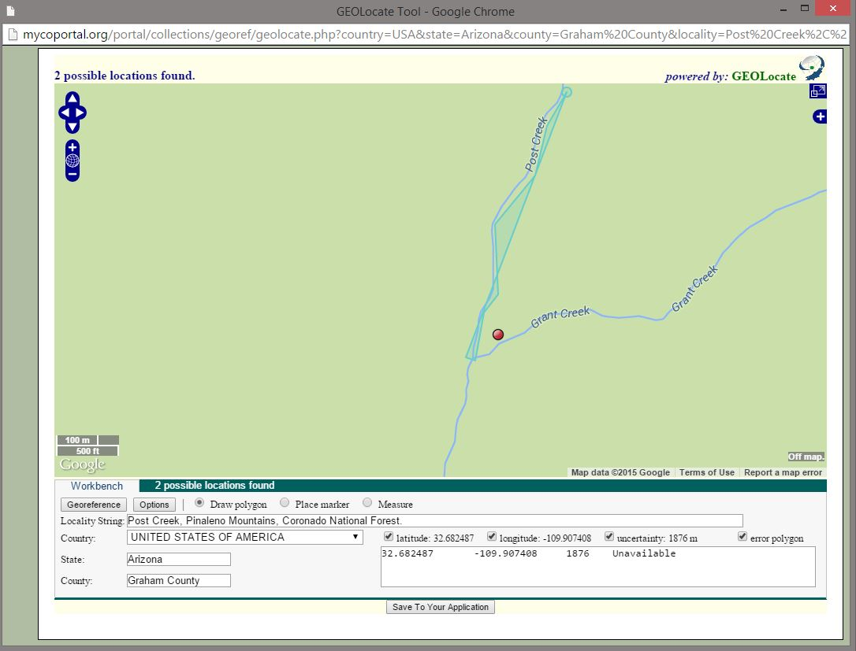

Slide 14
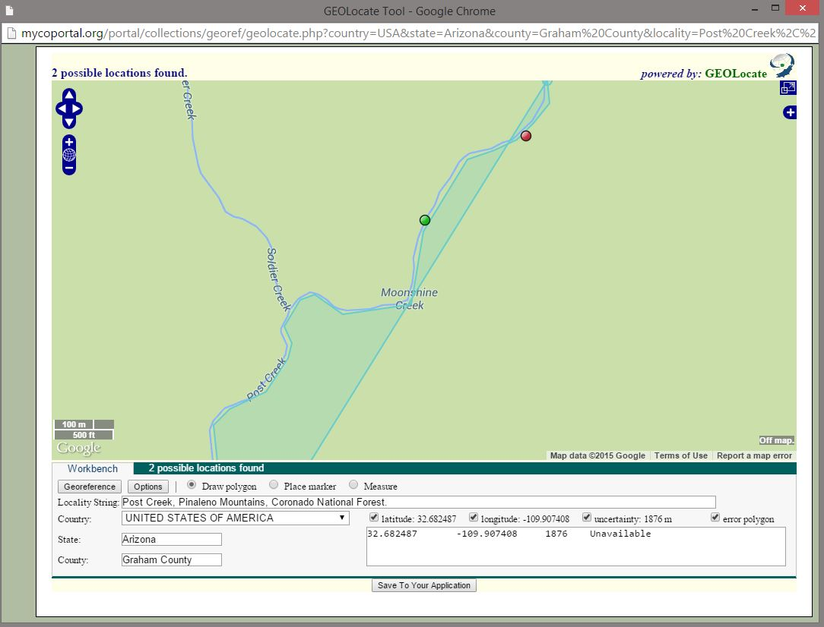

Slide 15
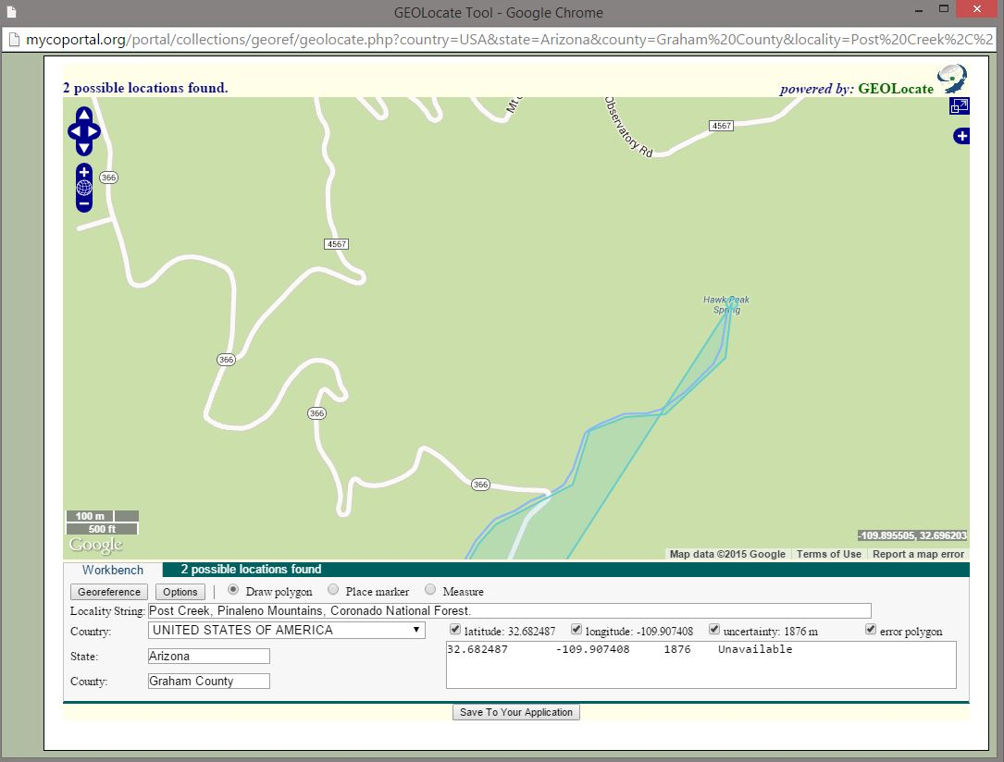

Slide 16
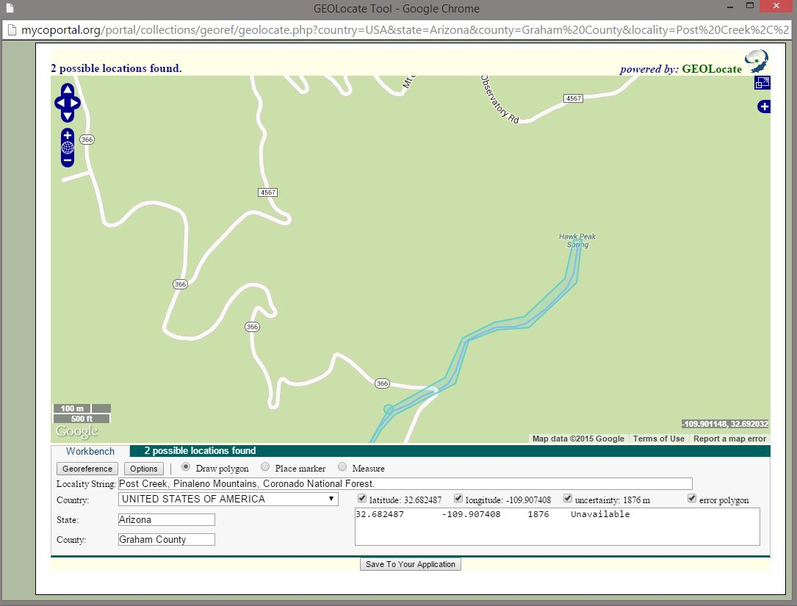

Slide 17
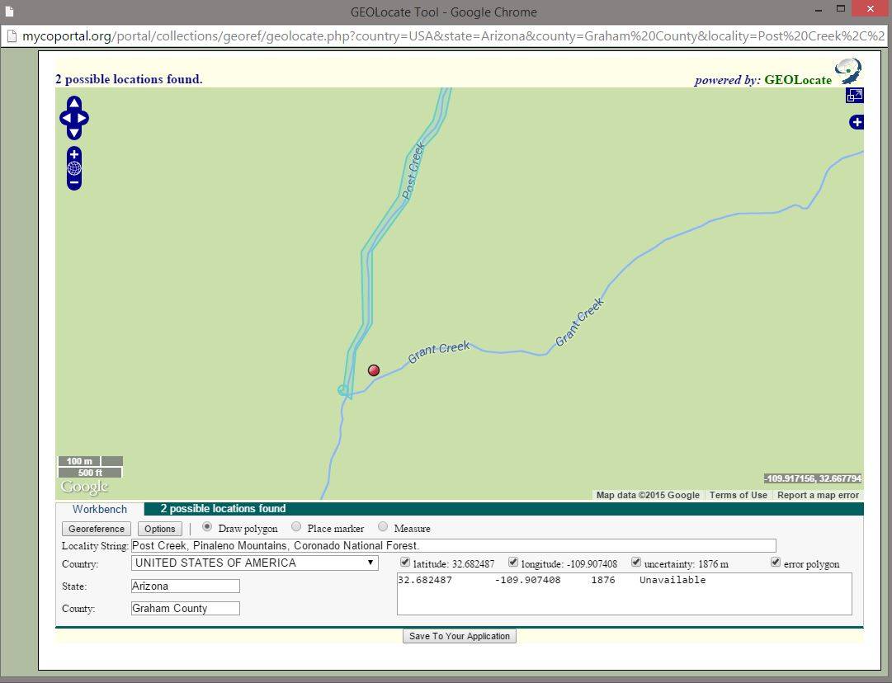

Slide 18
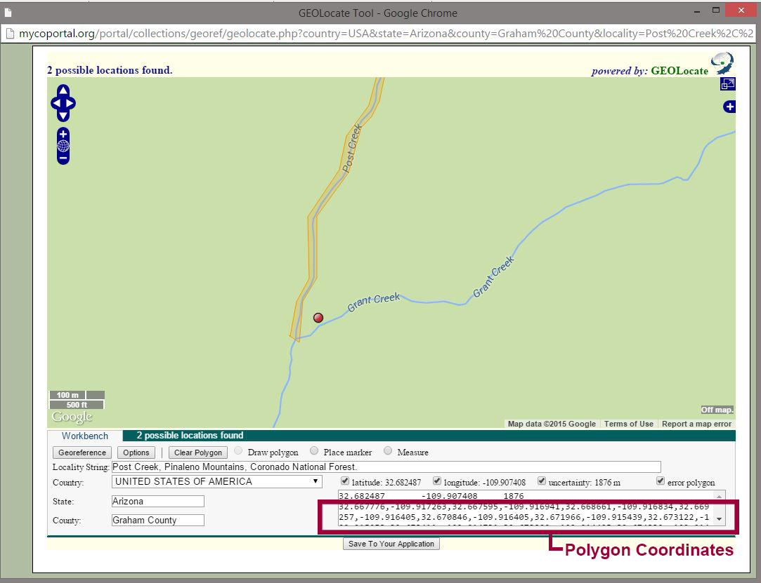

Slide 19
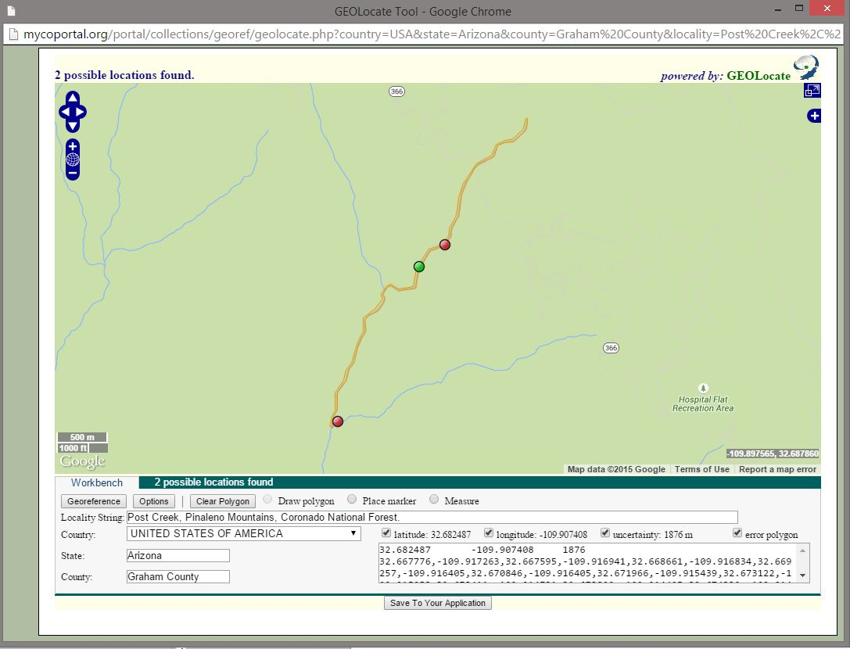

Slide 20
Remarks on Georeferencing Remarks
Leave a trail of yummy breadcrumbs:
As with point-radius, draft remarks that are comprehensive yet concise in explicating locality.
EXAMPLE: “Georeferenced with polygon to midpoint of Post Creek between mouth at Grant Creek to southwest and creek head to the northeast, with uncertainty radius encompassing entire creek and polygon enclosing creek banks.”

Slide 21
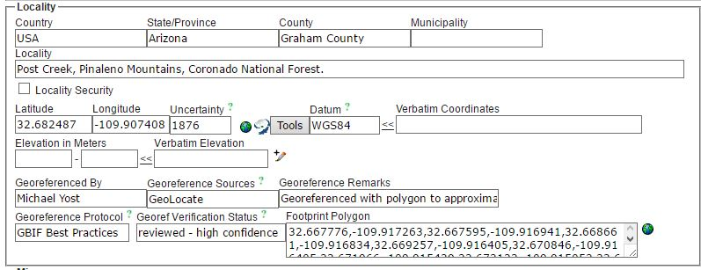
Editing Polygons [Symbiota]
Coordinate pairs for polygon are visible in Footprint Polygon field.
Click on globe next to Footprint Polygon field to edit polygon.

Slide 22
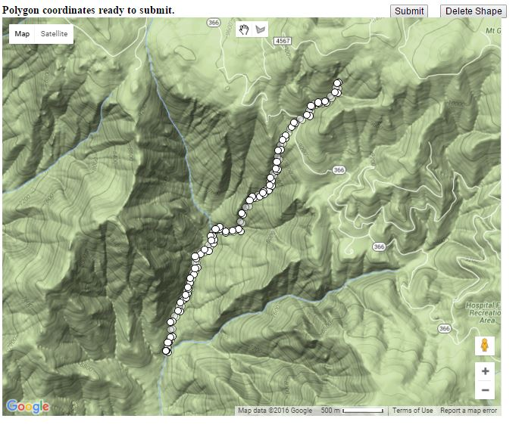

Slide 23
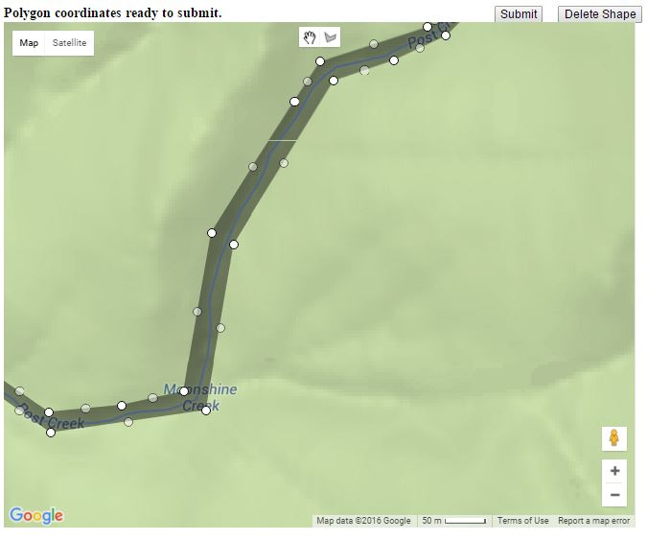

Slide 24
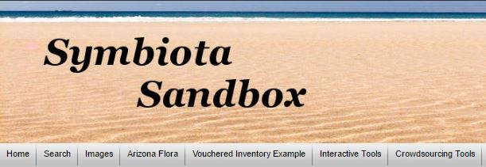
Symbiota Sandbox Shenanigans
Workflow can change depending on locality
Counties with rivers as boundaries for example
Workflow can change if locality has already been georeferenced using point-radius method.

Slide 25
Developing Protocols and Best Practices
How do polygons increase utility of data for your research?
Does that utility change with type of specimens being georeferenced?
What localities would be just as beneficial using point-radius?
What other protocols and best practices might we consider?
Do humans have free will, or is everything pre-determined?

