Slide 1
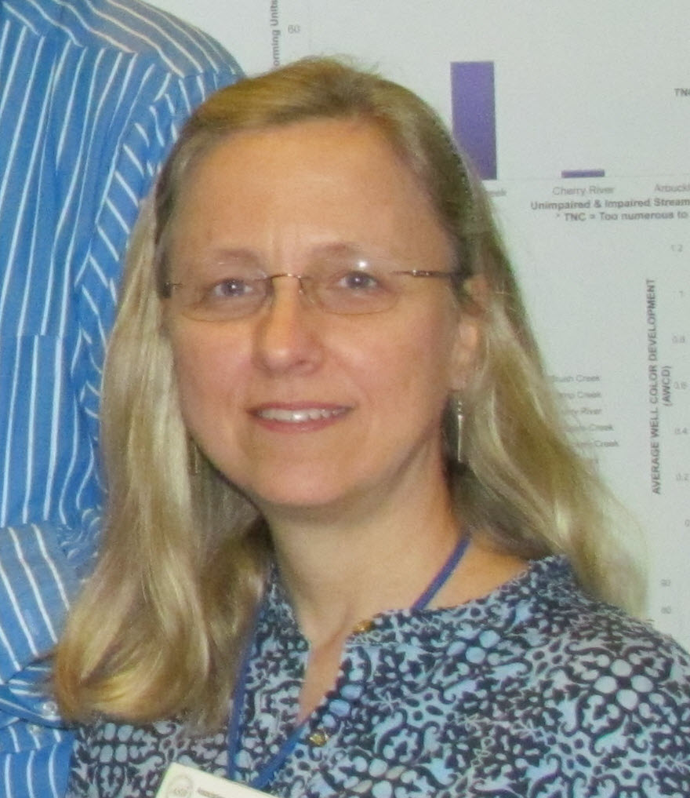
Workshop at iDigBio and AMNH
Making data science more efficient
29-30 Sep 2014
Deborah Paul, and the entire planning team
iDigBio, University of Florida and the
American Museum of Natural History (AMNH), New York
@idbdeb
@datacarpentry
@idigbio

Slide 2
Data Carpentry Workshop Wiki at iDigBio
http://tinyurl.com/idigbiodc
Schedule
Adobe Connect Link
EtherPad
Red/Green Stickies
Software
Participant List
Reading Material
Recordings
Workshops, Resources
Your Additions

Slide 3
Pre-workshop Survey ~ We are heterogeneous!
60/20/20 Grad/Post-doc/Faculty & Staff
Physics, Earth Sciences, Ecology, Zoology, Botany, Genetics, Engineering, Social Science, Humanities, Tech Support, Public Health, Information Science
Opportunities for cross-disciplinary collaboration!

Slide 4
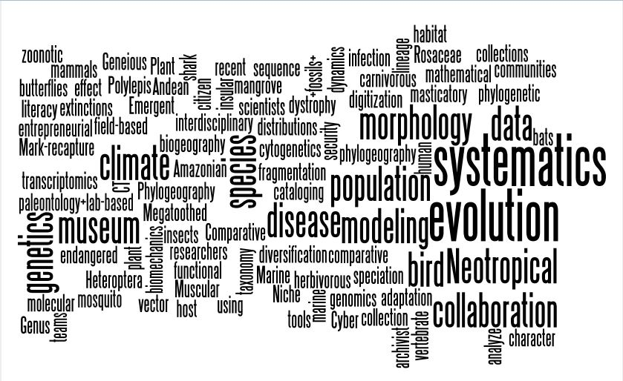

Slide 5
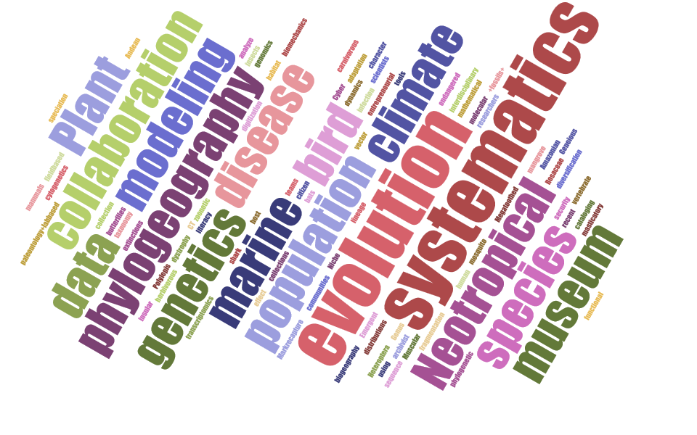

Slide 7
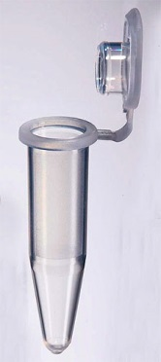
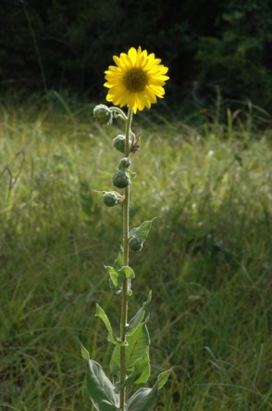
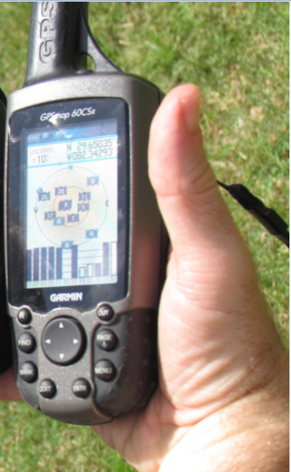
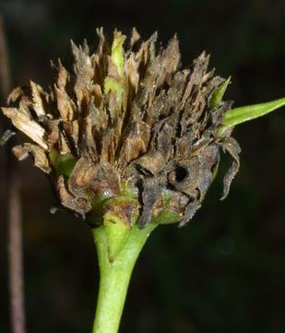
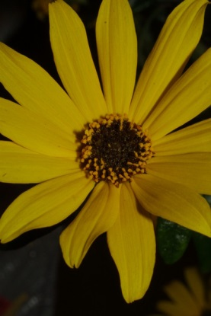
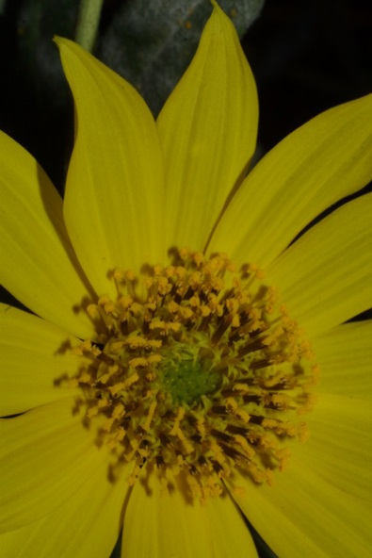
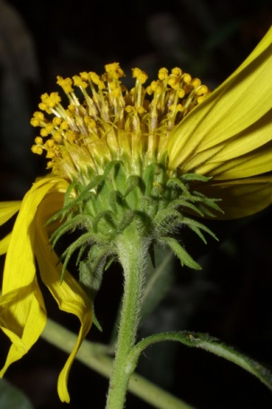
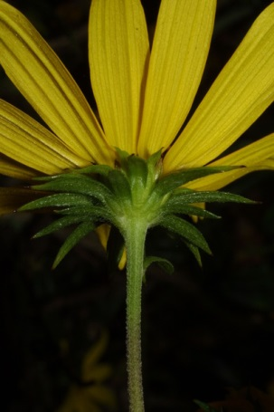
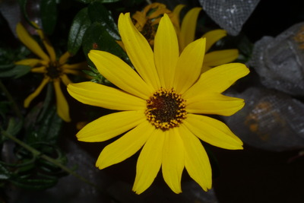
Notes:
Trend > proactive digitization (no more legacy data).
http://www.morphbank.net/?id=551005
http://herbarium.bio.fsu.edu/view-specimen.php?RecordID=22924
Mast, A. R., A. Stuy, G. Nelson, A. Bugher, N. Weddington, J. Vega, K. Weismantel, D. S. Feller, and D. Paul. 2004 onward (continuously updated). Database of Florida State University's Robert K. Godfrey Herbarium. Website http://herbarium.bio.fsu.edu/ [accessed 06 December 2013].
http://www.morphbank.net/?id=817663
http://www.morphbank.net/?id=816417
http://www.morphbank.net/?id=817662
http://bioimages.vanderbilt.edu/ind-baskauf/43875
Vanderbilt University, Nashville, Davidson County, Tennessee, US Click on these geocoordinates to load a map showing the location: 36.14528°, -86.80106° Coordinate uncertainty about: 20 m
http://www.morphbank.net/?id=817661
http://www.morphbank.net/?id=817673
http://www.morphbank.net/?id=817674
http://www.morphbank.net/?id=820776

Slide 8
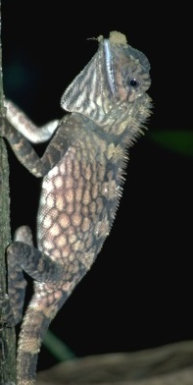
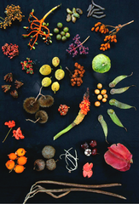
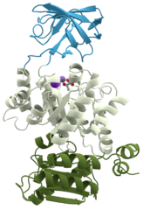
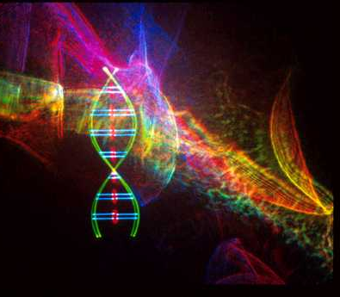
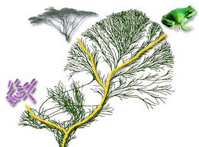
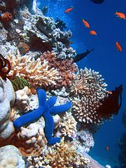
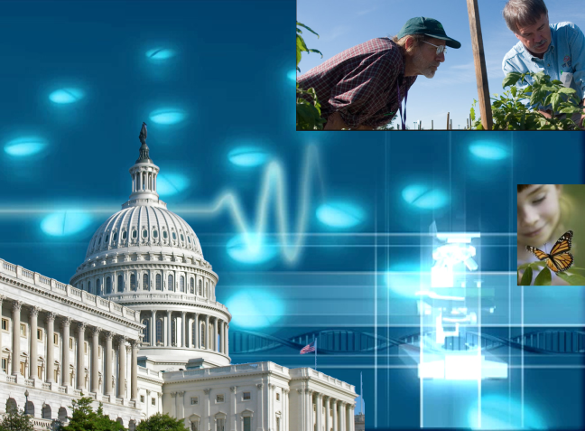
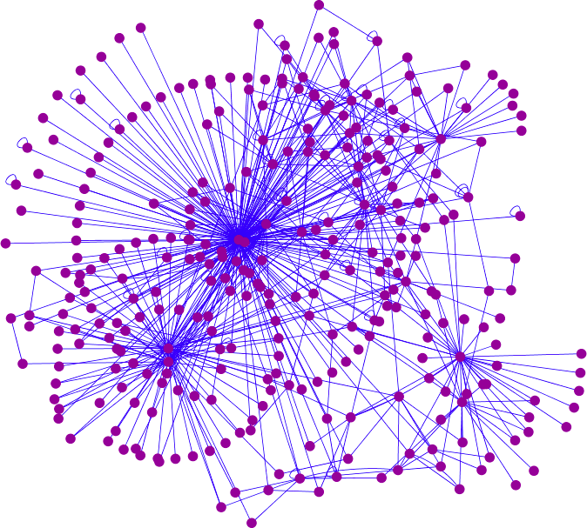
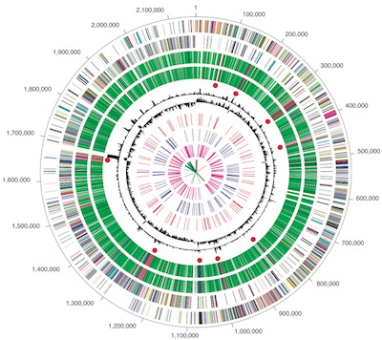
Integrative biodiversity research: It’s about the science questions
Facilitate use of biodiversity data to address environmental and economic challenges
Researchers
Educators
General public, citizen scientists
Policy-makers
Climate Change
Invasive Species
Human health
Food Security

Slide 9
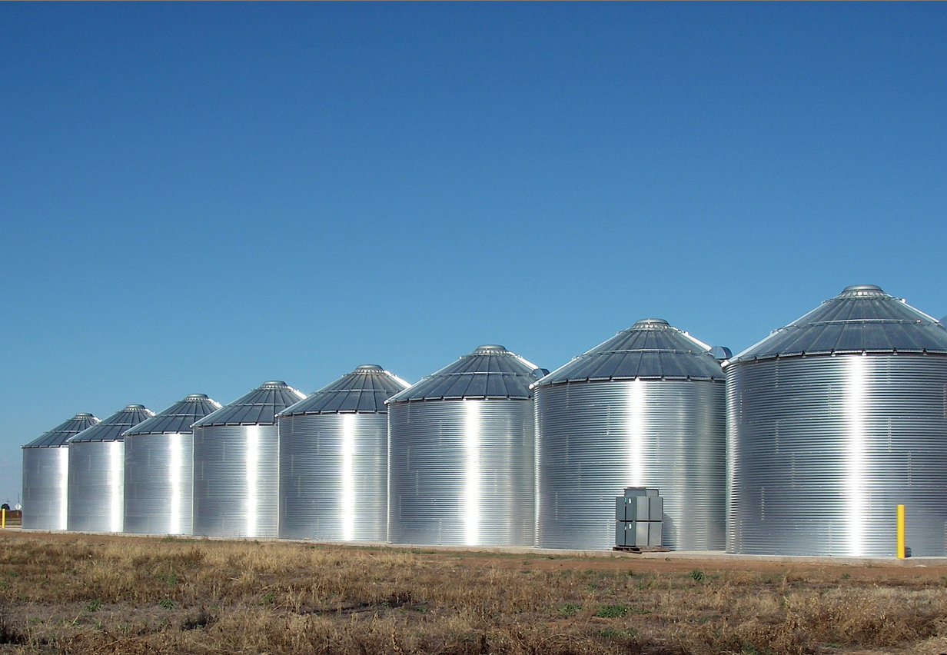
Tree of Life, phylogenomics
Organisms -> species
US National Science Foundation Dimensions of Biodiversity program
Interaction at the intersection of taxonomic, genetic, functional domains
Taxonomic/ phylogenetic
Trophic interactions
Phenotypic expression
Genetic
Functional
Bioactive compounds/chemistry
Molecular -> Ecosystem

Slide 10
iDigBio – Integrated Digitized Biocollections
10 year effort to digitize and mobilize the scientific information associated with vouchered specimens held in U.S. research collections (Larry Page – PI)
Project Management (PM) and PM skills development by David Jennings
Provide for cyberinfrastructure
needs (Jose Fortes et al.)
Effective digitization
standards and workflows
(Greg Riccardi et al.)
Develop research use cases and collaborations (Pam Soltis et al.)
Education and outreach (Bruce McFadden et al.)
Plan for long-term sustainability of the national digitization effort

Slide 11
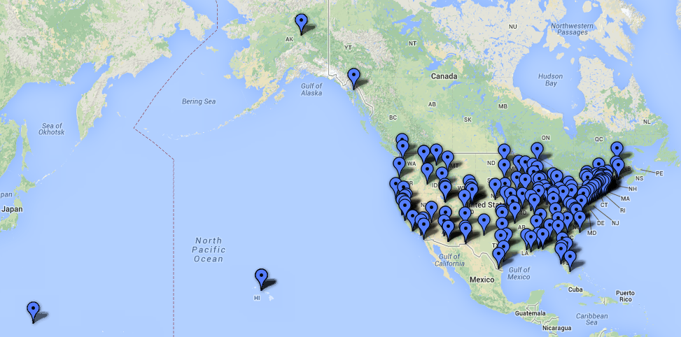
Estimated 1 billion specimens in 1,600 collections in the US
over 203 institutions

Slide 12
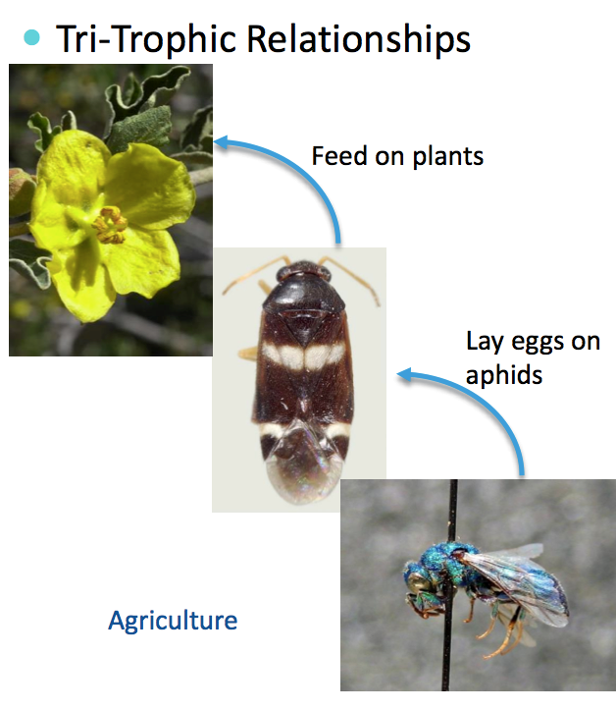
Thematic Collections Networks (2 of 13)…

Slide 13
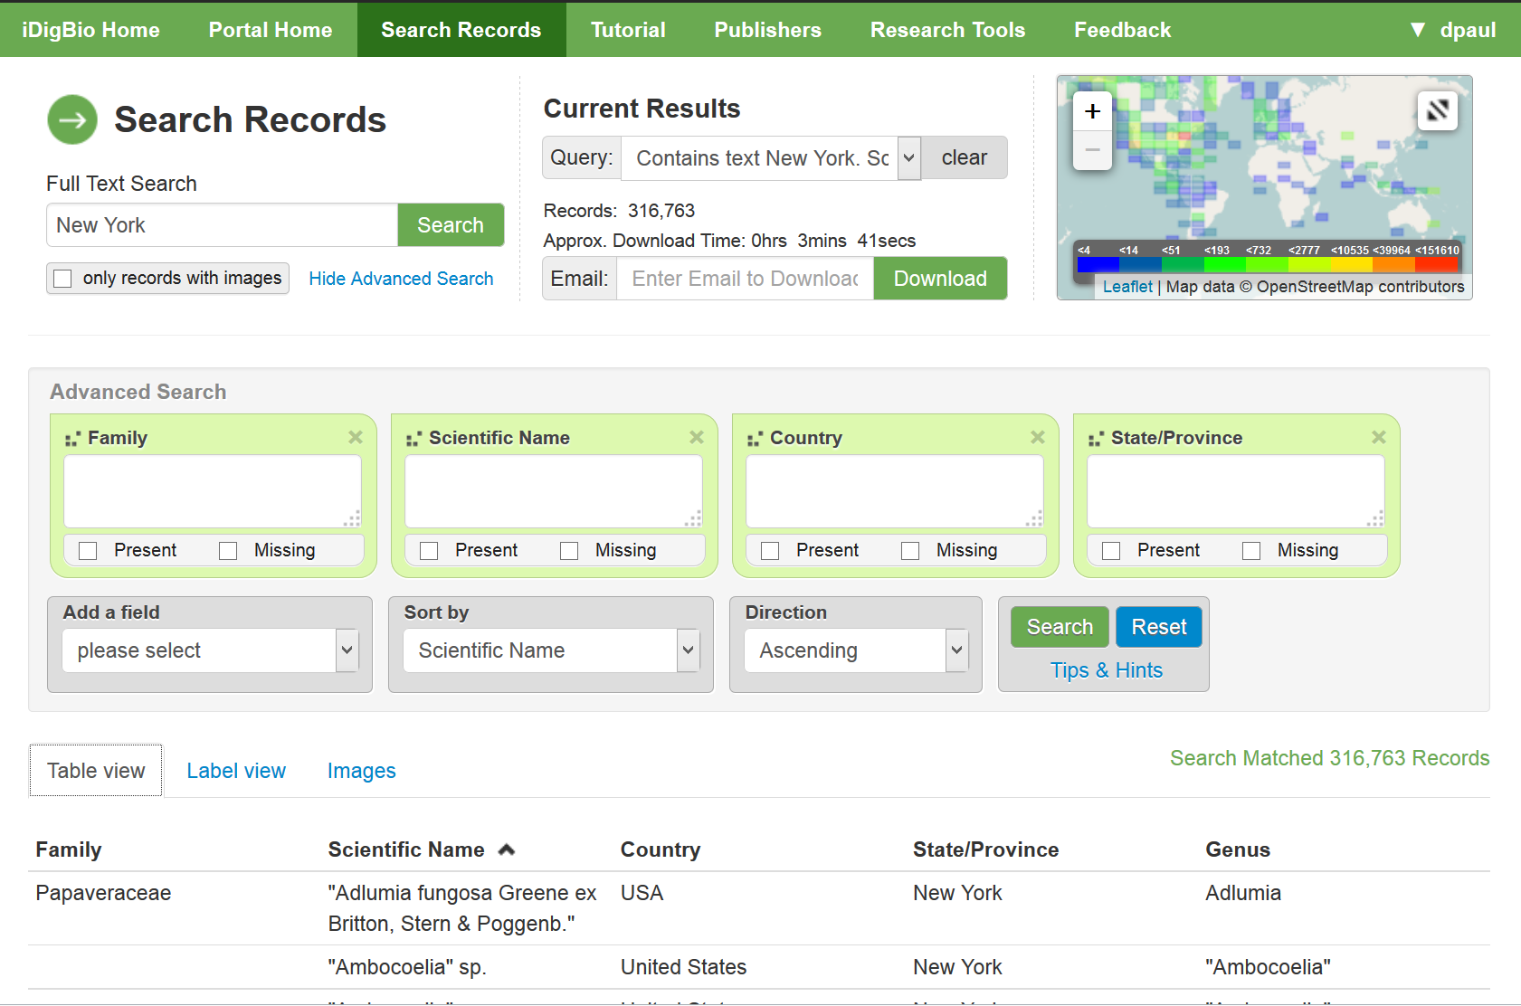

Slide 14
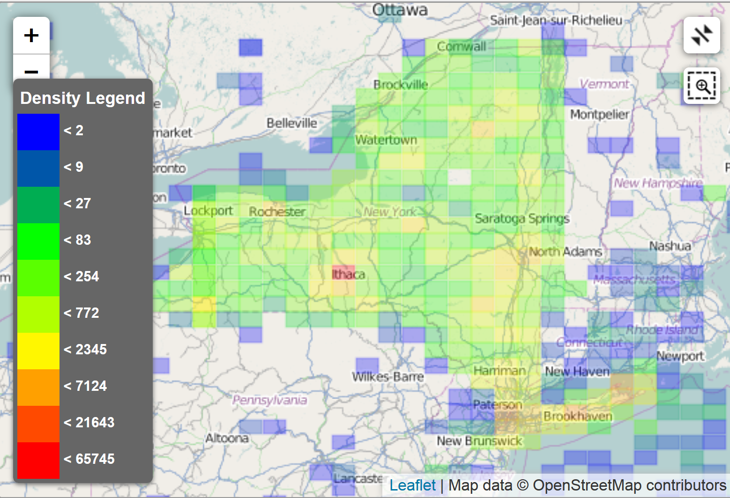

Slide 15
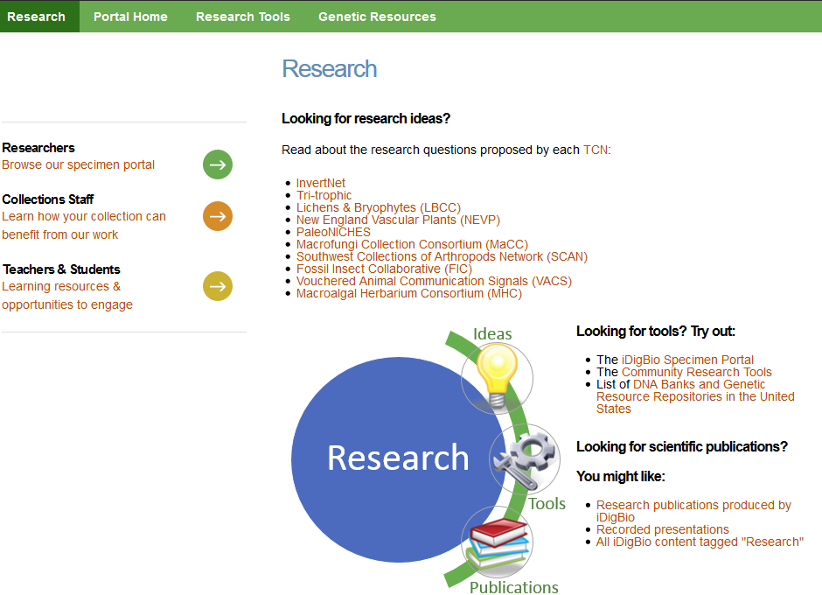

Slide 17
Thanks – and let’s get started!

